Slide 1


BUILD VKU ASSISTANT
VIETNAM - KOREA UNIVERSITY OF INFORMATION AND
COMMUNICATION TECHNOLOGY
Presenter: Nguyễn Văn Nam Nguyễn Phan Thành Công Class: 18IT5 Supervisor: PGS.TS.Huỳnh Công Pháp
TS. Đặng Đại Thọ
ThS. Nguyễn Văn Bình

Slide 2
CONTENT
2. Speech to text
3.
Text to speech
6. Demo
4.
Chrome
Driver
5.
Implement
in website
1. Introduce

Slide 3
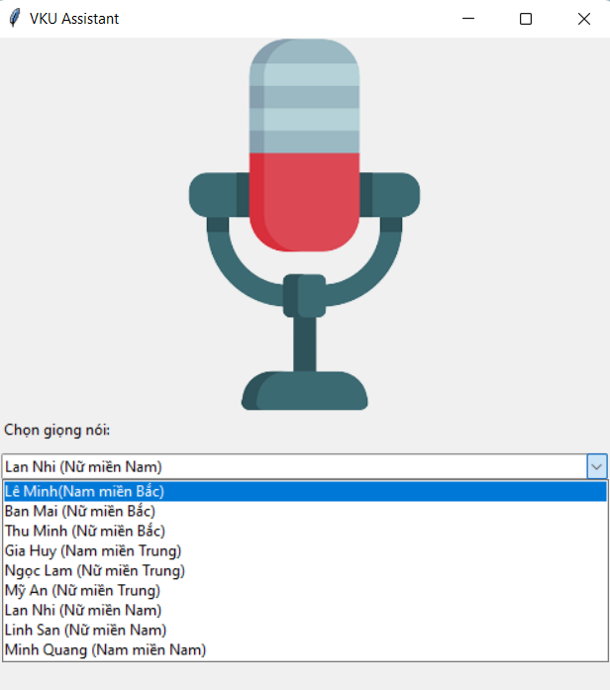
INTRODUCE
Select local voice
Say hello
Open app desktop
Open website
Open youtube
Search google
Weather forecast
Time information
Read news
Definition
Manage smart home

Slide 4
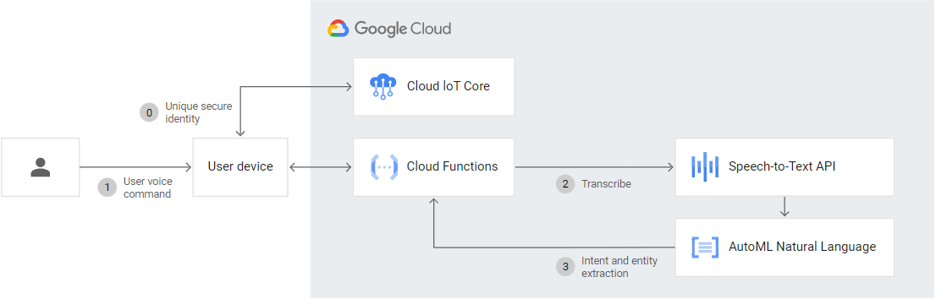
SPEECH TO TEXT

Slide 5




TEXT TO SPEECH
SERVER

Slide 6

CHROME DRIVER

Slide 7
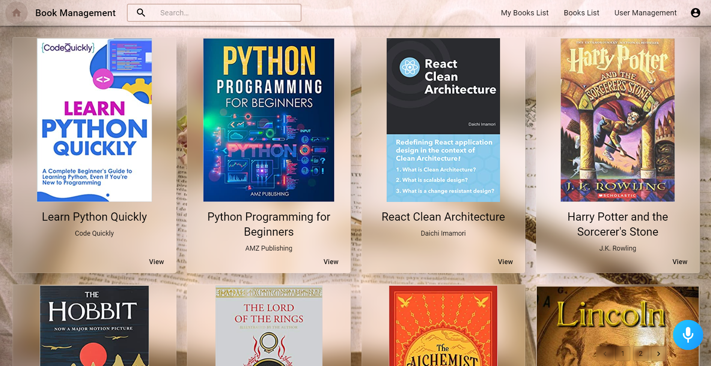
IMPLEMENT IN WEBSITE

Slide 8
DEMO

Slide 9
THANK YOU FOR
YOUR ATTENTION!

