Slide 1
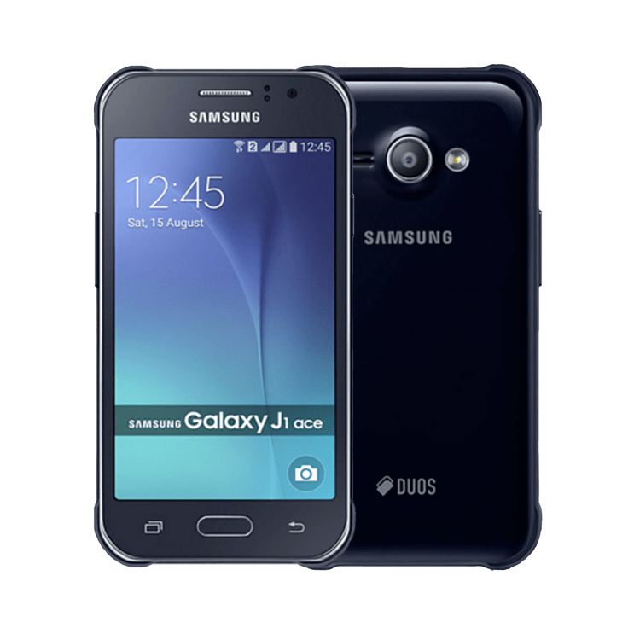
Samsung
Galaxy J1 Ace

Slide 2
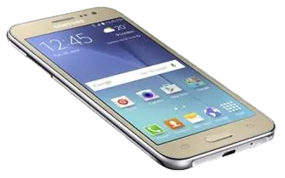
Samsung
Galaxy J2 4G

Slide 3
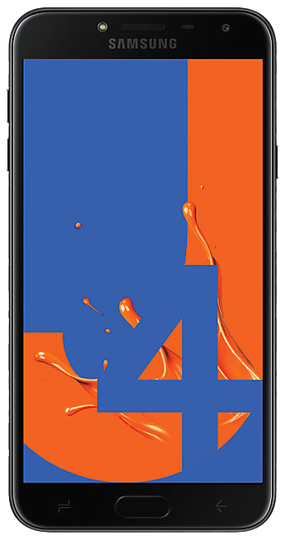
Samsung
Galaxy J4

Slide 4
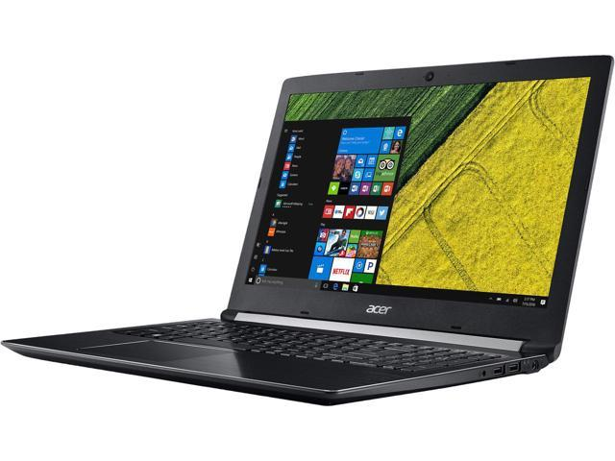
Aspire 5

Slide 5
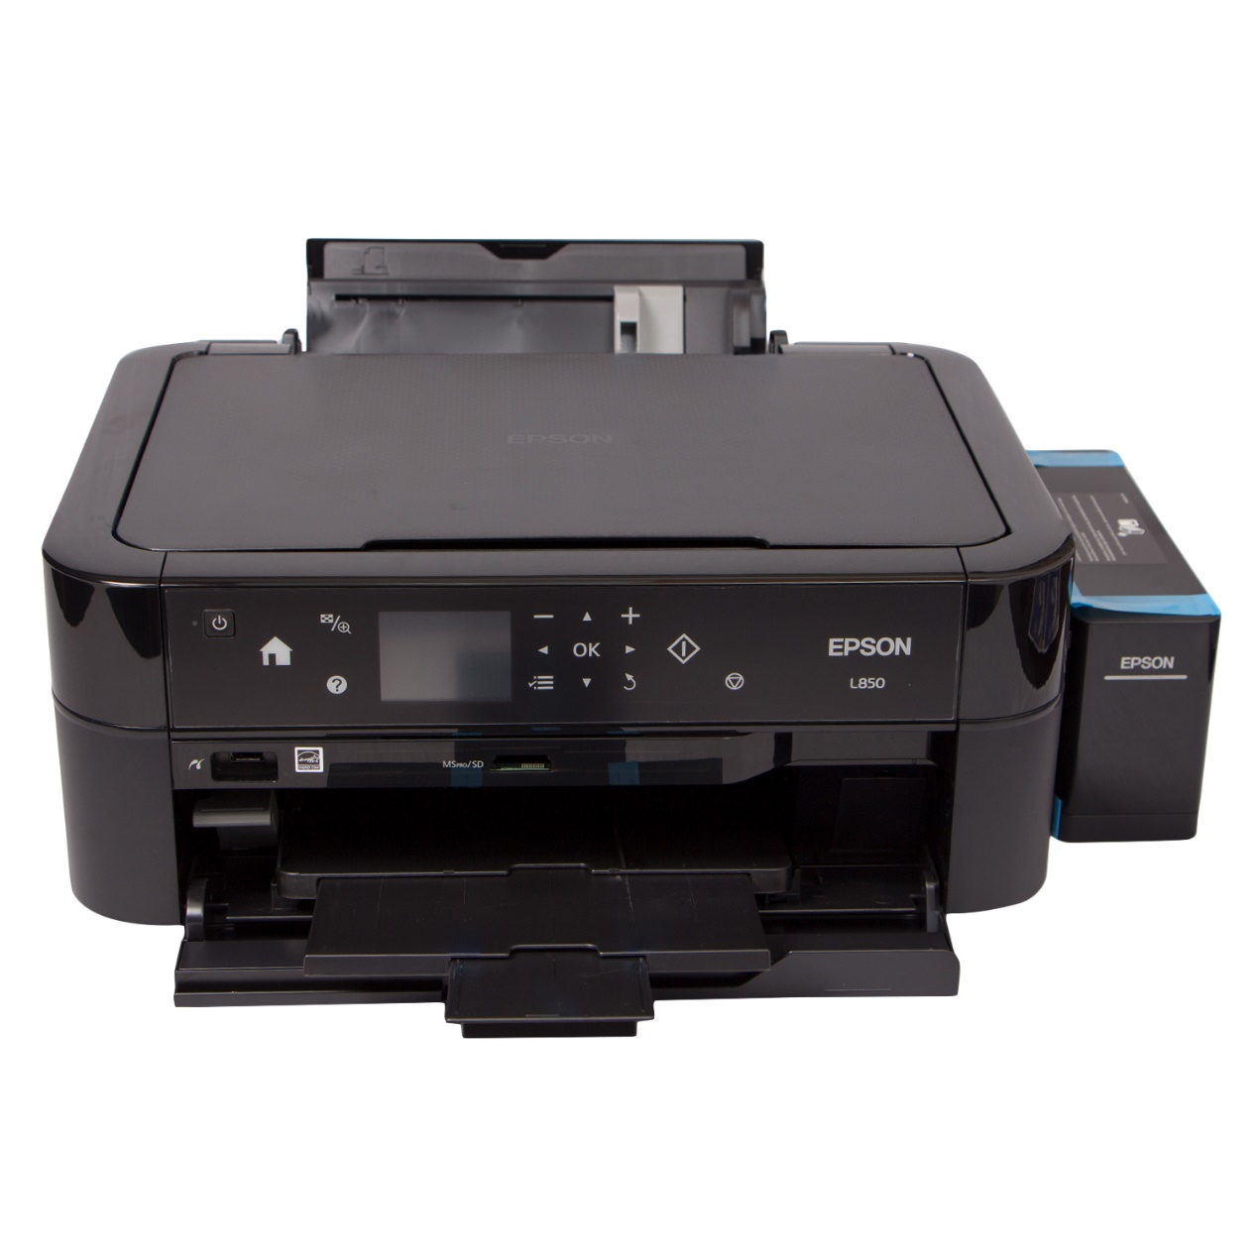
L850

