Slide 1
CHUNK TEXT USING PREVECTORCHUNKS

Slide 2
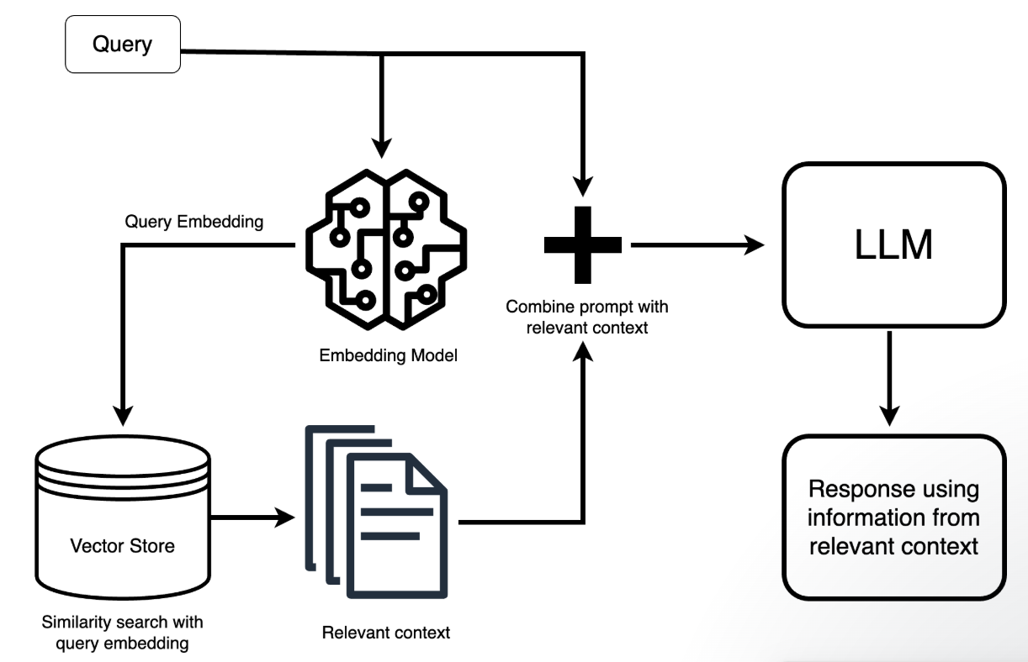
RAG

Slide 3
Why Chunking Matters in RAG – Chunking offers order in a world of knowledge entropy
Vector Database – domain specific knowledge store
We expect Vector Database to provide us with the most relevant knowledge or content in response to our query
Prompt query: how did Brexit influence our Department’s policy?
Context: Brexit has been a defining event for the United Kingdom. Brexit shapes trade policy in the United Kingdom. Brexit shapes immigration policy in the United Kingdom. Our Department took a range of measures in response to Brexit. The key measures are….
Notes:
Why Chunking Matters in RAG – Chunking offers order in a world of knowledge entropy
Vector Database – domain specific knowledge store
We expect Vector Database to provide us with the most relevant knowledge or content in response to our query
Prompt query: how did Brexit influence our Department’s policy?
Context: Brexit has been a defining event for the United Kingdom. Brexit shapes trade policy in the United Kingdom. Brexit shapes immigration policy in the United Kingdom. Our Department took a range of measures in response to Brexit. The key measures are….

Slide 4
PreVectorChunks: Smarter Chunking
Lightweight Python library for:
  Reinforcement Learning–based text chunking
  Proposition-aware splitting
  Standard, recursive, and character-based chunking
  Vector database integration (upsert, fetch, update)
Install: pip install prevectorchunks-core

Slide 5
.env file setup
OPENAI_API_KEY=your_openai_key
PINECONE_API_KEY=your_pinecone_key

