Slide 1
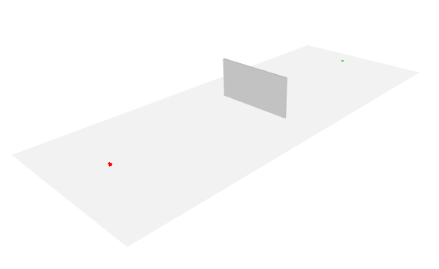
Rx
Wall
Tx

Slide 2
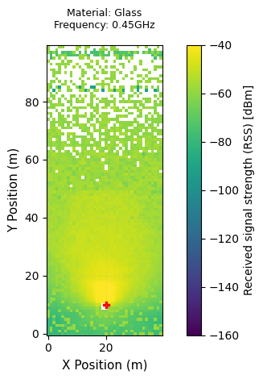
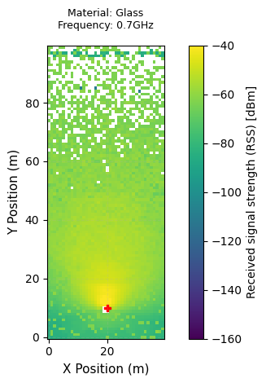
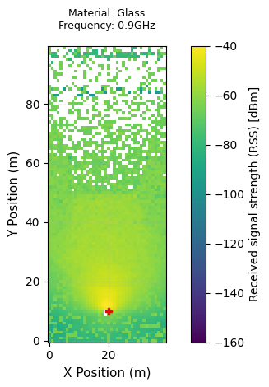
Rx
Rx
Rx
Wall
Wall
Wall
Tx
Tx
Tx

Slide 3
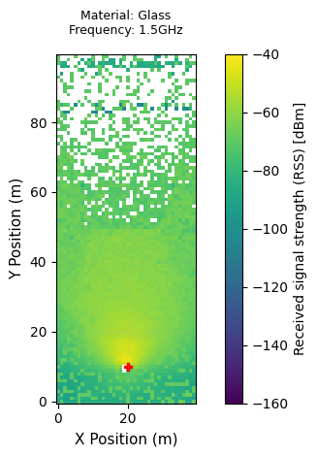
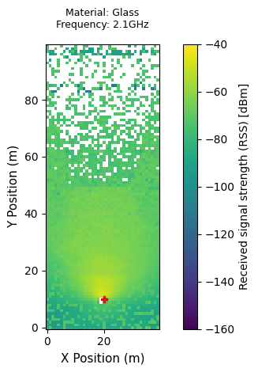
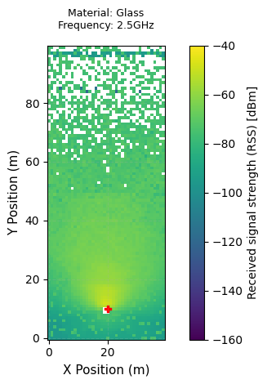
Rx
Rx
Rx
Wall
Wall
Wall
Tx
Tx
Tx

Slide 4
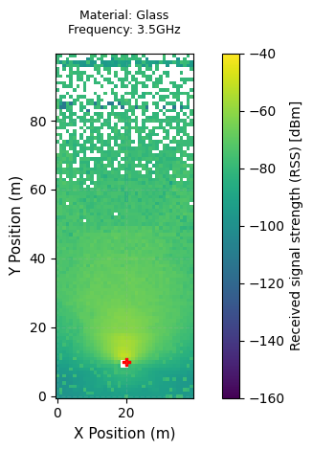
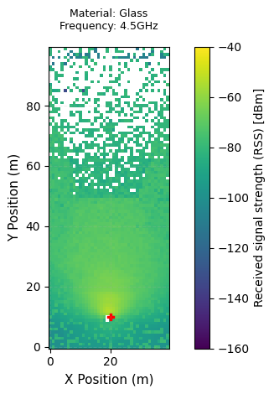
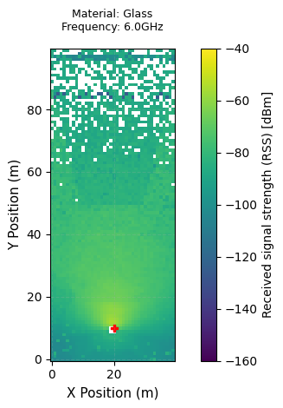
Rx
Rx
Rx
Wall
Wall
Wall
Tx
Tx
Tx

Slide 5
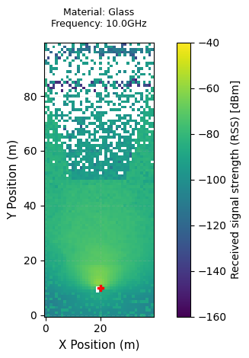
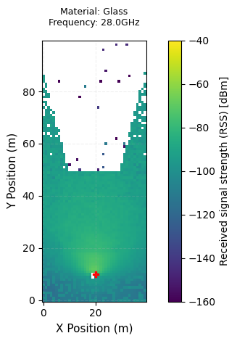

Rx
Rx
Rx
Wall
Wall
Wall
Tx
Tx
Tx

Slide 6
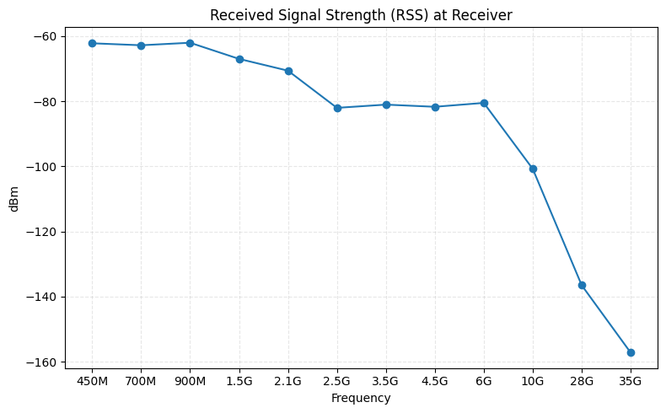

Slide 7
