Slide 1
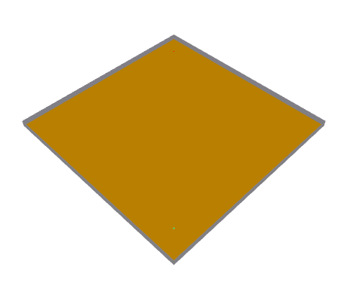
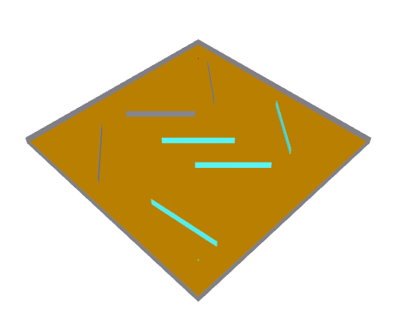
Empty Room
Obstacles
Tx
Wall
(Concrete)
Tx
Wall
(Concrete)
Ground
(Very Dry)
Obstacles
(Glass)
Obstacles
(Concrete)
Ground
(Very Dry)
Rx
Rx

Slide 2
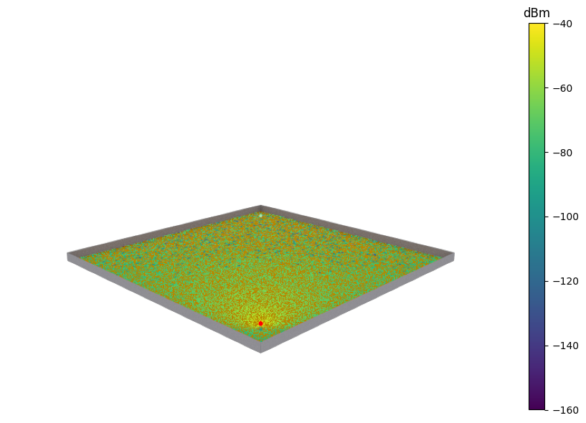
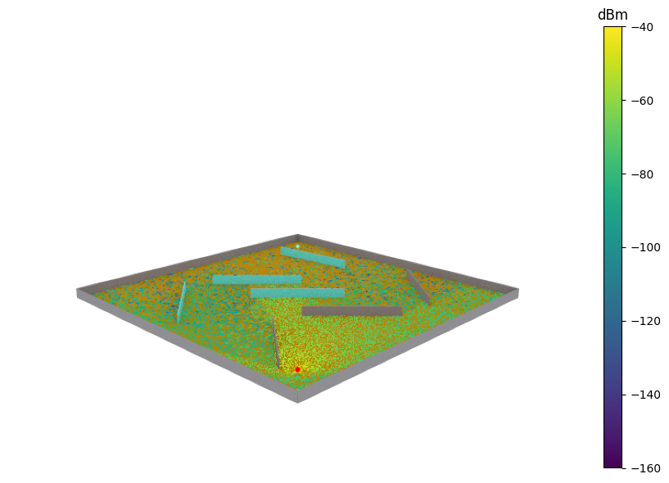
Empty Room
Obstacles
Obstacles
(Glass)
Rx
Rx
Tx
Tx

Slide 3
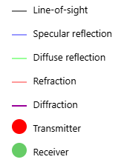
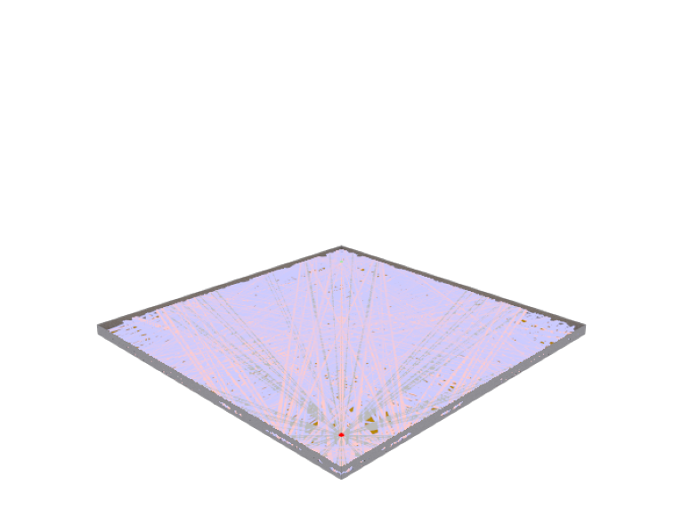
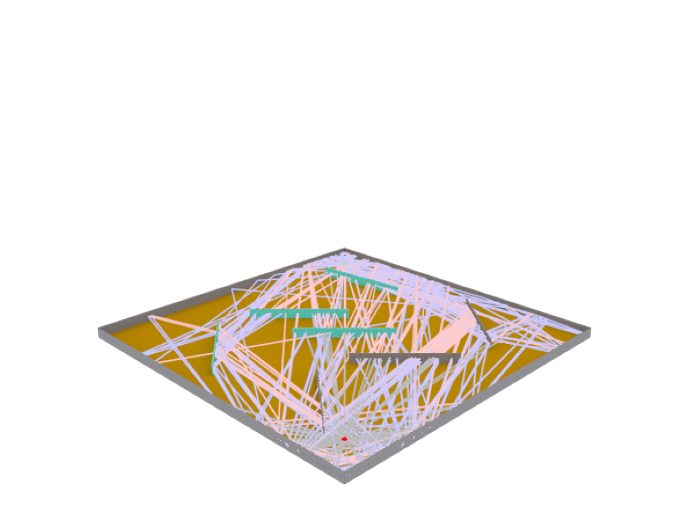
Empty Room
Obstacles
Rx
Rx
Tx
Tx

Slide 4
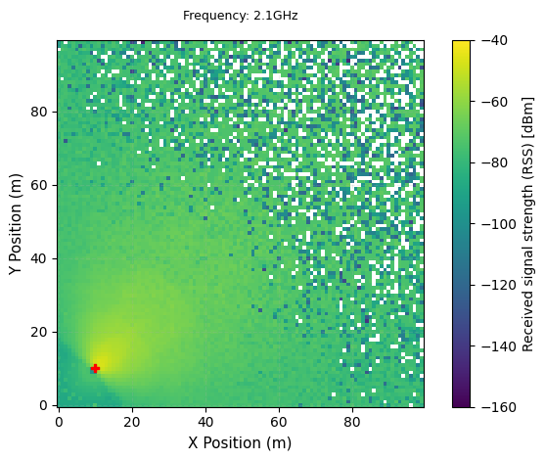
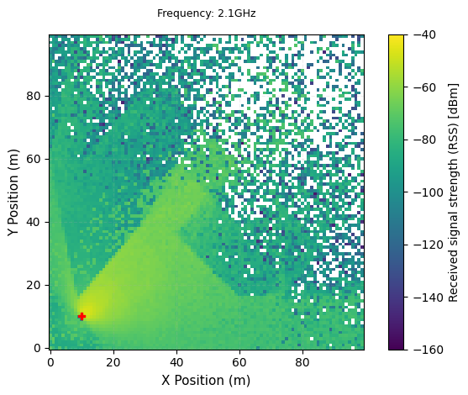
Empty Room
Obstacles
Rx
Rx
Tx
Tx

Slide 5
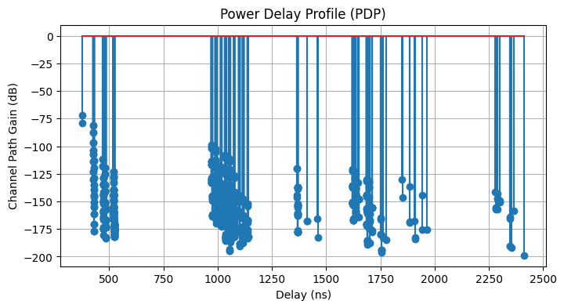
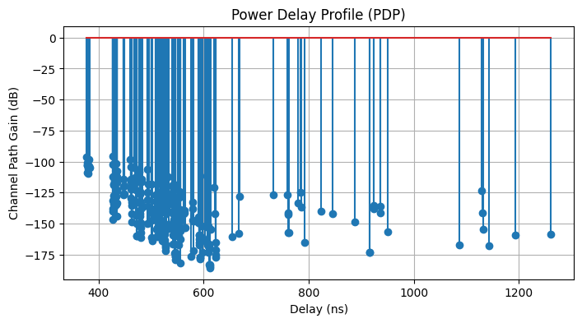
Empty Room
Obstacles

Slide 6
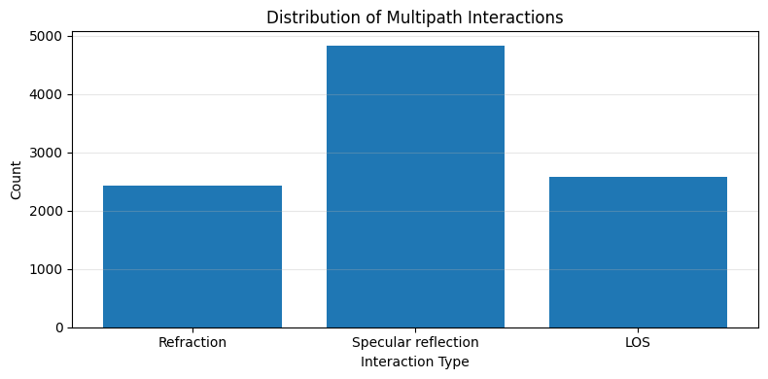
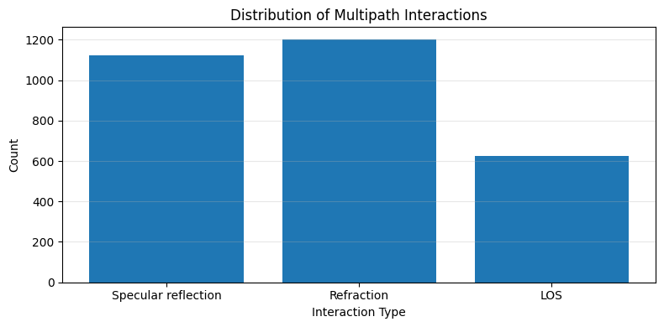
Empty Room
Obstacles

