Slide 1
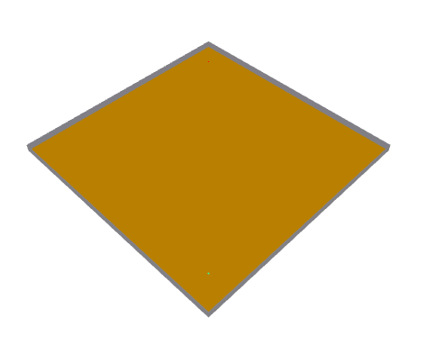
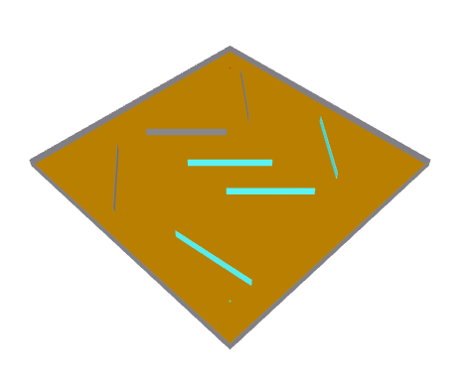
Empty Room
Obstacles
Tx
Wall
(Concrete)
Tx
Wall
(Concrete)
Ground
(Very Dry)
Obstacles
(Glass)
Obstacles
(Concrete)
Ground
(Very Dry)
Rx
Rx

Slide 2
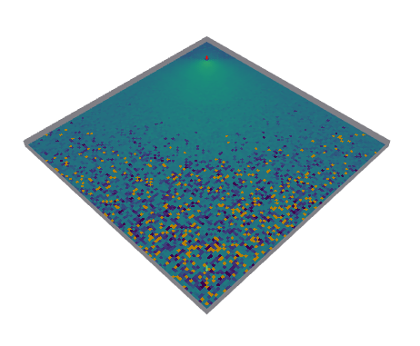
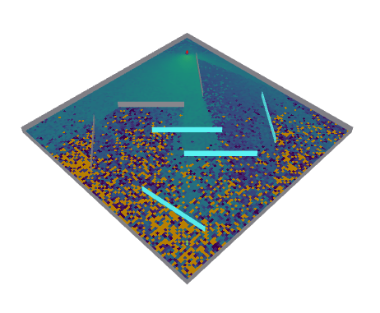
Empty Room
Obstacles
Tx
Wall
(Concrete)
Tx
Wall
(Concrete)
Ground
(Very Dry)
Obstacles
(Glass)
Obstacles
(Concrete)
Ground
(Very Dry)
Rx
Rx

Slide 3
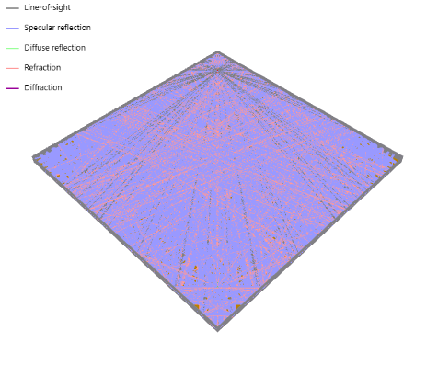
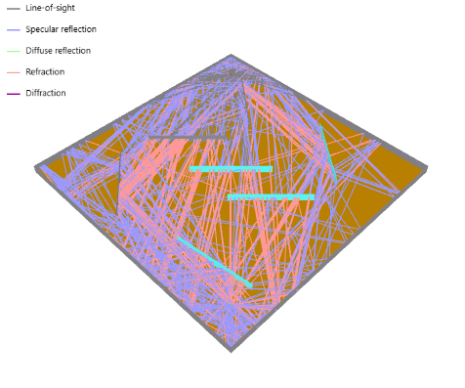
Empty Room
Obstacles
Tx
Wall
(Concrete)
Tx
Wall
(Concrete)
Ground
(Very Dry)
Obstacles
(Glass)
Obstacles
(Concrete)
Ground
(Very Dry)
Rx
Rx

Slide 4
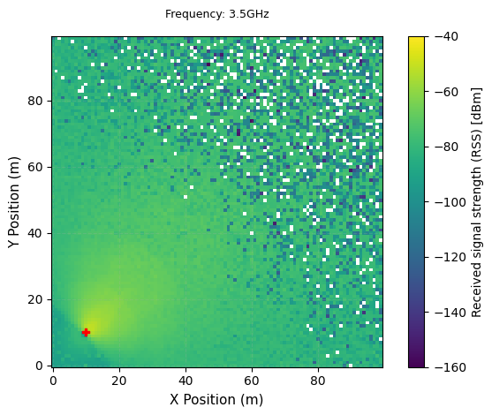
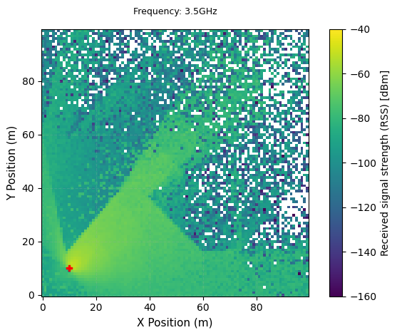
Empty Room
Obstacles
Rx
Rx
Tx
Tx

Slide 5
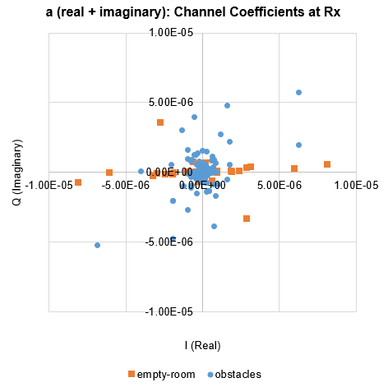
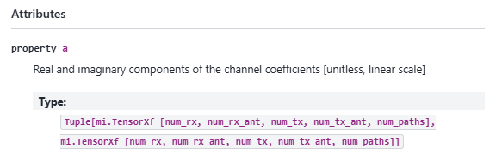
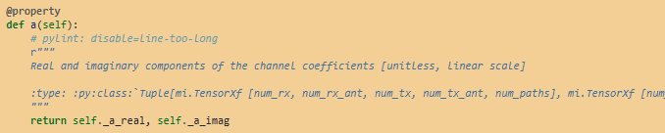

Slide 6
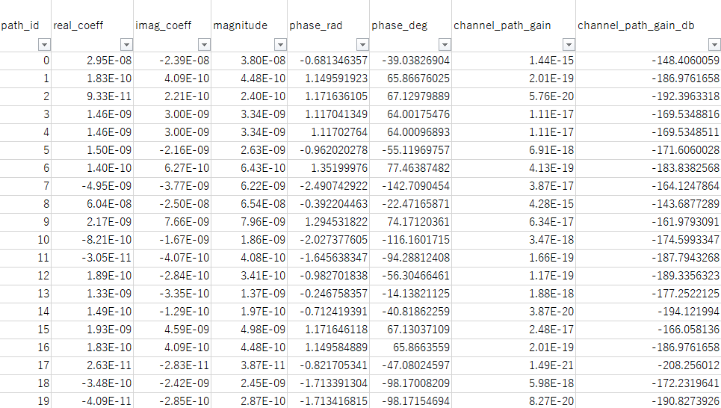

Slide 7
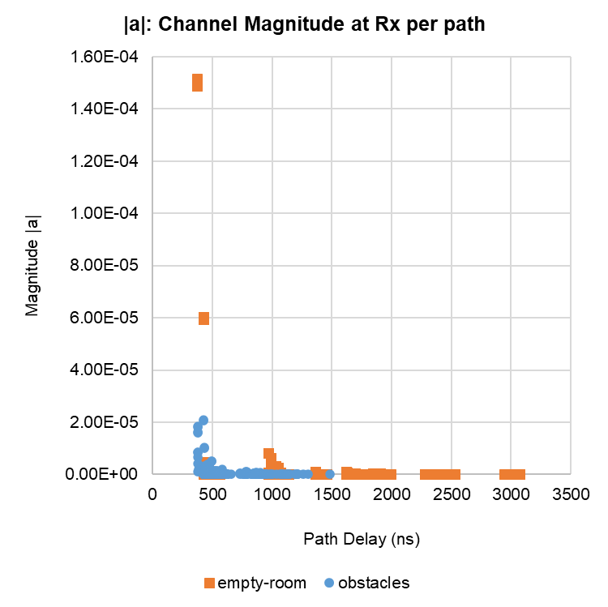
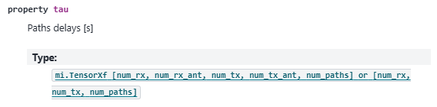
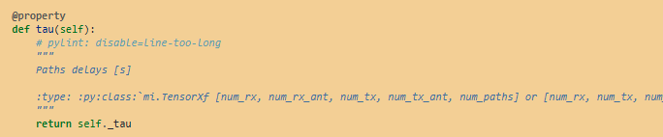

Slide 8
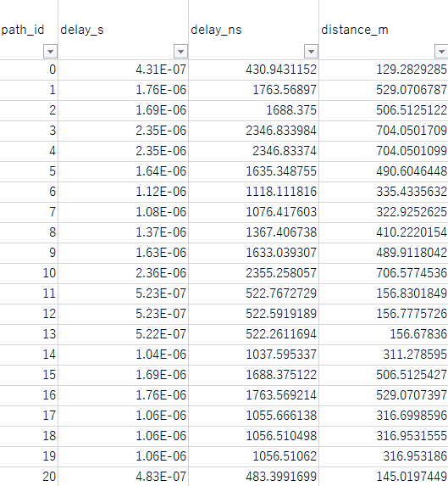

Slide 9
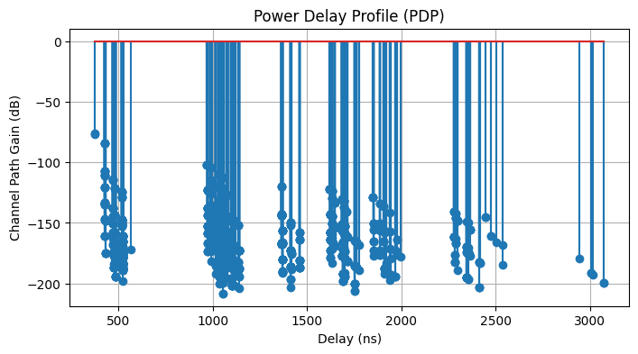
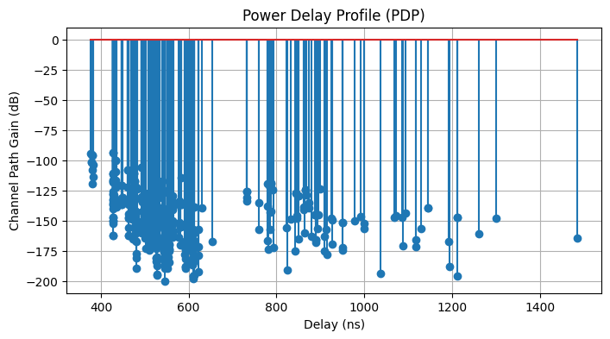
Empty Room
Obstacles

