Slide 1
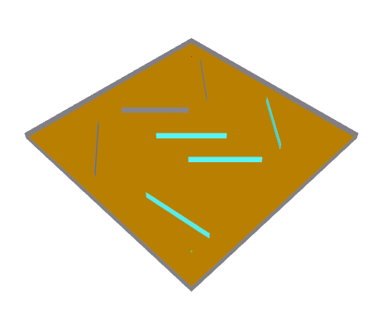
Tx
Wall
(Concrete)
Obstacles
(Glass)
Obstacles
(Concrete)
Ground
(Very Dry)
Rx

Slide 2
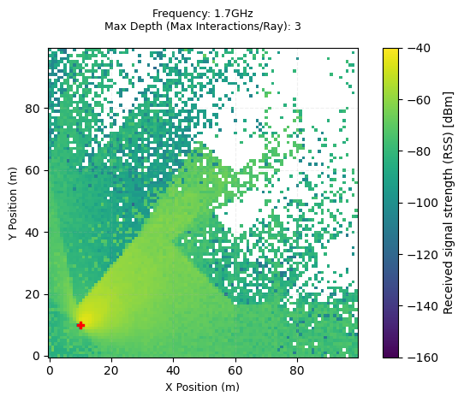
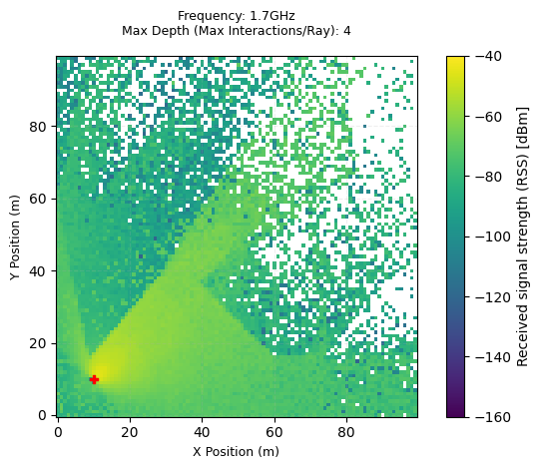
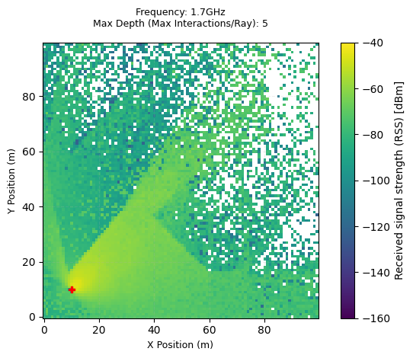
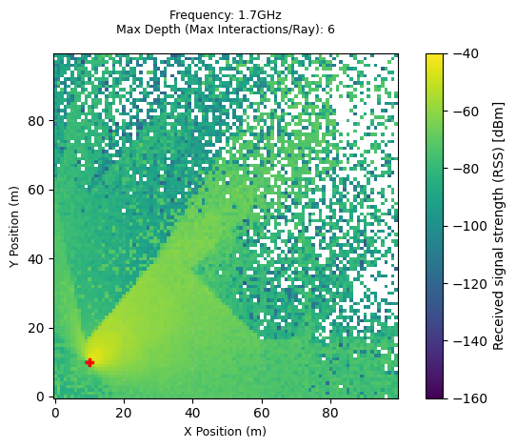

Slide 3
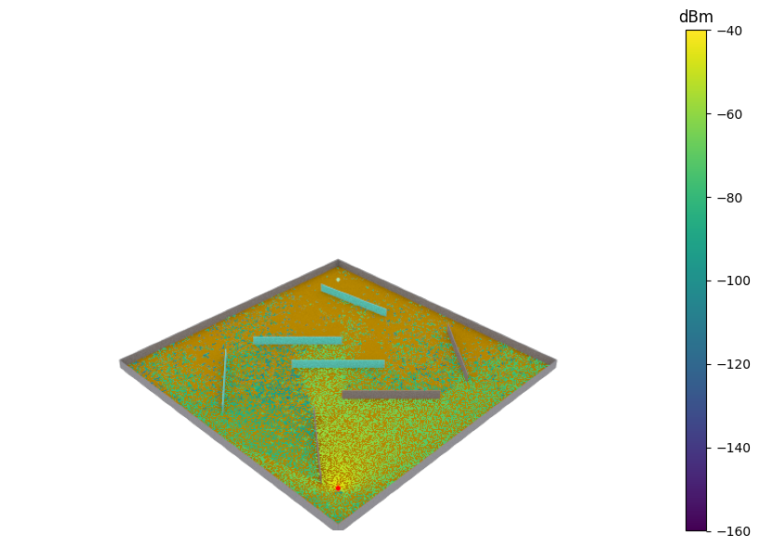
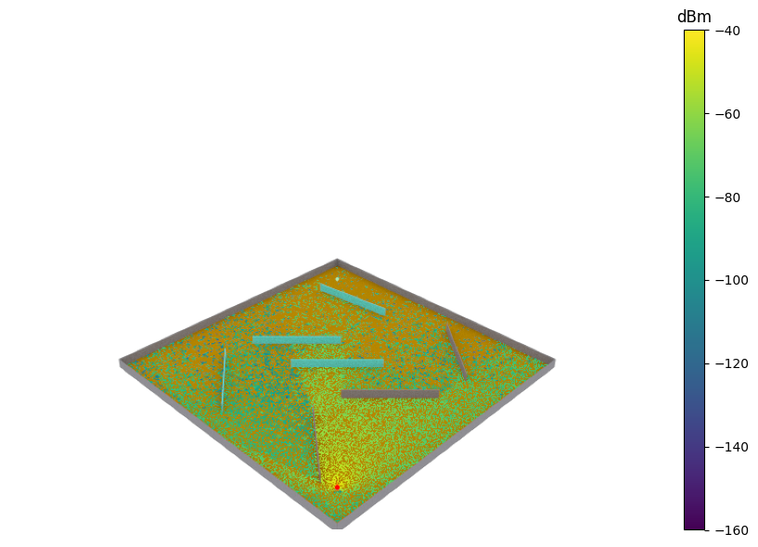


Max Depth (Max Interactions/Ray): 3
Max Depth (Max Interactions/Ray): 4
Max Depth (Max Interactions/Ray): 5
Max Depth (Max Interactions/Ray): 6

Slide 4
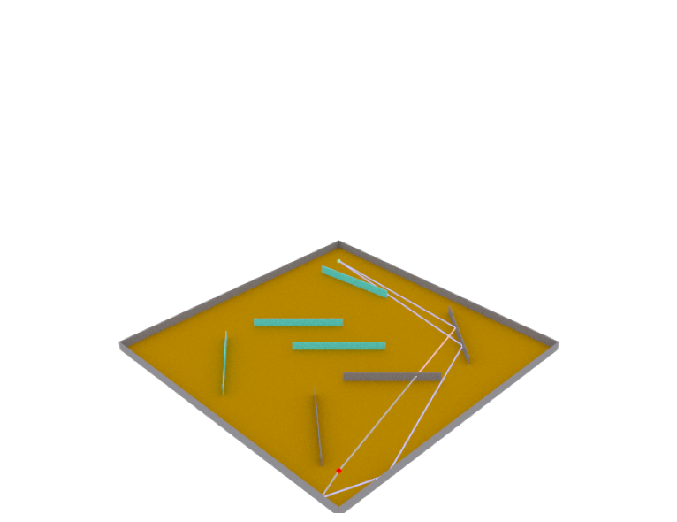
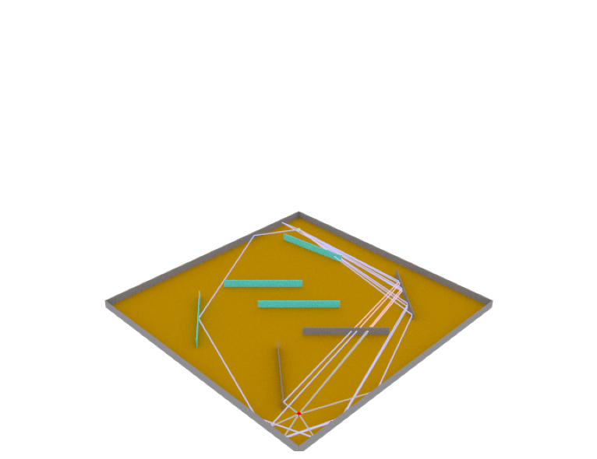
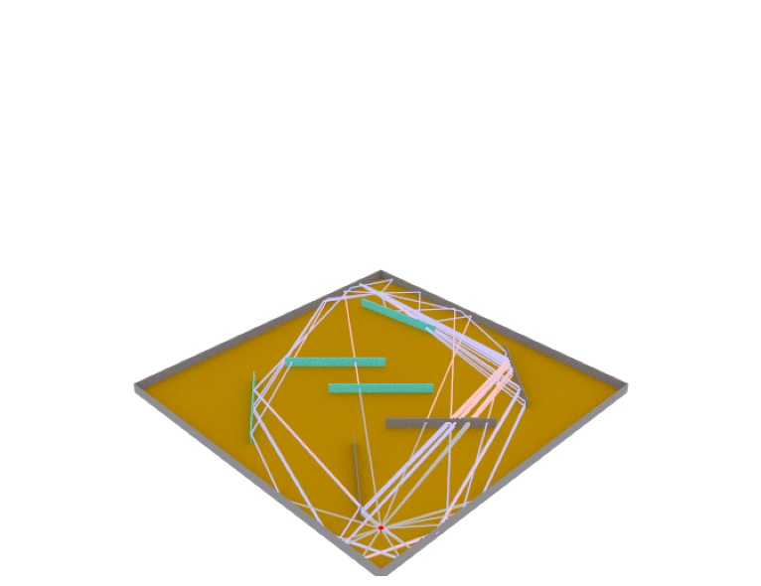
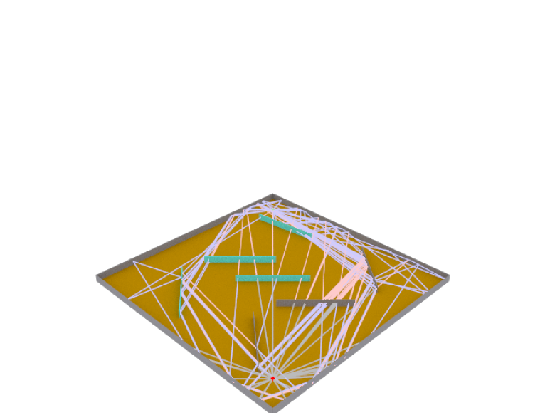
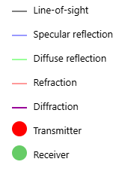
Max Depth (Max Interactions/Ray): 3
Max Depth (Max Interactions/Ray): 4
Max Depth (Max Interactions/Ray): 5
Max Depth (Max Interactions/Ray): 6

Slide 5
