Slide 1

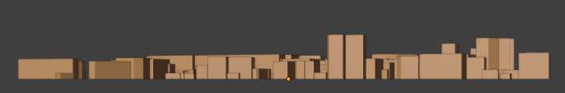
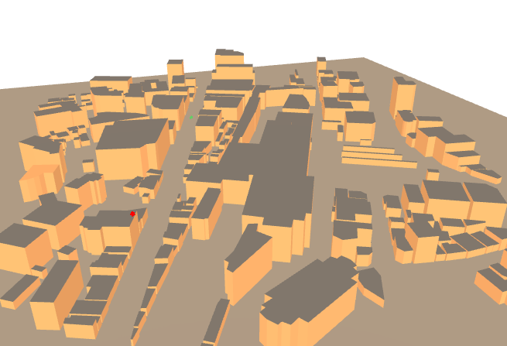
Tx
Rx
Rx
Rx
Azimuth
45°
Tx
Tx

Slide 2
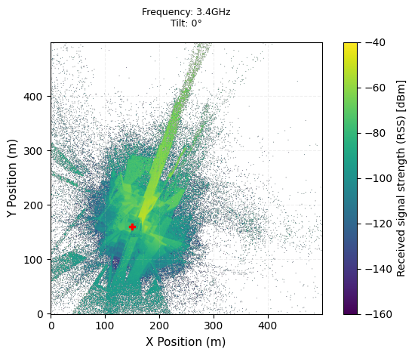
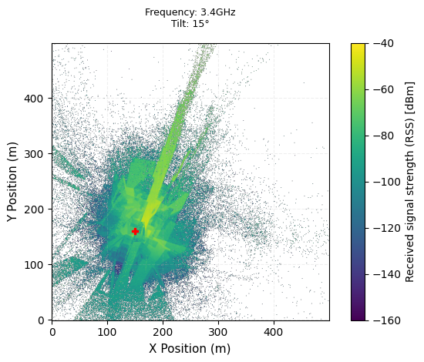

Rx
Rx
Rx
Tx
Tx
Tx

Slide 3
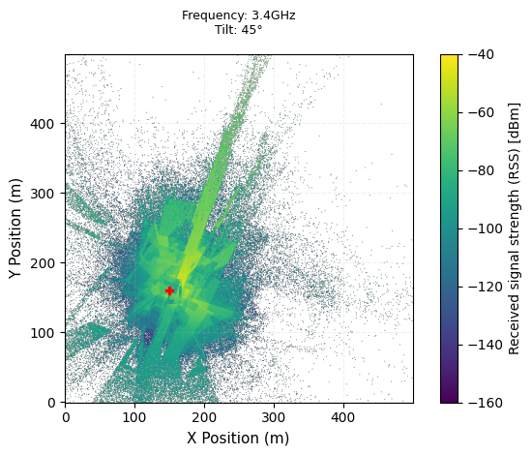
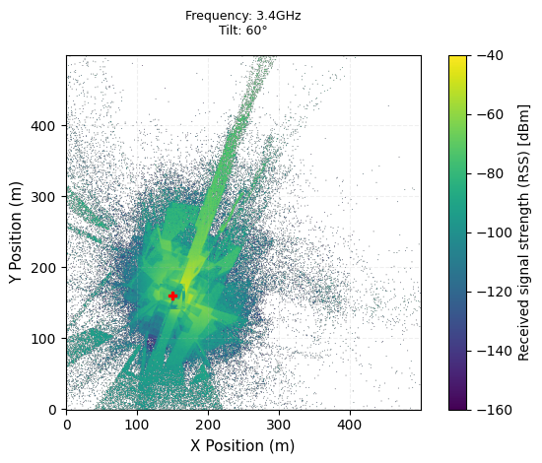

Rx
Rx
Rx
Tx
Tx
Tx

Slide 4
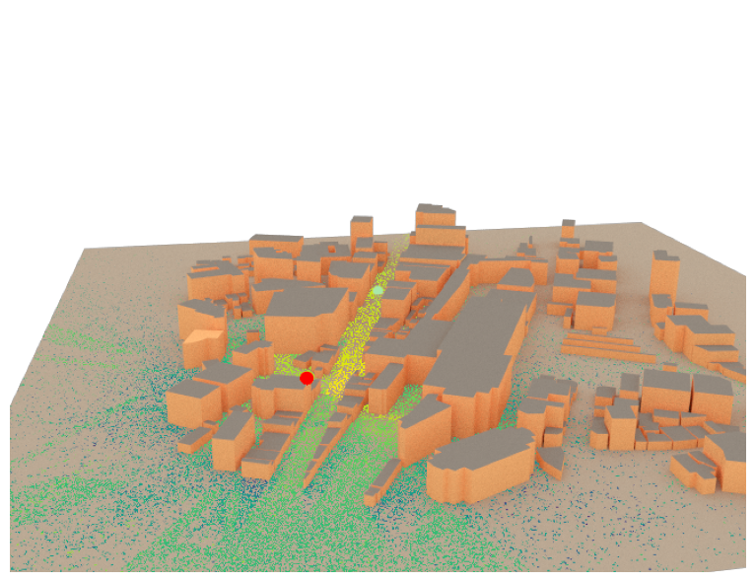
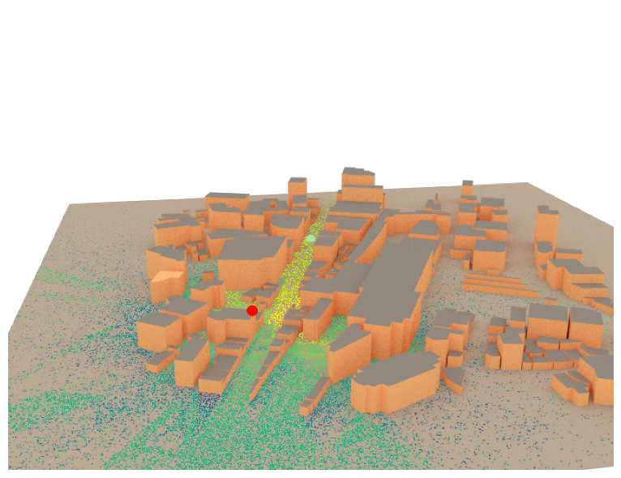

Frequency: 3.4G
Tilt: 0°
Frequency: 3.4G
Tilt : 15°
Frequency: 3.4G
Tilt : 30°
Rx
Rx
Rx
Tx
Tx
Tx

Slide 5

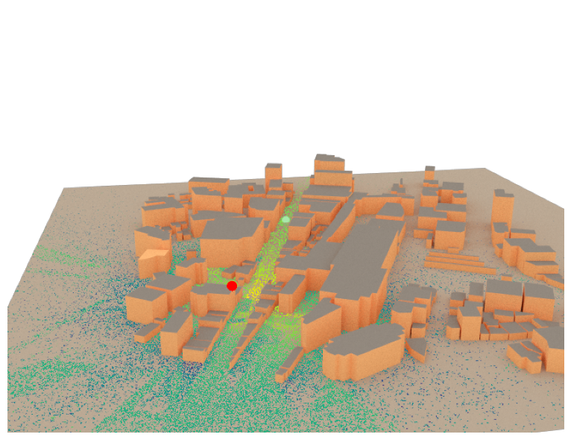
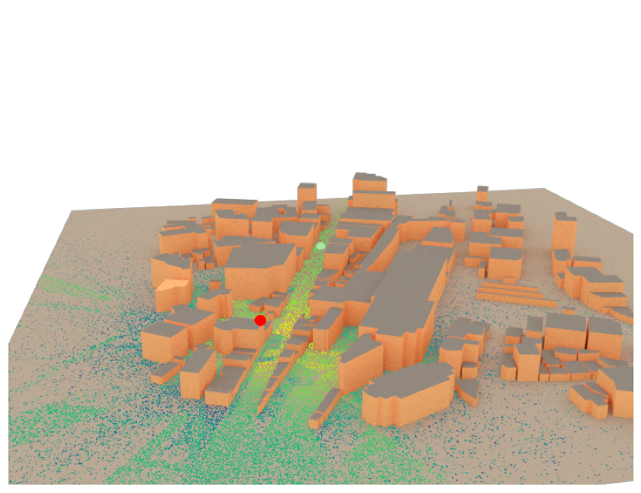
Frequency: 3.4G
Tilt : 45°
Frequency: 3.4G
Tilt : 60°
Frequency: 3.4G
Tilt : 75°
Rx
Rx
Rx
Tx
Tx
Tx

Slide 6
