Slide 1
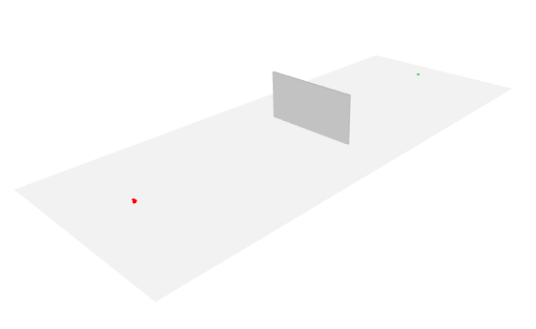
Rx
Wall
Tx

Slide 2
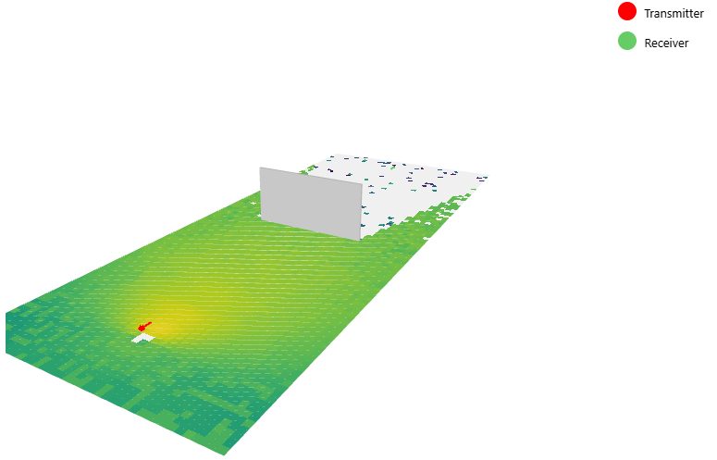
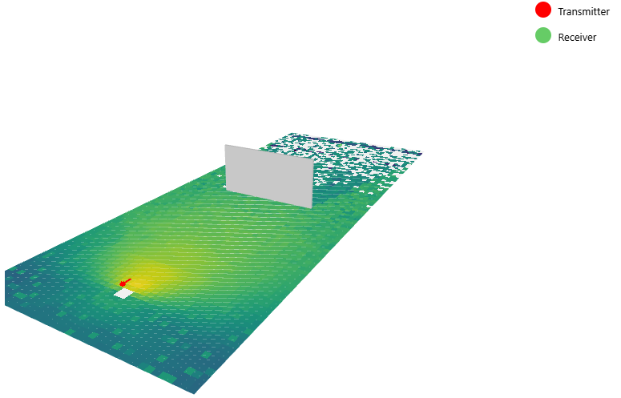
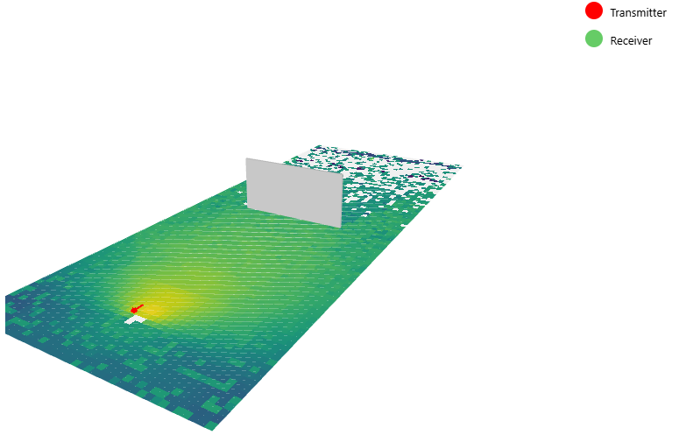
Concrete
Brick
Wood
Rx
Rx
Rx
Wall
Wall
Wall
Tx
Tx
Tx

Slide 3

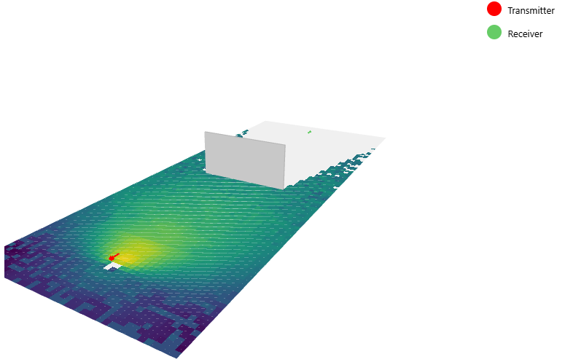

Glass
Plywood
Marble
Rx
Rx
Rx
Wall
Wall
Wall
Tx
Tx
Tx

Slide 4

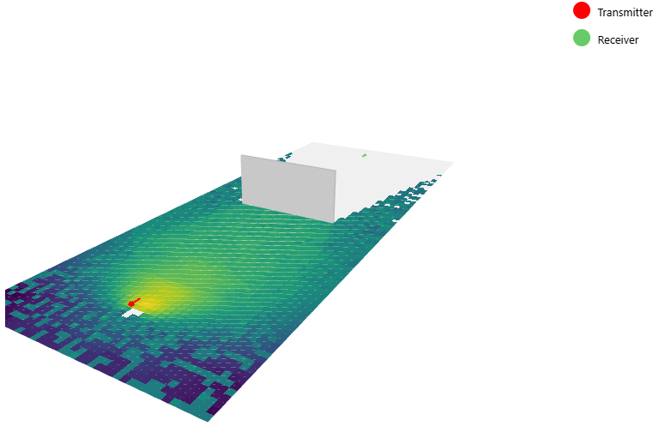
Metal
Plywood
Marble
Rx
Rx
Rx
Wall
Wall
Wall
Tx
Tx
Tx

Slide 5
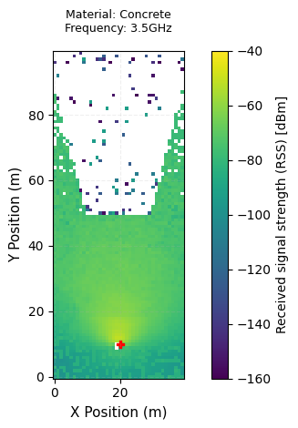
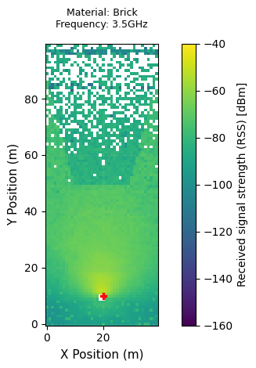
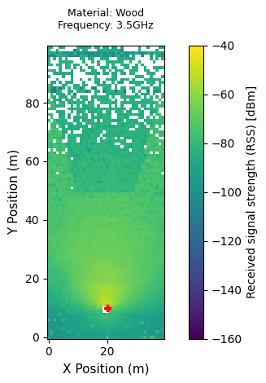
Rx
Rx
Rx
Wall
Wall
Wall
Tx
Tx
Tx

Slide 6
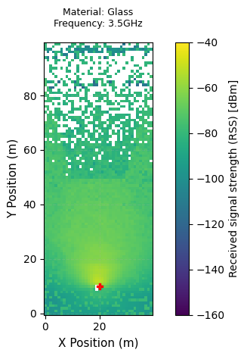
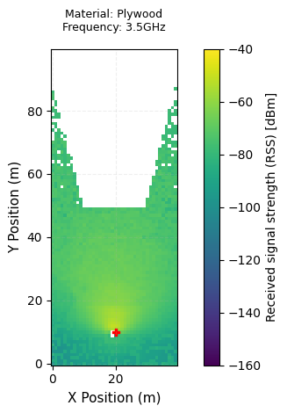
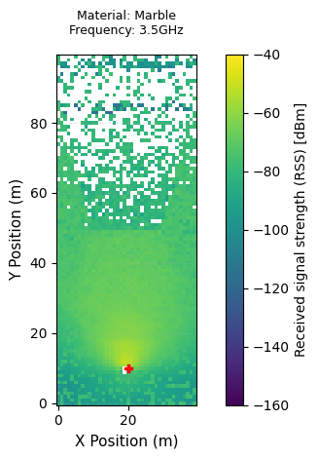
Rx
Rx
Rx
Wall
Wall
Wall
Tx
Tx
Tx

Slide 7
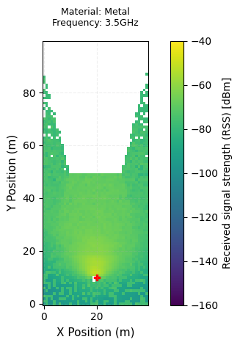
Rx
Rx
Rx
Wall
Wall
Wall
Tx
Tx
Tx

