Slide 1
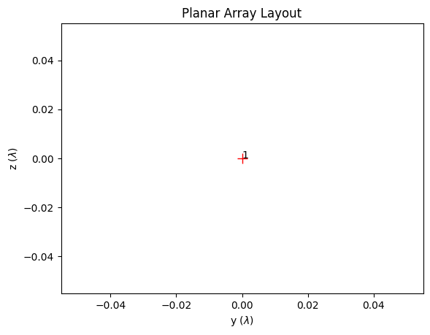
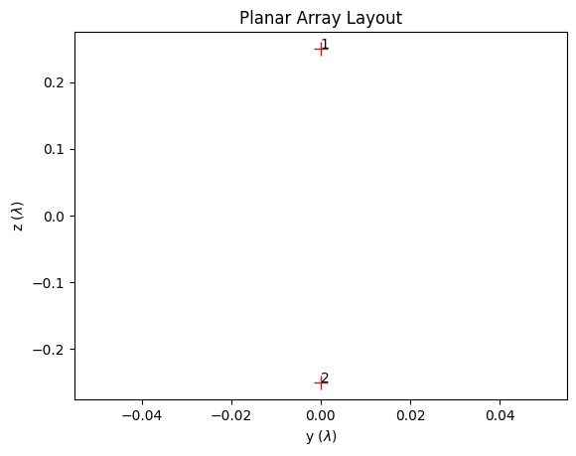
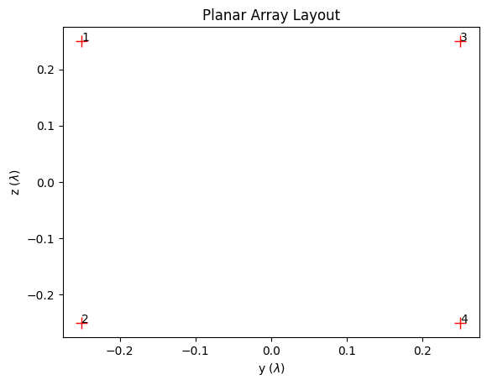
2T (1x1)SA (1x1)
4T (1x1)SA (2x1)
8T (1x1)SA (2x2)

Slide 2
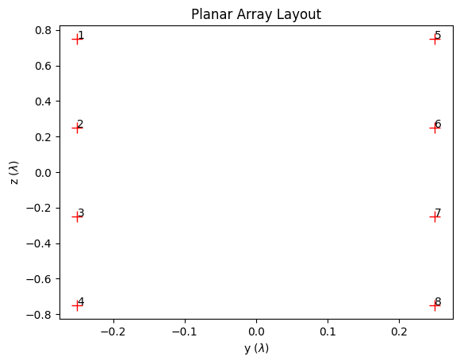
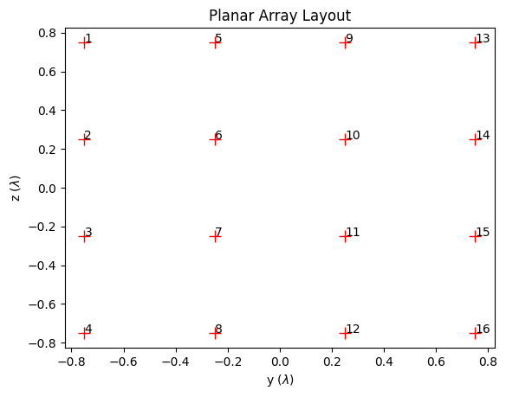
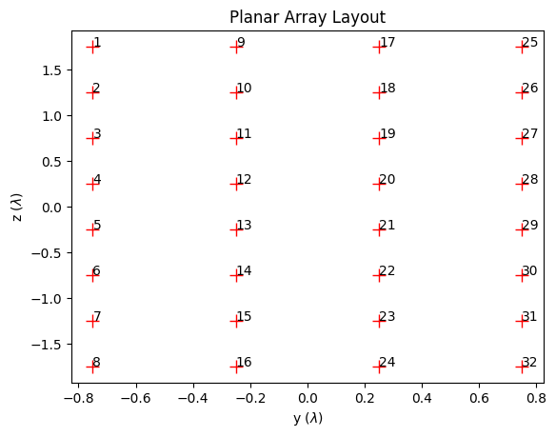
16T (1x1)SA (4x2)
32T (1x1)SA (4x4)
64T (1x1)SA (8x4)

Slide 3
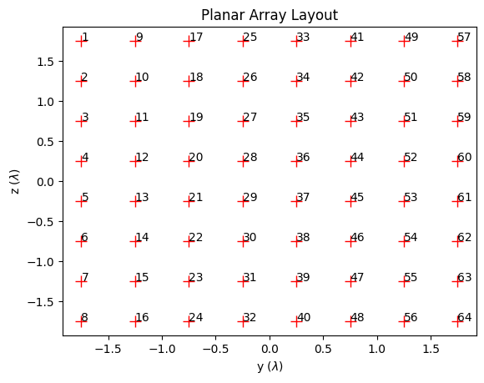
128T (1x1)SA (8x8)

Slide 4
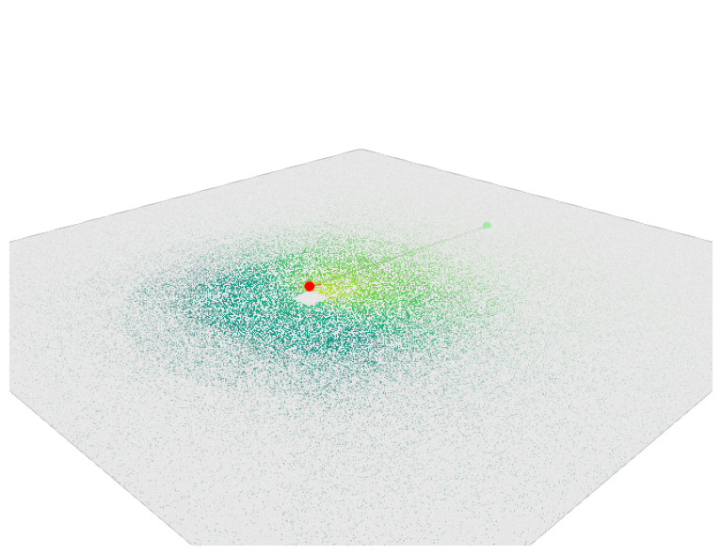
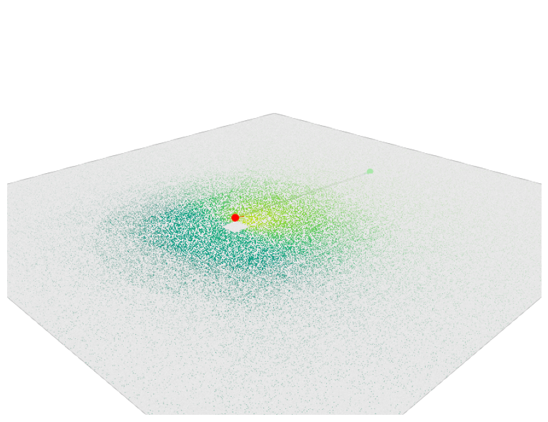
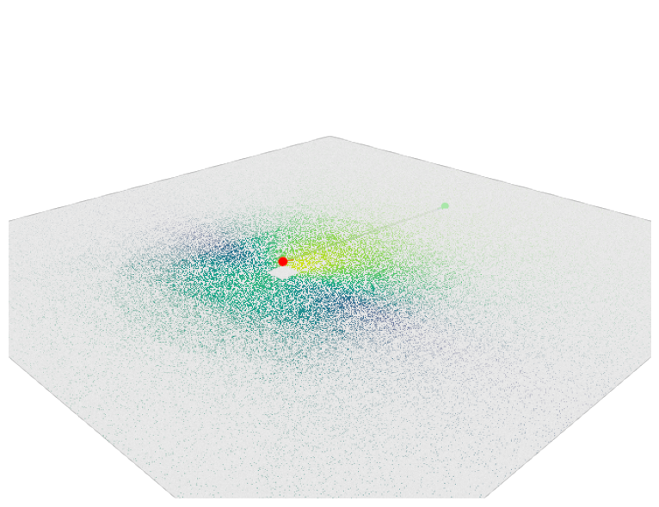
2T (1x1)SA (1x1)
4T (1x1)SA (2x1)
8T (1x1)SA (2x2)

Slide 5
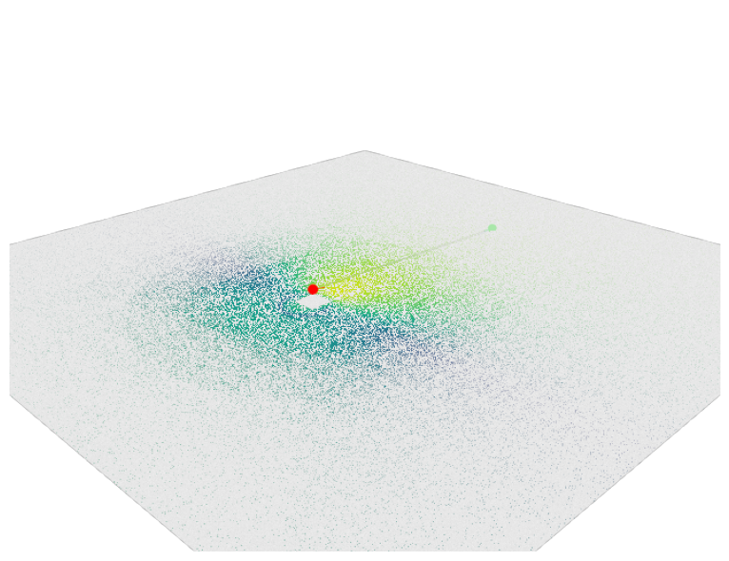
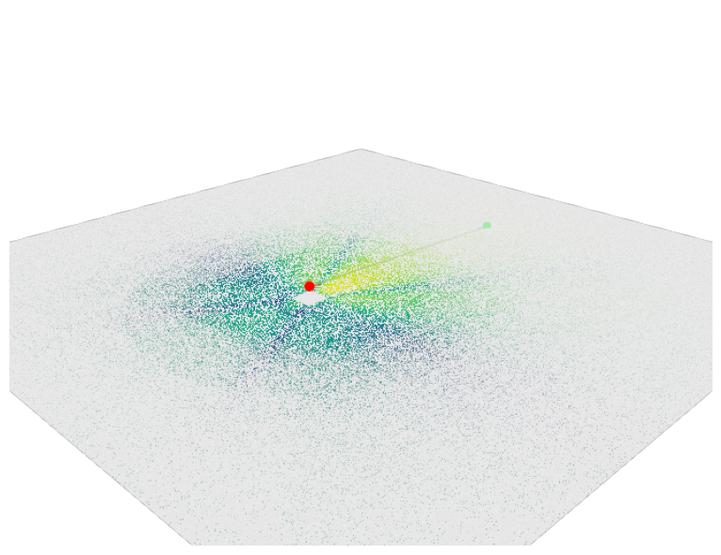

16T (1x1)SA (4x2)
32T (1x1)SA (4x4)
64T (1x1)SA (8x4)

Slide 6
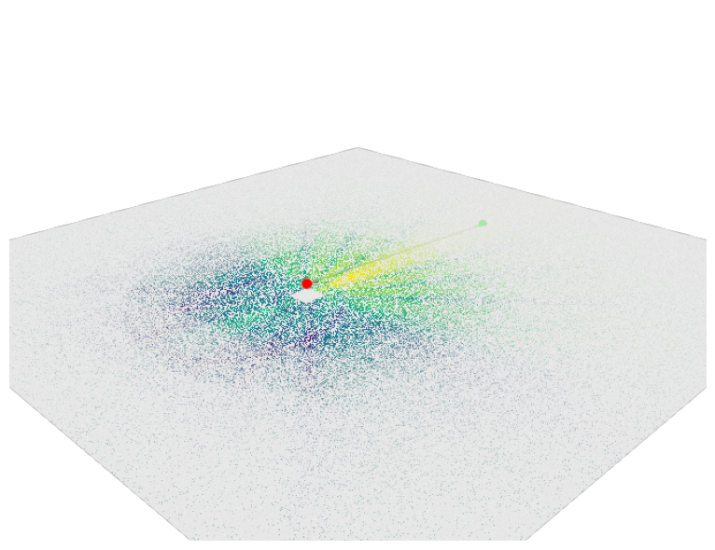
128T (1x1)SA (8x8)

Slide 7
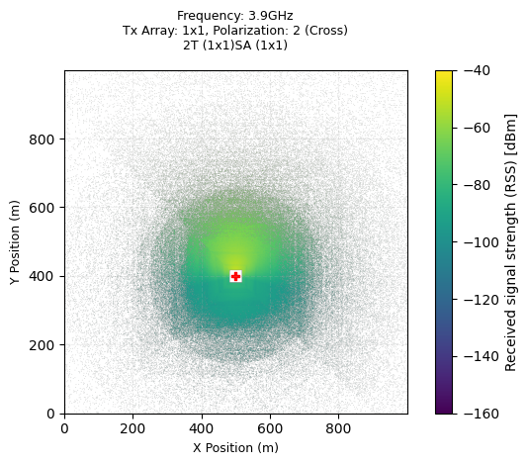

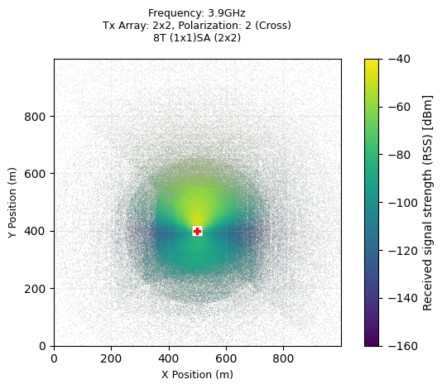

Slide 8


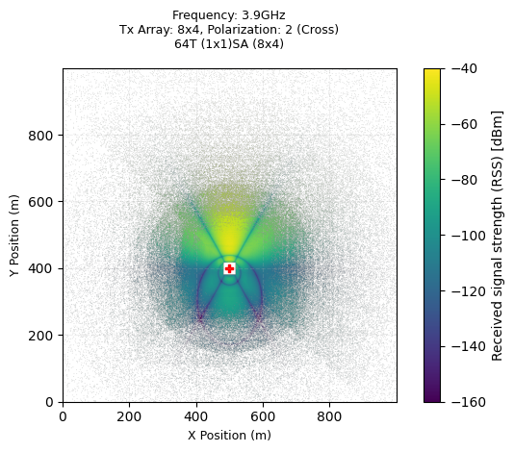

Slide 9
