Slide 1
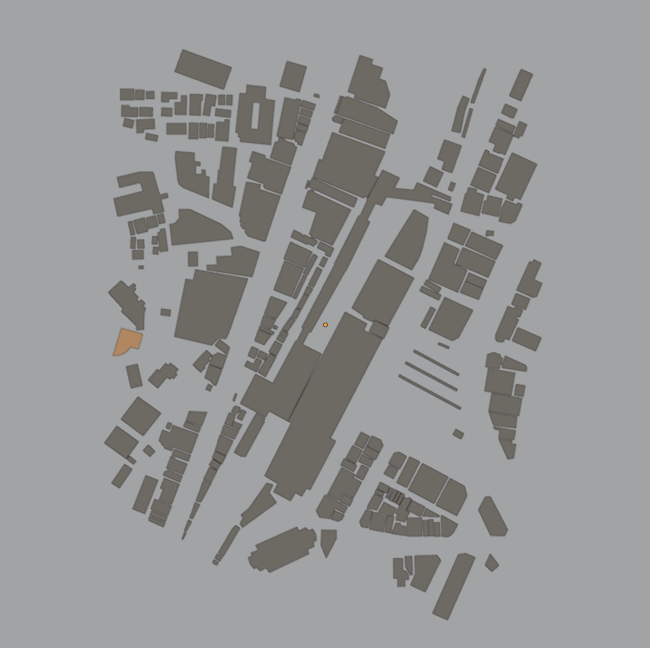
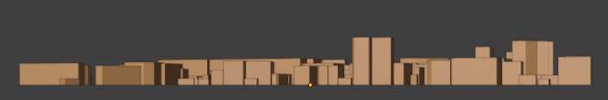
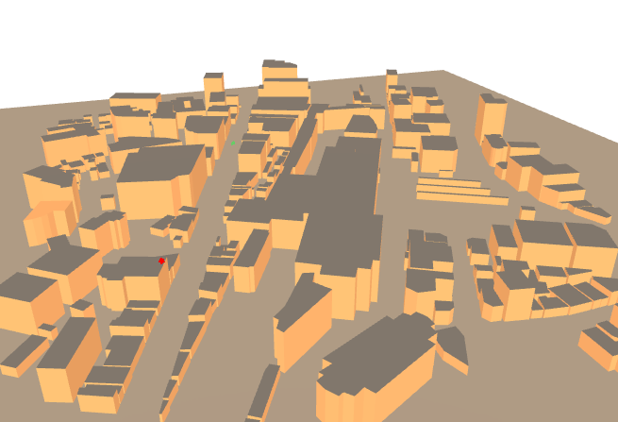
Tx
Rx
Rx
Scene
0°
Rx
Tx
Tx

Slide 2
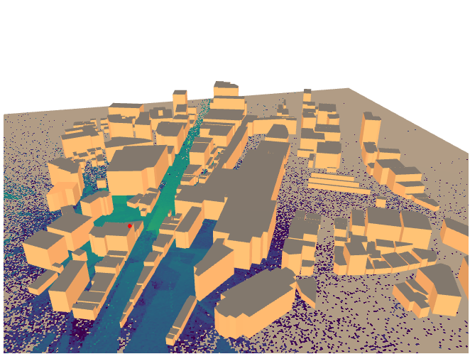
Rx
Tx

Slide 3
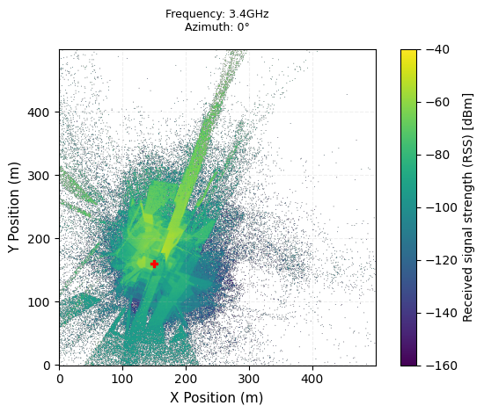
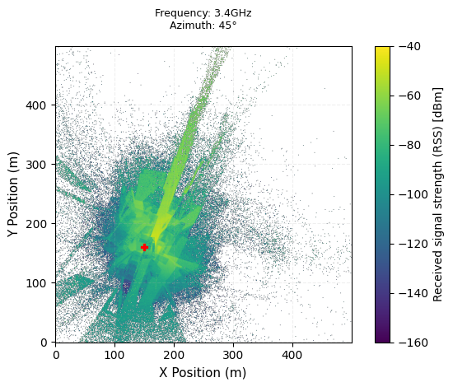
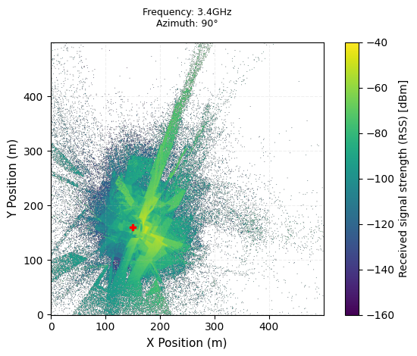
Rx
Rx
Rx
Tx
Tx
Tx

Slide 4
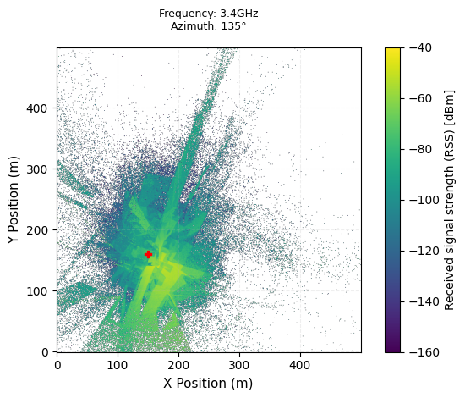
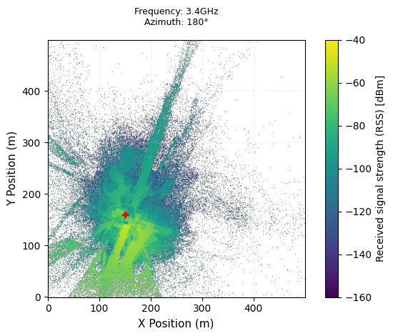
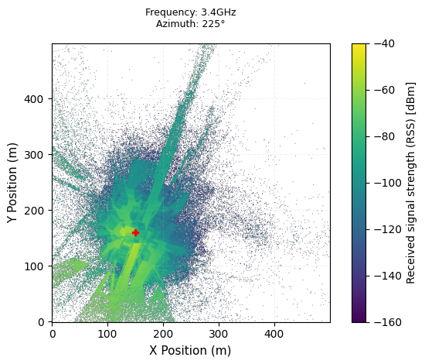
Rx
Rx
Rx
Tx
Tx
Tx

Slide 5
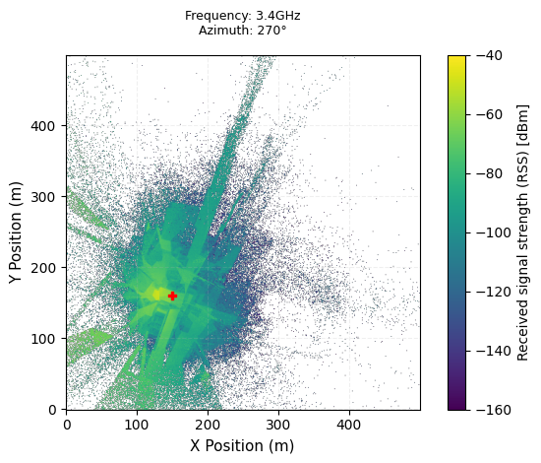
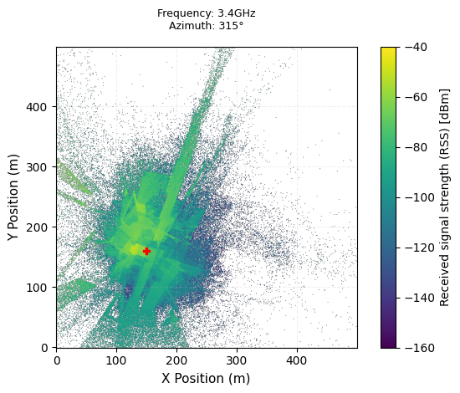
Rx
Rx
Tx
Tx

Slide 6
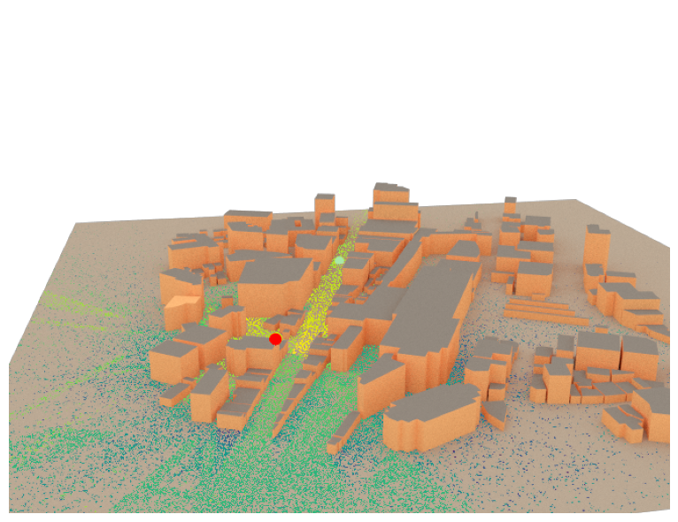
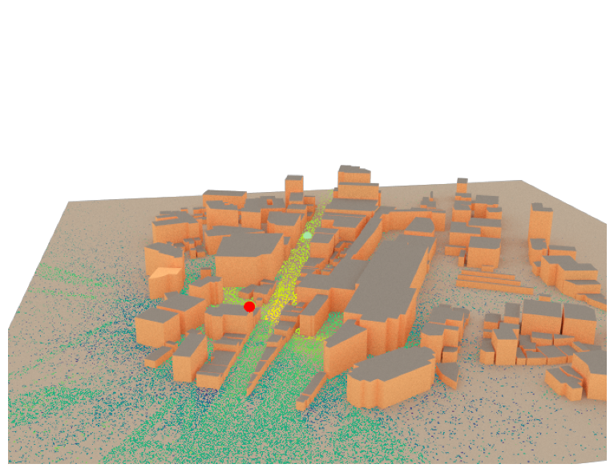
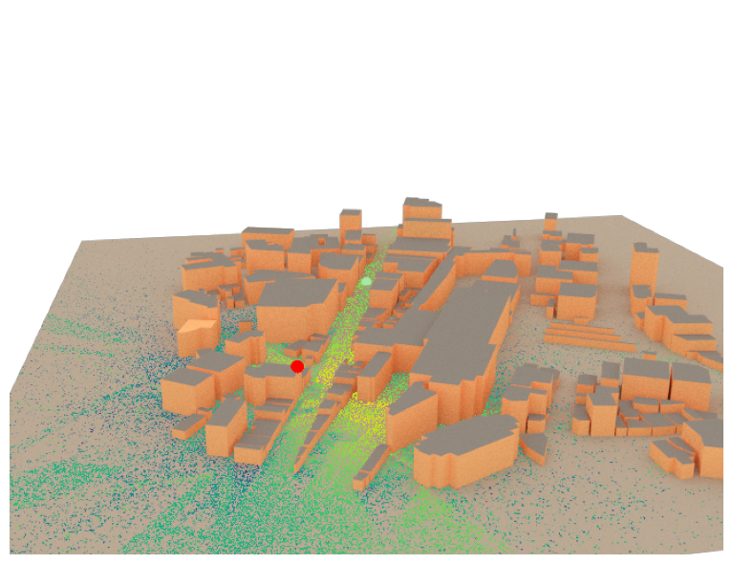
Frequency: 3.4G
Azimuth: 0°
Frequency: 3.4G
Azimuth: 45°
Frequency: 3.4G
Azimuth: 90°
Rx
Rx
Rx
Tx
Tx
Tx

Slide 7
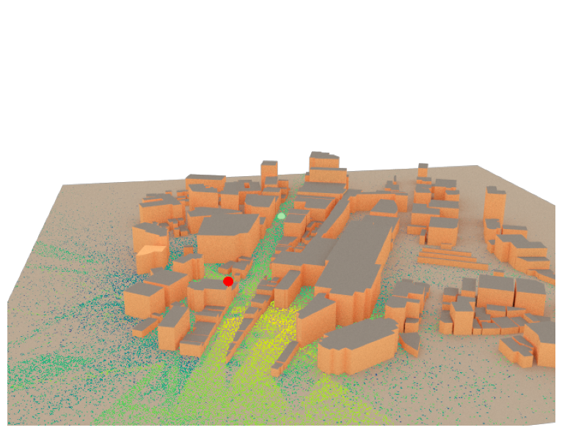

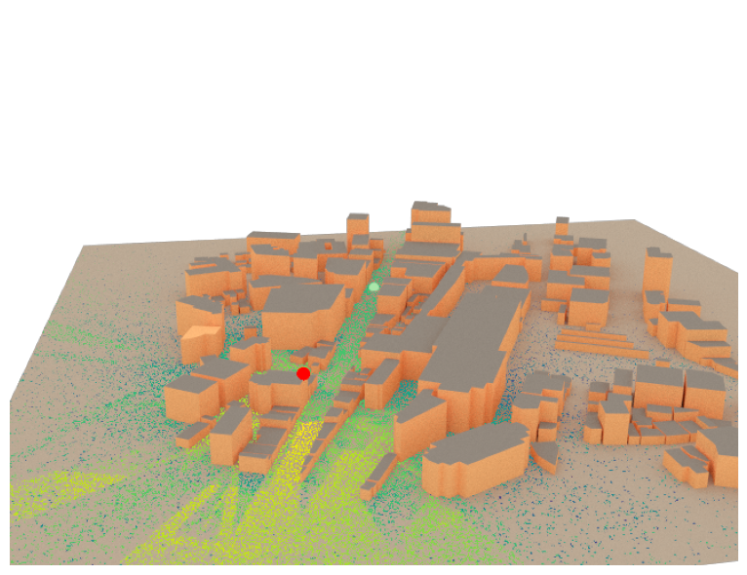
Frequency: 3.4G
Azimuth: 135°
Frequency: 3.4G
Azimuth: 180°
Frequency: 3.4G
Azimuth: 225°
Rx
Rx
Rx
Tx
Tx
Tx

Slide 8
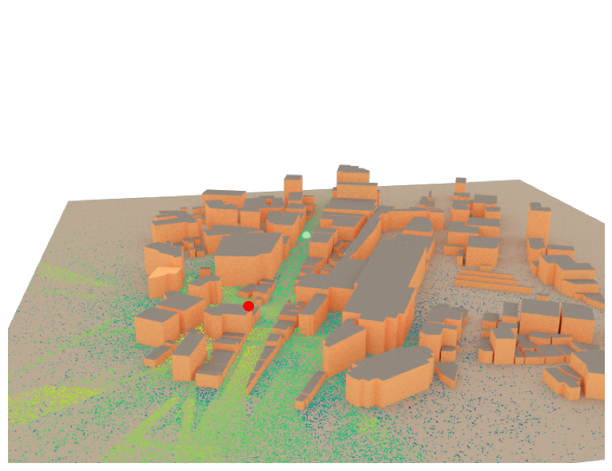
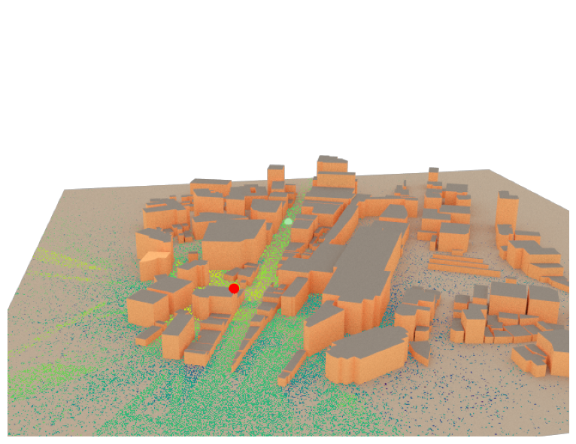
Frequency: 3.4G
Azimuth: 270°
Frequency: 3.4G
Azimuth: 315°
Rx
Rx
Tx
Tx

