Slide 1
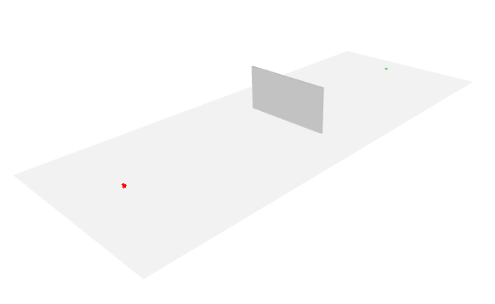
Rx
Wall
Tx

Slide 2
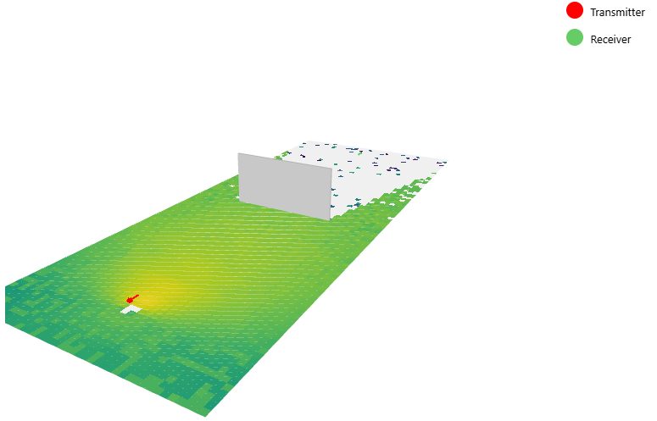
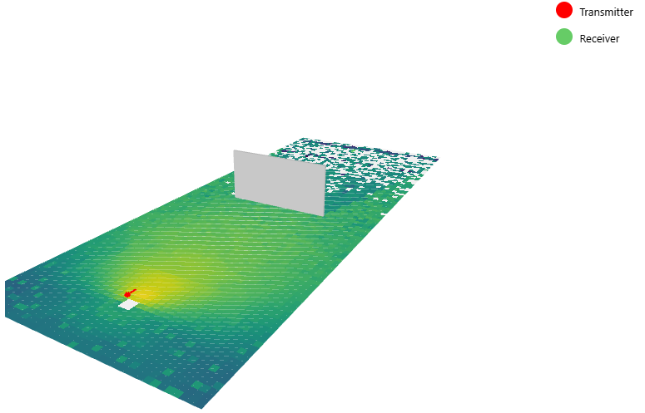
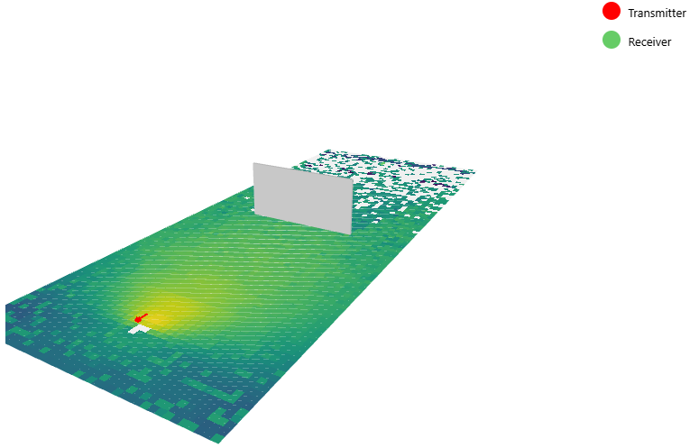


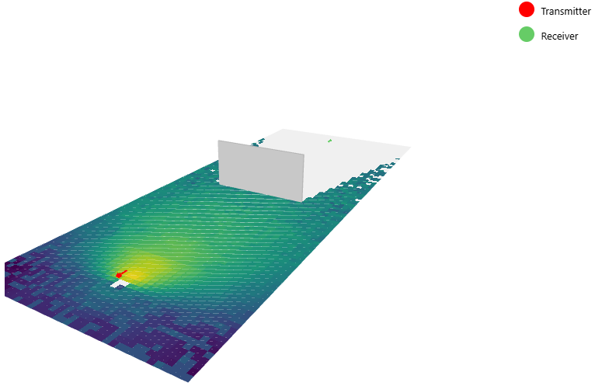

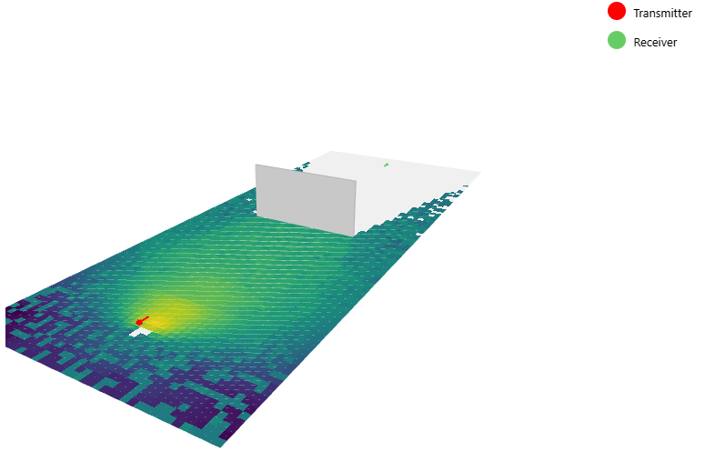

Concrete
Brick
Wood
Glass
Rx
Rx
Rx
Rx
Wall
Wall
Wall
Wall
Tx
Tx
Tx
Tx
Plywood
Marble
Metal
Rx
Rx
Rx
Wall
Wall
Wall
Tx
Tx
Tx

Slide 3
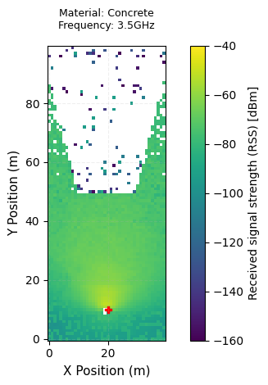
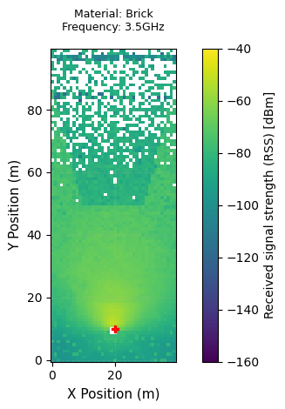
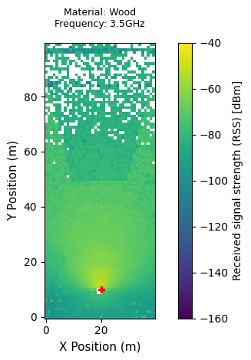
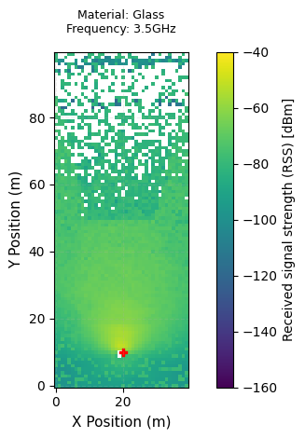
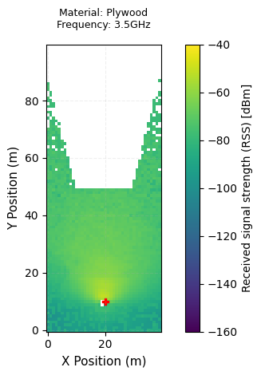
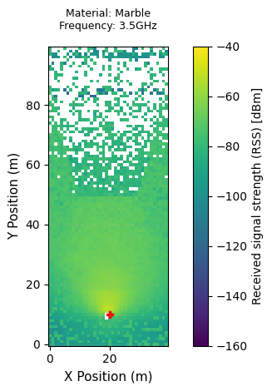
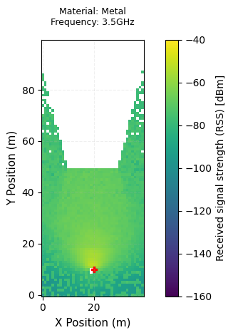
Concrete
Brick
Wood
Glass
Rx
Rx
Rx
Rx
Rx
Wall
Wall
Wall
Wall
Wall
Tx
Tx
Tx
Tx
Tx
Plywood
Marble
Metal
Rx
Rx
Rx
Wall
Wall
Wall
Tx
Tx
Tx

