Slide 1
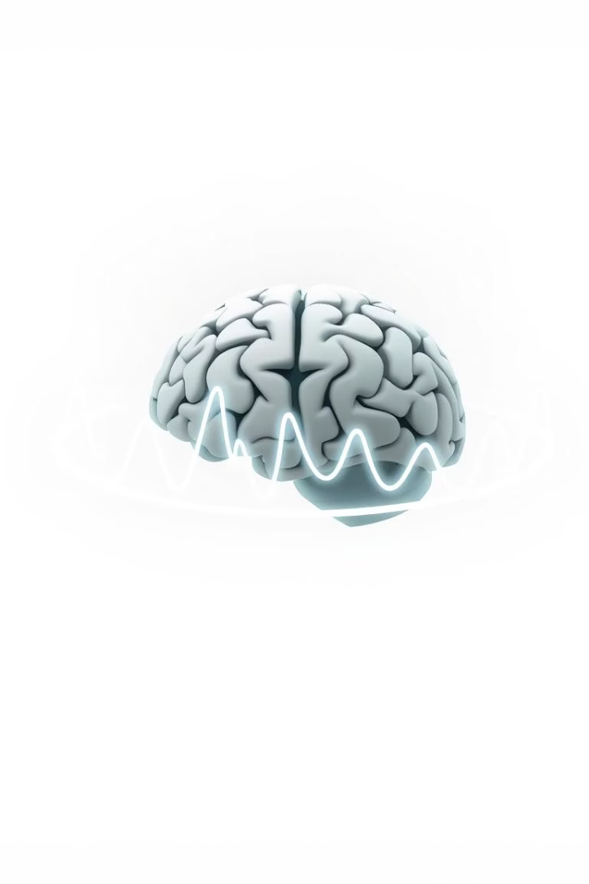
EEG Binary Seizure Detection Project
This presentation explores the development and evaluation of machine learning models for automated seizure detection from short EEG segments.
ZK
by Zulfiqar Khan

Slide 2
Introduction: Epilepsy & EEG
Epilepsy
EEG
A chronic neurological disorder characterized by recurrent seizures.
A non-invasive tool for diagnosing epilepsy that records brain electrical activity via scalp electrodes.

Slide 3
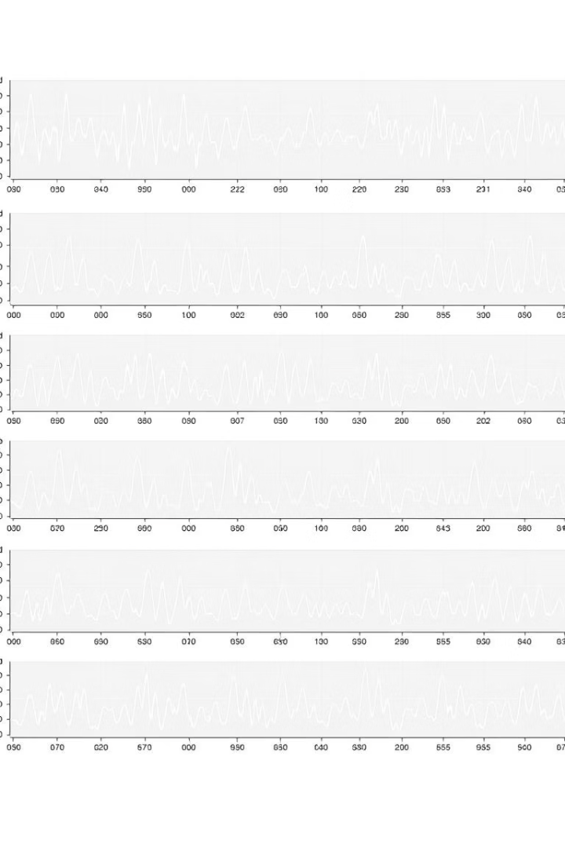
Dataset & Preprocessing
1
Dataset Source
2
Data Format
Clinical EEG recordings (Wong et al., 2023).
Numerical segments (.npy files).
3
Preprocessing Pipeline
Filtering, segmentation, label binarization, amplitude normalization.

Slide 4
Data Visualization: Understanding the Data
Class Distribution
Sample Segments
Dataset is well-balanced (Figure 1).
Visual differences between Non-Seizure and Seizure segments (Figure 2).

Slide 5
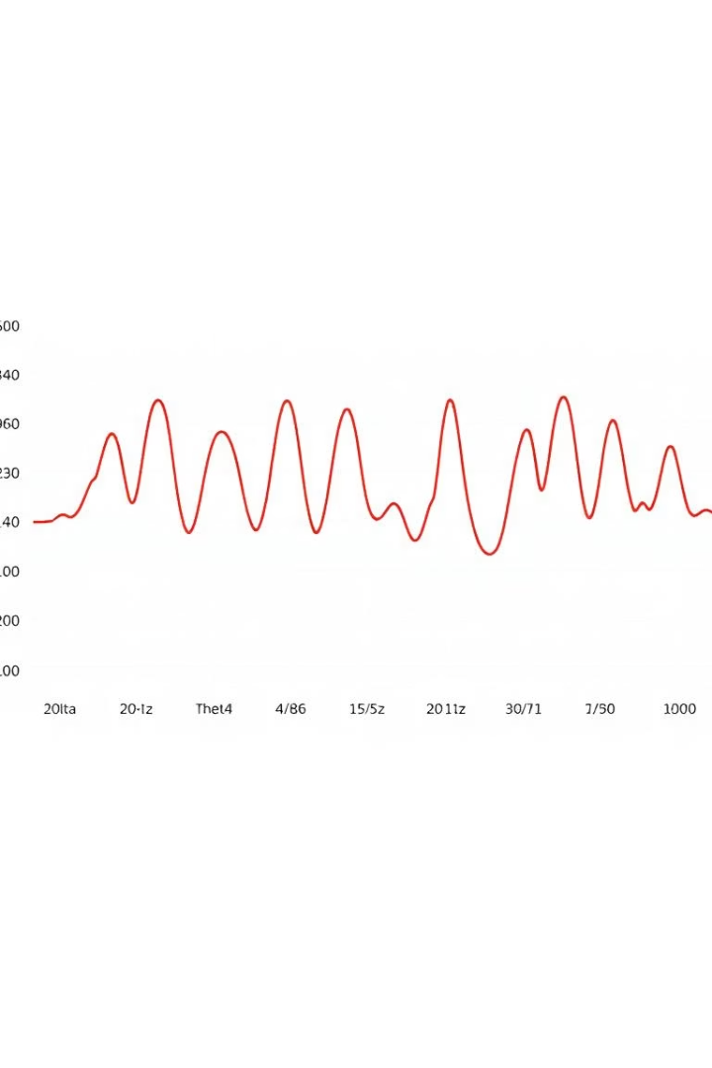
Data Visualization: Frequency Characteristics
1
Power Spectral Density
Seizure segments have higher power, especially in lower frequencies (Figure 4).
2
Average Band Power
Power distribution across standard EEG bands (Figure 5).

Slide 6
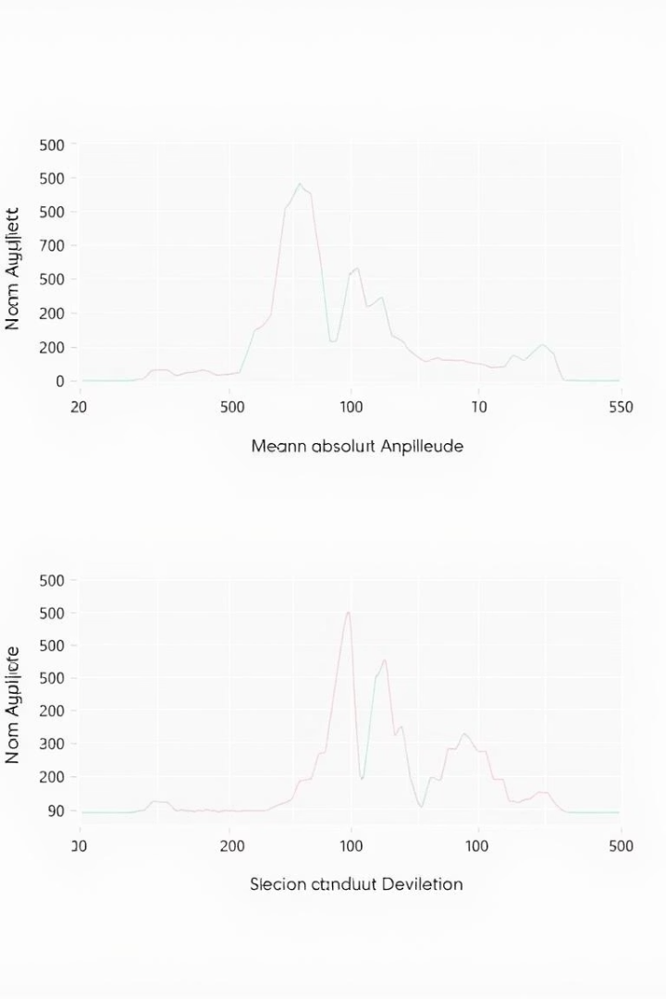
Data Visualization: Statistical Differences
Seizure segments show higher values for Mean Abs Amplitude and Std Dev (Figure 6).

Slide 7

Machine Learning Approaches
SVM
Random Forest
Effective for classification, uses kernel trick (RBF) for non-linear data (Temko et al., 2011a).
Ensemble of decision trees, robust, handles complex relationships (Wang et al., 2019).
CNN
Designed for structured data like time series with spatial dimensions (Zhou et al., 2018).

Slide 8
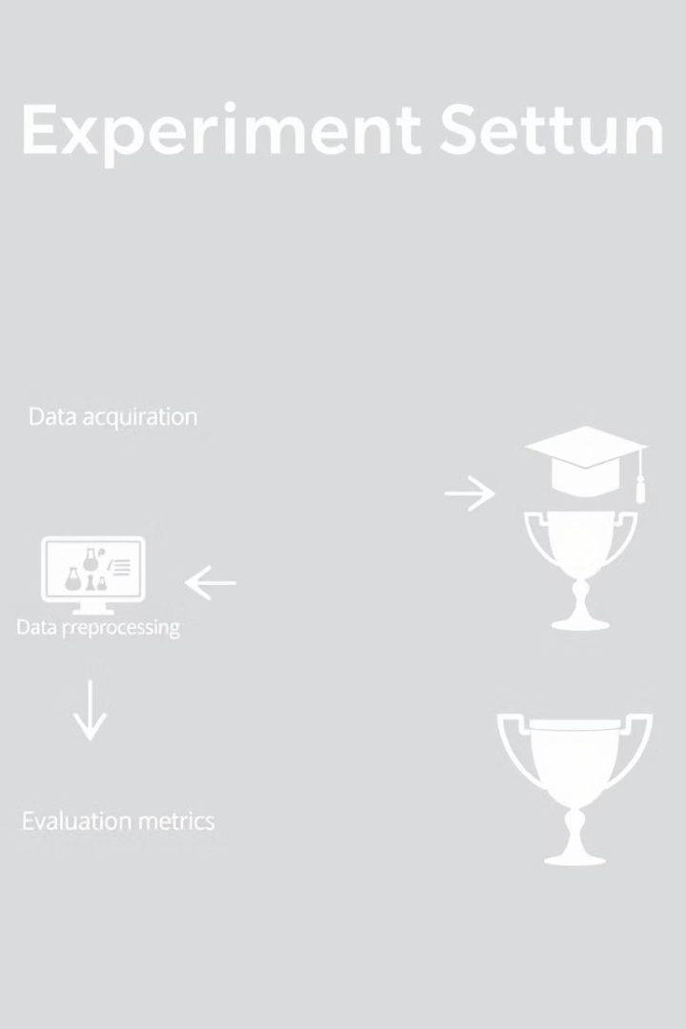
Experimental Design & Evaluation
1
Data Split
Training (7011 segments), Testing (779 segments).
2
Evaluation Metrics
Accuracy, Precision, Recall, F1-score.

Slide 9
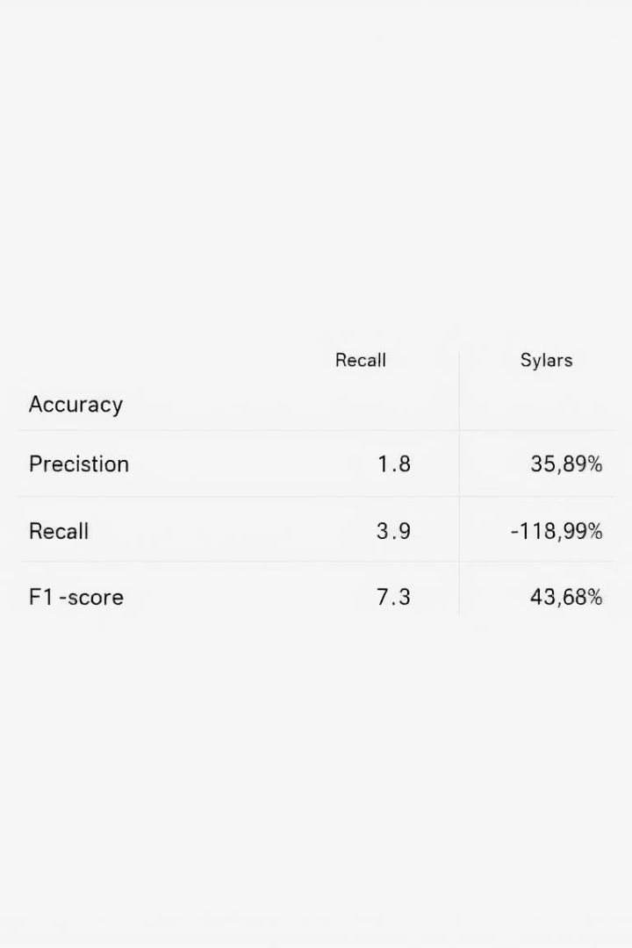
Performance Results (Table 1)
Table 1 summarizes the performance of the models. CNN achieved the highest Accuracy and F1-score, exceeding the target of >90%.

Slide 10

Conclusion & Future Directions
The project successfully developed and evaluated machine learning models for automated seizure detection. Future work includes hyperparameter tuning, exploring more advanced DL architectures, and real-time implementation feasibility.

