Slide 1
SummarAIze
Muhammad Zulfiqar Ali
2021493

Slide 2
Introduction
This project focuses on the development of an AI-based text summarization system using transformer-based models to address the challenges of information overload and improve the efficiency of summarizing large volumes of text.
The project's significance lies in its contribution to advancing text summarization techniques, addressing existing gaps in the field, and providing a more efficient and accurate solution for summarizing large volumes of text.
The key methods employed in this project include utilizing transformer-based models (T5, BART, LED) for abstractive summarization and incorporating extractive summarization using BERT for enhanced coherence and accuracy in the generated summaries.

Slide 3
Background
This project aims to address the problem of information overload by developing an AI-based text summarization system that can automatically generate concise and coherent summaries, improving information retrieval and comprehension in various domains.
Text summarization is a vital technique that condenses large volumes of text into concise summaries, enhancing information retrieval and comprehension by providing an overview of the main points and key information.
Different approaches to text summarization include extractive techniques that select and rearrange existing sentences, and abstractive techniques that generate new sentences to summarize the main content of the text.
Transformer-based models, such as T5, BART, and LED, have played a pivotal role in achieving state-of-the-art performance in text summarization tasks, thanks to their ability to capture contextual information and generate coherent and accurate summaries.

Slide 4
Literature Review
The existing research and literature on text summarization encompasses various techniques, including extractive, abstractive, and hybrid approaches, with a focus on improving the quality, coherence, and efficiency of summarization algorithms.
Key studies, papers, and approaches in the field of text summarization include "Attention is All You Need" by Vaswani et al., which introduced the transformer model, and advancements in neural network architectures, reinforcement learning, and domain-specific fine-tuning techniques.
Advancements in text summarization techniques include the development of transformer-based models, fine-tuning approaches, reinforcement learning methods, and the integration of domain-specific knowledge, resulting in significant improvements in summary quality, coherence, and fluency.
Previous research has identified challenges and limitations in text summarization, including difficulties in generating coherent and contextually appropriate summaries, handling long and diverse documents, addressing information redundancy, and developing effective evaluation metrics for assessing summary quality.

Slide 5
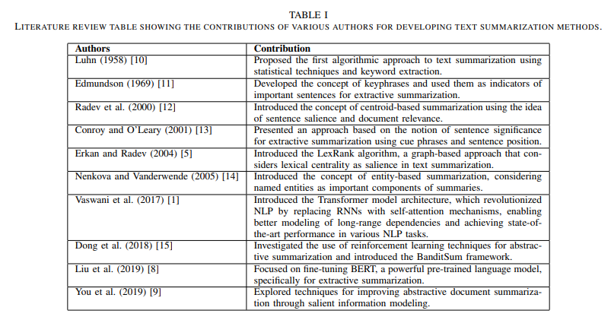
Literature Review

Slide 6
Gap Analysis
Existing text summarization techniques have gaps and limitations related to the generation of coherent and contextually appropriate summaries, handling document length and diversity, addressing information redundancy, and establishing comprehensive evaluation metrics for accurate assessment.
The incorporation of domain-specific knowledge and fine-tuning techniques is crucial for achieving enhanced summarization results, as it enables the models to capture domain-specific nuances and generate summaries that are more relevant, accurate, and tailored to specific contexts.
This project aims to address the identified gaps and limitations in text summarization techniques by developing an AI-based system that leverages advanced models and techniques, ultimately improving the quality, coherence, and fluency of generated summaries.

Slide 7
Problem Statement
This project aims to address the problem of generating accurate and coherent summaries from large volumes of text using advanced AI techniques, improving information retrieval and comprehension.
There is a critical need for an accurate and efficient text summarization system to facilitate effective information retrieval, comprehension, and decision-making in the era of information overload.
Automated text summarization holds great potential in various domains, including academia, research, news analysis, business intelligence, and content curation, enabling efficient information processing, knowledge extraction, and decision-making.

Slide 8
Proposed Solution
The proposed solution for text summarization utilizes advanced AI techniques, including transformer-based models, to generate accurate and coherent summaries from large volumes of text.
Leveraging transformer-based architectures allows for better contextual understanding and capturing of complex relationships in text, leading to more accurate and contextually relevant summaries.
The project utilizes pretrained models such as T5, BART, and LED for abstractive text summarization, while also integrating the bert-extractive-summarizer library for extractive summarization using BERT, enabling a comprehensive approach to summarization.
The project includes the development of a user-friendly streamlit app that provides an intuitive interface for users to input text and receive accurate and concise summaries, enhancing the accessibility and usability of the text summarization system.

Slide 9
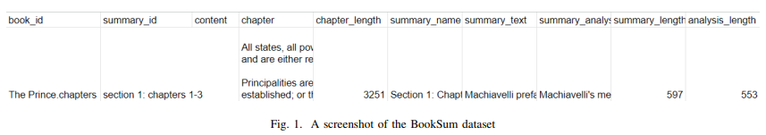
Dataset Used
The project employs the BookSum dataset for training and evaluation, facilitating the development and assessment of the text summarization system's performance and effectiveness.
The chosen dataset, BookSum, exhibits relevance in capturing diverse text genres and styles, allowing the text summarization system to handle a wide range of content and produce comprehensive summaries.

Slide 10
Methods and Experimental Setup
The project utilizes a combination of transformer-based models (T5, BART, LED) for abstractive summarization and extractive summarization using BERT to enhance the quality, coherence, and accuracy of the generated summaries.
The project leverages pretrained models (T5, LED) and performs fine-tuning on the BookSum dataset to enhance the performance and adaptability of the text summarization system.
The project incorporates the bert-extractive-summarizer library, which utilizes BERT for extractive summarization, extracting important sentences from the input text to generate concise and informative summaries.

Slide 11
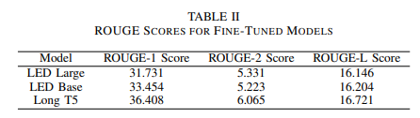
Results
The performance of the text summarization system was evaluated using standard metrics, including ROUGE-1, ROUGE-2, and ROUGE-L scores, which assess the similarity between the generated summaries and reference summaries, providing quantitative measures of summary quality and effectiveness.
The fine-tuned models (LED Large, LED Base, Long T5) achieved impressive ROUGE scores on the BookSum dataset, with LED Large obtaining ROUGE-1: 31.731, ROUGE-2: 5.331, and ROUGE-L: 16.146, LED Base obtaining ROUGE-1: 33.454, ROUGE-2: 5.223, and ROUGE-L: 16.204, and Long T5 obtaining ROUGE-1: 36.408, ROUGE-2: 6.065, and ROUGE-L: 16.721.

Slide 12
Significance of Results
The obtained results demonstrate the effectiveness and potential of the text summarization system, showcasing improved summarization quality, coherence, and relevance, thus contributing to the advancement of text summarization techniques and addressing the challenges of information overload in various domains.
The enhanced text summarization system holds immense potential in domains such as academia, research, and professional settings, facilitating efficient information retrieval, literature review, knowledge extraction, and decision-making processes.
The developed text summarization system has the potential to significantly enhance efficiency, productivity, and accessibility by effectively summarizing large volumes of text, enabling users to quickly grasp key information, make informed decisions, and navigate complex information landscapes with ease.

Slide 13
Conclusion
The project successfully developed an advanced text summarization system utilizing transformer-based models and fine-tuning techniques, resulting in improved summary quality, coherence, and relevance, with potential applications in academia, research, and professional domains.
The developed AI-based text summarization system demonstrates success in generating accurate and coherent summaries, enhancing information retrieval and comprehension in large volumes of text.
The integration of domain-specific fine-tuning techniques and advanced transformer-based models significantly enhances the text summarization system's performance, allowing for more contextually relevant and accurate summaries that capture domain-specific nuances and complexities.
The system has the potential to revolutionize efficiency, productivity, and accessibility in dealing with large volumes of text by providing concise and informative summaries, enabling users to extract key information quickly and make informed decisions with ease.

Slide 14
Thank You!

