Slide 1
World Cup Performance Visualization and Analysis
Steven Zulim & Aaron Burke
(with support from Tara Fathinejad)

Slide 2

The World Cup is here!
Let’s look at historical performance records
Which teams have been best?
What teams over/underperform
Map and graph results
World Cup Performance Analysis
Steven Zulim and Aaron Burke

Slide 3
Full-Stack Web App:
SQLite
Flask
GeoJson
Leaflet
d3
Bootstrap
Interactive Choropleth map
D3 scatterplot
Select Year
World Cup Performance Analysis
Steven Zulim and Aaron Burke

Slide 4
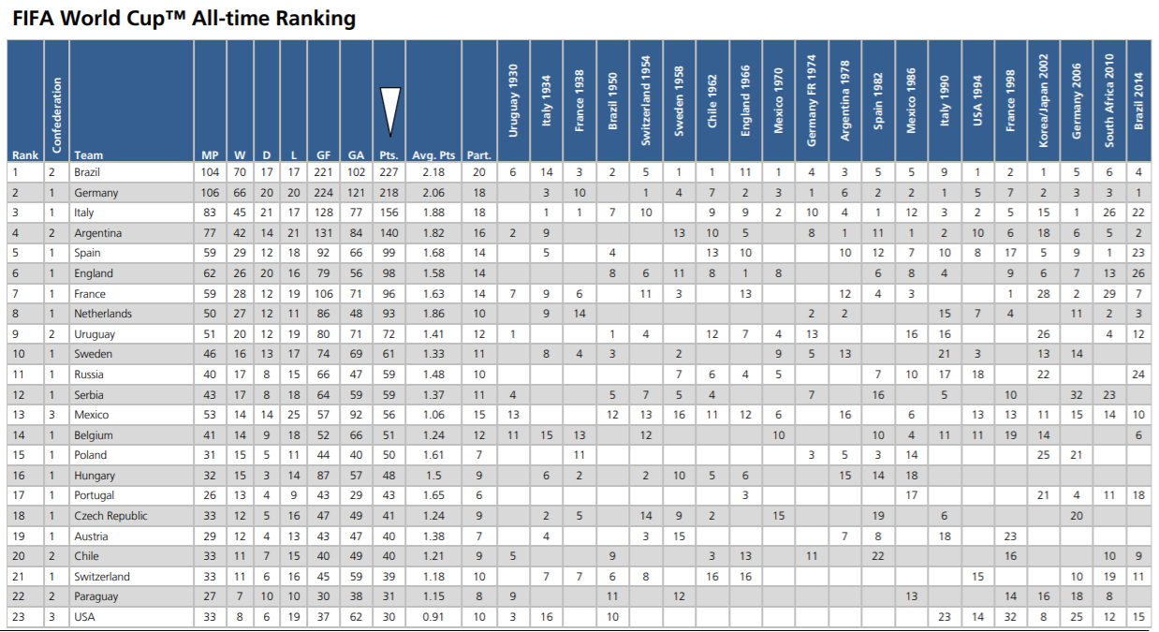
The Data
FIFA World Cup All-time Rankings – only found in PDF format on fifa.com
FIFA Rankings (starting in 1993) – Kaggle
World Cup Metadata – Kaggle
World Cup Performance Analysis
Steven Zulim and Aaron Burke

Slide 5

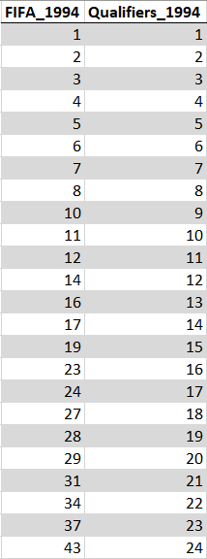

For an even comparison against World Cup outcomes, we indexed by FIFA Rank and then turned that index into a new “Qualifiers” column
World Cup Performance Analysis
Steven Zulim and Aaron Burke

Slide 6
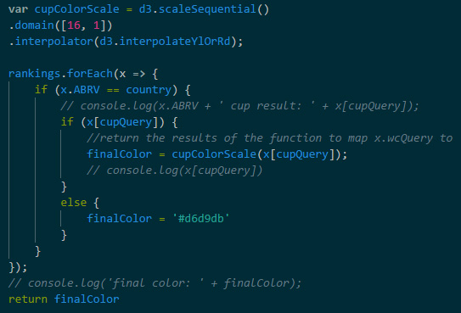
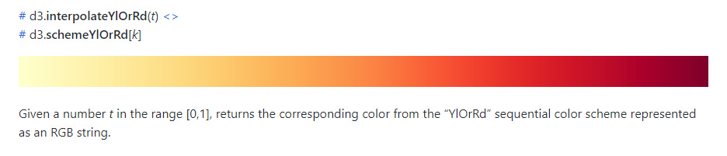
Map Design
Challenges:
Make only 1 layer active
Make borders always show and be top layer
Connect GeoJson data to database data
Flexible color scale
d3-scale-chromatic
World Cup Performance Analysis
Steven Zulim and Aaron Burke

Slide 7
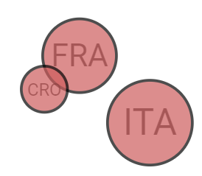
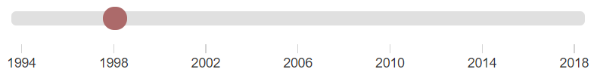
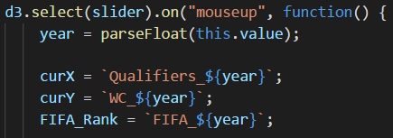
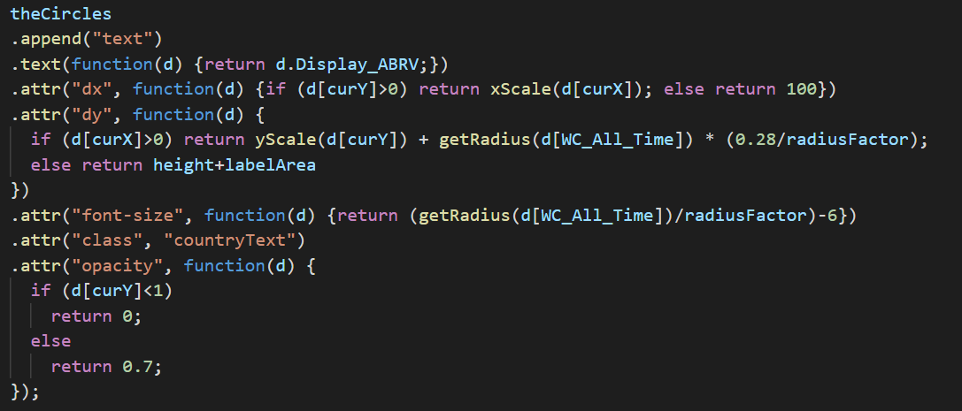
Dynamic Scatterplot:
Built with D3 and controlled by custom range slider
World Cup Performance Analysis
Steven Zulim and Aaron Burke

