Slide 1
Exercise Week 04

Slide 2


summary statistics of numeric variables
Rural
Cities

Slide 3


Boxplots of prices per m2
Rural
Cities

Slide 4


Boxplots of areas
Rural
Cities

Slide 5
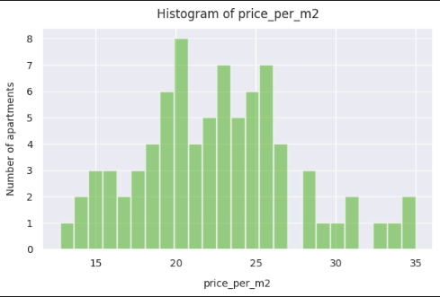
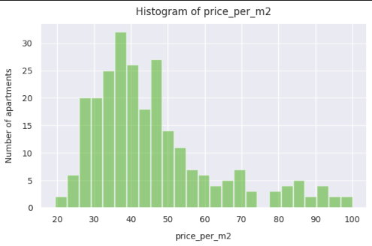
Histograms of prices per m2
Rural
Cities

Slide 6
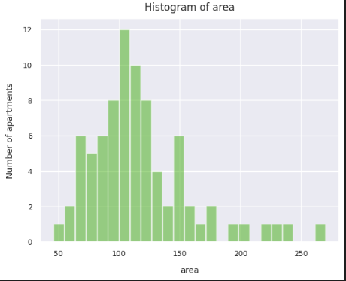
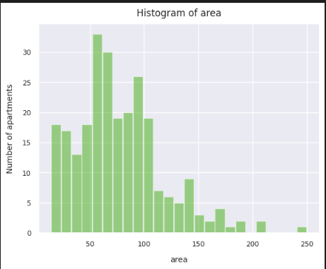
Histograms of areas
Rural
Cities

