Slide 1

Introduction to DSA
Instructor: Nauman Khan

Slide 2
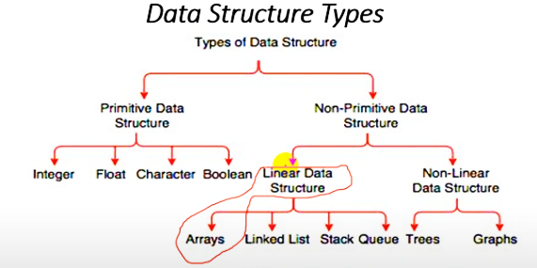
What is Array?

Slide 3
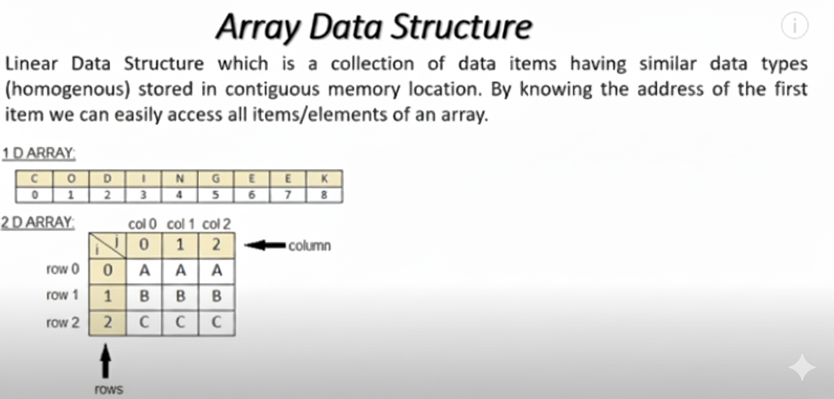
What is Array?
Notes:
Contiguous memory refers to a single, unbroken block of memory allocated to a process, where all the addresses are sequential and adjacent. It’s one of the oldest and simplest memory allocation techniques used in operating systems.

Slide 4
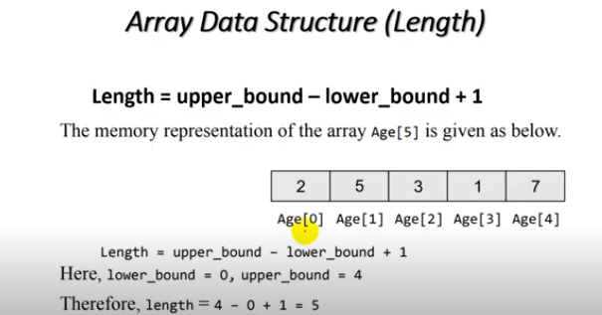
What is Array Length?

Slide 5
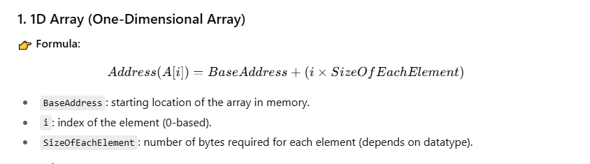
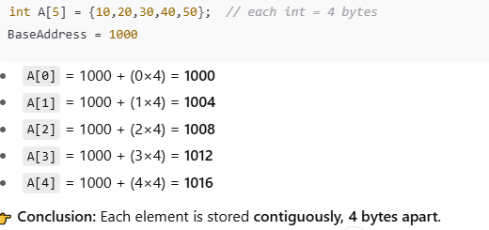
CALCULATE Memory ARRAY ADDRESS

Slide 6
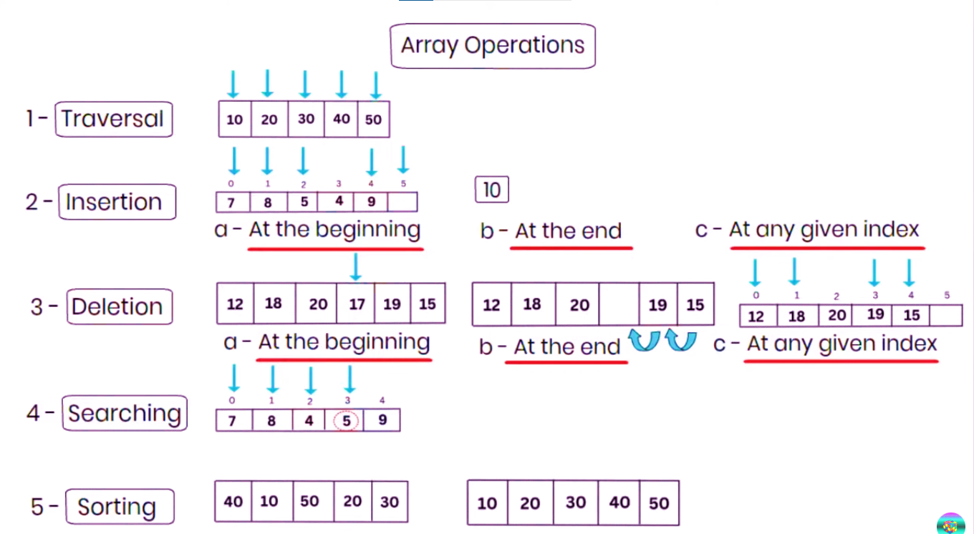
Array Operation

Slide 7
Array Operation

Slide 8
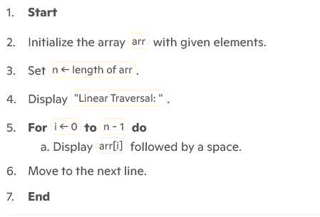
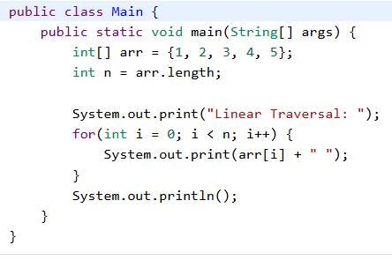
ARRAY TRAVERSAL

Slide 9
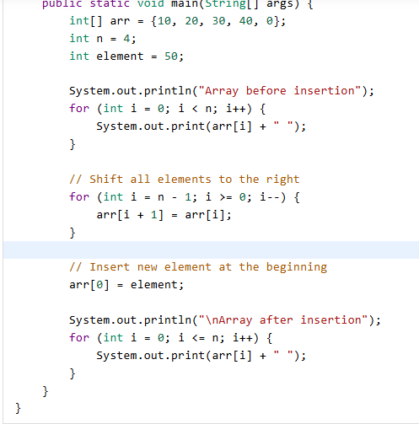
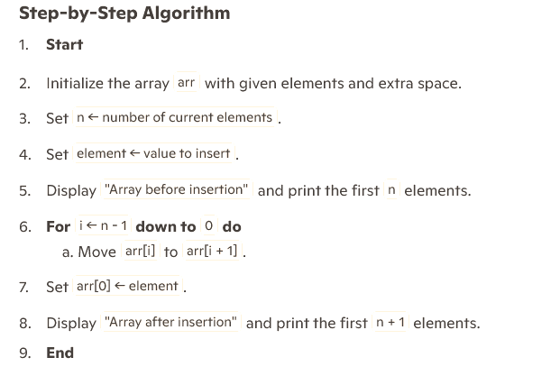
ARRAY Insertion AT BEGINNING

Slide 10
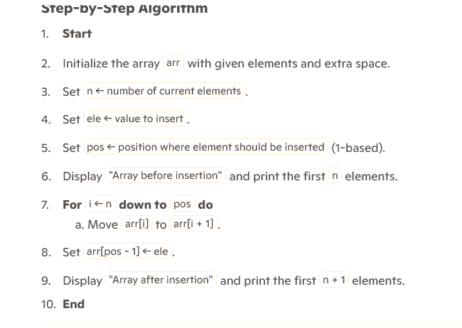
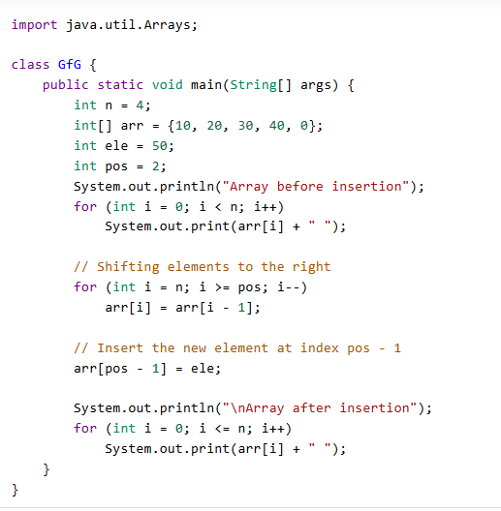
ARRAY Insertion AT ANY POSITION

Slide 11
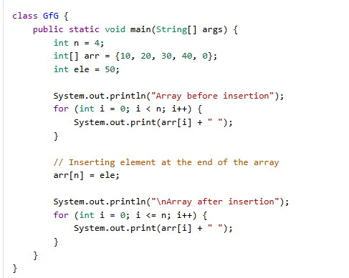
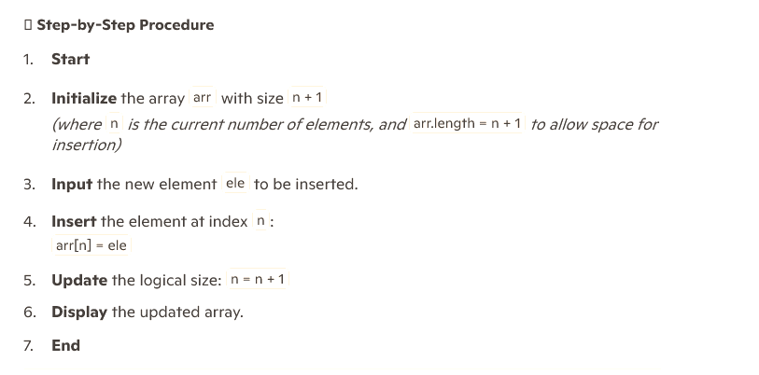
ARRAY Insertion AT END

Slide 12
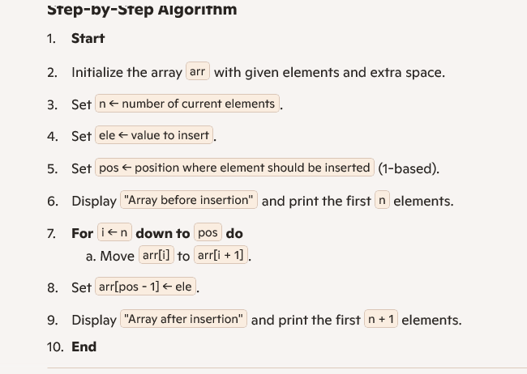
ARRAY Insertion AT END

Slide 13
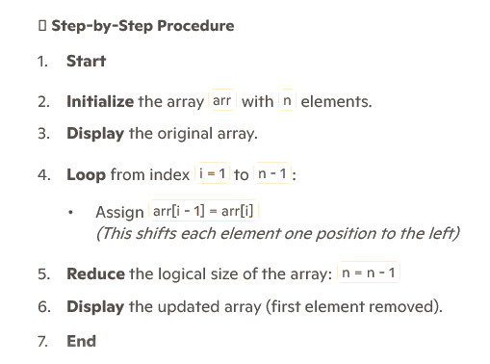
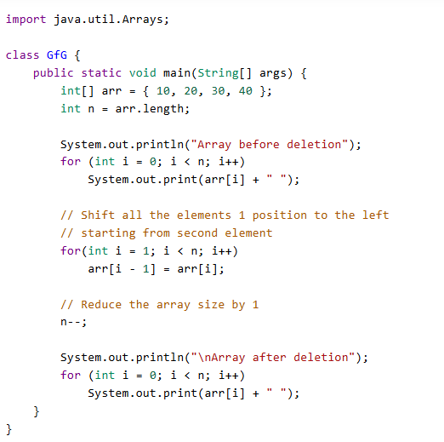
ARRAY DELETION AT START

Slide 14
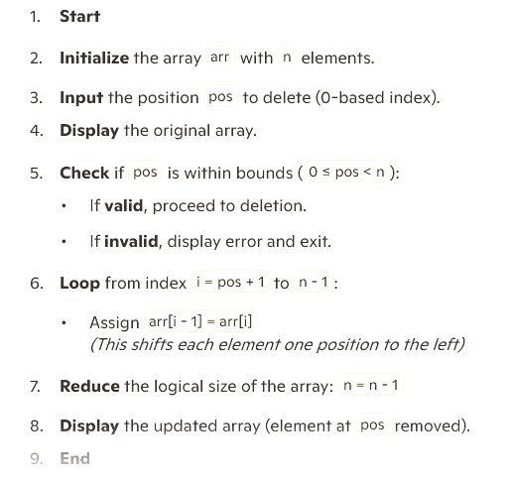
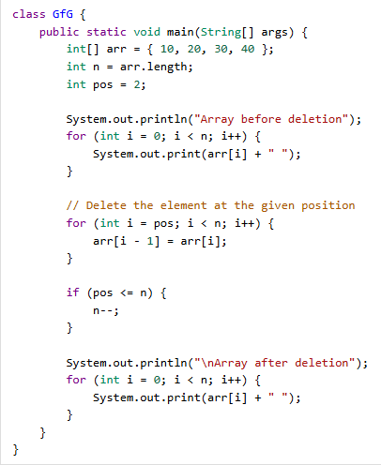
ARRAY DELETION AT ANY POINT

Slide 15
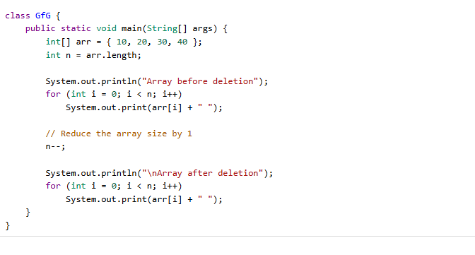
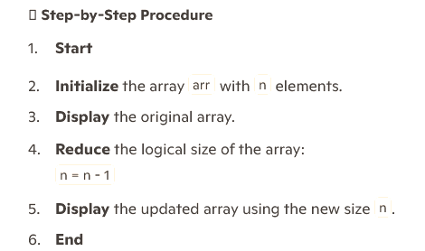
ARRAY DELETION AT END

Slide 16
ARRAY DELETION AT END

Slide 17
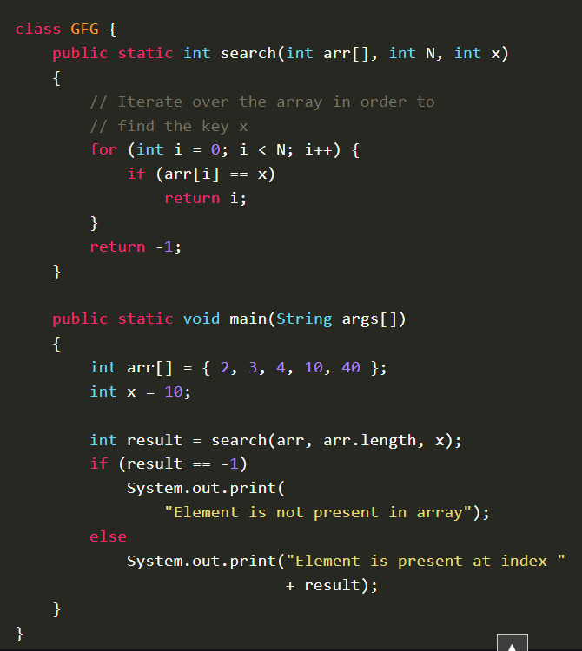
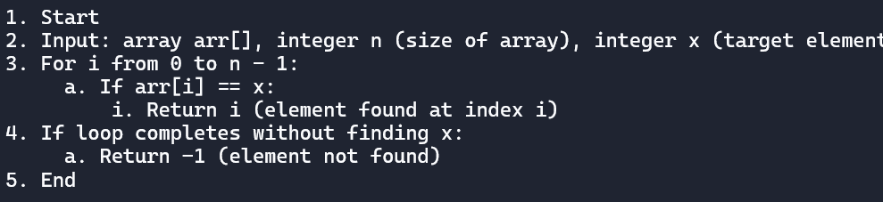
Searching in array

