Slide 1

Introduction to DSA
Instructor: Nauman Khan

Slide 2

What is a Data Structure?
Definition
A Data Structure is a way of storing, organizing, and managing data so it can be used efficiently.
Analogy
Think of data structures as containers in a kitchen:
• Fridge → Keeps things fresh (organized by shelf)
• Jars → Store specific ingredients
• Baskets → Hold groups of items
Without containers → your kitchen (memory) is messy and hard to use.

Slide 3

Big Picture: Kitchen Analogy
• Data Structures → Containers (fridge, jars, baskets)
• Algorithms → Recipes (step-by-step cooking)
• Without containers → kitchen is a mess
• Without recipes → you can’t cook efficiently

Slide 4
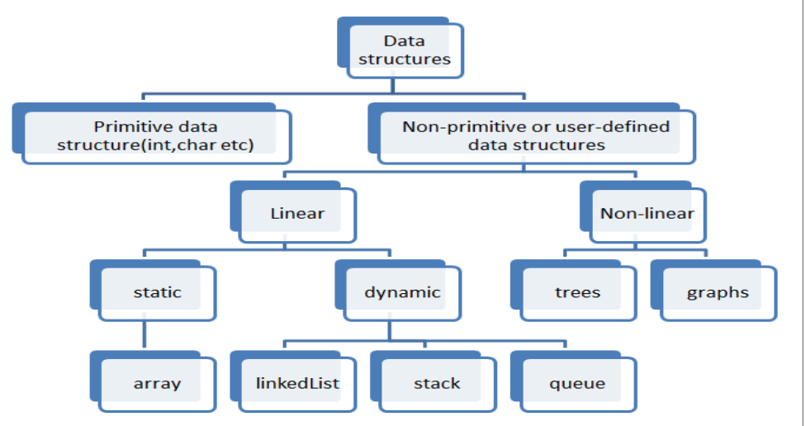
Classification of Data Structures

Slide 5
Linear Data Structures (like a line at a store)
• Arrays → Egg carton (fixed slots, ordered)
• Stacks (LIFO) → Plates in cafeteria
• Queues (FIFO) → Line at ticket counter
• Linked Lists → Treasure hunt map

Slide 6
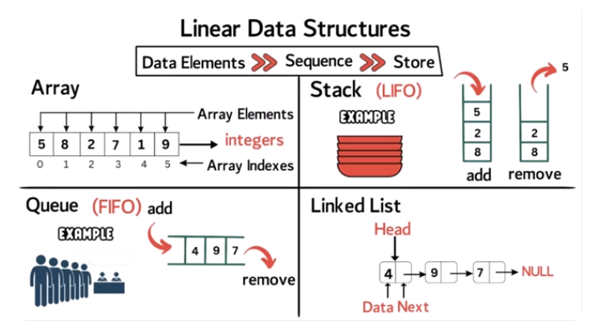

Slide 7
Non-Linear Data Structures (like relationships)
• Graphs → Social network (friends = connections)
• Trees → Family tree (root + children, no cycles)

Slide 8
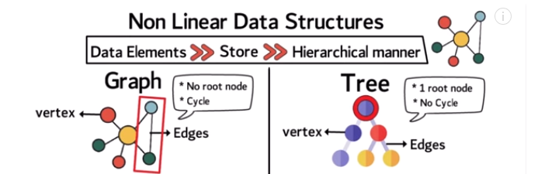

Slide 9
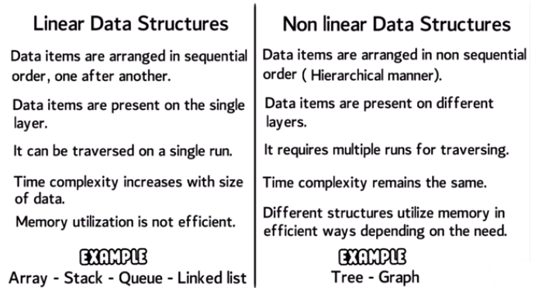

Slide 10
What are Algorithms?
Like a recipe in cooking
1. Boil water
2. Add tea leaves
3. Add sugar + milk
4. Serve
• In Coding:
- Add two numbers → Combine sugar + flour
- Find largest of three → Compare fruit boxes

Slide 11
Why DSA Matters
• Efficiency → Suitcase packing (fold clothes → fit more)
• Problem Solving → Right tool for right job
• Job Opportunities → Like sports tryouts

Slide 12
Summary
Pick the right container (Data Structure)
Follow the best recipe (Algorithm)
Save time + effort while solving problems

Slide 13

Q & A
Thank you! Any questions?

