Slide 1

Introduction to DSA
Instructor: Nauman Khan

Slide 2
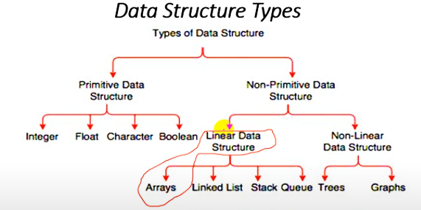
What is Array?

Slide 3
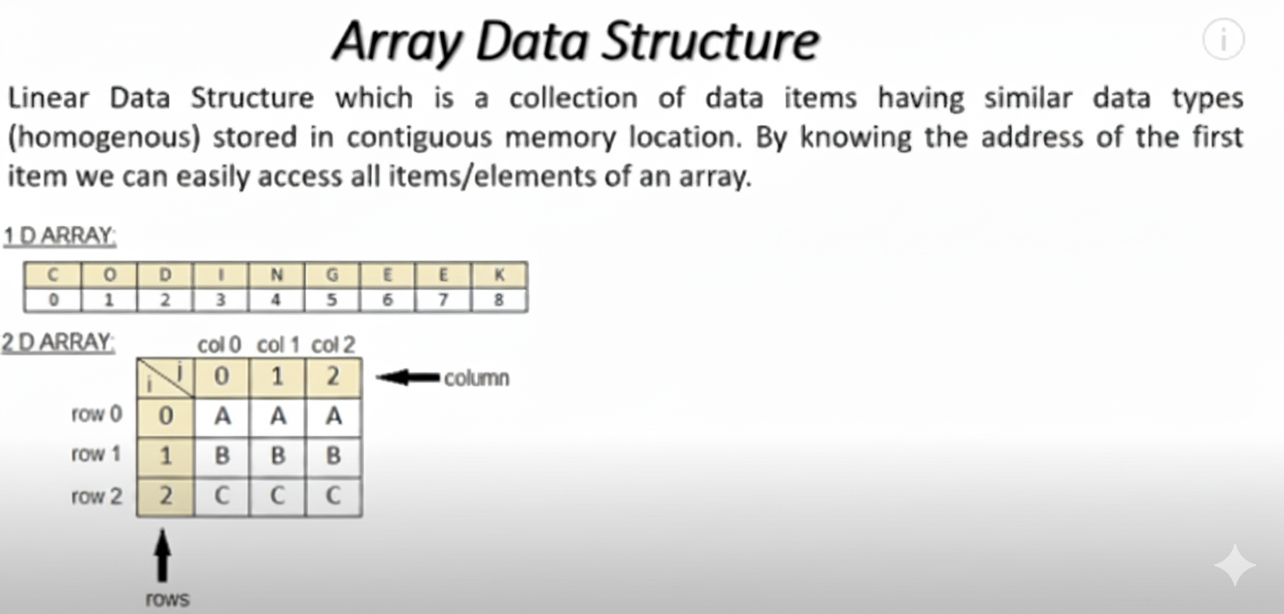
What is Array?
Notes:
Contiguous memory refers to a single, unbroken block of memory allocated to a process, where all the addresses are sequential and adjacent. It’s one of the oldest and simplest memory allocation techniques used in operating systems.

Slide 4
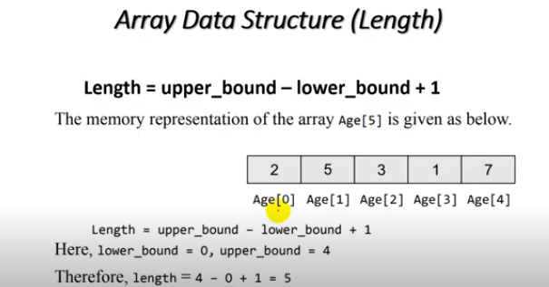
What is Array Length?

Slide 5
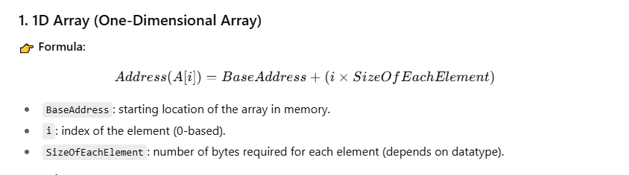
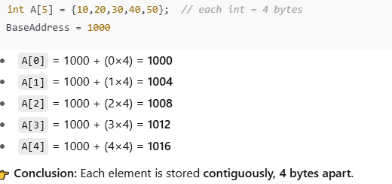
CALCULATE Memory ARRAY ADDRESS

Slide 6
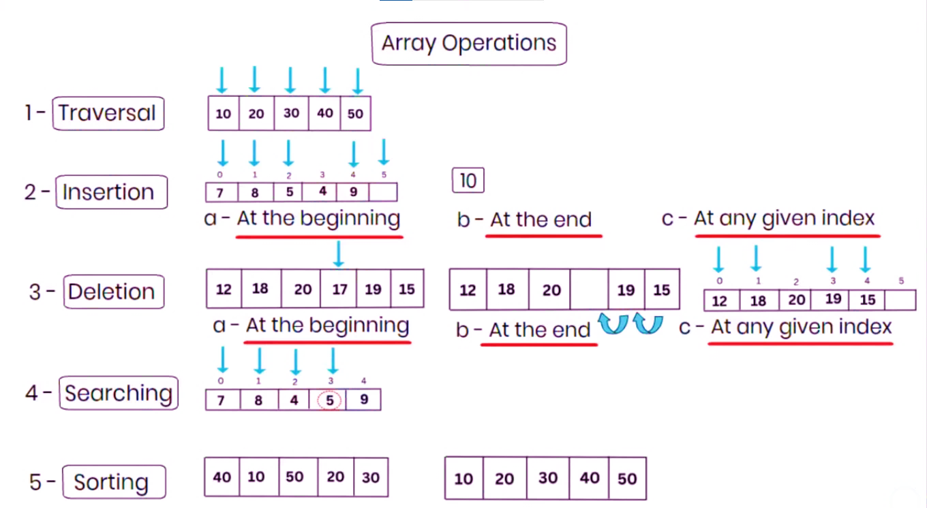
Array Operation

Slide 7

Array Operation

Slide 8
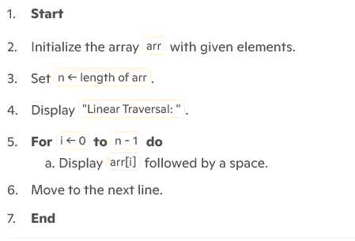
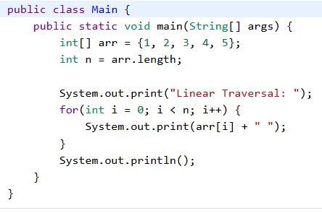
ARRAY TRAVERSAL

Slide 9
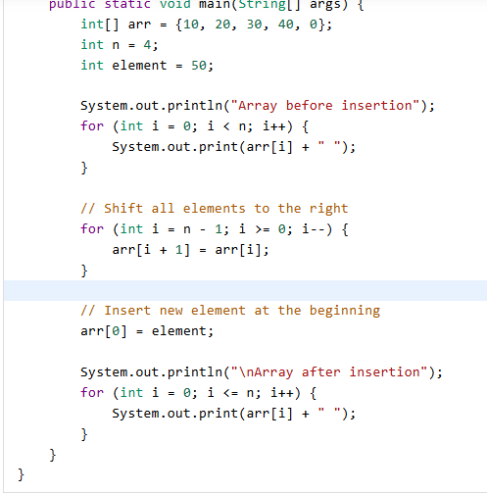
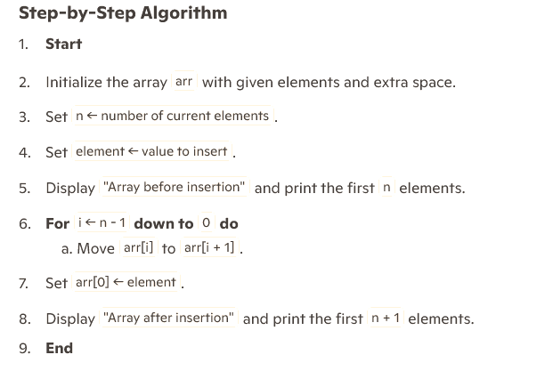
ARRAY Insertion AT BEGINNING

Slide 10
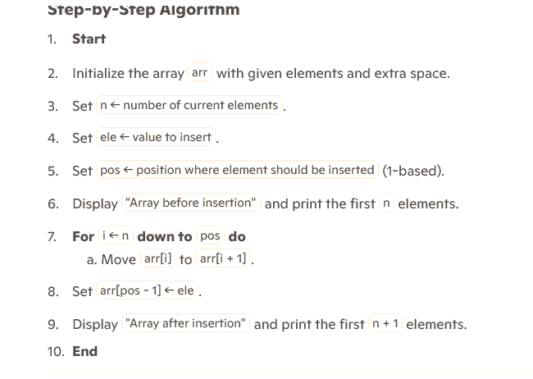
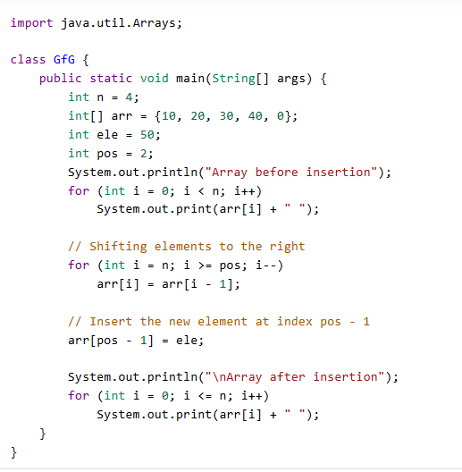
ARRAY Insertion AT ANY POSITION

Slide 11
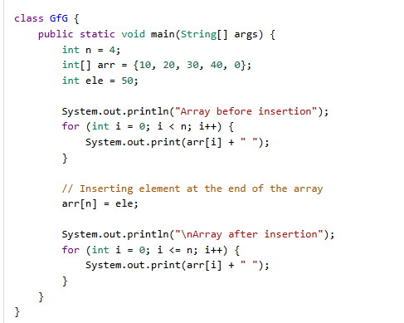
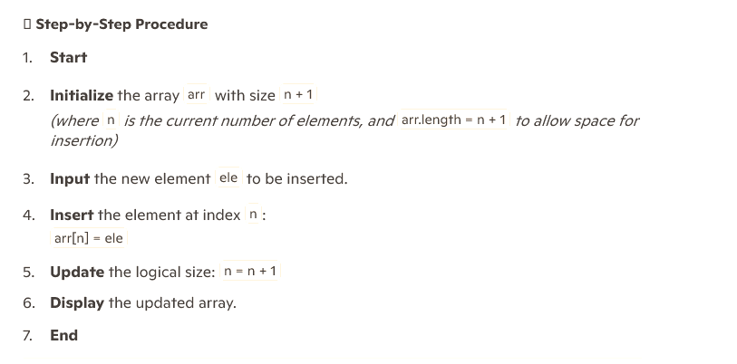
ARRAY Insertion AT END

Slide 12
ARRAY Insertion AT END

Slide 13
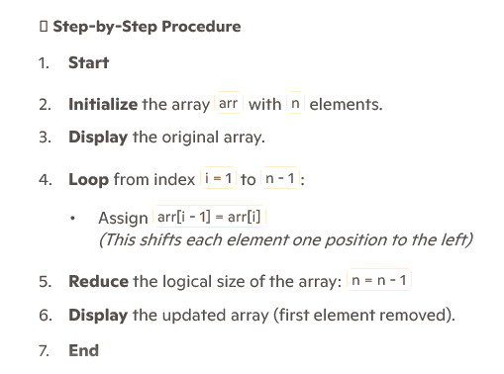
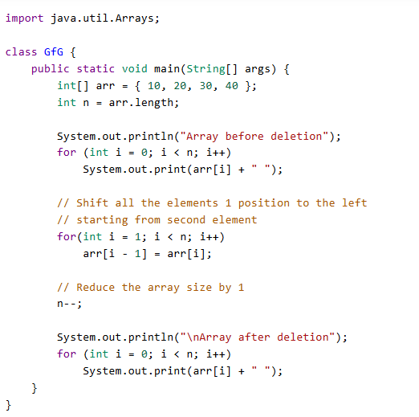
ARRAY DELETION AT START

Slide 14
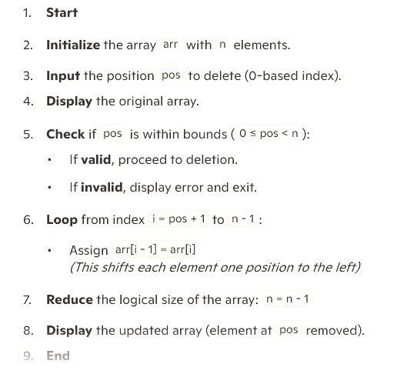
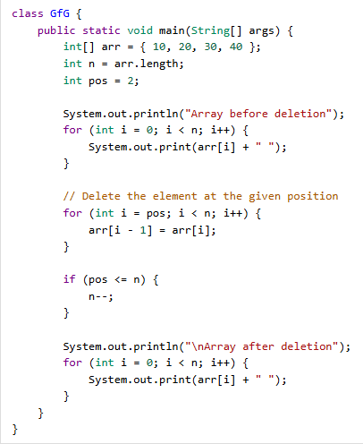
ARRAY DELETION AT ANY POINT

Slide 15
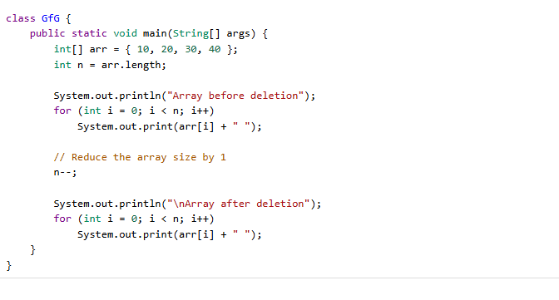
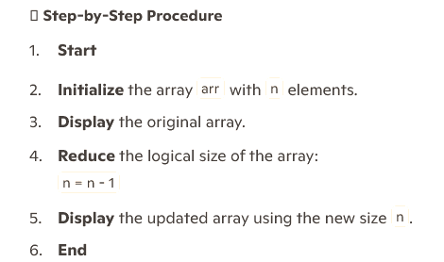
ARRAY DELETION AT END

Slide 16
ARRAY DELETION AT END

Slide 17
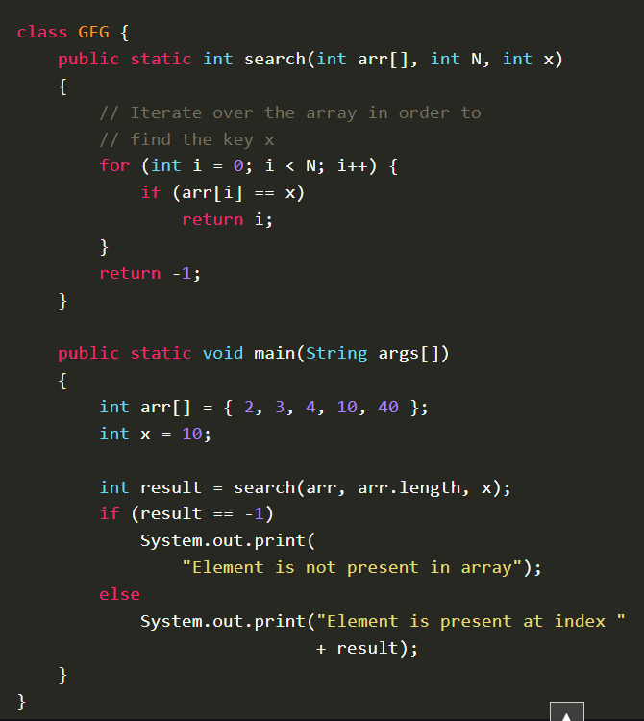
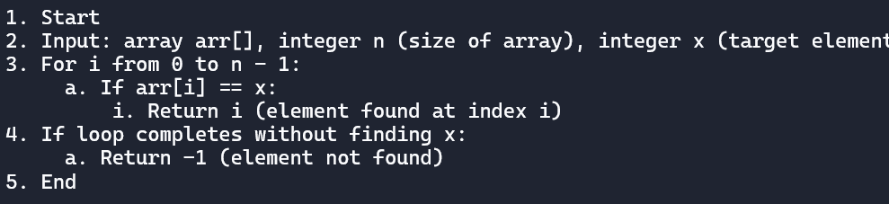
Searching in array

Slide 18
Limitations of Arrays in DSA

Slide 19
Fixed Size
• Once declared, array size cannot be changed
• Wastage if too large, shortage if too small

Slide 20
Contiguous Memory Requirement
• Arrays need continuous memory blocks
• Large arrays may fail if memory is fragmented

Slide 21
Insertion & Deletion Costly
• Inserting or deleting requires shifting elements
• Operations like insert at beginning take O(n) time

Slide 22
Wastage of Memory
• Extra allocated slots remain unused
• Example: Array of size 100 but only 20 used

Slide 23
Homogeneous Elements Only
• All elements must be of same type
• Cannot mix int, string, float, etc.

Slide 24
No Built-in Flexibility
• No auto-resizing
• No built-in search or insert/delete support

Slide 25
Summary
✔ Arrays: Fast for access (O(1))
✘ Rigid, costly for insertion, deletion, resizing
➡ Use when size is fixed and access is priority

Slide 26

Q & A
Thank you! Any questions?

