Slide 1
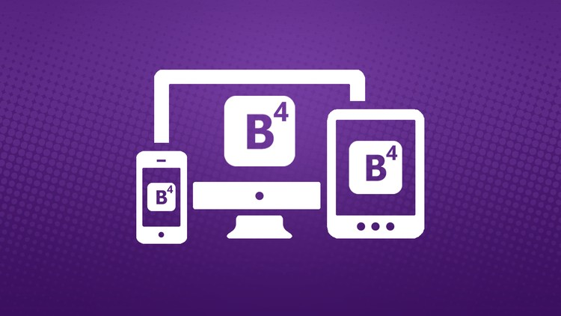
Bootstrap4

Slide 2
What is Bootstrap?
Bootstrap is a free front-end framework for faster and easier web development.
Bootstrap is a powerful front-end framework for faster and easier web development.
Bootstrap also gives you the ability to easily create responsive designs.
Bootstrap includes HTML and CSS based design templates for typography, forms, buttons, tables, navigation, modals, image carousels and many other, as well as optional JavaScript plugins

Slide 3
LAYOUT
CONTENT
COMPONENTS
UTILITIES

Slide 4
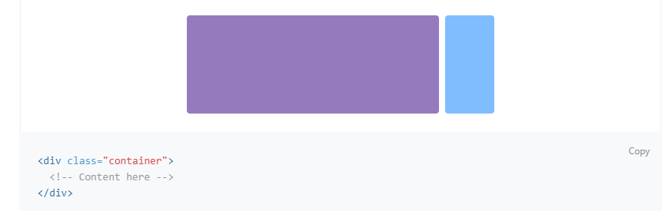
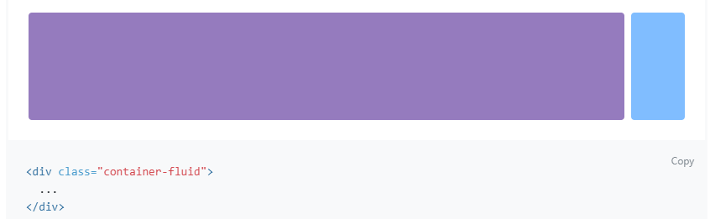
LAYOUT

Slide 5
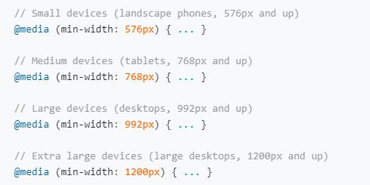
Responsive breakpoints

Slide 6
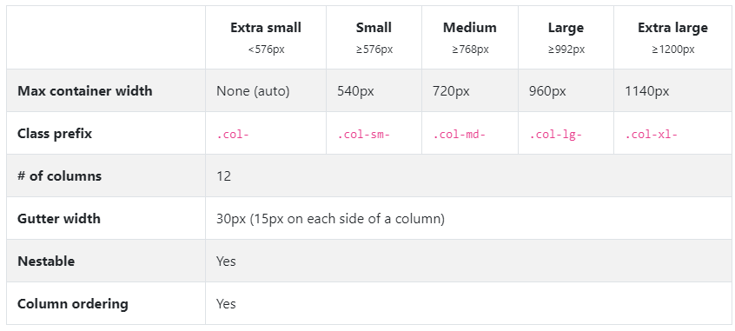
Grid system
<div class="container">
<div class="row">
<div class="col"> text </div>
<div class="col"> text </div>
</div>
</div>
</div>

Slide 7
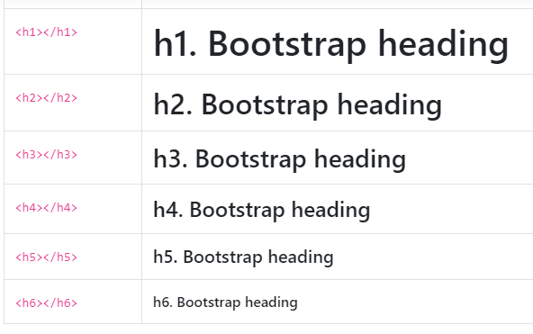
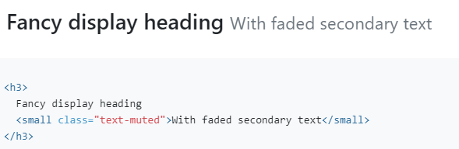
CONTENT
Typography

Slide 8
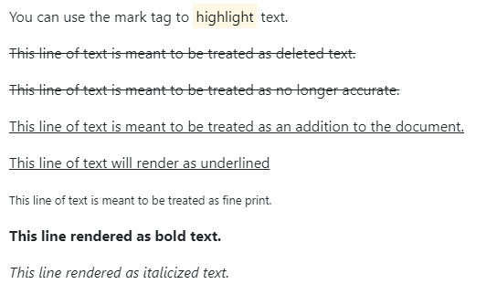
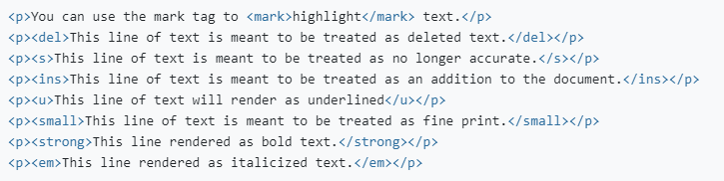

Slide 9
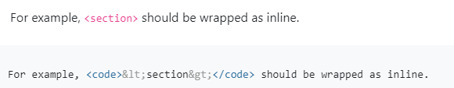
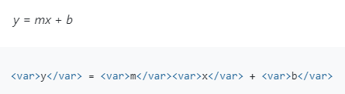
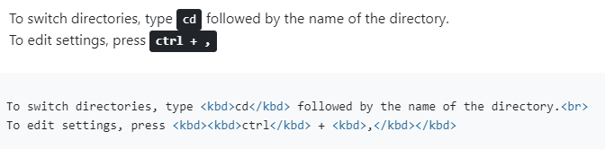
Code

Slide 10
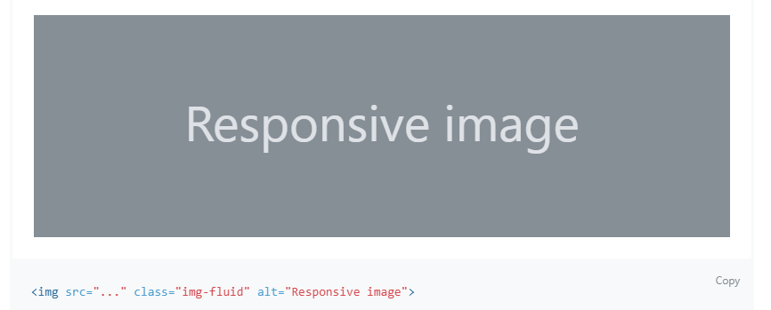
Images

Slide 11
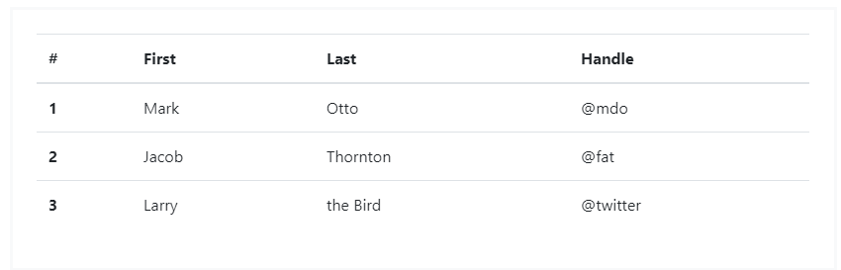
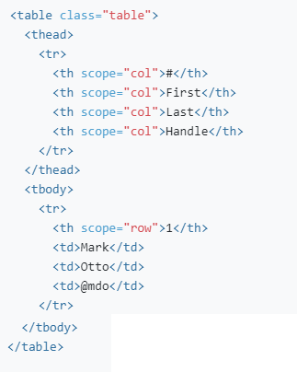
Tables

Slide 12

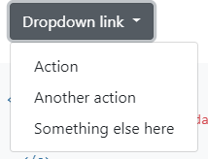
COMPONENTS
Alerts
Badges
Dropdown

Slide 13
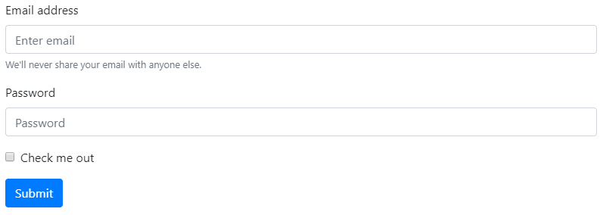
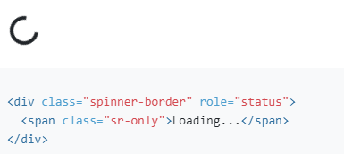
Forms
Border spinner

Slide 14
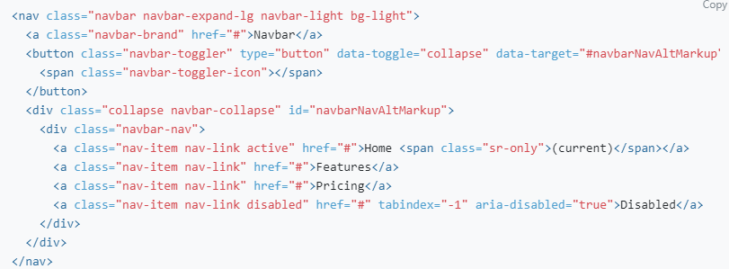
Navbar

Slide 15
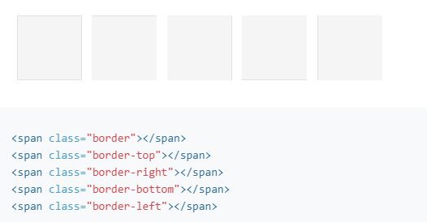
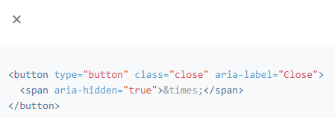
UTILITIES
Border
Close icon

Slide 16
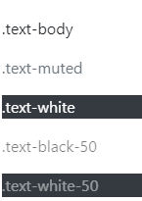
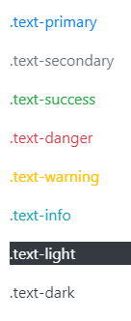
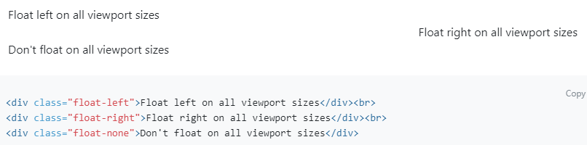
Color
Float

Slide 17
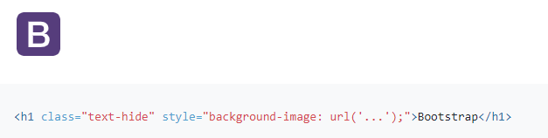
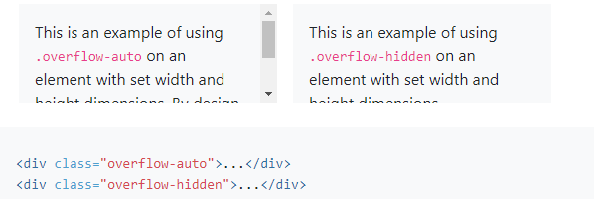
Image replacement
Overflow

Slide 18
Spacing
m - for classes that set margin
p - for classes that set padding
t - for classes that set margin-top or padding-top
b - for classes that set margin-bottom or padding-bottom
l - for classes that set margin-left or padding-left
r - for classes that set margin-right or padding-right
x - for classes that set both *-left and *-right
y - for classes that set both *-top and *-bottom

