Slide 1
SWP391 CAPSTONE · 2026
Manga Creation Workflow &
Publishing Management System
An internal production & publishing platform for a manga studio
— it is an operational tool, not a manga reader.
5 roles · 29 tables · 66 REST endpoints · in-browser AI Studio
Notes:
Opening. This is an internal studio operations tool that digitizes the full manga production pipeline — from a mangaka's series pitch through board approval, production, editorial review, publishing, reader-style board voting, editorial decisions, and assistant earnings/disputes. Emphasize up front that it is NOT a reader app; the audience is studio staff across five roles.

Slide 2
Agenda
01
The Product & Why
05
The Five Roles in Action
What it solves and the operating model
What each role does, screen by screen
02
Architecture & Technology
06
Key Feature Flows
Monorepo, stack, request flow, workflow engine
Proposal, production, governance, disputes
03
Data Model
07
Studio & On-Device AI
29 tables, relationships, state machines
In-browser drawing + ONNX assists
04
Security & Access Control
08
Quality & Roadmap
JWT/OAuth and role-based permissions
Verification, backlog, live demo
Notes:
Roadmap of the talk: start with the why and the operating model, then go technical (architecture, data, security), then walk each role and the concrete feature flows, cover the differentiating in-browser AI Studio, and finish with quality evidence and a live-demo script.

Slide 3
01
The Product & Why
Why a studio needs this, and how the pipeline works end to end
Notes:
Section 1 frames the business problem and the end-to-end operating model before any code.

Slide 4
01 · PRODUCT
The problem we solve
A manga studio coordinates many people around one series
Mangaka pitch series; a board decides what gets greenlit
Assistants do paid production work (backgrounds, characters, effects…)
Editors review chapters; the board governs which series continue
Today this lives in spreadsheets, chat and email — no single source of truth
Lost work & versions
Files and approvals scattered across tools
No status truth
Nobody knows a chapter's real state
Payment disputes
Earnings computed by hand, hard to audit
Notes:
The core pain is coordination and truth. A studio runs many series in parallel, each with a mangaka, assistants, an assigned editor, and board oversight. Without one system, status is ambiguous, work and versions get lost, and — critically — money (per-task pricing and assistant earnings) is tracked by hand and disputed. This platform makes the whole pipeline explicit, authoritative, and auditable.

Slide 5
01 · PRODUCT
What it is — and what it is not
IT IS
IT IS NOT
An internal operations tool for studio staff
A workflow engine for the production pipeline
A role-based system (5 roles, RBAC)
A pricing + earnings + dispute ledger
A browser drawing Studio with optional AI
A public manga reader / consumer app
A payment gateway (it records, doesn't charge)
A cloud AI service — AI runs on-device
A CMS for marketing the manga
Dependent on any paid third-party API
Notes:
Set expectations sharply. The product is an internal operational tool — the value is in coordinating staff and money, not in serving manga to readers. AI is a built-in assist that runs in the browser, so there is no per-call cloud cost and no images leave the client. Payments are recorded and reconciled, not processed.

Slide 6
01 · PRODUCT
The end-to-end pipeline
One continuous flow from idea to governance to payment
Each stage has an explicit status; illegal transitions are rejected server-side
Approval auto-creates a Series; publishing schedules a release; voting drives ranking & risk; decisions change a series' fate
Notes:
This single diagram is the spine of the whole system. A proposal is approved by the board, which creates a Series. The mangaka builds chapters → pages → regions, then creates priced tasks. Assistants submit work; the mangaka reviews it; the assigned editor reviews the chapter; it is published. After publishing, the board runs voting periods that compute a ranking and a risk level, which inform an editorial decision (continue / change frequency / hiatus / cancel). Earnings accrue along the way and can be disputed. Every arrow here maps to a real endpoint and a real status transition.

Slide 7
01 · PRODUCT
The five roles
M
A
T
E
A
Mangaka
Assistant
Tantou Editor
Editorial Board
Admin
Author & produce series
Execute paid production tasks
Review & annotate chapters
Govern: approve, vote, decide
Operate users & disputes
Proposals · Series · Tasks · Review
My Tasks · Studio · Earnings
Review queue · Annotations
Proposals · Assign · Rankings
Console · Disputes
Notes:
Five roles, each with its own profile, navigation, and re-skinned dashboard. Mangaka and Assistant are the production pair; the Tantou (assigned) Editor is the quality gate; the Editorial Board is governance — both the front gate (approvals) and the steering wheel (voting and decisions); Admin runs accounts and adjudicates earnings disputes. RBAC is enforced by JWT plus role guards on every endpoint.

Slide 8
02
Architecture & Technology
How the monorepo, API, database and browser pieces fit together
Notes:
Section 2 is the technical architecture: the monorepo, the stack with versions, the request lifecycle, and the small workflow state-machine engine.

Slide 9
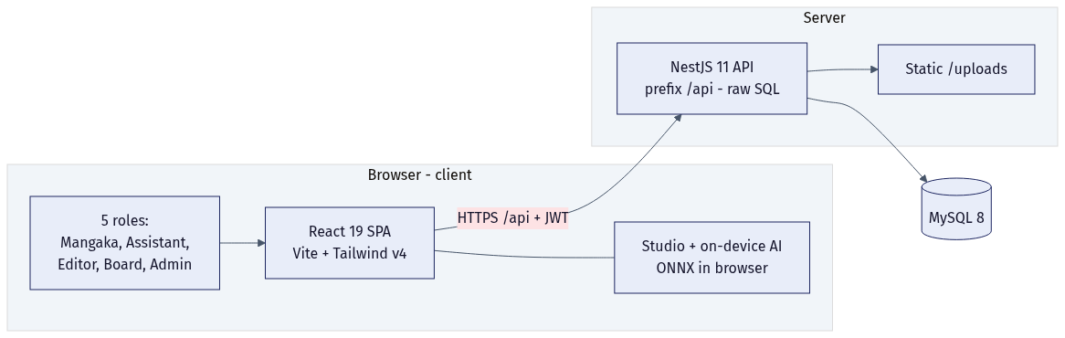
02 · ARCHITECTURE
System architecture
Single-page React app talks to one NestJS API
API exposes everything under /api; serves uploads statically
Raw SQL via mysql2 — no ORM, full control of queries
Shared TypeScript enums = one source of truth for both sides
The Studio + AI run entirely in the browser
Notes:
The shape is deliberately simple: a React SPA, a single NestJS service, and MySQL. The API uses raw parameterized SQL through a thin DbService rather than an ORM. The shared package holds the status enums and transition maps consumed by both the API (as runtime values) and the web app (imported directly via a Vite alias). The browser also hosts the drawing Studio and the optional on-device AI, which never call the server.

Slide 10
02 · ARCHITECTURE
Technology stack
Layer | Technology | Version
Web app | React + Vite + TypeScript + Tailwind | 19.2 · 8 · ~6.0 · v4.3
Routing / HTTP | react-router-dom · axios | 7.16 · 1.16
API | NestJS + TypeScript | 11 · 5.7
Database access | mysql2 (raw SQL, no ORM) | 3.22
Auth | @nestjs/jwt · passport (jwt + google) | 11 · —
Shared | TS enums + state-machine transition maps | workspace pkg
Drawing core | AssemblyScript → WebAssembly | canvas-wasm
On-device AI | onnxruntime-web (YOLO · SAM · DeOldify) | 1.26
Tests | jest (API) · vitest + RTL (web) | 30 · 4
Notes:
Everything is current-generation: React 19, Vite 8, TypeScript 6 on the web (which forbids enums, hence the shared enums build to runtime values for the API side). The API is NestJS 11 on TypeScript 5.7. Persistence is deliberately raw SQL via mysql2 for transparency. The drawing core is compiled AssemblyScript to WASM, and AI inference is ONNX Runtime Web. Tests are jest on the API and vitest + React Testing Library on the web.

Slide 11
02 · ARCHITECTURE
Monorepo & shared types
manga-workflow/ (pnpm workspace)
├─ apps/
│ ├─ web/ React 19 SPA (Vite, Tailwind v4)
│ └─ api/ NestJS 11 (raw SQL, /api)
├─ packages/
│ ├─ shared/ enums + *_TRANSITIONS + canTransition()
│ └─ canvas-wasm/ AssemblyScript → WASM
└─ db/ MySQL 8 schema + seed (Docker)
One repo, four packages, clear boundaries
Build order: shared + wasm → then apps
Shared enums prevent web/API status drift
DB schema + seed live in db/ and run via Docker
Notes:
A pnpm workspace keeps the web app, API, shared types, and the WASM drawing core in one repo with explicit dependencies. The shared package is the linchpin: status enums and their legal-transition maps are defined once and consumed by both sides, so the front and back end can never disagree about what states exist or which transitions are legal. The database schema and seed are versioned in db/ and brought up with Docker.

Slide 12
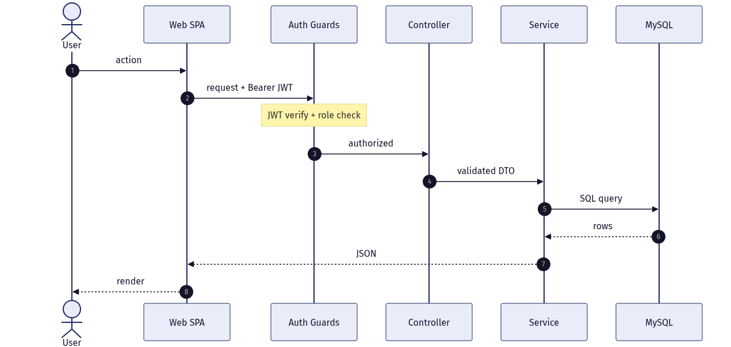
02 · ARCHITECTURE
Request lifecycle
Every authenticated call follows the same path
JWT verified, then @Roles checked by a guard
DTOs validated by a global ValidationPipe
Service runs parameterized SQL via DbService
Consistent JSON + Nest error shape back
Notes:
A request carries a Bearer JWT. The JwtAuthGuard validates it and RolesGuard checks the endpoint's @Roles. The global ValidationPipe whitelists and validates the DTO, stripping unknown fields. The controller calls a service, which runs parameterized SQL through DbService (query / queryOne / insert). Errors come back in NestJS's consistent shape. This uniformity is what makes the system easy to reason about and secure by default.

Slide 13
02 · ARCHITECTURE
The workflow engine: state machines
Status enums + transition maps are the rules engine
Six entities have explicit, enforced transition maps
Services call canTransition() before any status write
Illegal transition → HTTP 400, never a bad state
Proposal
Chapter
transition map
transition map
Page
Task
transition map
transition map
export function canTransition<T extends string>(
map: Record<T, T[]>, from: T, to: T,
): boolean {
return map[from]?.includes(to) ?? false;
}
Submission
Earning Dispute
transition map
transition map
Notes:
This is the heart of correctness. Instead of scattering if-statements, each stateful entity has a transition map (e.g. SUBMITTED can only go to APPROVED or REVISION_REQUIRED). A tiny canTransition() helper guards every status change in the services. Attempting an illegal jump returns a 400 — the data model can never enter an invalid state. Six entities use this pattern; Series, Vote Period and Publication statuses are driven directly by their services.

Slide 14
03
Data Model
29 tables across nine domains, with enforced lifecycles
Notes:
Section 3 covers the relational model and the entity lifecycles.

Slide 15
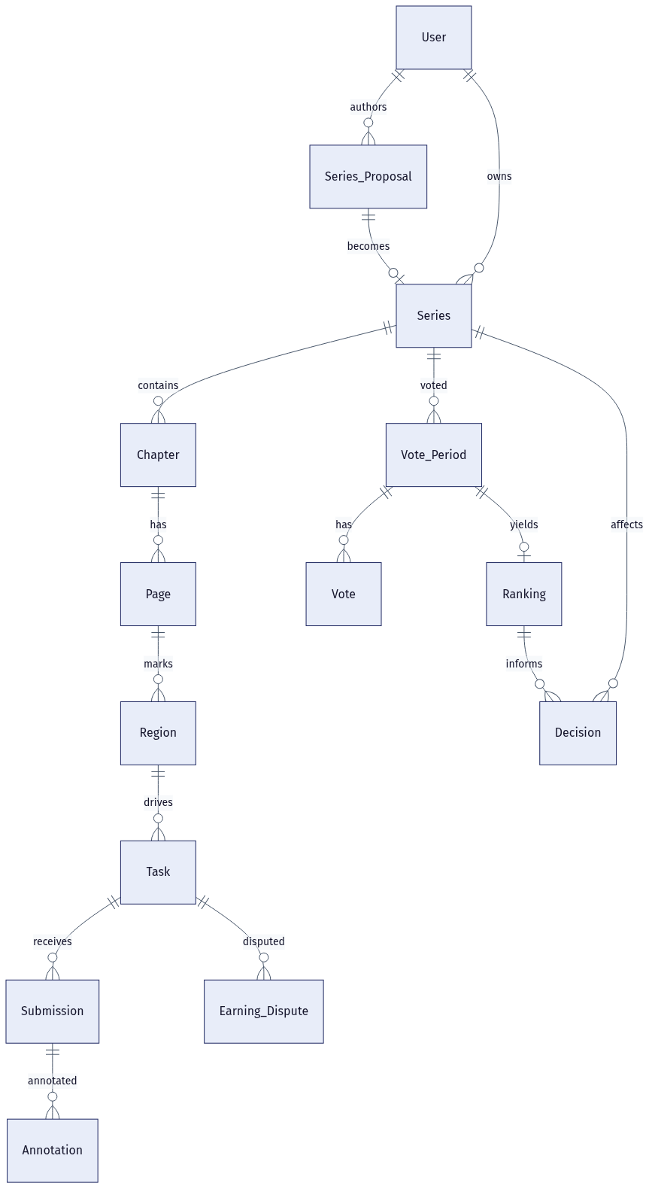
03 · DATA MODEL
Domain map
Nine domains, 29 tables, foreign-key integrity
Identity & profiles: User + 4 role profiles
Series lifecycle: Proposal → Series (+ editor assignment)
Production: Chapter → Page → Region → Task → Submission
Editorial feedback: polymorphic Annotation
Governance: Vote Period → Vote → Ranking → Decision
Money: Assistant earnings + Earning Dispute
Cross-cutting: Notification, Audit Log, System Config
Notes:
This is a slide-friendly subset of the full ER diagram (the complete 29-table dictionary is in the docs). It shows the backbone: a User authors a Proposal that becomes a Series; the Series contains Chapters, which contain Pages, which carry Regions; each Region drives a priced Task that receives Submissions and can be disputed. On the governance side, a Series has Vote Periods that collect Votes, yield a Ranking, and inform a Decision. Foreign keys keep all of this consistent.

Slide 16
03 · DATA MODEL
Core entities
User + Profiles
Series_Proposal → Series
Chapter · Page · Page_Version
One identity, four role-specific profile tables (earnings live on Assistant_Profile)
Approval converts a pitch into a live series with a frequency
Versioned page images grouped into chapters
Region · Task · Task_Price_Rule
Submission · Annotation
Vote_Period · Vote · Ranking · Decision
Regions are priced into tasks by region type
Assistant work + polymorphic editorial notes
The governance loop, snapshotted per period
Notes:
Six entity clusters worth knowing. Identity splits a base User from four profile tables — note that assistant earnings accrue on Assistant_Profile.total_earnings. Production is a clean hierarchy from chapter down to region, where regions become priced tasks. Annotations are polymorphic — one table annotates pages, manuscripts, or submissions. The governance cluster snapshots votes into a ranking and a decision per period.

Slide 17
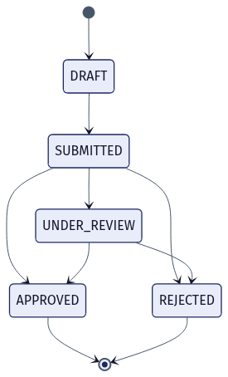
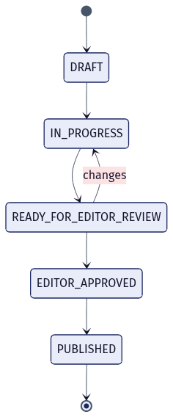
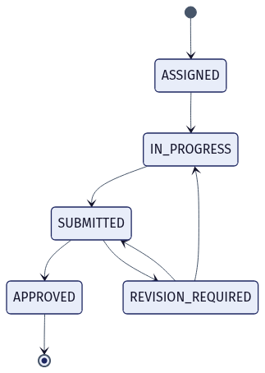
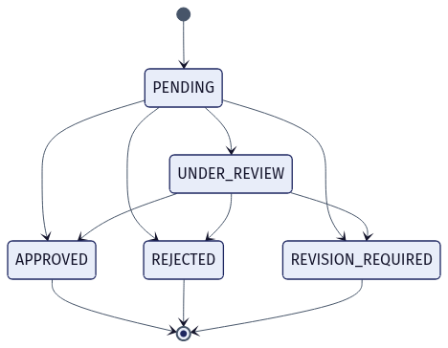
03 · DATA MODEL
Enforced state machines
Proposal
Chapter
Task
Submission
Notes:
Four of the six enforced lifecycles, shown as real state diagrams. Proposal is a one-way approval flow. Chapter loops back to IN_PROGRESS when the editor requests changes. Task and Submission carry the revision loop that powers iterative review between assistant and mangaka. Each arrow is exactly what canTransition() permits — these images are generated from the same transition maps the code enforces.

Slide 18
04
Security & Access Control
Authentication, RBAC, and data-level ownership
Notes:
Section 4 covers how identity and permissions work.

Slide 19
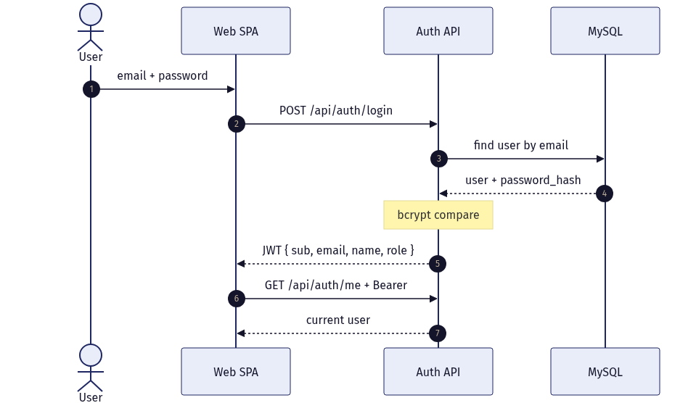
04 · SECURITY
Authentication
Two ways in: local password + Google OAuth
Passwords hashed with bcrypt (nullable for OAuth-only)
JWT carries { sub, email, name, role }
Web sends it as an Authorization: Bearer header
Account must be activated to sign in
Notes:
Users authenticate locally (email + bcrypt-hashed password) or via Google OAuth, in which case the local password is null. On success the API signs a JWT containing the user id, email, name, and role. The SPA stores it and attaches it as a Bearer token to every call. The role claim is what downstream guards use for authorization — so authentication and authorization share one token.

Slide 20
04 · SECURITY
Authorization — permission matrix
Capability / endpoint group | Mangaka | Assist. | Editor | Board | Admin | Public
Login · Google OAuth |  |  |  |  |  | ✓
Proposals — create / mine | ✓
Proposals — review / decide |  |  |  | ✓
Series — assign / unassign editor |  |  |  | ✓
Chapters · Pages · Regions · Tasks | ✓
Tasks — mine / start |  | ✓
Submissions — submit |  | ✓
Submissions — review | ✓
Chapter review · Annotations |  |  | ✓
Vote periods · Votes · Decisions |  |  |  | ✓
Earnings — mine / disputes (open) |  | ✓
Disputes — list / review / resolve |  |  |  |  | ✓
Admin — users / overview |  |  |  |  | ✓
Notes:
Authorization is endpoint-level via @Roles plus data-level via ownership checks. The matrix shows who can call each group: only mangaka author proposals and production data; only the board decides proposals, assigns editors, and runs governance; only assistants submit work and open disputes; only the assigned editor reviews chapters; only admins resolve disputes and manage users. Beyond roles, mangaka see only their own series, assistants only their own tasks, and editors only series they are assigned to. A last-admin guard prevents removing the final administrator.

Slide 21
05
The Five Roles in Action
What each person sees and does, screen by screen
Notes:
Section 5 walks each role's day-to-day: navigation, responsibilities, the endpoints they touch, and the statuses they drive.

Slide 22
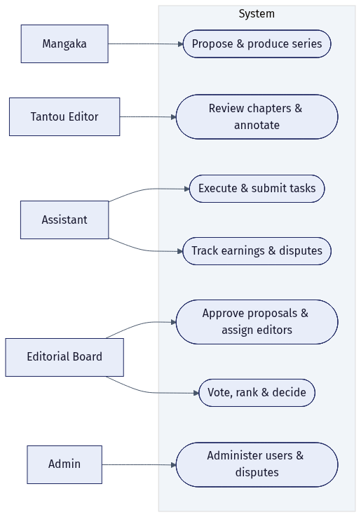
05 · ROLES
Use-case overview
Each actor has a focused set of use cases
Mangaka: propose & produce a series
Assistant: execute & submit tasks; track earnings
Tantou Editor: review chapters & annotate
Board: approve, assign, vote, rank, decide
Admin: administer users & disputes
The System also acts: notify, price, accrue, rank
Notes:
A map of who does what. Note the System itself is an actor: it sends notifications on key events, auto-prices tasks from the price rules, accrues earnings on approval, and computes rankings when a vote period closes. The next five slides drill into each human role.

Slide 23
05 · ROLES
Mangaka
漫画家 · Series Author
WHAT THEY DO
KEY ENDPOINTS
Pitch and submit series proposals
Create chapters, pages, and regions
Create priced tasks and assign assistants
Review submissions: approve or request revision
POST /api/proposals
POST /api/chapters · /pages · /regions
POST /api/tasks (auto-priced)
PATCH /api/submissions/:id/review
NAVIGATION
DRIVES STATUSES
Tổng quan /
Đề xuất /proposals
Series /series
Chờ duyệt /review
Proposal · Chapter · Task · Submission review
Notes:
Mangaka — 漫画家 · Series Author. Responsibilities: Pitch and submit series proposals; Create chapters, pages, and regions; Create priced tasks and assign assistants; Review submissions: approve or request revision. They primarily work through these endpoints: POST /api/proposals, POST /api/chapters · /pages · /regions, POST /api/tasks (auto-priced), PATCH /api/submissions/:id/review. The statuses they move: Proposal · Chapter · Task · Submission review.

Slide 24
05 · ROLES
Assistant
アシスタント · Production Artist
WHAT THEY DO
KEY ENDPOINTS
Pick up and start assigned tasks
Draw in the in-browser Studio (optional AI)
Upload and submit work for review
Track earnings; file a dispute if needed
GET /api/tasks/mine · PATCH /:id/start
POST /api/uploads · /api/submissions
GET /api/earnings/mine
POST /api/disputes
NAVIGATION
DRIVES STATUSES
Tổng quan /
Việc của tôi /my-tasks
Thu nhập /earnings
Studio /studio/region/:taskId
Task start/submit · Submission · Dispute (open)
Notes:
Assistant — アシスタント · Production Artist. Responsibilities: Pick up and start assigned tasks; Draw in the in-browser Studio (optional AI); Upload and submit work for review; Track earnings; file a dispute if needed. They primarily work through these endpoints: GET /api/tasks/mine · PATCH /:id/start, POST /api/uploads · /api/submissions, GET /api/earnings/mine, POST /api/disputes. The statuses they move: Task start/submit · Submission · Dispute (open).

Slide 25
05 · ROLES
Tantou Editor
担当編集 · Series Editor
WHAT THEY DO
KEY ENDPOINTS
See a queue scoped to assigned series only
Page through a chapter under review
Leave categorized annotations on pages
Approve the chapter or request changes
GET /api/chapters/review-queue
GET /api/chapters/:id/pages
POST /api/annotations · PATCH /:id/resolve
PATCH /api/chapters/:id/editor-review
NAVIGATION
DRIVES STATUSES
Tổng quan /
Duyệt chương /editor/review
Chapter review /editor/review/:id
Chapter → EDITOR_APPROVED / IN_PROGRESS
Notes:
Tantou Editor — 担当編集 · Series Editor. Responsibilities: See a queue scoped to assigned series only; Page through a chapter under review; Leave categorized annotations on pages; Approve the chapter or request changes. They primarily work through these endpoints: GET /api/chapters/review-queue, GET /api/chapters/:id/pages, POST /api/annotations · PATCH /:id/resolve, PATCH /api/chapters/:id/editor-review. The statuses they move: Chapter → EDITOR_APPROVED / IN_PROGRESS.

Slide 26
05 · ROLES
Editorial Board
編集委員会 · Governance
WHAT THEY DO
KEY ENDPOINTS
Approve or reject proposals (→ Series)
Assign / unassign the Tantou editor
Open vote periods and cast scored votes
Close periods → ranking; record decisions
PATCH /api/proposals/:id/decision
PUT/DELETE /api/series/:id/editor
POST /api/vote-periods · /votes · /:id/close
POST /api/decisions
NAVIGATION
DRIVES STATUSES
Tổng quan /
Duyệt đề xuất /board/proposals
Phân công BT /board/series
Xếp hạng /board/rankings
Proposal · Vote Period · Series status
Notes:
Editorial Board — 編集委員会 · Governance. Responsibilities: Approve or reject proposals (→ Series); Assign / unassign the Tantou editor; Open vote periods and cast scored votes; Close periods → ranking; record decisions. They primarily work through these endpoints: PATCH /api/proposals/:id/decision, PUT/DELETE /api/series/:id/editor, POST /api/vote-periods · /votes · /:id/close, POST /api/decisions. The statuses they move: Proposal · Vote Period · Series status.

Slide 27
05 · ROLES
Admin
システム管理者 · Platform Admin
WHAT THEY DO
KEY ENDPOINTS
See a system overview / metrics
Activate users and assign roles
Guarded so the last admin can't be removed
Adjudicate earning disputes (adjust amount)
GET /api/admin/overview · /users
PATCH /api/admin/users/:id
GET /api/disputes
PATCH /api/disputes/:id/review · /resolve
NAVIGATION
DRIVES STATUSES
Tổng quan /
Quản trị /admin
Khiếu nại /admin/disputes
User activation/role · Earning Dispute
Notes:
Admin — システム管理者 · Platform Admin. Responsibilities: See a system overview / metrics; Activate users and assign roles; Guarded so the last admin can't be removed; Adjudicate earning disputes (adjust amount). They primarily work through these endpoints: GET /api/admin/overview · /users, PATCH /api/admin/users/:id, GET /api/disputes, PATCH /api/disputes/:id/review · /resolve. The statuses they move: User activation/role · Earning Dispute.

Slide 28
06
Key Feature Flows
Five flows that exercise the whole system
Notes:
Section 6 traces the concrete end-to-end flows with real endpoints and side effects.

Slide 29
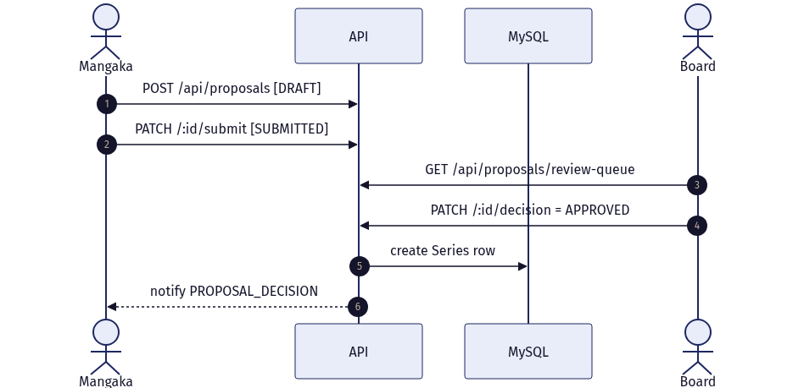
06 · FEATURE FLOWS
Proposal → approval → Series
Board approval creates the Series
Mangaka drafts then submits a proposal
Board reviews the queue and decides
APPROVED auto-inserts a Series row
Mangaka is notified of the decision
Notes:
The front gate. A mangaka creates a proposal (DRAFT), submits it (SUBMITTED), and the board works a review queue. On APPROVED, the API transactionally creates the Series and notifies the mangaka. REJECTED ends the flow. This is where governance meets production.

Slide 30
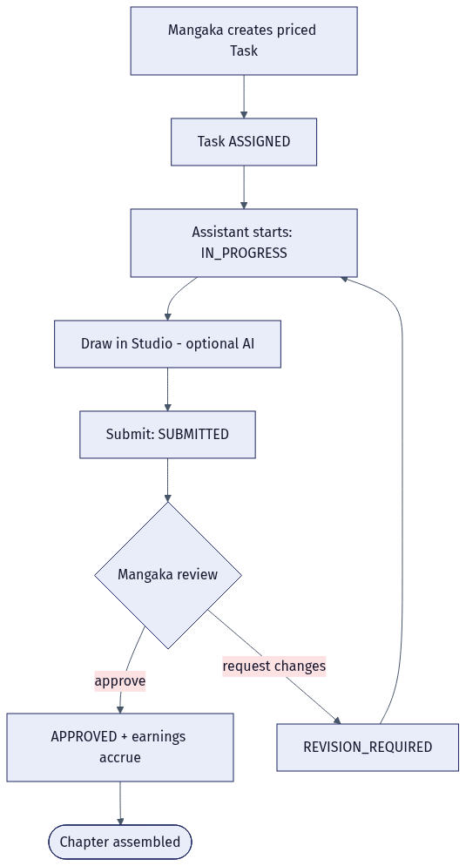
06 · FEATURE FLOWS
Production loop
Tasks iterate until approved
Task auto-priced from Task_Price_Rule
Assistant starts, draws, submits
Mangaka approves → earnings accrue
Or requests changes → loops back
Notes:
The money loop. When the mangaka creates a task, its payment is set automatically from the active price rule for that region type. The assistant starts it, optionally uses the Studio + AI, and submits. The mangaka either approves — which accrues the payment onto the assistant's total_earnings — or requests a revision, which sends the task back to IN_PROGRESS. This loop is the revision engine enforced by the Task and Submission state machines.

Slide 31
06 · FEATURE FLOWS
Submission review & earnings accrual
Approval is the only path to payment
Mangaka reviews from a queue
APPROVED → total_earnings += task payment
REVISION_REQUIRED → assistant iterates
Every outcome notifies the assistant
Auto
task pricing by region type
+$
accrues only on APPROVED
Δ
disputes adjust by delta
Notes:
Drill into the review decision. Submissions follow PENDING → UNDER_REVIEW → APPROVED / REVISION_REQUIRED / REJECTED. Crucially, earnings only accrue when the mangaka approves — the service adds the task's payment_amount to the assistant's total_earnings at that moment. A revision request keeps the loop open. Later, an admin resolving a dispute can adjust the amount by a delta. These three rules — auto-price, accrue-on-approve, adjust-by-delta — are the entire earnings model.

Slide 32
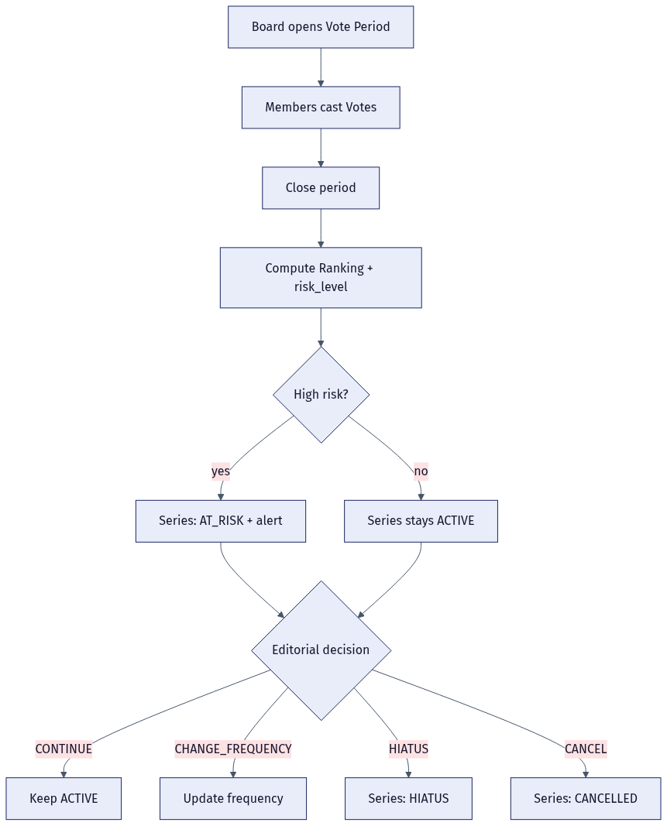
06 · FEATURE FLOWS
Governance: vote → ranking → decision
Voting steers a series' future
One vote per board member per period
Closing computes ranking + risk level
High risk flips Series to AT_RISK
Decision: continue / change / hiatus / cancel
Notes:
The steering wheel. The board opens a vote period; each member casts one scored vote (enforced by a unique key). Closing the period computes a Ranking with rank position, total score, and a risk level — and can flip the series to AT_RISK with an alert. The board then records a Decision that updates the series status. This is how the studio decides what to keep publishing.

Slide 33
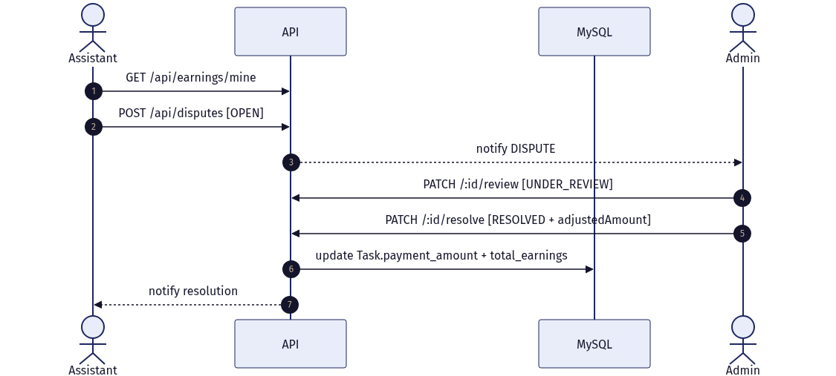
06 · FEATURE FLOWS
Earnings & disputes
A fair, auditable money trail
Assistant views earnings by task
Opens a dispute on an approved task
Admins are notified; one reviews
Resolve can adjust pay + re-accrue
Notes:
Closing the loop on money. An assistant sees per-task earnings and can open a dispute, which notifies admins. An admin moves it to UNDER_REVIEW and resolves it — RESOLVED or REJECTED — optionally adjusting the amount, which updates both the task's payment and the assistant's total_earnings by the delta, then notifies the assistant. Every change is explicit and traceable.

Slide 34
07
Studio & On-Device AI
An in-browser drawing tool with private, zero-cost AI
Notes:
Section 7 is the differentiator: a real drawing Studio in the browser, accelerated by WASM, with optional AI that runs entirely on-device.

Slide 35
07 · STUDIO & AI
The in-browser Studio
Layers & document
Brush engine
Selection & transform
Non-destructive layer stack with history
Pressure-style brush, WASM-accelerated pixels
Rect, ellipse, lasso, wand, move/scale
Manga tools
Text & bubbles
Import / export
Panels, tone, lines, symmetry
Speech bubbles and text layers
Load references, export the artwork
Pixel operations are compiled from AssemblyScript to WebAssembly for native-like speed — all in the browser.
Notes:
Assistants don't leave the platform to draw. The Studio is a real raster editor — layers with undo/redo, a brush engine, selection and transform tools, manga-specific helpers (panels, tone, lines, symmetry), text and speech bubbles, and import/export. The pixel-heavy operations are compiled from AssemblyScript to WebAssembly so it performs well without a server.

Slide 36
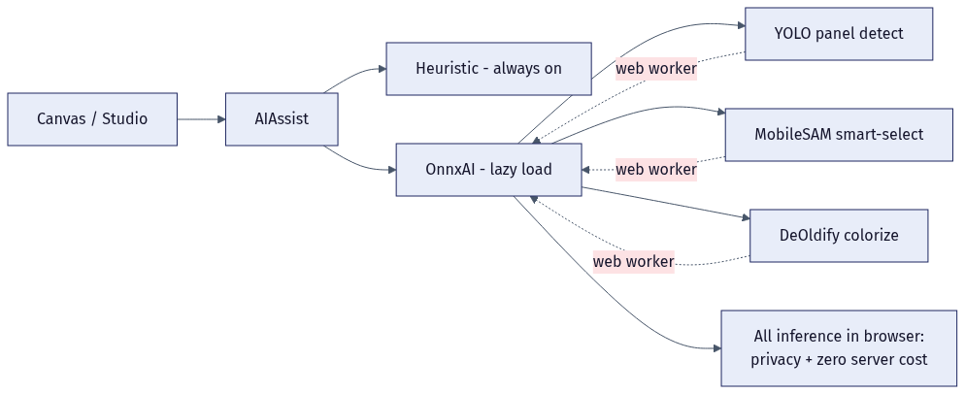
07 · STUDIO & AI
On-device AI assists
ONNX Runtime Web — inference in the browser
Panel detection (YOLO)
Smart selection (MobileSAM)
Colorization (DeOldify)
Heuristic fallback if models unavailable
Privacy: images never leave the client
Cost: zero per-inference server cost
Notes:
The standout feature. AI assists run with ONNX Runtime Web inside web workers — panel detection with a YOLO model, smart selection with MobileSAM, and colorization with a DeOldify model — with a fast heuristic fallback when models aren't loaded. Because everything runs on-device, manuscript artwork never leaves the browser (a real privacy win for unpublished work) and there is no per-inference cloud bill. Models are lazy-loaded only when used.

Slide 37
08
Quality & Roadmap
How we verified it, what's next, and a live demo
Notes:
Section 8 is the evidence of quality, the honest backlog, and a demo script.

Slide 38
08 · QUALITY
Verification & quality
Green across the board
API: 46 jest tests + build pass
Web: 124 vitest tests + tsc -b + build pass
3 live end-to-end smokes against real DB
0 failures; integration via PR #5
Notes:
Quality isn't claimed, it's measured. The API has 46 jest tests and builds clean; the web app has 124 vitest tests plus a passing TypeScript project build; and three live smoke scripts exercise the real API against the real database end-to-end, with 43 assertions and zero failures. These caught integration bugs that mocked unit tests missed. The whole thing integrates through pull request #5.

Slide 39
08 · QUALITY
Roadmap & backlog
SHIPPED
NEXT
Full pipeline: proposal → decision → earnings
All 5 roles, RBAC, notifications
In-browser Studio + on-device AI
29-table schema, enforced state machines
Wire Audit_Log + System_Config tables
Profile-edit pages; Task_Price_Rule admin UI
Production hardening: object storage for uploads
Refresh-token rotation + rate limiting
Notes:
Be honest about scope. The full pipeline, all five roles, RBAC, notifications, the Studio + AI, and the enforced data model are shipped and verified. The backlog is mostly cross-cutting polish: wiring the Audit_Log and System_Config tables (present in the schema but not yet used), profile-edit and price-rule admin screens, and production hardening like object storage for uploads, refresh-token rotation, and rate limiting.

Slide 40
08 · QUALITY
Live demo script
Board logs in → approves a proposal → a Series appears
Board assigns a Tantou editor to the new series
Mangaka builds a chapter, marks regions, creates priced tasks
Assistant starts a task, draws in Studio, submits work
Mangaka approves → assistant's earnings increase
Editor approves the chapter → publish → board votes → decides
DEMO LOGINS
mangaka
dungminer69@gmail.com
assistant
mai.assistant@inkframe.studio
editor
hiroshi.editor@inkframe.studio
board
yamamoto.board@inkframe.studio
admin
admin@inkframe.studio
password: Dung123456@ (local demo seed)
Notes:
A six-step demo that exercises the entire pipeline across four logins. Start as the board (approve + assign), switch to the mangaka (build a chapter and tasks), then the assistant (draw and submit), back to the mangaka (approve, earnings move), and finish with editor approval, publish, and a board vote + decision. The demo accounts share a throwaway local seed password.

Slide 41
Thank you
Questions & live demo
Full technical docs: documents/ — overview, architecture, database design, API reference (66 endpoints), diagrams, and per-role guides.
Notes:
Close, invite questions, and run the live demo. Point the audience to the documents/ folder for the full written documentation set that backs every claim in this deck.

