Slide 1

Business Plan
Watching a game is fun, playing is recreation, working on it, is Passion

Slide 2

As per our observation, e-Gaming industry has evolved enormously for the past 10 years . Tournaments are being organized very often with a good lucrative prize money . Game developing companies also need game testers and game developers ,this provides the opportunity for players to choose Gaming as a Profession.
So , the idea is to open a Gaming School for this very purpose.
Notes:
Summarize key technology, concept or strategy on which your business is based

Slide 3

To assist ambitious, growing game development companies in meeting their game development requirements.
To train the students to become a Pro Developer and Tester.
To provide a Perfect Gaming Environment

Slide 4

Games are more than just a recreational activity.
Increasing popularity of online games .
Increase in average time spent playing games.
Big Sponsors at Major Game Event like Intel , NVIDIA , MSI etc.
Many International Game Competitions are held around the Globe – Healthy Prize Money and Fame.

Slide 5

Game development companies such as
Dhruva Interactive
Syna-G
Arena Animation
Raffles Millennium International
Global School of Animation and Games
Game organizing companies
such as BYOC, ERP

Slide 6

Bangalore, India, Dhruva Interactive is India’s oldest games company, with over 15 years of experience. Since its inception, Dhruva has created several award winning games, and has matured to become one of the leading game art service providers in the world.

Slide 7

“I’ll be back Rich” : Developed and published India’s first web based 3D game based on Wild Tangent’s browser based 3D game engine.
Kaun Banega Crorepati : Built this official blockbuster web-based game for the Star TV network.
Need For Speed: PROSTREET: Partnered with EA's Black Box Studio for content creation on NFS ProStreet.
Terminator 3 – Rise of the Machines
Mission: Impossible Operation Surma

Slide 8
Post offered Starting Salary
Game Developer 40,000 - 70,000
Tester 30,000 – 55,000

Slide 9

The BYOC at PAX(a three day festival organized to play PC games ) is a room with tables and internet connected network set up so you can bring your own computer, hang out, and play games with a bunch of other cool people. There will be tournaments, mini competitions, and activities exclusive to the BYOC.

Slide 10

DOTA
C.S 1.6
NFS Most Wanted
FIFA 09
Call Of Duty

Slide 11
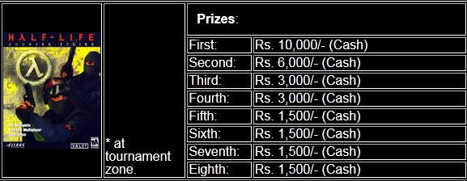

Slide 12

Requirements:-
1. Staff
2. Gaming pc
3. Furniture
4. Cooling system
5. Building

Slide 13

Major Expense in Enriched Computer Lab consisting of many Computer Systems and Networking Facility.
Hiring Pool of Trainers (Game Developers and Testers ).

Slide 14

Technology requirements
Personnel requirements:
-Management: CEO, Receptionist,
Resource requirements
  Financial, distribution, promotion, etc.
External requirements
  Products/services/technology required to be purchased outside company

Slide 15

Gaming computer:-
configuration:-
Hard disc(320GB,seagate) - 3000 /-
RAM(4GB,samsung) - 1200 /-
Processor (i3,intel) - 6000 /-
LCD - 3000 /-
Graphic card (2 GB,NVIDIA) - 5000 /-
Motherboard(intel) -2500 /-
Extra(keyboard , etc) - 4000 /-
For 1 System TOTAL → 24,700 /-
For 120 Systems TOTAL → 29,64,000 /-
  source www.flipkart.com/computers

Slide 16
Furniture:-
Computer table x 130 2,34,000 /-
Chair x 130 1,95,000 /-
Cooling system:-
Ac(panasonic) x 9 1,53,000 /-
Fan(pspo) x 9 9,000 /-
Lighting :-
Light rod x 20 10,000 /-
Advertisement Expanse 1,00,000/-
Total initial investment → 36,65,000 Rs

Slide 17
Total investment:_-- 36,65,000 Rs
Bank loan:---25,00,000 Rs
Personal investment:--11,65,000 Rs

Slide 18

State Bank of India (SBI): 12.50-13.00%...
Union Bank of India:11.5...
Canara Bank:10.5...
HDFC: 14.25..
IDBI Bank13.0...
We were going as per the interest rate offered by Canara Bank

Slide 19


The most typical loan payment type is the fully payment in which each monthly rate has the same value over time.
The fixed monthly payment P for a loan of L for n months and a monthly interest rate c is:

Slide 20
We have taken loan for the 5 years from CANARA bank on 10.5% rate pa . so monthly rate will be0.87%per month.
According to the above data , the paid amount per month by us will be…..53707 Rs .

Slide 21

Electricity bill:-
Typical pc power → 200 watt
power used by 100pc in 5 hours → 100 unit
1 unit price(commercial) → 11 Rs
100 unit → 1100 Rs/day
monthly → 33,000 /-
Ac power → 1400 watt
power used in 5 hours by 9 ac → 63 unit/day
Price → 693 Rs/day
monthly → 20,790 /-
Extra → 2000 /-
Monthly total → 55,790 Rs/month

Slide 22

Staff :-
Professional gaming tutor x 4 2,20,000 /-
Technician x 2 20,000 /-
Guard x 2 14,000 /-
Receptionist x 1 8,000 /-
Rent :- Building rent(4000 ft2) 1,50,000 /-
Extra :- 10,000 /-
Loan payment:-53,707/-
Total monthly expenses → 5,31,497 Rs

Slide 23

Expected number of student 300
Fees per student → 2000 Rs/month
Monthly income → 6,00,000 Rs/month
Profit per month = 600000-531497
= 68,503 Rs/month
Tax paid:-97,239Rs
Net Annual income =8,13,932Rs

Slide 24

Advertisement in Various Newspapers .
Launch Website .
Upload Demo projects of our college to Website
Have an professional GAMERS team which will participate in various tournaments on behalf of our institute .
Organize tournaments in which the prizes will be , the game developed by us .

Slide 25
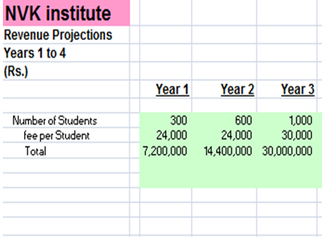

Slide 26

 | Year 1 | Year 2 | Year 3 | Year 4
Monthly income | 6,00,000 | 12,00,000 | 25,00,000
Monthly expense | 5,39,600 | 9,49,975 | 13,52,430
Net profit (per month) | 60,400 | 2,50,025 | 11,47,570

Slide 27


NPV is The difference between the present value of cash inflows and the present value of cash outflows. NPV is used in capital budgeting to analyze the profitability of an investment or project.
Present value describes how much a future sum of money is worth today

Slide 28
t - the time of the cash flow
i - the discount rate (the rate of return that could be earned on an investment in the financial markets with similar risk.);
Rt- the net cash flow (the amount of cash, inflow minus outflow) at time t.

Slide 29
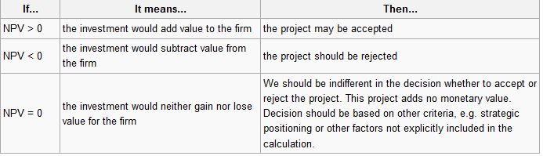

Slide 30
We need to add a “risk factor” percentage. This will vary according to the level of risk we associate with the project. Let’s add 3% for risk
i=0.03.
Rt= 60,400
t - the time of the cash flow

Slide 31
Month | Cash Flow | Present Value
t=0 | 60,400/(1+0.03)^0 | 60400
t=1 | 60,400/(1+0.03)^1 | 58640.7
t=2 | 60,400/(1+0.03)^2 | 56932.7
t=3 | 60,400/(1+0.03)^3 | 55275.9
t=4 | 60,400/(1+0.03)^4 | 53665.0
t=5 | 60,400/(1+0.03)^5 | 52104.8
t=6 | 60,400/(1+0.03)^6 | 50586.2
t=7 | 60,400/(1+0.03)^7 | 49113.6
t=8 | 60,400/(1+0.03)^8 | 47682.9
t=9 | 60,400/(1+0.03)^9 | 46294.1
t=10 | 60,400/(1+0.03)^10 | 44943.8
t=11 | 60,400/(1+0.03)^11 | 43635.3
t=12 | 60,400/(1+0.03)^12 | 42385.9

Slide 32
Net present value : 661,654.2
NPV>0
So our project in feasible to implent

Slide 33
PROFIT & lOSS
Dr. | Cr.
To computer expances 29,64,000 | By fee 72,00,000
To furniture 4,29,000
To cooling expances 1,62,000
To lightning expances 10,000
To advertisement 1,00,000
To electricity expances 55,790
To rent expances 1,50,000
To extra expances 10,000

Slide 34

Dr. | Cr.
To tax 97,239
To salary 2,62,000
To loan paid 6,44,487
To balance 23,15,484
By the p%l we can see that a profit of 23,15,484 Rs

Slide 35

LIABILITIES | ASSETS
Capital 11,65,000 | Cash 59,80,484
Loan 25,00,000

Slide 36

Risks
Social Convention: Gaming is Bad ☹
Consumer Problems: Uncertainty of Income
Addressing risk
  Hire current world class players

Slide 37

Short term:-Adding different courses.
Long term
  Game Design and Programming
  Opening institute in all high-tech cities( Bangalore , Mumbai , Hyderabad etc..)

Slide 38

With proper advertisement in initial months and proper management the company will be able to stand on its feet within 2 years and will be an established Institution .It can then look to expand in other cities i.e. Mumbai, Bangalore etc where e-gaming is widely popular.

