Slide 1
FEDERATED learning
Strategies for Improving Communication Efficiency

Slide 2
Contents
Introduction of upload models in Federated Learning
Goal of this paper
Proposed method
  Structured updates
  Sketched updates
Experiment results
Conclusion

Slide 3
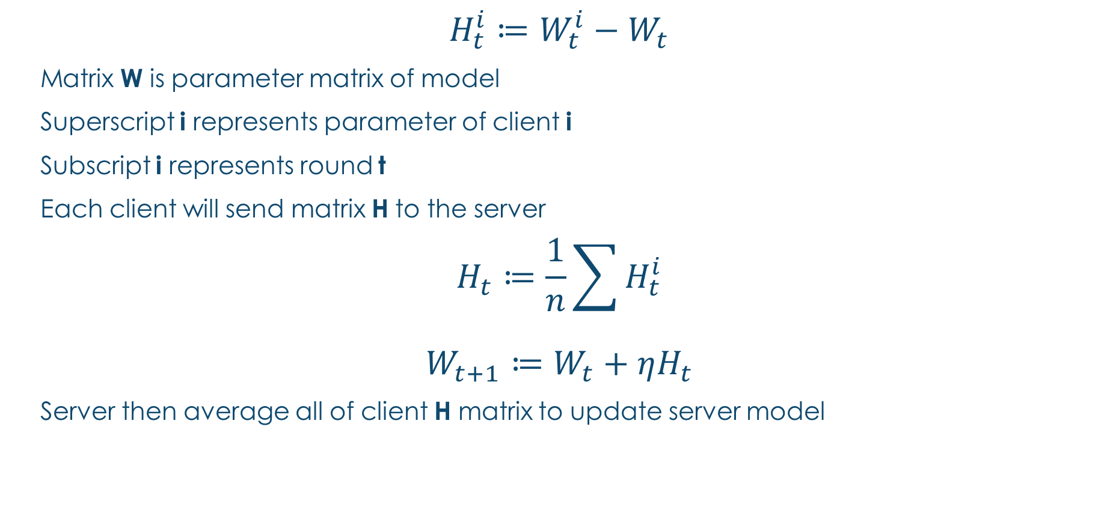
Introduction of Uploading model
$$H_{t}^{i}≔W_{t}^{i}−W_{t}$$
Matrix W is parameter matrix of model
Superscript i represents parameter of client i
Subscript i represents round t
Each client will send matrix H to the server
$$H_{t}≔\frac{1}{n}\sum{H_{t}^{i}}$$
$$W_{t+1}≔W_{t}+ηH_{t}$$
Server then average all of client H matrix to update server model

Slide 4
Goal of this paper
Naïve implementation of Federated Learning require each client to send whole model to server, thus the time of uploading models in Federated Learning become a bottleneck.
In this paper, authors propose some method that can reduce the time of uploading models to the server.

Slide 5
Structured updates
This method restrict the update matrix H to have a pre-specified structure, and authors introduce two structures in this paper.
Low rank
Random mask

Slide 6

Low rank
$$H_{t}^{i}=A_{t}^{i}B_{t}^{i} where{ A}_{t}^{i}∈R^{d1∗k}, B_{t}^{i}∈R^{k∗d2}$$
d1 is # of outputs and d2 is # of inputs in network
k is a fixed number
In this method, each client will generate matrix A by random seed independently and send only matrix B as well as random seed to the server.

Slide 7
Random mask
Restrict matrix H to be a sparse matrix
Use random seed to generate random mask
Each client will only send non-zero entries as well as random seed to the server.

Slide 8
Sketched updates
This method will upload model with some lossy form.
Subsampling
Probabilistic quantization

Slide 9
subsampling
Instead of send whole matrix H to the server, this method only send random subset of matrix H to the server.
Notes:
# of client are high -> smaller subset
# of client are low -> larger subset

Slide 10
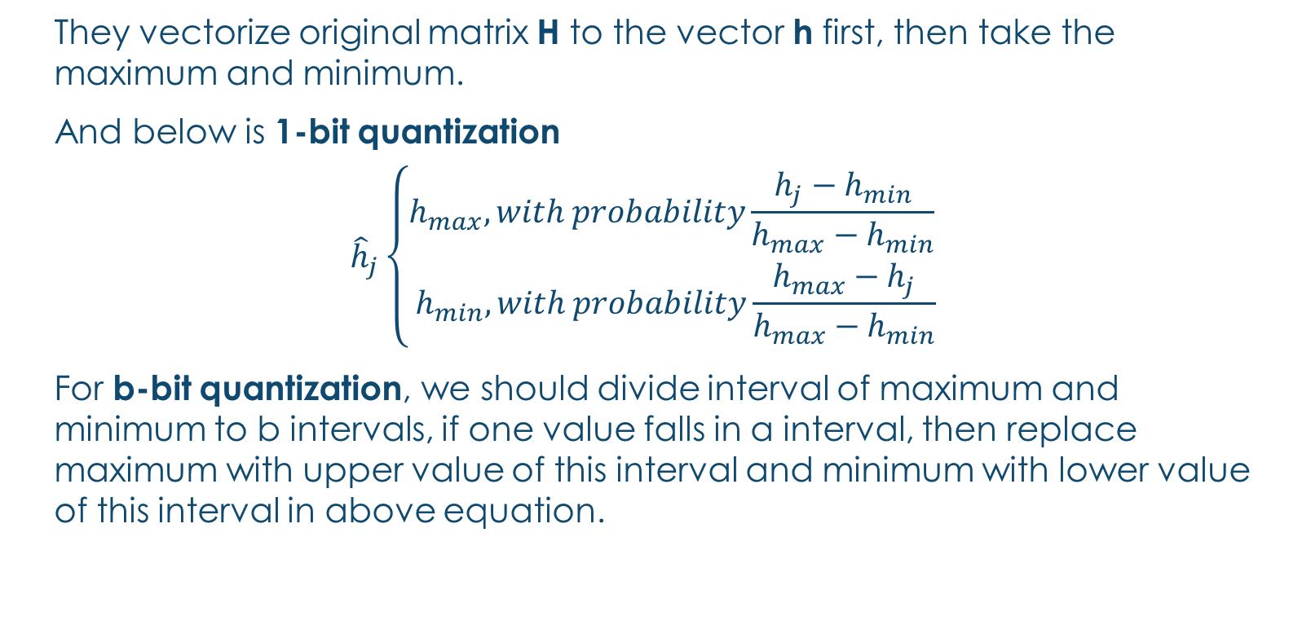
Probabilistic quantization
They vectorize original matrix H to the vector h first, then take the maximum and minimum.
And below is 1-bit quantization
$${\hat{h}}_{j}\left\{\begin{aligned}h_{max}, with probability\frac{h_{j}−h_{min}}{h_{max}−h_{min}} \\ h_{min}, with probability\frac{h_{max}−h_{j}}{h_{max}−h_{min}}\end{aligned}\right.$$
For b-bit quantization, we should divide interval of maximum and minimum to b intervals, if one value falls in a interval, then replace maximum with upper value of this interval and minimum with lower value of this interval in above equation.

Slide 11
Probabilistic quantization
This method will cause some error if we don’t preprocess the matrix.
For example, if maximum = 1 and minimum = -1and most of value are 0, 1-bit quantization will produce large error.
Author introduce a method. This method solve problem by multiplying vector h by a random orthogonal matrix.
Notes:
Other paper prove it

Slide 12
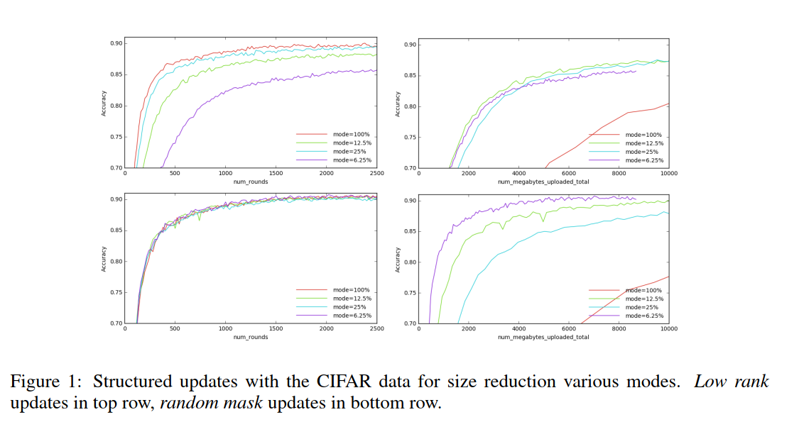
Experiment Result
This is experiment result using CIFAR-10 as task using CNN.
From this picture, it is obviously that random mask outperform low rank.
Notes:
25% mean ¼ of rank in low rank
25% mean only 25% of data remain
Compare random mask and low rank

Slide 13
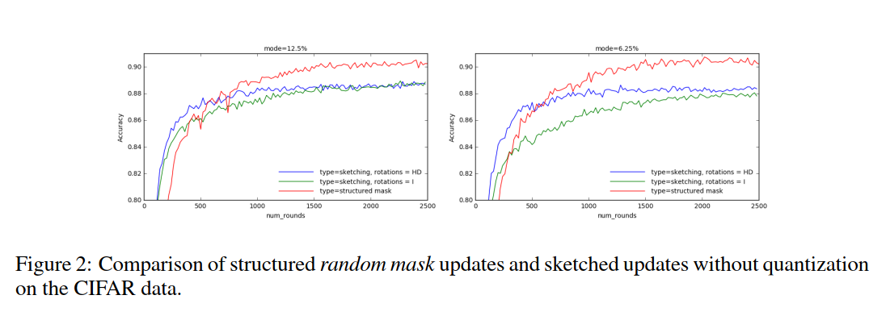
Experiment Result
Same task as previous slide.
From this picture, we can see that structure updates have better performance than sketched updates.
Notes:
Compare sketch and structure

Slide 14
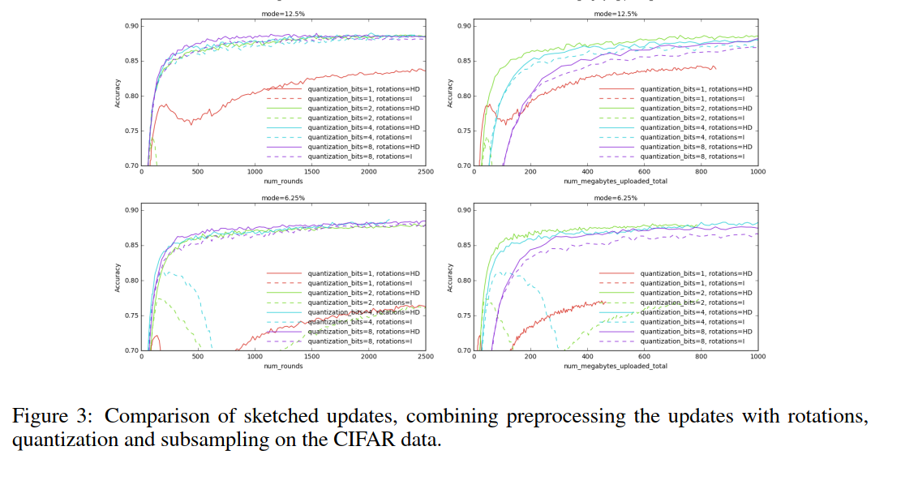
Experiment Result
This result is based on next word prediction task using RNN model.
From this picture, we can see that sketched updates with rotation can have better accuracy.
Notes:
Compare with and without rotation

Slide 15
Conclusion
Federated Learning will become more and more important in future because of data privacy, so method in this paper will be useful if we want to deploy Federated Learning to train a large model.

