Slide 1
Self-introduction
2021/9/23

Slide 2
1
Resume
2
Research orientations
3
Literature Search & Review
CONTENTS

Slide 3
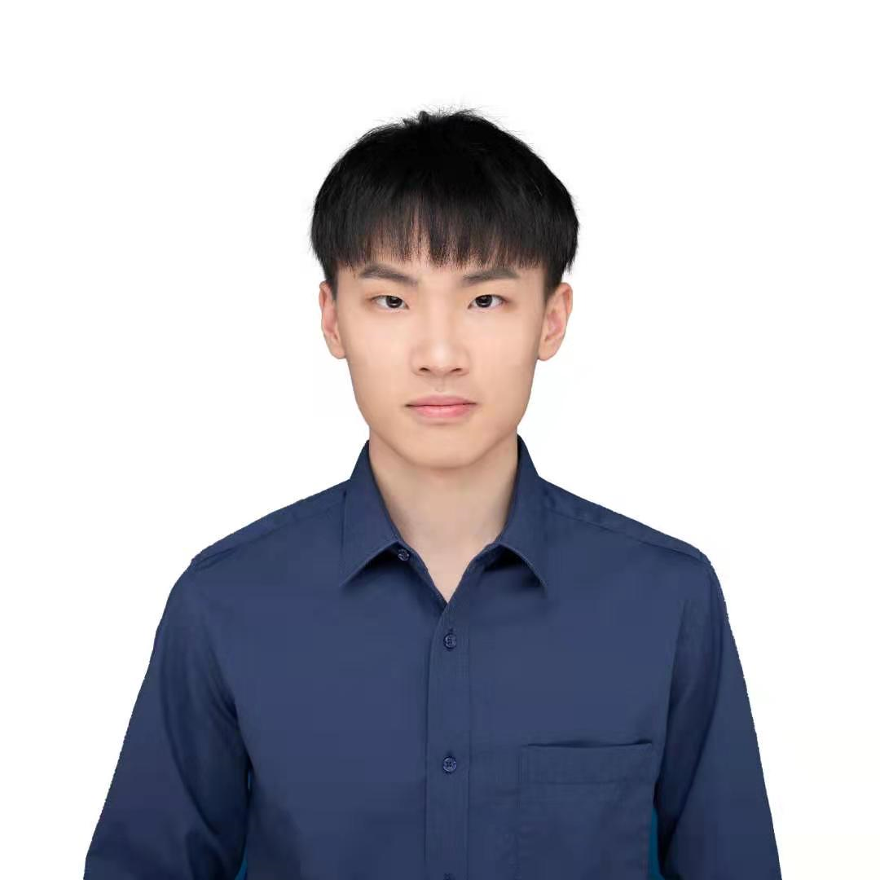
Resume
Name: Xiaoxing Zuo (左小幸)
Academic program: master student
Adviser: Lei Zhu
Research: Modeling of atmospheric chemistry
Email: 12132243@mail.sustech.edu.cn

Slide 4
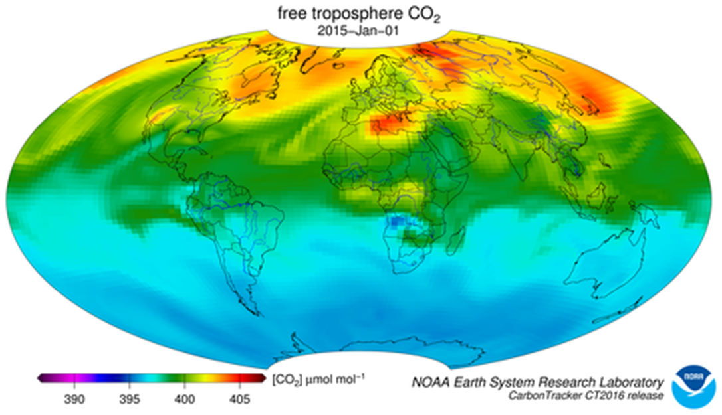
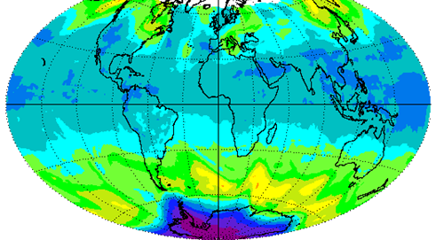
Research orientations
Modeling of atmospheric chemistry
Using atmospheric chemistry models to predict the distribution of polluting gases(such as ozone).
Assimilating different data to improve the simulations.

Slide 5
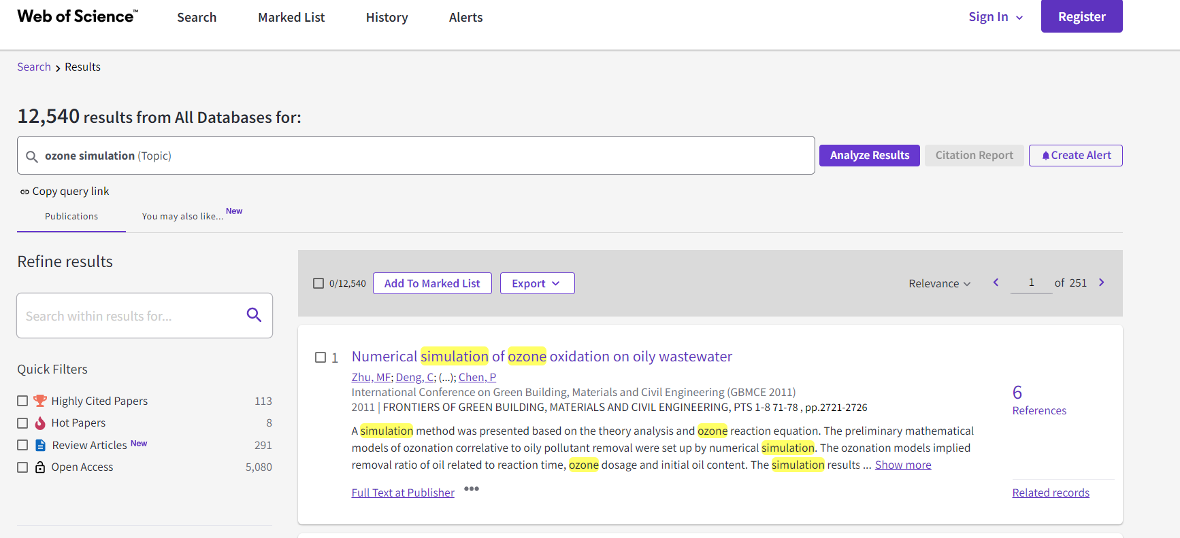
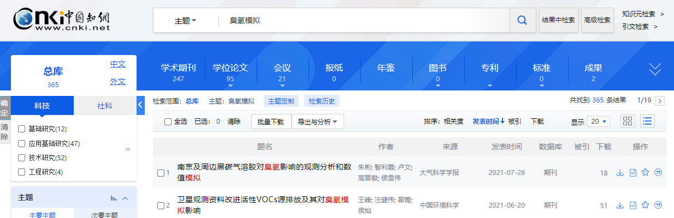
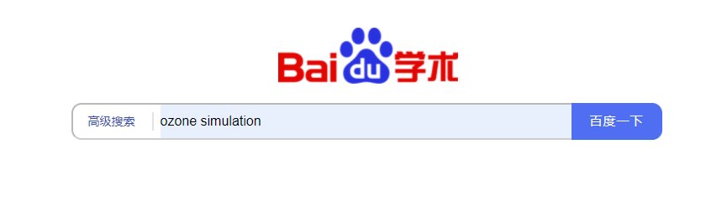
Literature Search & Review
Website:
https://www.webofscience.com/wos/alldb/basic-search
https://xueshu.baidu.com/
https://www.cnki.net/
etc.
The basis of literature selection:
Relevance, Citations,
The journal in which the article is published,
etc.

Slide 6
Thank you
2021/9/23

