Slide 1
Self-introduction
2021/9/23

Slide 2
1
Resume
2
Research orientations
3
Literature Search & Review
CONTENTS

Slide 3
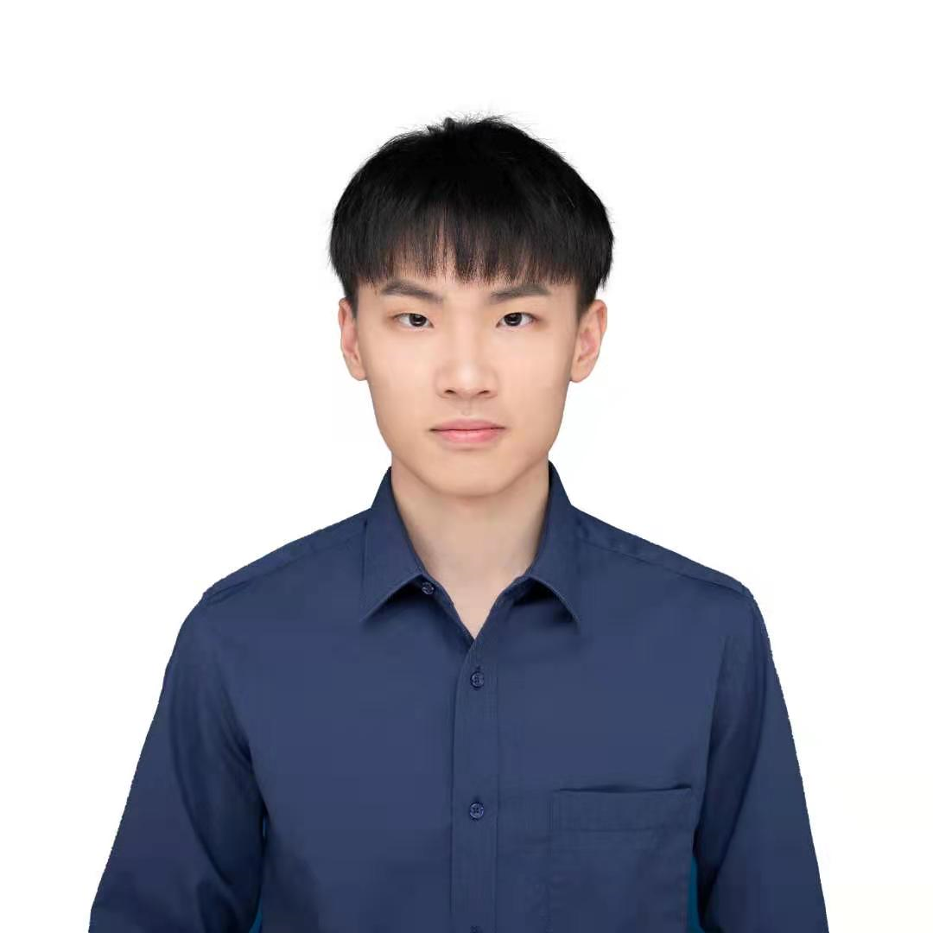
Resume
Name: Xiaoxing Zuo (左小幸)
Adviser: Lei Zhu
Academic program: master student
Research: Modeling of atmospheric chemistry
Email: 12132243@mail.sustech.edu.cn

Slide 4
Research orientations

Slide 5
Literature Search & Review

Slide 6
Thank you
2021/9/23

