Slide 1
satellite
two versions of the AHSI onboard the GF5 and ZY1 platforms (China, launched in May 2018 and September 2019, respectively)
and the core instrument onboard PRISMA (Italy, launched in March 2019).
The 2100- to 2450-nm window is especially sensitive to methane

Slide 2
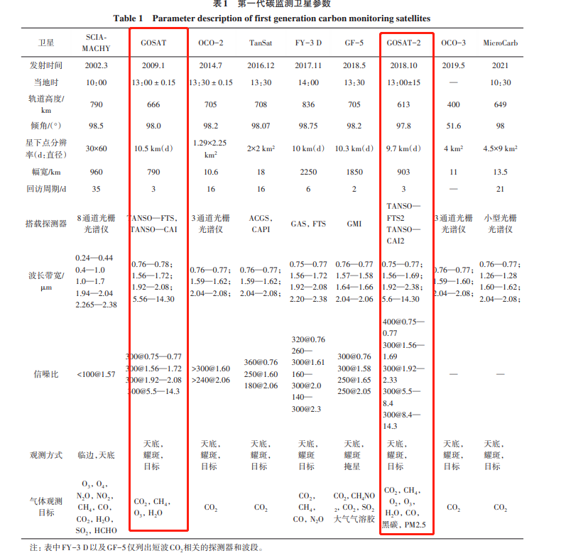

Slide 3
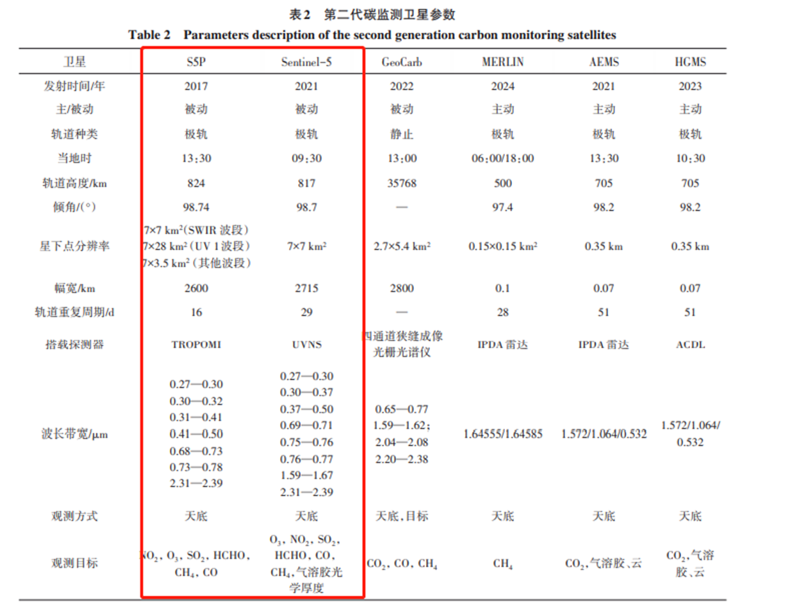

Slide 4
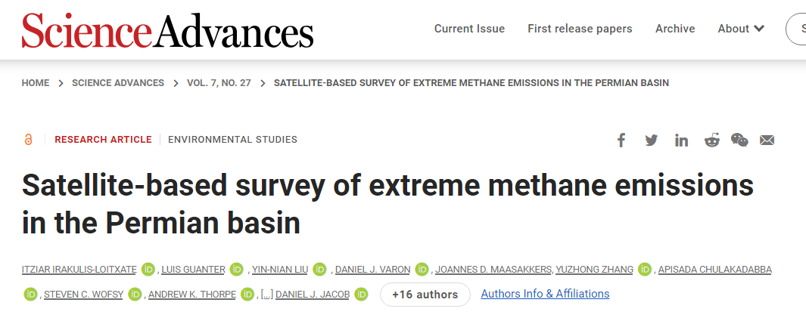
satellite
two versions of the AHSI onboard the GF5 and ZY1 platforms (China, launched in May 2018 and September 2019, respectively)
and the core instrument onboard PRISMA (Italy, launched in March 2019).
The 2100- to 2450-nm window is especially sensitive to methane

