Slide 1
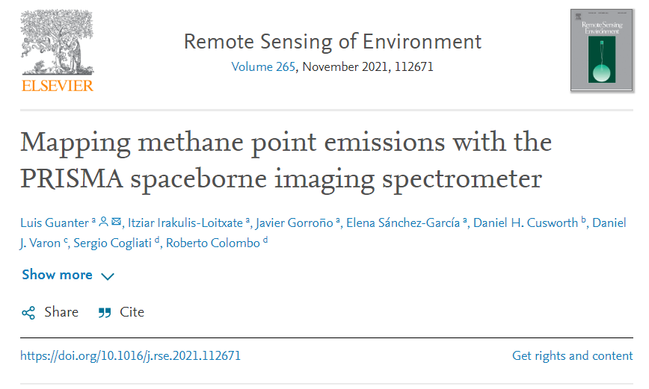

Slide 2


Estimation of emission flux rates
IME: integrated mass enhancement
n_{p} is the number of pixels in the plume,
k is a scaling factor equal to 5.155⋅10⁻³ kg/ppb.
U_{eff} is an effective wind speed, L is the plume length scale.
The U_{eff} term is calculated from the measurable 10-m wind speed U₁₀ as
Guanter, L .et.al (2021)
Notes:
计算每个探测到的羽流的排放通量速率(Q)值，单位为千克每小时(kg/h)。
作者手动定义一个多边形来将羽毛从背景中分离出来。首先，根据图像的中值应用一个阈值来去除背景。然后，将甲烷检索图像覆盖在第2.3节描述的高分辨率图像上，以识别羽流附近可能干扰信号的假阳性源。考虑到附近的伪影和假阳性源，作者绘制的多边形只掩蔽在发射羽流内的像素，避免假像素或错误源。我们丢弃了在不均匀表面上的辐射，在这些表面上，附近人造物体产生的信号无法清楚地掩盖羽流。
np是羽流中像素的数量，k是一个比例因子等于5.155⋅10−3 kg/ppb,将每个pixel大小的甲烷浓度ppb转化为了kg（假设阿伏伽德罗定律成立并设定pixel大小为30米，并考虑了甲烷的分子质量）。
其中Ueff为有效风速，L为羽流长度尺度(羽流遮罩面积的平方根)。Ueff项由可测10 m风速U10计算，公式如下。

Slide 3


Slide 5
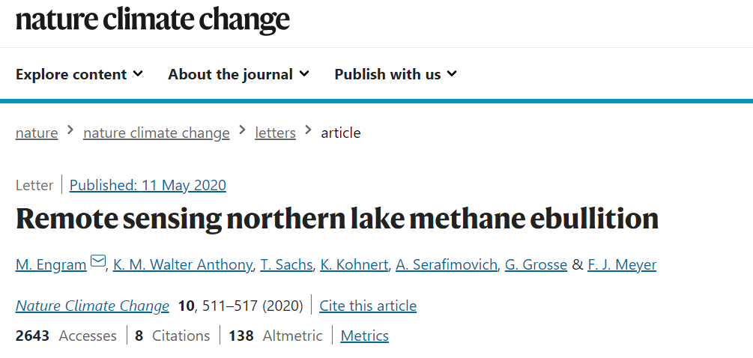

Slide 6
We used all available quad-pol space-borne ALOS Phased Array type L-band Synthetic Aperture Radar (PALSAR) SAR data (L-band, 21.5° off-nadir angle) from early winter in each region, after empirically defining a temporal window when correlations between field-measured CH4 fluxes and calibrated SAR brightness were statistically the strongest, generally from early November to mid-December (Supplementary Table 1).

Slide 7
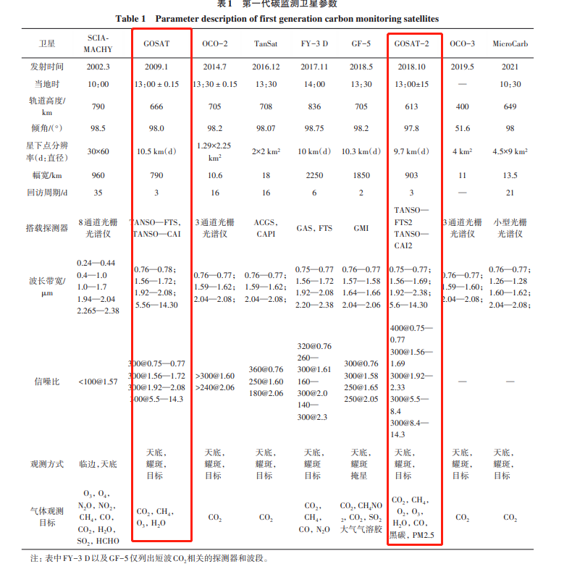

Slide 8
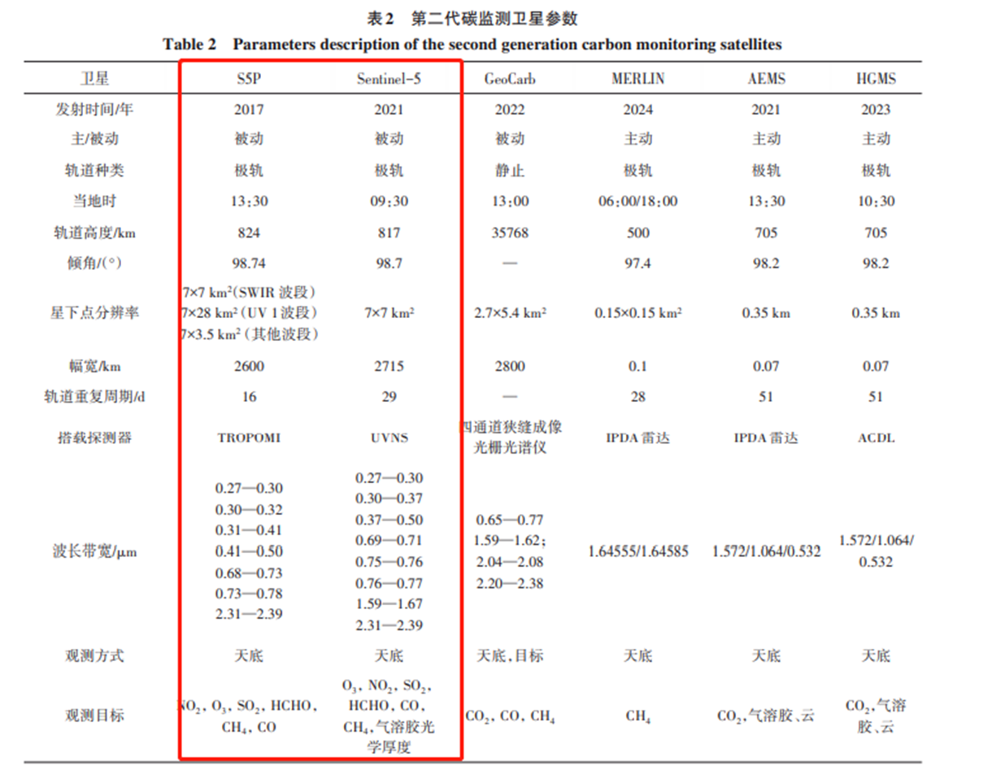

Slide 9
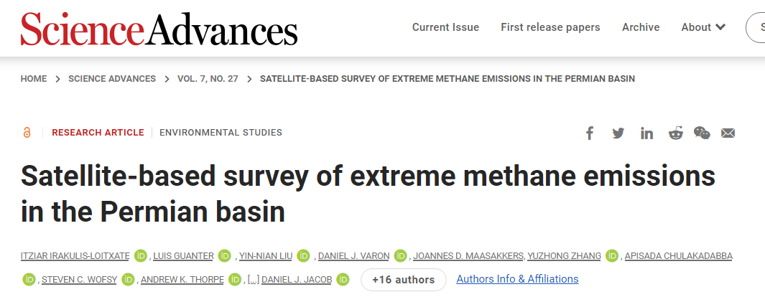
satellite
two versions of the AHSI onboard the GF5 and ZY1 platforms (China, launched in May 2018 and September 2019, respectively)
and the core instrument onboard PRISMA (Italy, launched in March 2019).
The 2100- to 2450-nm window is especially sensitive to methane

Slide 10
水库，相对小尺度，可以试用Tropomi

