Slide 1
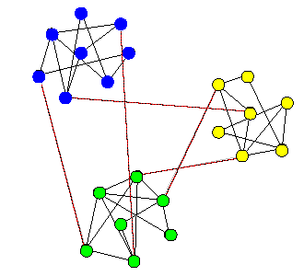
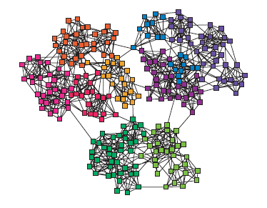
Community Structure in Complex Networks
Communities: groups of nodes between which links are sparse but within which links are dense.

Slide 2
Many real networks have a natural community structure
We want to discover this structure rather than impose a certain size of community or fix the number of communities
Without “looking”, can we discover community structure in an automated way?

Slide 3
Which is the best algorithm to characterize networks of known community structure?
Benchmarks
How to evaluate algorithm performance when the community structure is unknown?
Quality measures

Slide 4
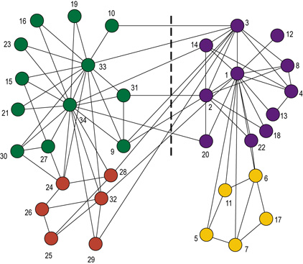
An real network:
Zachary’s Karate(空手道) Network
W. W. Zachary, J. Anthropological Research 33, 452-473 (1977).

Slide 5
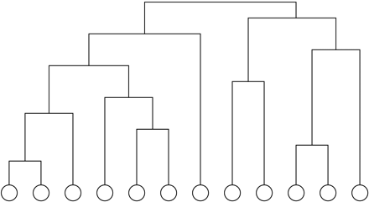
Calculate a “weight” (e.g., no. of node-independent paths) for every pair of vertices, which represents how closely connected the vertices are
Start with all n vertices disconnected, add edges between pairs one by one in order of decreasing weight
Result: nested components, where one can take a ‘slice’ at any level of the tree

Slide 6
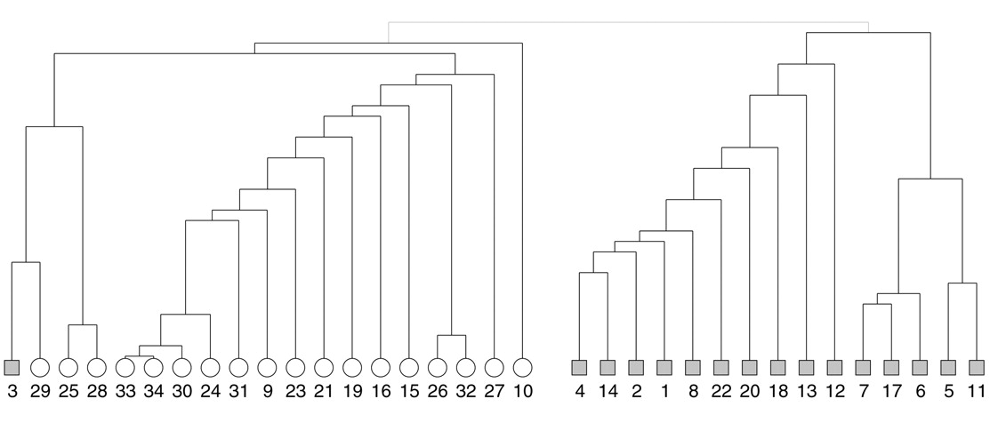
Girvan & Newman, PNAS June 11, 2002 99(12):7821-7826

Slide 7


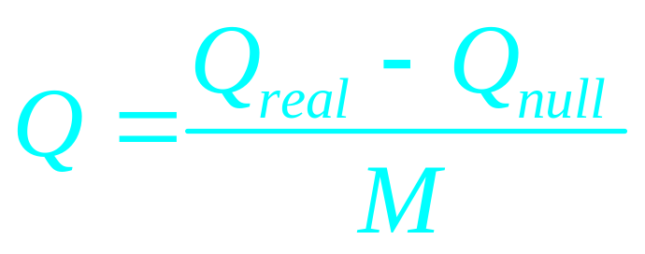
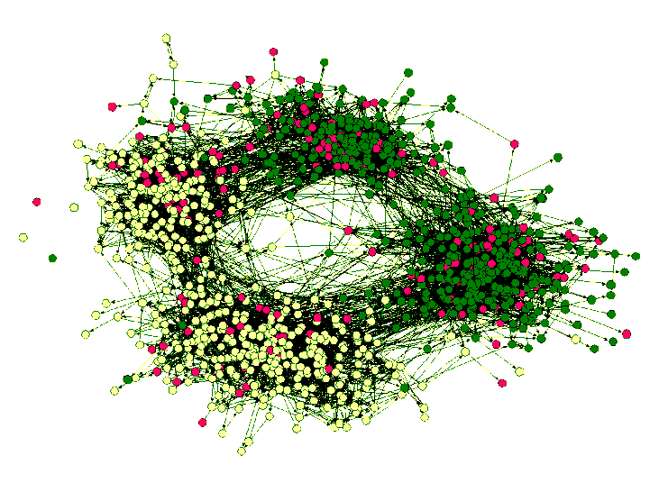
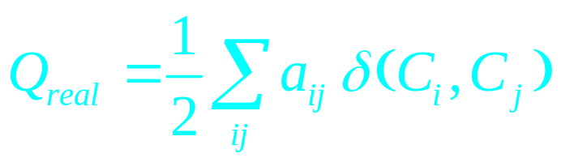
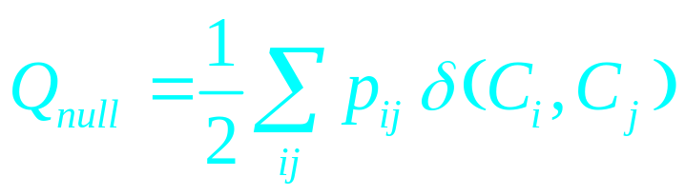
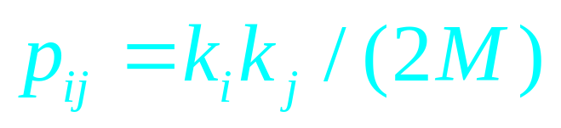
社团内部的边
  Compare to a null model with the same degree distribution
A. Clauset, M. E. J. Newman, & C. Moore, Finding community structure in very large networks, Phys. Rev. E 70, 066111 (2004).

Slide 8
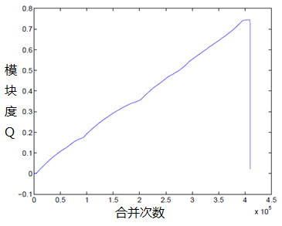
  Start with all vertices as isolates
  follow a greedy strategy (or simulated annealing…) :
    successively join clusters with the greatest increase ΔQ in modularity
    stop when the maximum possible ΔQ <= 0 from joining any two

Slide 9
随机化网络生成方法
目的：生成给定网络G对应的一个随机网络
重复进行以下步骤足够多次：
从G中任意选取两条边(a,b)和(c,d)，生成新的边(a,c)和(b,d)替换原来的两条边，要求替换后没有重边，没有自回路，否则不做替换

