Slide 1
SIPP: Safe Interval Path Planning for Dynamic Environments
CMPT417 Group 10
Yifan Zuo
YiLun Huang
Lizhou Ding

Slide 2

Introduction
Planning in the presence of dynamic obstacles
Example:
Autonomous Car
House cleaner
Goal: agents perform tasks with ability to safely navigate from place to place in the presence of moving objects.

Slide 3
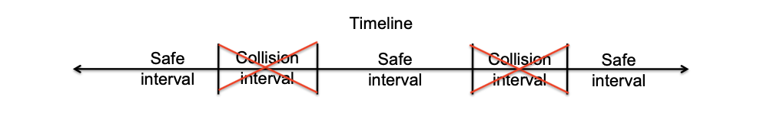
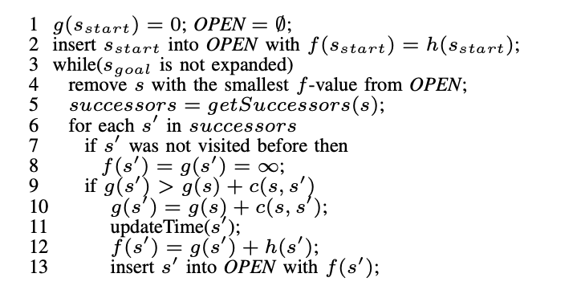
Algorithm
Safe interval and Collision interval:
Dynamic Obstacles Representation
Another system tracks dynamic obstacles and predict their future trajectories.
Each obstacles trajectory is list of points. (Each obstacle could have more than one trajectories).
A* with safe interval

Slide 4
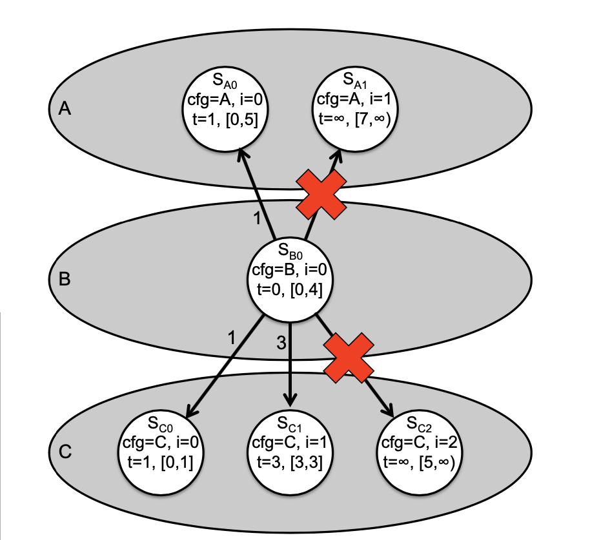
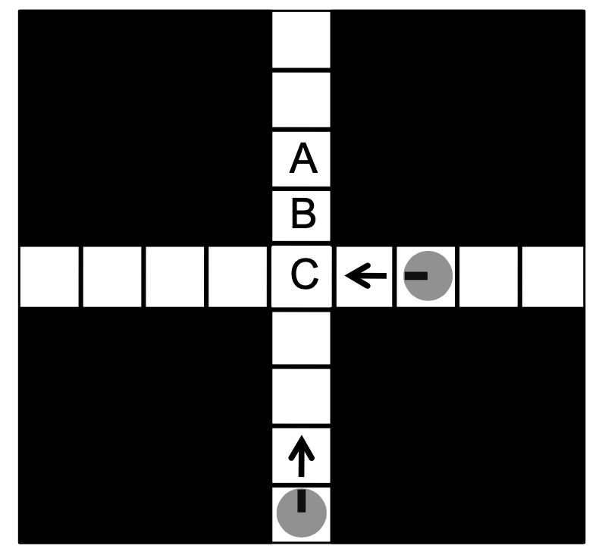
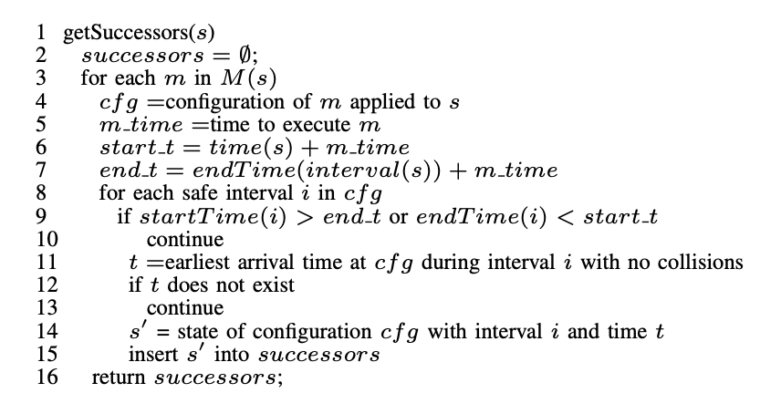
Algorithm(cntd)
Get Successors:

Slide 5
Advantages
Fast since SIPP group contiguous, collision-free timesteps into safe interval which reduce the search space.

Slide 6
END

