Slide 1
Quantum TSP
TSP Group:
Yifan Zuo,
JiaQing Hu,
Mingzhen Mou,
Jiangsheng Guo,
Zhongliang Wang

Slide 2
Introduction
TSP(Travelling Salesman Problem):
Given a list of cities and the distances between each pair of cities, what is the shortest possible route that visits each city exactly once and returns to the origin city?”(wiki)
It is an NP-hard problem in combinatorial optimization.
In our project, the distance between cities are symmetric.
In our project, the first and last cities are not defined.
Classical VS Quantum:
Classical brute force: number of possible solutions is growing exponentially with each additional city.
Quantum TSP: polynomial speed up.

Slide 3
Prerequisites
Forest SKD:
In order to connect to Quantum Virtual Machine.
Pyquil:
Use pyquil.api, pyquil.paulis, pyquil.gates.
Grove:
QAOA: Quantum approximate optimization algorithm.
QAOA is an algorithm for solving a broad range of optimization problems using NISQ (Noisy Intermediate-Scale Quantum) devices.

Slide 4
QAOA
QAOA:
An algorithm that combine quantum part and classical part.
The quantum part prepare the quantum state and measure it , repeat the process.
The classical part use Nelder-Mead algorithm find the most improved angles iteratively.
betas, gammas = QAOA_inst.get_angles()
Beta and gammas are the angles that we got.
most_common_result, _ = QAOA_inst.get_string(betas, gammas, samples=50000)
By knowing the angles, we can get the most common results. Since the result is probabilistic, we should find the most common result.

Slide 5
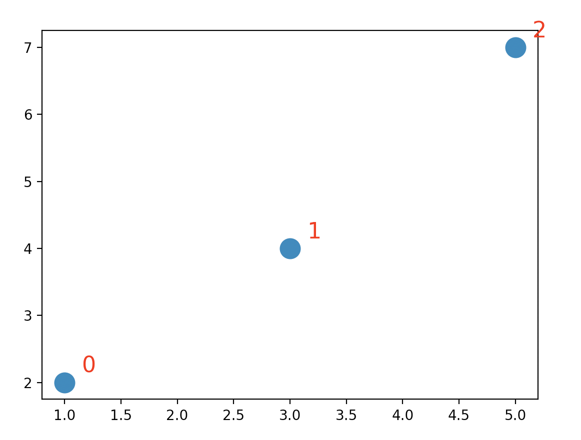
Problem representation
Graph:
For example, we want to present 3 cities: [(1,2), (3,4), (5,7)]
The distance matrix is:
[[0, 2.82842712, 6.40312424]
[2.82842712 0. 3.60555128]
[6.40312424 3.60555128 0. ]]
Cost function is the sum of the cost we want to minimize.

Slide 6
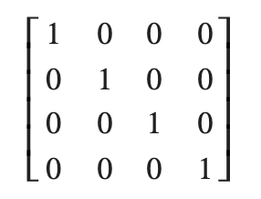
Encode Problem
Points representation:
[0, 1, 2, 3]: Means city 0 to 1 … to 3.
Time-city matrix:
row represents time slots,
columns represent cities
Point representation and time-city matrix are interchangeable.

Slide 7
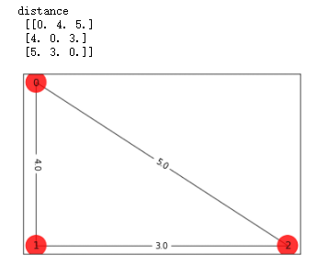
Solving TSP
Naïve Approach
Start with 3 cities, calculate the best distance(fig 1.1)
Then go for more cities…
Use ForestTSPSolverNaive() to solve the whole problem.
Naïve Solution:[0, 1, 2, 2]
Fig 1.1

Slide 8

Solving TSP
Naïve Approach Contd.
The output doesn’t make sense(fig 2.1)
One big reason is that ForestTSPSolverNaive() doesn’t have enough constraints. – Adding penalties to the solver
(fig 2.1)

Slide 9
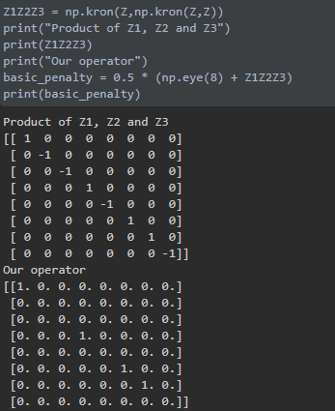

Solving TSP
Improved naïve approach
Create penalty matrices - add huge penalty for the states we don't want.
Example of 3 cities
At t = 0, only possible states are 100,010,001. So we penalize other states by creating an operator matrix(fig 3.1), such operator ignores 100,010,001 and 111 and penalizes the rest states.
To penalize state 111, it requires a little bit of linear algebra.
After we combine those operators to the final operator, we can
implement it in QAOA.
Fig 3.1

Slide 10
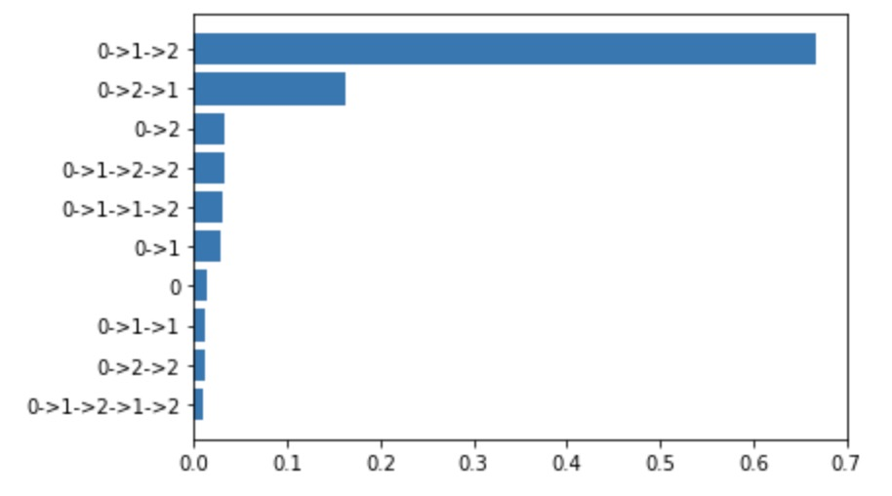
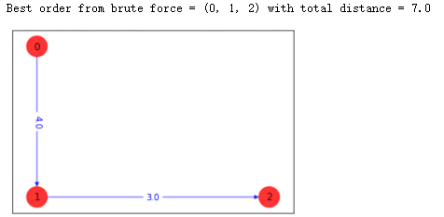
Solving TSP
Improved naïve approach:
Results:

Slide 11
Solving TSP
Naïve approach summary
QAOA - An algorithm that combine quantum part and classical part.
Initially not good enough to solve TSP due to the missing of constraints.
Encoding constraints and costs in QAOA to solve TSP.
Possible improvements
Tuned parameters
More compact encoding
Check for changes dynamically

Slide 12
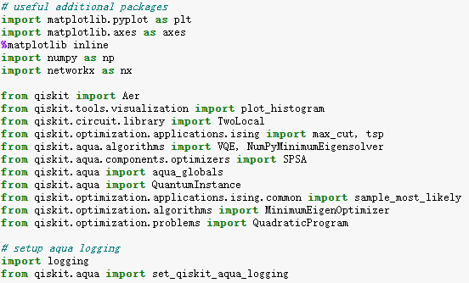
Implement using Qiskit useful packages

Slide 13
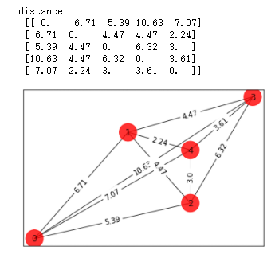
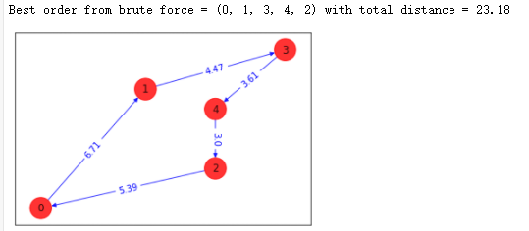
Implement using Qiskit
Example: 5 cities [[0,0],[3,6],[5,2][7,8],[5,5]]
distance matrix and graph(right):
result：

Slide 14
Reference
Max-Cut and Traveling Salesman Problem. From https://qiskit.org/documentation/tutorials/optimization/6_examples_max_cut_and_tsp.html
Quantum_tsp_tutorials. From https://github.com/mstechly/quantum_tsp_tutorials

Slide 15
Thanks ！

