Slide 1


Follow Instructions with Human Feedback: InstructGPT for Summarization Task
Yifan ZUO yzuo@connect.ust.hk
2023 Summer IP
HKUST

Slide 2

Introduction
HKUST

Slide 3
Background - Introduction to instructGPT
instructGPT is a language model developed by OpenAI.
Trained using Reinforcement Learning from Human Feedback (RLHF), it's a sibling model to ChatGPT.
It's designed to generate detailed responses to instructions given in natural language, demonstrating an understanding of the task and performing it accurately.
HKUST

Slide 4
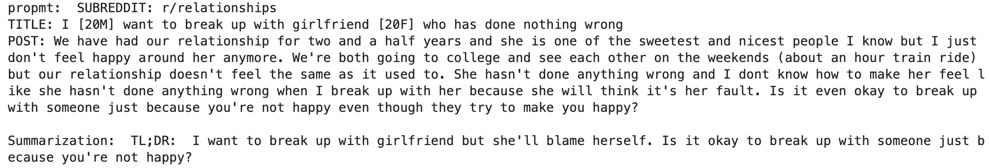
Task Description
Text Summarization
Demo:
HKUST

Slide 5
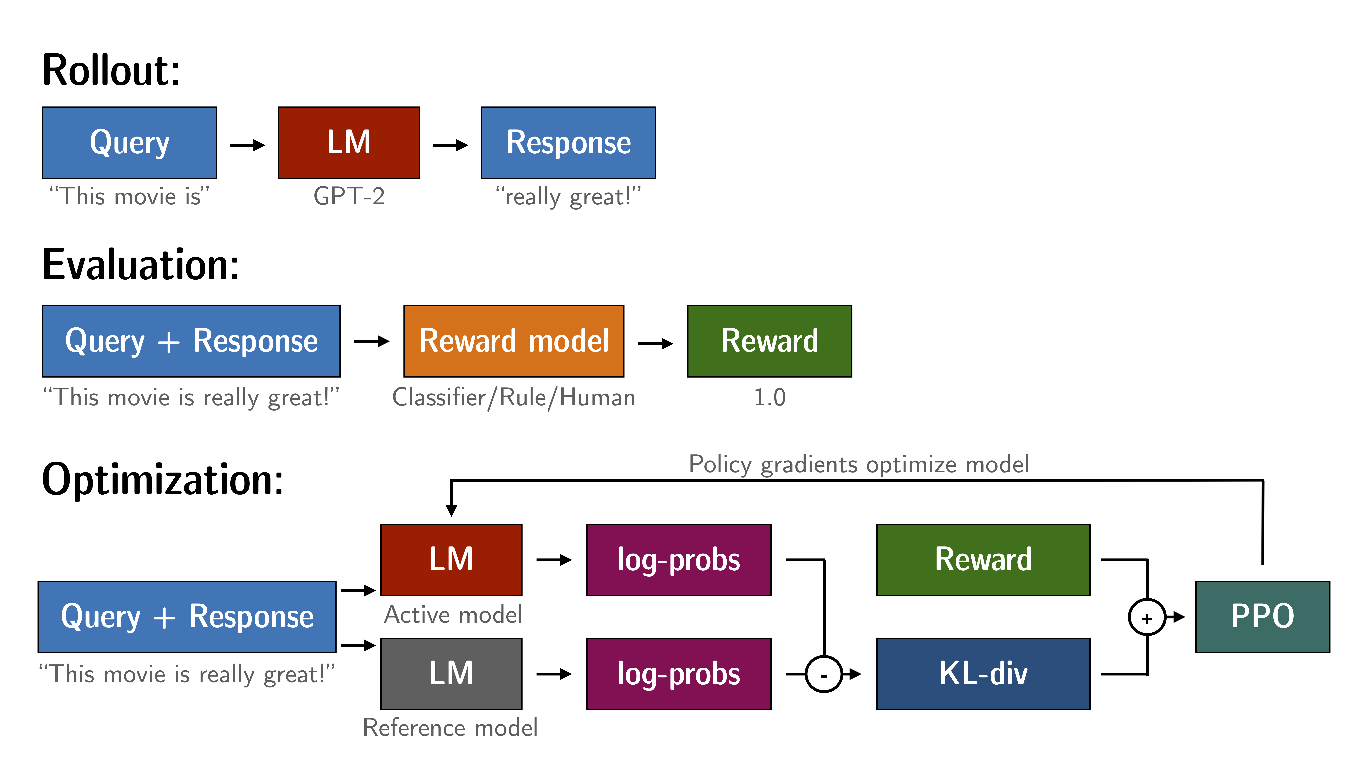
Overall Architecture
HKUST

Slide 6
Reward Model
HKUST

Slide 7
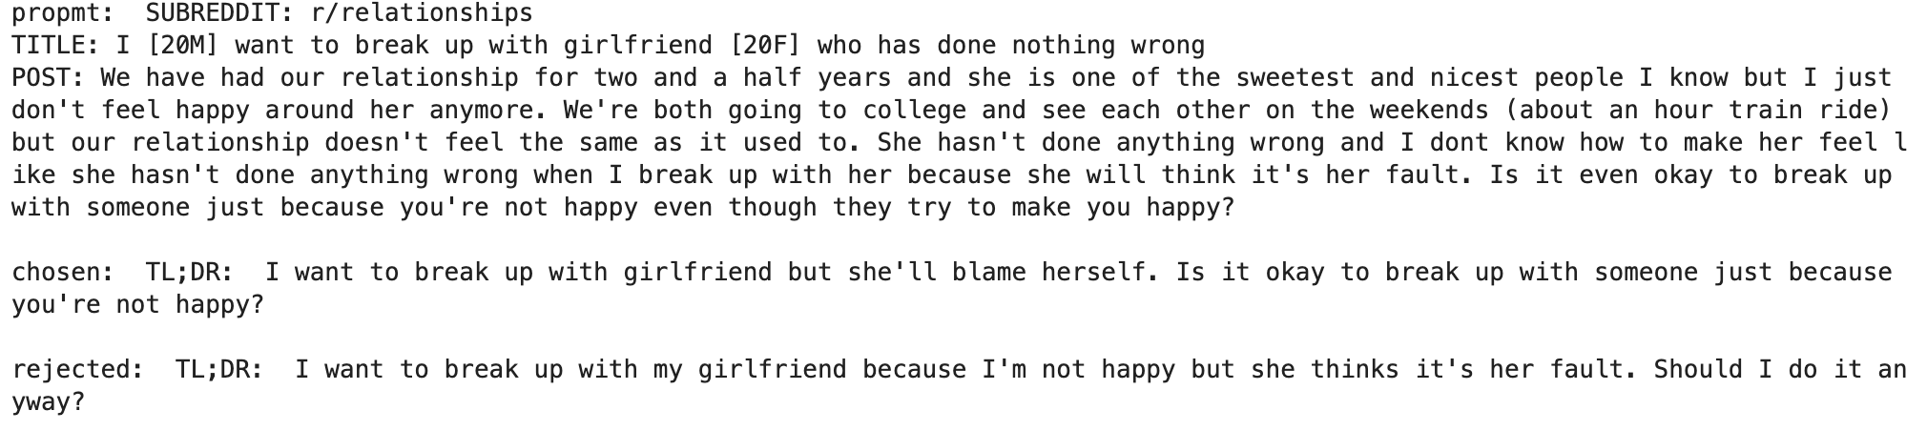
Reward Model - Dataset
Training Dataset
CarperAI/openai_summarize_comparisons
Dataset Cardinality: 90000
Dataset Attribute
“Prompt”
“Chosen”
“Rejected”
HKUST

Slide 8
Reward Model - Architecture
Base Model:
Any auto language model: gpt2
Any tokenizer: gpt2 tokenizer
Custom head:
Dropout
Linear(n_embed, 1)
Sigmoid
Reward Value:
Take last token and first feature embedding value as reward value
HKUST

Slide 9
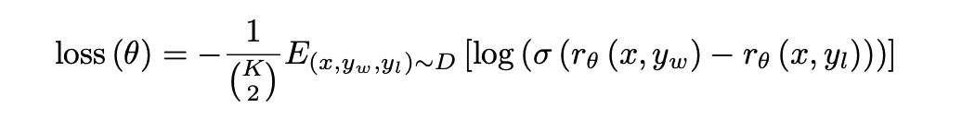
Reward Model – Pairwise Loss
HKUST

Slide 10
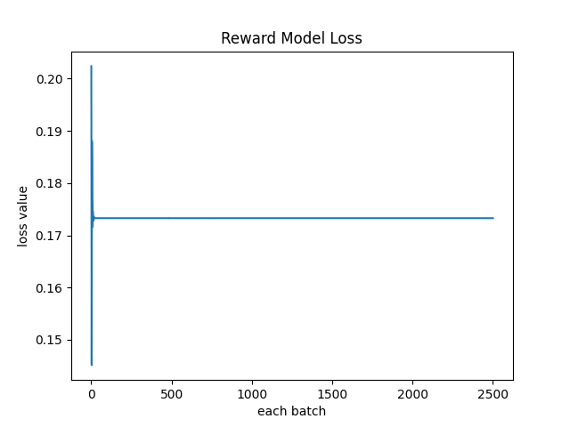
Reward Model - Training
Hyperparameters:
Learning rate: 1e-3
Number of epochs: 8
Batch size: 4
Number of data used: 10000/90000
Device: RTX 3090 24GB
Base model: gpt2
Tokenzier: gpt2
Loss converge to: 0.173286
Time: 4hrs
HKUST

Slide 11
RLHF Trainer
HKUST

Slide 12
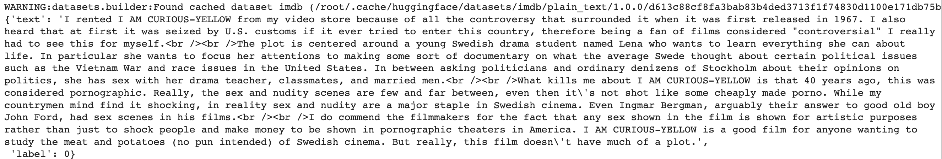
RLHF Trainer - Dataset
Training Dataset
imdb
Dataset Cardinality: 10000/25000
Dataset Attribute
“Text”
“sentiment_label”
HKUST

Slide 13
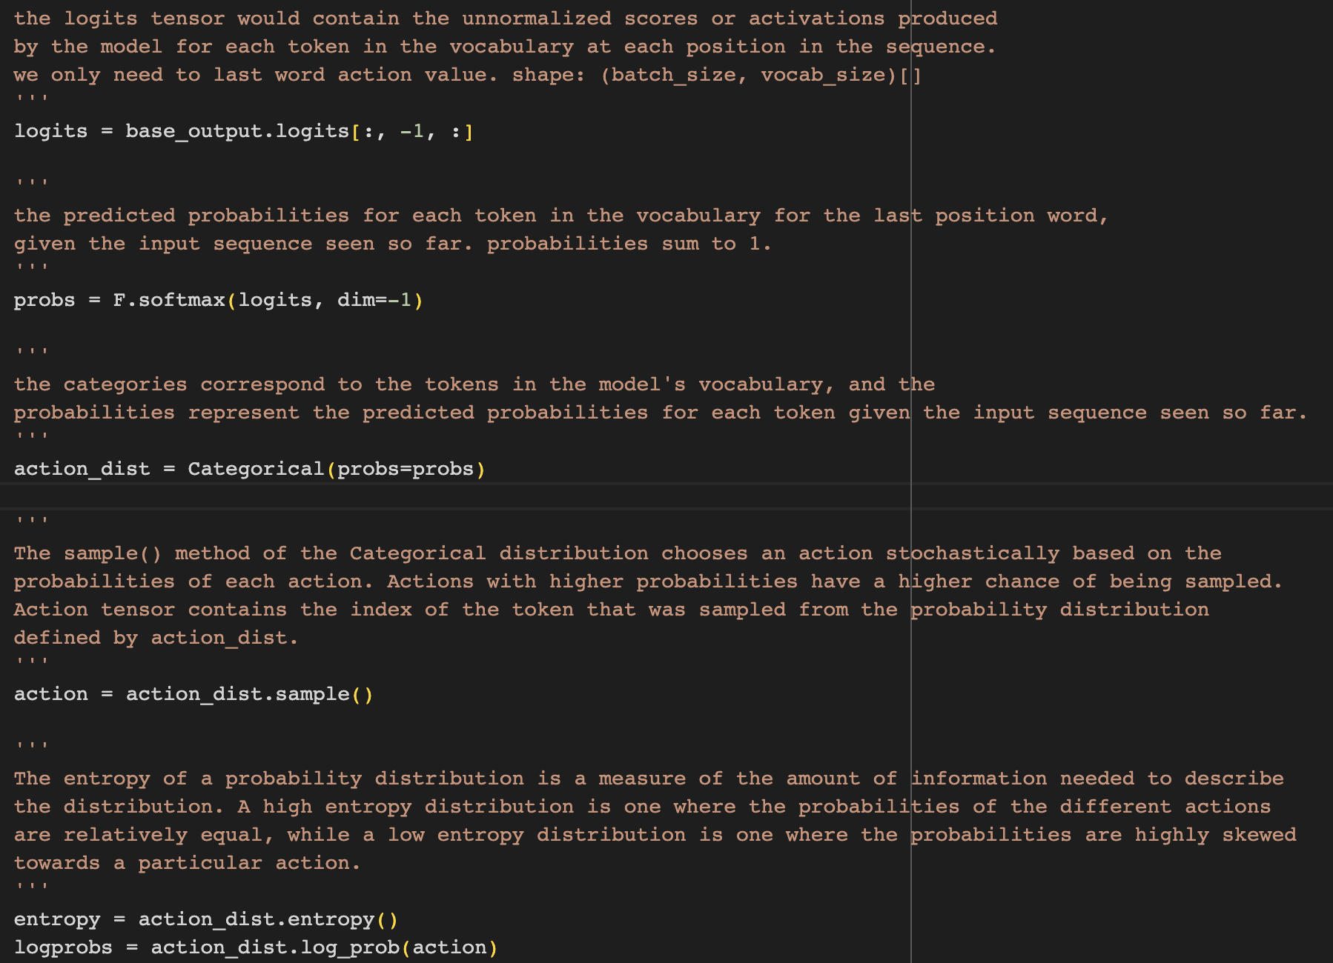
RLHF Trainer – RL Base Model(agent)
Policy Network:
Any auto language model for CausalLM: gpt2
Generate text based on inputs sequence
Probability distribution for last token
Action
Logprobs → PPO loss
Entropy → PPO loss
Value Network:
Custom head
Predict the reward → Advantage
HKUST

Slide 14
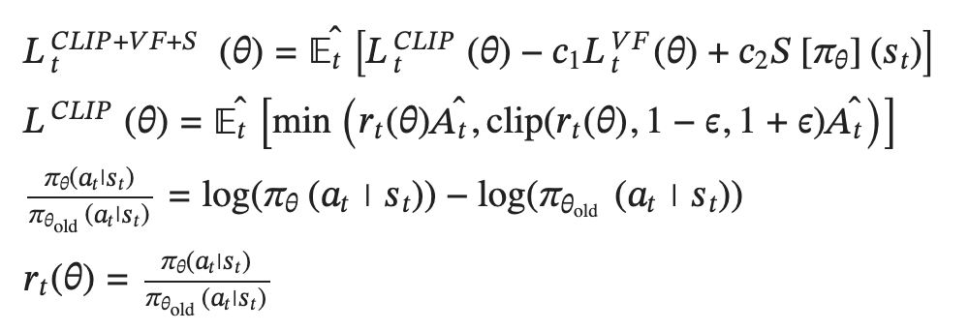
RLHF Trainer - PPO
Clipping:
Limit a value in certain range
Don’t update too much if an action is good
Don’t ignore an action if it is bad
Min: Solve the PG large policy update issue
Subtract model entropy:
encourage the model to generate more diverse and exploratory actions
HKUST

Slide 15
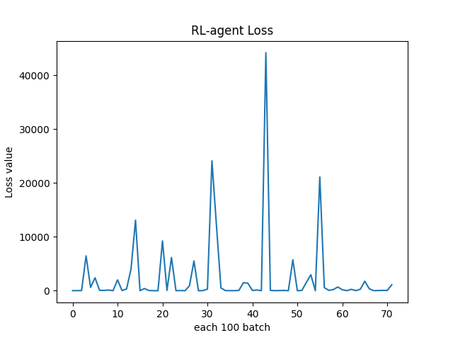
RLHF Trainer - Training
Hyperparameters:
Learning rate: 1e-3
Optimizer: SGD
Number of epochs: 10
Batch size: 4
Number of data used: 10000/25000
Device: RTX 3090 24GB
Base model: gpt2
Tokenzier: gpt2
Loss is not converge
Time: 10hrs
HKUST

Slide 16
Performance and Limitation
HKUST

Slide 17
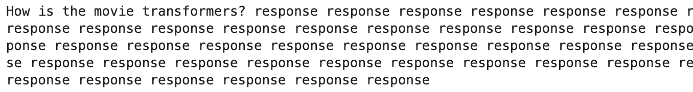
Performance and Limitation
Lack of computing power
10% data for training reward model
40% of data for training RL agent model
Number of epochs too small
Performance
reward model performs poorly
RL agent model gives undesirable output
HKUST

Slide 18
Future Discussion
HKUST

Slide 19
Future Discussion
Possible experiments:
Different base language model
Use different dataset for RLHF Trainer → Different area
Different tasks
HKUST

Slide 20
Reference
Demystifying ChatGPT: A Deep Dive into Reinforcement Learning with Human Feedback: https://bmanikan.medium.com/demystifying-chatgpt-a-deep-dive-into-reinforcement-learning-with-human-feedback-1b695a770014
Reinforcement Learning from Human Feedback, InstructGPT, and ChatGPT: https://medium.com/aiguys/reinforcement-learning-from-human-feedback-instructgpt-and-chatgpt-693d00cb9c58
Training language models to follow instructions with human feedback: https://arxiv.org/abs/2203.02155
Coding PPO from Scratch with PyTorch: https://medium.com/analytics-vidhya/coding-ppo-from-scratch-with-pytorch-part-3-4-82081ea58146
https://www.zhihu.com/zvideo/1608523868355665922
https://github.com/xrsrke/instructGOOSE
https://zhuanlan.zhihu.com/p/111049450
HKUST

Slide 21
END
HKUST

