Slide 1

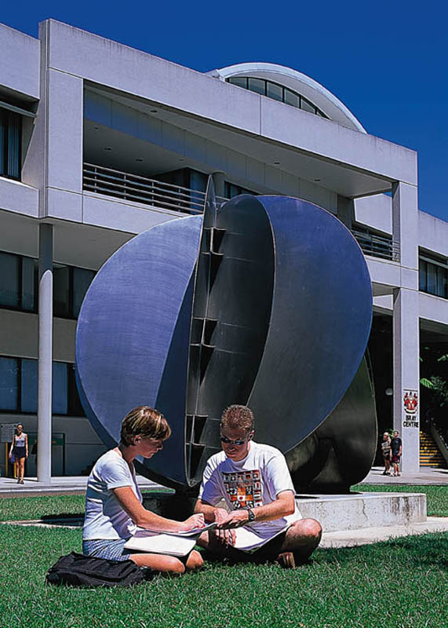
2509ICT Software Engineering
Introduction to
Software Engineering
Professor R.G. Dromey
Dr Larry Wen
School of Information and Communication Technology
Lecture 1
© R.G.Dromey, Griffith University, 2006

Slide 2
Teaching staff
Lecturer
  Dr. Larry Wen (Nathan) Email: l.wen@griffith.edu.au
  → Subject line must contain course code and summary of question, e.g. 2509ICT_NA/GC:Question on behaviour trees
Convenor (Gold Coast)
  Dr Larry Wen
  Email: l.wen@griffith.edu.au
Tutors
  Mr. Kushal Ahmed (Nathan) kushal.ahmed@griffithuni.edu.au
  Mr. Rupam Deb (Gold Coast) rupam.deb@griffithuni.edu.au

Slide 3
Self Introduction
Larry Wen
Tel: 55042
Office: N44 2.39
l.wen@griffith.edu.au

Slide 4
Topics
Introduction
Processes and software life cycle
Modelling languages
Requirement Engineering
Software Design
Software Inspection
Software Testing
Development Methodology
Software Change and Evolution
Formal Method
User Interface

Slide 5
Assessment
Group Assignment 1 (20%)
Group Assignment 2 (20%)
Workshops (20%)
Final Exam (40%)

Slide 6
Secret to be successful
First - forget your past academic performance - good or bad
What you ACHIEVE this semester will be largely determined by what you DO this semester not by what you have done in the past
You will need to be involved and committed for the whole semester
You will need to have a goal for what you want to achieve.
You will need to put effective effort into the subject on a weekly basis no matter what else happens in your life

Slide 7
Secret to be successful 2
Attend and be involved in all lectures and workshops
Plan how you are going to spend your time each day and each week and stick to that plan no matter what. This is easy to say but much harder to do.
Do plenty of extra reading/note-taking on key topics. Use your lecture notes only as a guide or a summary on each topic. Do the problems.
Do the workshop sheets and make sure you understand them. Ask your tutor questions when you don't understand.
Put a big effort into each of the assignments over the whole three weeks. Get organized and don't bludge on others.

Slide 8
Time Management
“Unless time is managed,
everything else is
Impossible”
--- Peter Drucker

Slide 9
Time Management
“Your future depends on
Every day that passes”
--- J.D.Rockefellar
Never waste a single day!

Slide 10
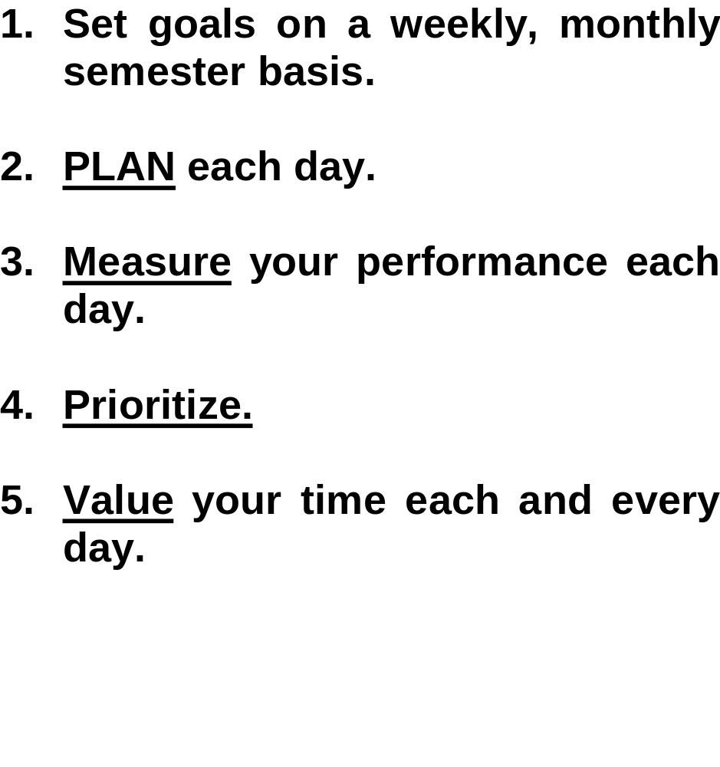
Time Management
Time Management

Slide 11
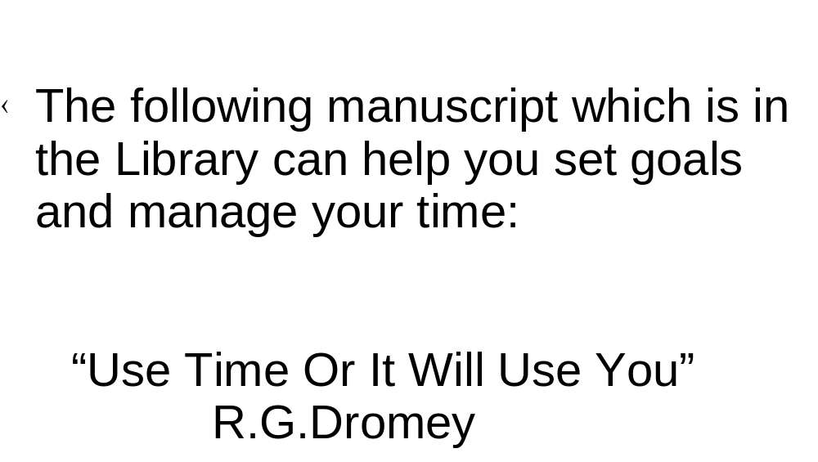
Time Management

Slide 12
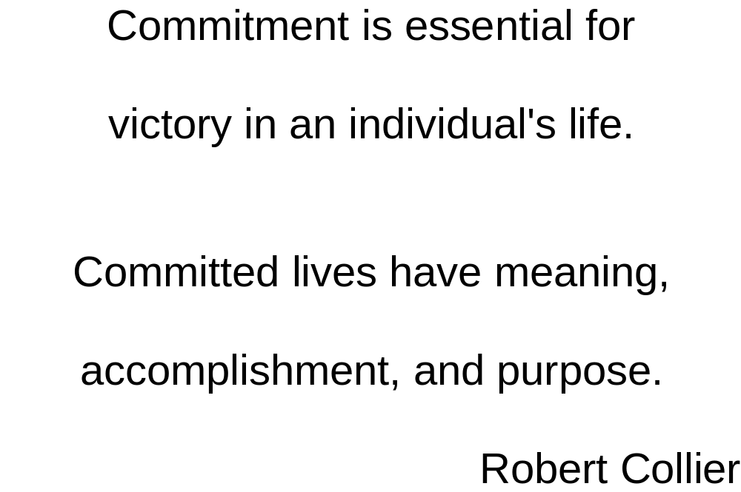
Something to Reflect On

Slide 13
Fundamental Questions

Slide 14
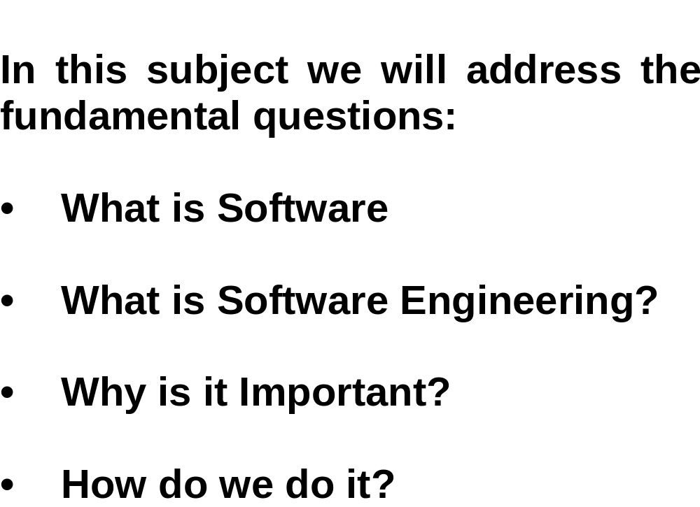
Fundamental Questions

Slide 15
What is Software?
Software is:
instructions (computer programs) that when executed provide desired features, function, and performance;
data structures that enable the programs to adequately manipulate information and
documentation that describes the operation and use of the programs.

Slide 16
Software is special
Software is developed or engineered, it is not manufactured in the classical sense.
Software doesn't "wear out."
Although the industry is moving toward component-based construction, most software continues to be custom-built.

Slide 17

Wear vs. Deterioration

Slide 18
Software Applications
system software
application software
engineering/scientific software
embedded software
product-line software
WebApps (Web applications)
AI software

Slide 19
Software—New Categories
Open world computing—pervasive, distributed computing
Ubiquitous computing—wireless networks
Netsourcing—the Web as a computing engine
Open source—”free” source code open to the computing community (a blessing, but also a potential curse!)
Also …
  Data mining
  Grid computing
  Cognitive machines
  Software for nanotechnologies

Slide 20
What is Engineering?

Slide 21
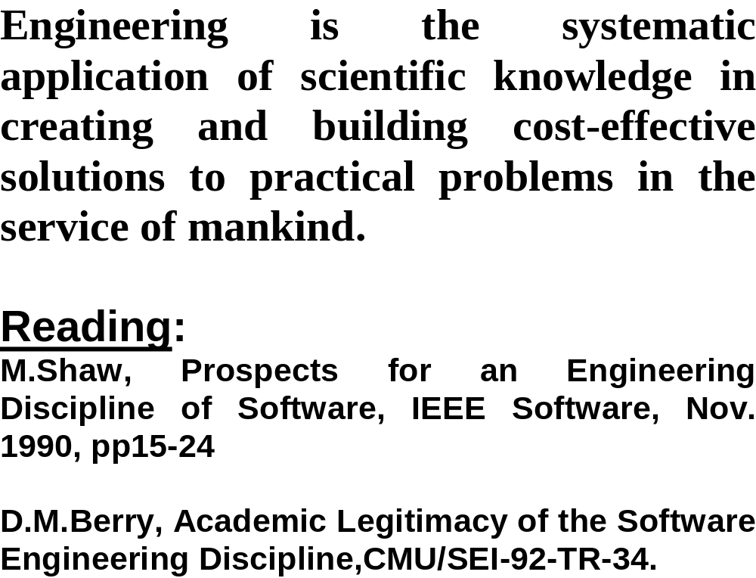
What is Engineering?

Slide 22
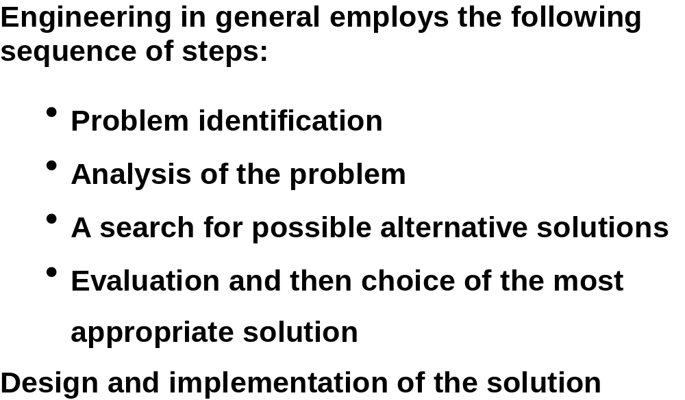
What Sets Engineering Apart From Other Disciplines

Slide 23
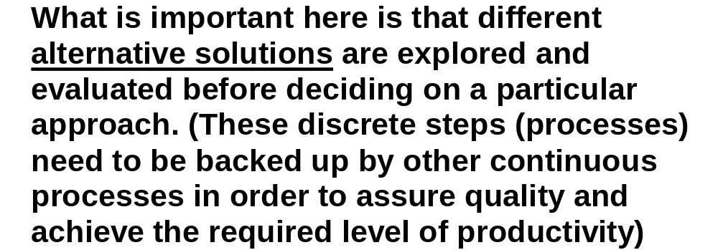
What Sets Engineering Apart From Other Disciplines

Slide 24
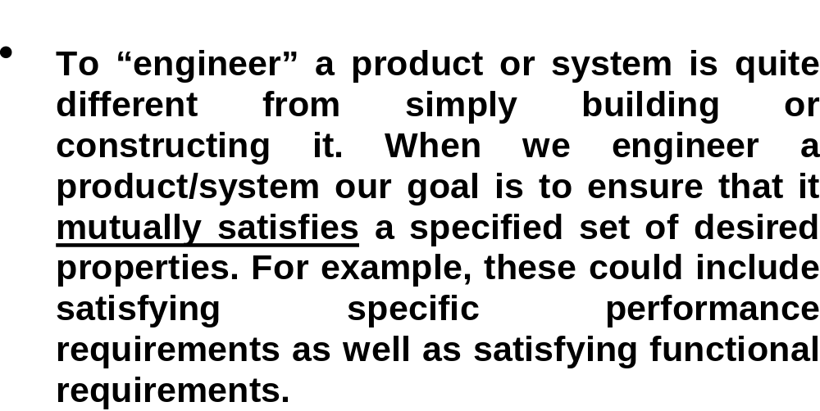
What Sets Engineering Apart From Other Disciplines

Slide 25
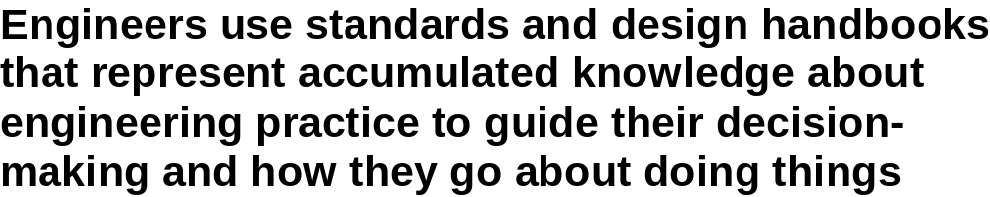
What Sets Engineering Apart From Other Disciplines

Slide 26
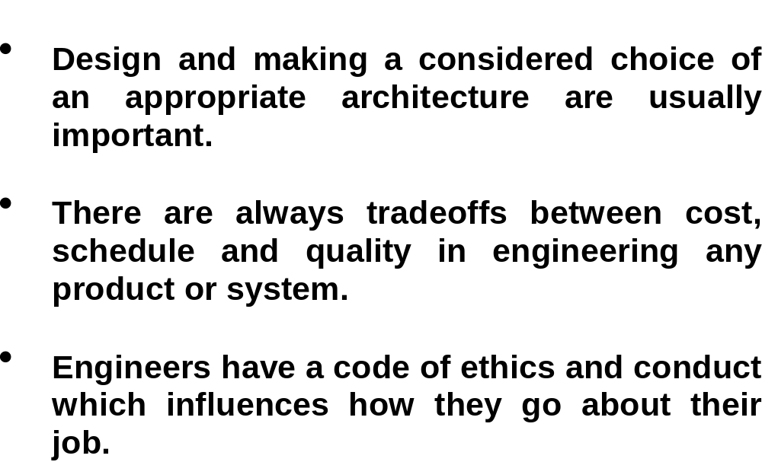
What Sets Engineering Apart From Other Disciplines

Slide 27
What is
Software Engineering?

Slide 28
Software Engineering
Some realities:
  a concerted effort should be made to understand the problem before a software solution is developed
  design becomes a pivotal activity
  software should exhibit high quality
  software should be maintainable
The seminal definition:
  [Software engineering is] the establishment and use of sound engineering principles in order to obtain economically software that is reliable and works efficiently on real machines.

Slide 29
Software Engineering
The IEEE definition:
  Software Engineering: (1) The application of a systematic, disciplined, quantifiable approach to the development, operation, and maintenance of software; that is, the application of engineering to software. (2) The study of approaches as in (1).

Slide 30
A Layered Technology
tools
methods
process model
a “quality” focus
Software Engineering

Slide 31
What is Software Engineering
Software engineering
  consists of a body of knowledge,
    defined processes,
    practices,
    tools and
    standards
  that are used by project teams
    to manage the development of,
    to specify, design, implement, verify, test
    and maintain
  large software systems
    of high quality that are
    produced cost effectively,
    on schedule
  to satisfy a set of defined, or evolving, user-requirements.

Slide 32
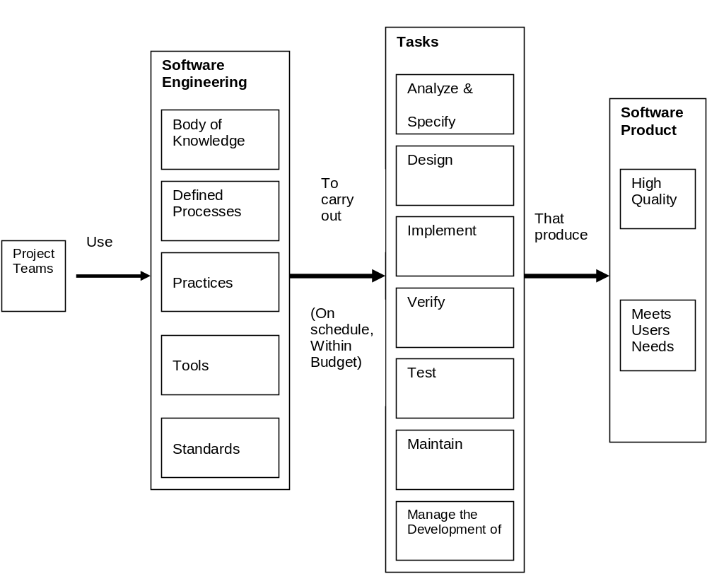
What is Software Engineering?

Slide 33
Why is
Software Engineering
Important?

Slide 34
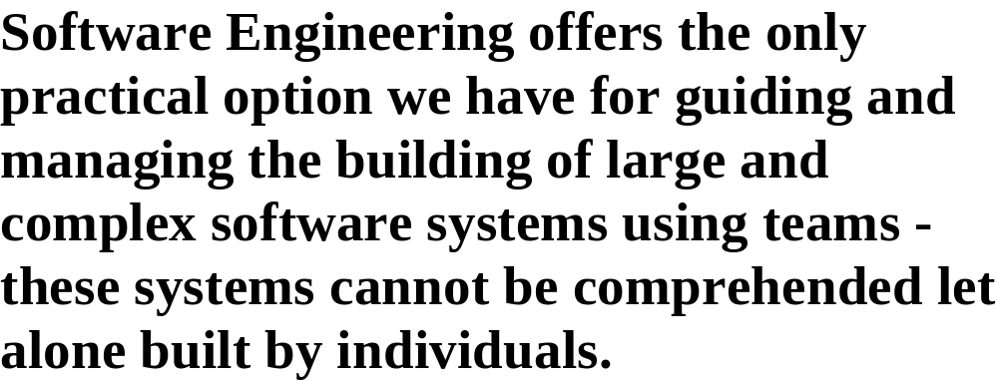
Why is Software Engineering Important ?
NO VIABLE ALTERNATIVE

Slide 35
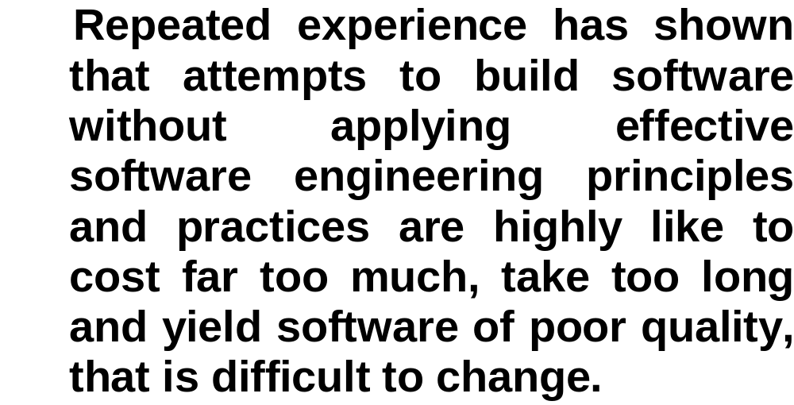
Why is Software Engineering Important ?
ALTERNATIVES – Poor Outcomes

Slide 36
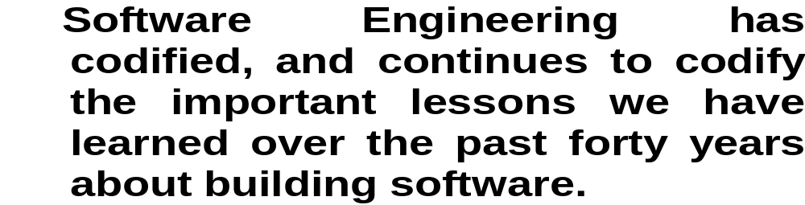
Why is Software Engineering Important ?
Accumulated Experience

Slide 37
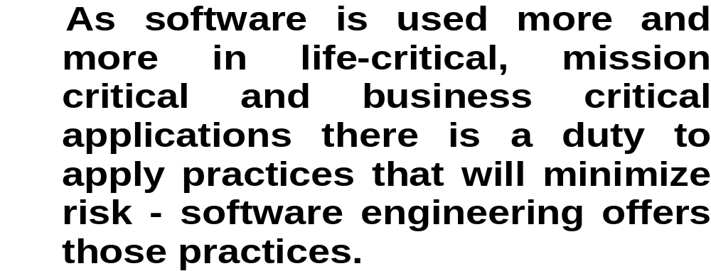
Why is Software Engineering Important ?
Social Responsibility

Slide 38
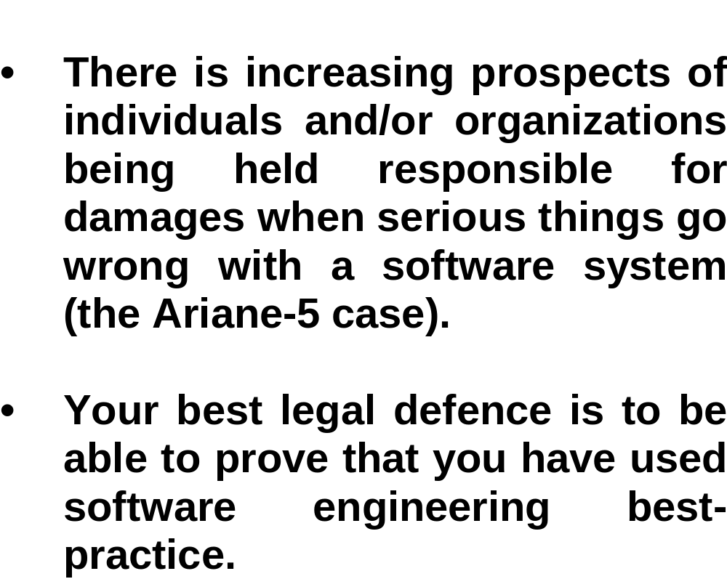
Why is Software Engineering Important ?
Legal Responsibility

Slide 39
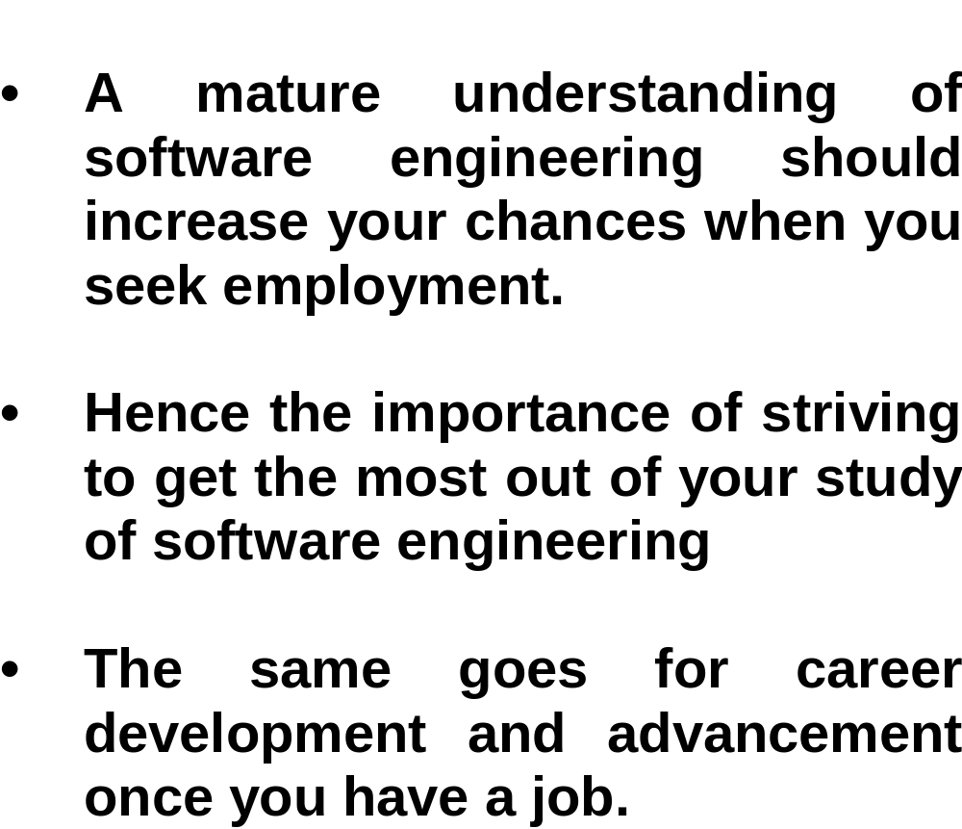
Why is Software Engineering Important ?
Employment and Career Advancement

Slide 40
Software Engineering’s
Biggest Challenges

Slide 41
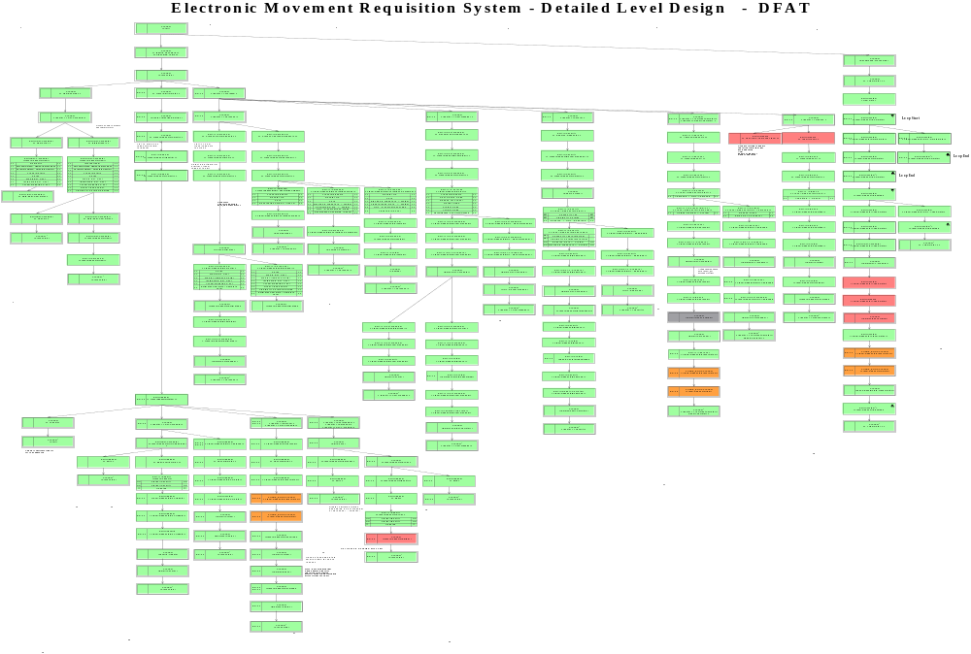
Large Systems

Slide 42
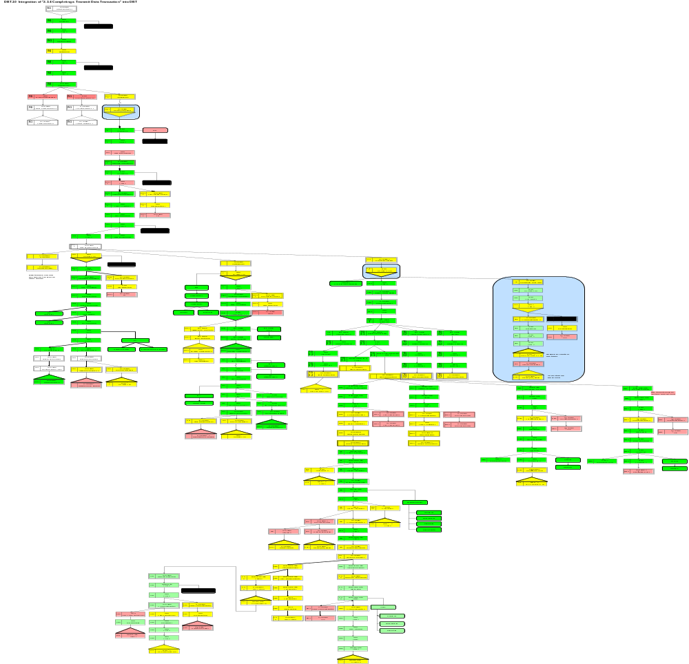
Large System
Satellite Control
System

Slide 43
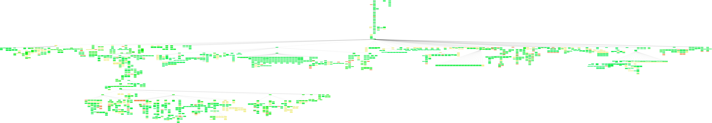
Part of Integrated Behavior of a Large System

Slide 44
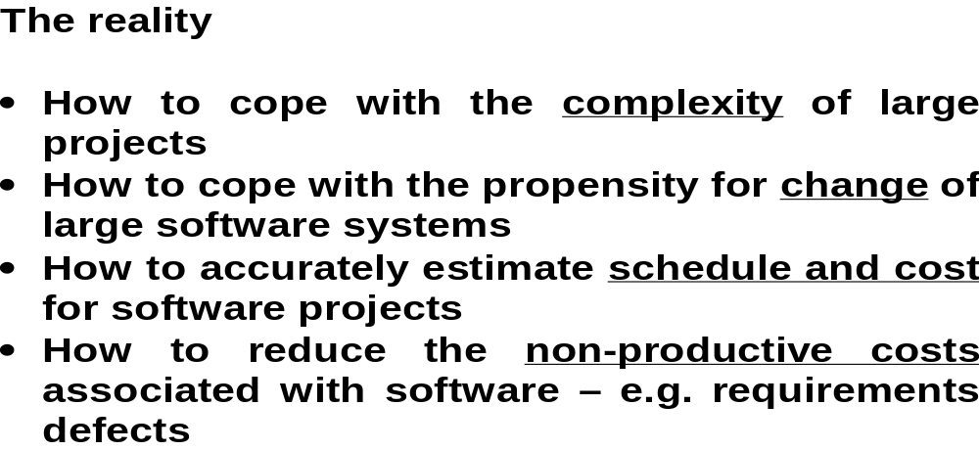
Software Engineering’s Biggest Challenges

Slide 45
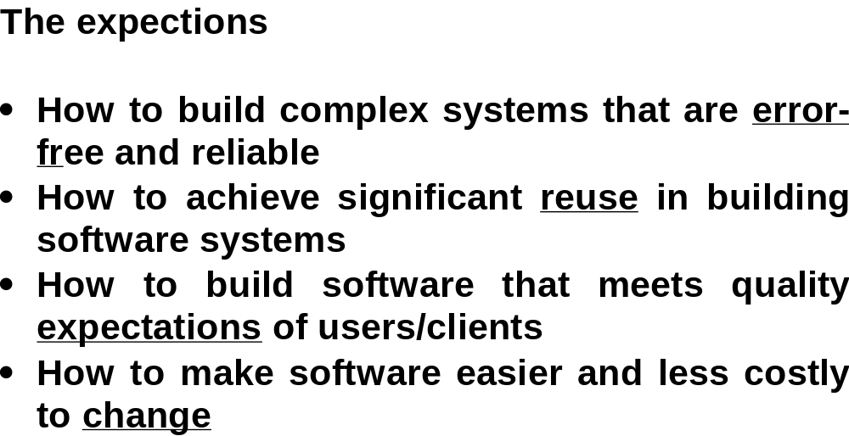
Software Engineering’s Biggest Challenges

Slide 46
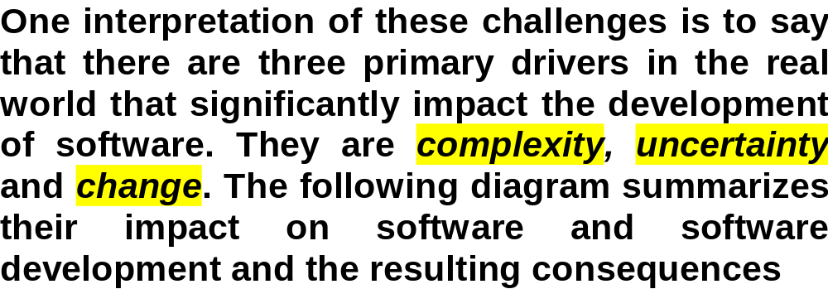
Software Engineering’s Biggest Challenges

Slide 47
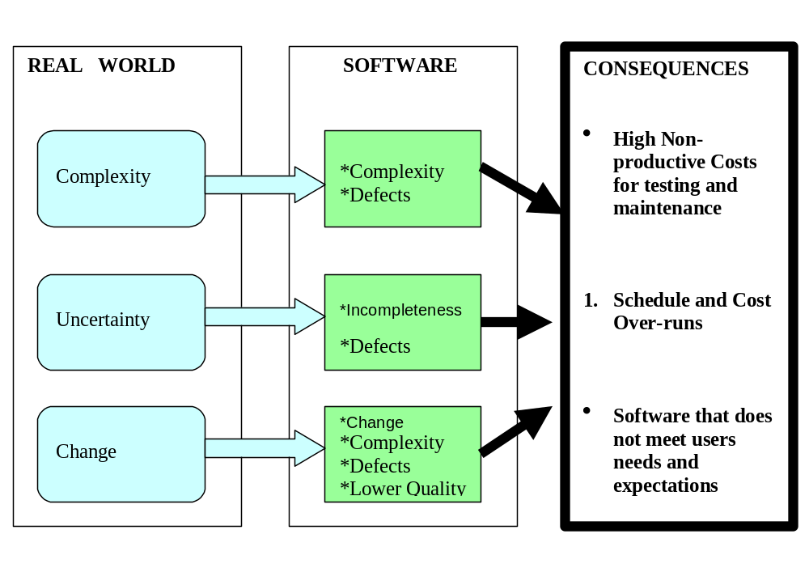
Software Engineering’s Biggest Challenges

Slide 48
How do we practice Software Engineering?

Slide 49
How do we Practice Software Engineering?
By using a phased or staged life-cycle model to guide development based on the steps of
  eliciting user requirements,
  specifying functional and quality requirements,
  undertaking a modular architectural design
    that identifies the high level modules and their interfaces.
  From the architectural design, detailed design
  and then implementation
  and testing follow.
  At each stage rigorous inspection needs to be undertaken.

Slide 50
What does good
Software Engineering
Practice Entail?

Slide 51
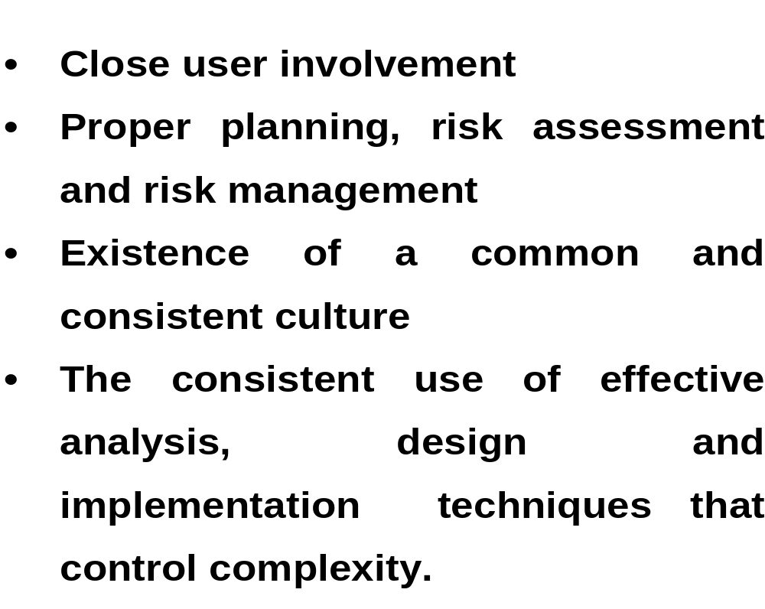
Good Software Engineering Practice

Slide 52
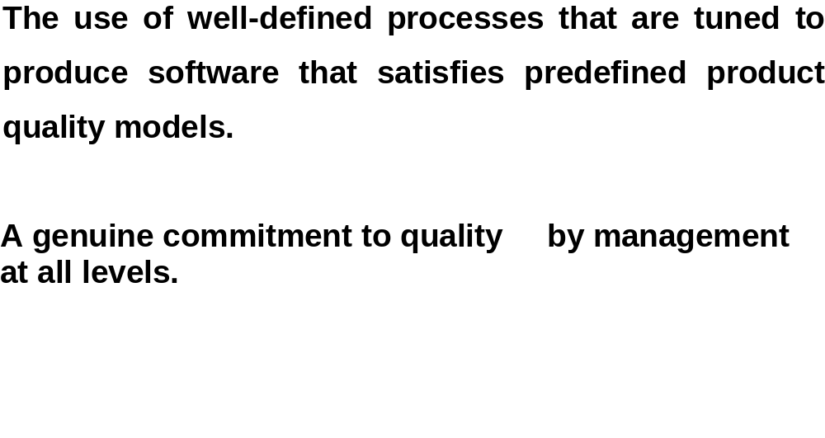
Good Software Engineering Practice

Slide 53
Summary
What is engineering?
What is software engineering?
Why it is important?
Who need to study software engineering?
What is the outcome of software engineering?
What tasks are included in software engineering practice?
List the biggest challenges of software engineering
How do we practice software engineering?

