Slide 1


2509ICT Software Engineering
Requirements Engineering
Professor R.G. Dromey
Roger S. Pressman
School of Information and Communication Technology
Lecture 5

Slide 2
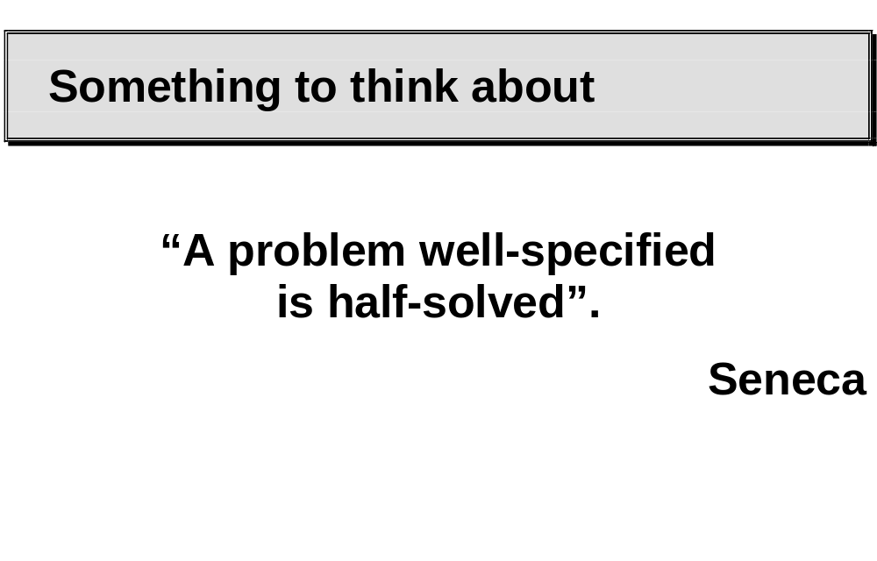

Slide 3
Discussion
Why requirements are important

Slide 4
Topics of this week
Requirements
Requirement Engineering
Software Requirement Specification (SRS)

Slide 5
Requirements

Slide 6
Form of Requirements
There are only two fundamental kinds of requirements:
  (functional requirements) those that express functionality, and
  (non-functional requirements) those that express constraints or relations

Slide 7
Functional Requirements
Functional requirements specify which outputs should be produced from given inputs
  They describe the relationship between the input and output for a system
  For each functional requirement, a detailed description of all the data inputs and their source, the units of measure, and the range of valid inputs must be specified
  All the operations to be performed on the input to obtain the output should be specified
  This includes specifying validity checks on input and output data
  Must specify system behaviour in abnormal situations e.g. airline reservations - fully booked situation

Slide 8
Performance Requirements
Static and dynamic performance requirements.
  Static requirements
    do not impose constraints on the execution characteristics of a system
    These are capacity requirements like number of terminals, number of simultaneous users, number of files and their sizes.
  Dynamic requirements
    specify constraints on the execution behaviour of the system. These typically include response time and throughput constraints.
    Acceptable ranges for the different performance parameters should be specified.
    These should be stated in measurable terms

Slide 9
Design Constrains
Many of them are also called quality attributes
There are factors present in the client's environment that may affect the choices of the designer, e.g.:
  standards that must be followed
  resource limits
  operating environment
  hardware requirements
  reliability requirements
  security requirements
  policy issues

Slide 10
External Interface Requirements
All possible interactions of the software with people, hardware and other software should be clearly specified
The user interface characteristics for each screen should be specified.
It can be helpful to create a preliminary user manual containing all user commands, screen formats and explanations of how the system will appear to the user including feedback and error messages
For hardware interface requirements the SRS should specify the logical characteristics of each interface between software and hardware components.
All hardware characteristics including memory restrictions should be given
The interfaces with all other software should also be specified

Slide 11
Quality of Requirements
Most software defects are related to problems in the requirements
To fix problems in the requirement analysis stage is much cheaper than to fix in the later stage.
A focus on the quality of requirements has the potential to yield very significant payoffs in terms of improving the quality of software.
QUESTION:
  What is the Purpose of Requirements?
Requirements are used to guide the development of a software system.
Their purpose is to indicate to the developer what functionality, under what particular constraints is required by the user.

Slide 12
Problems with requirements
Potential high-level problems are:
  users do not know what they want,
  users know what they want but they are unable to express it,
  users know what they want but it is inappropriate
    Example (lottery problem)
  the software engineer misunderstands what is wanted,
  the true needs for situation will only manifest themselves once the system has been installed

Slide 13
Quality of Requirements
In assessing a set of requirements two things are at issue:
  the quality of individual requirements
  the quality of the set of requirements

Slide 14
Individual Requirement Quality
The potential deficiencies (and hence quality problems) associated with individual requirements are:
  The input, output, constraints used to define variables and their domains are incomplete or inaccurate or ambiguous.
  the relationships defined among variables are either too weak or too strong. (for example: valid input, y2k)

Slide 15
Set Requirements Quality
There are potentially two kinds of problems with a set of requirements:
  the set is incomplete in terms of the defined functionality
  there is inconsistency, incompatibility or conflict among the set of requirements. Redundancy.
For other than small closed problems it is often very difficult to guarantee that a system has all the desired functionality

Slide 16
Requirement Engineering

Slide 17
Definition
REQUIREMENTS ENGINEERING
  is the disciplined application of
    proven,
    principles,
    methods,
    tools,
    and notations
  to describe a proposed system's
    intended behaviour
    and its associated constraints.

Slide 18
Traditions
Over the past 20 years understanding of how to write relatively unambiguous, complete and consistent specifications has improved. However this ideal is seldom realized
The dominating state of practice is that requirements engineering produces one large document written in natural language

Slide 19
Process
The quality of software is only as good as the process that creates it.
Requirements is a crucial step in software development but one in which the state-of-practice is often a long way from the state-of-the-art.

Slide 20
Requirements Engineering-I
Inception—ask a set of questions that establish …
  basic understanding of the problem
  the people who want a solution
  the nature of the solution that is desired, and
  the effectiveness of preliminary communication and collaboration between the customer and the developer
Elicitation—elicit requirements from all stakeholders
Elaboration—create an analysis model that identifies data, function and behavioral requirements
Negotiation—agree on a deliverable system that is realistic for developers and customers

Slide 21
Requirements Engineering-II
Specification—can be any one (or more) of the following:
  A written document
  A set of models
  A formal mathematical
  A collection of user scenarios (use-cases)
  A prototype
Validation—a review mechanism that looks for
  errors in content or interpretation
  areas where clarification may be required
  missing information
  inconsistencies (a major problem when large products or systems are engineered)
  conflicting or unrealistic (unachievable) requirements.
Requirements management

Slide 22
Inception
Identify stakeholders
  “who else do you think I should talk to?”
Recognize multiple points of view
Work toward collaboration
The first questions
  Who is behind the request for this work?
  Who will use the solution?
  What will be the economic benefit of a successful solution
  Is there another source for the solution that you need?

Slide 23
Eliciting Requirements
meetings are conducted and attended by both software engineers and customers
rules for preparation and participation are established
an agenda is suggested
a "facilitator" (can be a customer, a developer, or an outsider) controls the meeting
a "definition mechanism" (can be work sheets, flip charts, or wall stickers or an electronic bulletin board, chat room or virtual forum) is used
the goal is
  to identify the problem
  propose elements of the solution
  negotiate different approaches, and
  specify a preliminary set of solution requirements

Slide 24
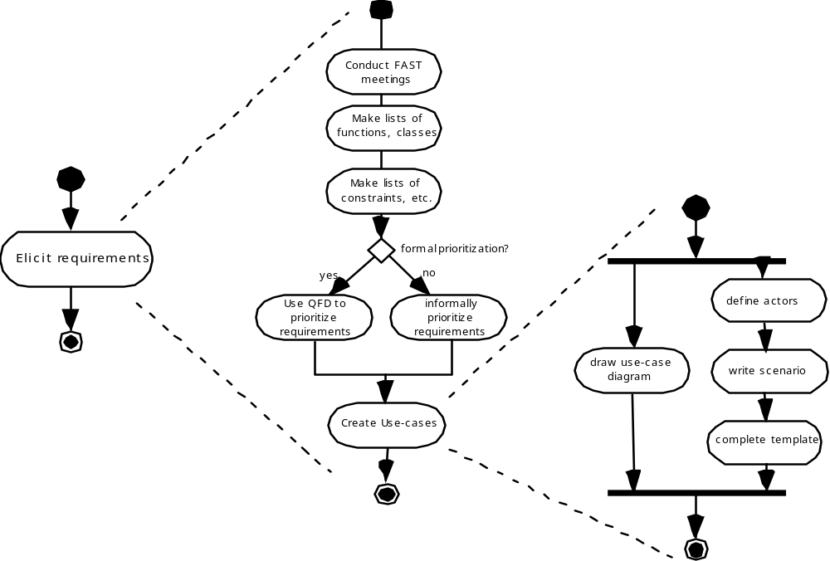
Eliciting Requirements

Slide 25
Quality Function Deployment
Function deployment determines the “value” (as perceived by the customer) of each function required of the system
Information deployment identifies data objects and events
Task deployment examines the behavior of the system
Value analysis determines the relative priority of requirements

Slide 26
Require Elaboration - Building the Analysis Model
UML
  Scenario-based elements
    Functional—processing narratives for software functions
    Use-case—descriptions of the interaction between an “actor” and the system
  Class-based elements
  Behavioral elements
  Flow-oriented elements
Behavior engineering
  Behavior Trees
  Composition Trees

Slide 27
Negotiating Requirements
Identify the key stakeholders
  These are the people who will be involved in the negotiation
Determine each of the stakeholders “win conditions”
  Win conditions are not always obvious
  For example: bonus report
Negotiate
  Work toward a set of requirements that lead to “win-win”

Slide 28
Validating Requirements - I
Is each requirement consistent with the overall objective for the system/product? For example security.
Have all requirements been specified at the proper level of abstraction? That is, do some requirements provide a level of technical detail that is inappropriate at this stage?
Is the requirement really necessary or does it represent an add-on feature that may not be essential to the objective of the system?
Is each requirement bounded and unambiguous?
Does each requirement have attribution? That is, is a source (generally, a specific individual) noted for each requirement?
Do any requirements conflict with other requirements?

Slide 29
Validating Requirements - II
Is each requirement achievable in the technical environment that will house the system or product?
Is each requirement testable, once implemented?
Does the requirements model properly reflect the information, function and behavior of the system to be built.
Has the requirements model been “partitioned” in a way that exposes progressively more detailed information about the system.
Have requirements patterns been used to simplify the requirements model. Have all patterns been properly validated? Are all patterns consistent with customer requirements?

Slide 30
Software Requirement Specification (SRS)

Slide 31
SRS
A requirements specification must treat a system as a black-box. It must delineate:
  inputs and outputs
  functional requirements that show external behaviour in terms of I/O and their relationships
  nonfunctional requirements and their constraints including performance, portability and reliability

Slide 32
Purpose of SRS
A requirements specification should be understandable by:
  users, customers
  Designers and developers
  testers
  and capable of serving as a basis for both design and test.

Slide 33
SRS phases
Two phases:
  problem or requirements analysis
  requirements specification
The first step is harder, it deals with understanding
  The problem,
  the goals and
  the constraints
In the second part the focus is upon clearly specifying what has been discovered during analysis
  Issues such as
    representation,
    specification languages
    and tools
    and checking the specification are considered during this step
The requirements phase terminates with the production of a validated requirements specification document

Slide 34
Benefit of good SRS
Establishes the basis for agreement between client and supplier on what the software product will do.
Reduces the development cost. It forces rigorous specification of requirements before the design begins.
Careful development of an SRS can reveal defects such as omissions, inconsistencies and misunderstandings.
The SRS provides a reference for the validation of the final product. It assists the client in determining whether the software meets the requirements.

Slide 35
SRS should include
a complete information description
a detailed functional description
performance requirements
design constraints
appropriate validation criteria

Slide 36
IEEE 830 - Software Requirements Specification
The standard is divided into three main sections:
  Introduction
  General description
  Specific Requirements

Slide 37
IEEE 830
Introduction.
  This section contains an overview of the complete SRS document. It consists of:
    Purpose
    Scope
    Definitions, acronyms, abbreviations
    References
    Overview

Slide 38
IEEE 830
General Description
  Contains a general description of matters that concern the overall product and its requirements.
  It provides a perspective for understanding the specific requirements documented in section 3 of the SRS.
    Product Perspective
    Product Functions
    User Characteristics
    General Constraints
    Assumptions and dependencies
  This section answers questions such as is the product an independent product or part of a larger product.
  It identifies hardware to be used and provides an overview of the functionality.

Slide 39
IEEE 830
Specific Requirements
  This section contains all the details that are relevant for the design phase. Specific things covered in this phase are:
    Each functional requirement
    External Interface requirements
    Performance requirements
    Design Constraints
    Attributes
    Other requirements
  For functional requirements the standard advises Inputs, Processing, Outputs be covered
  For external interfaces these should cover User interfaces, and hardware, Software and Communication interfaces.

Slide 40
Essential Characteristics of an SRS
Understandability is crucial for the SRS document. It must be something on which the client, users and developers can agree and approve.
An SRS is unambiguous if every statement has one and only one interpretation.
An SRS is consistent if there is no requirement that conflicts with another.

Slide 41
Essential Characteristics of an SRS
An SRS is complete if everything the software is supposed to do is specified in the SRS.
A requirement is verifiable if their exists a cost-effective process that can check if the final software meets that requirement
An SRS is traceable if the origin of each of its requirements is clear and it facilitates the referencing of each requirement in future development stages

Slide 42
Summary
What are the different types of requirements? What are the properties of those different types of requirements?
What are reasons for poor requirements?
What are the common requirement defects?
Requirement engineering and the process model
What feasibility issues should be addressed when doing the feasibility study?
What is requirements engineering and what activities does it usually include?
Describe two activities during requirements specification phase.
Be familiar to IEEE Standard 830 Software Requirements Specification
What are the characteristics of an SRS?

