Slide 1

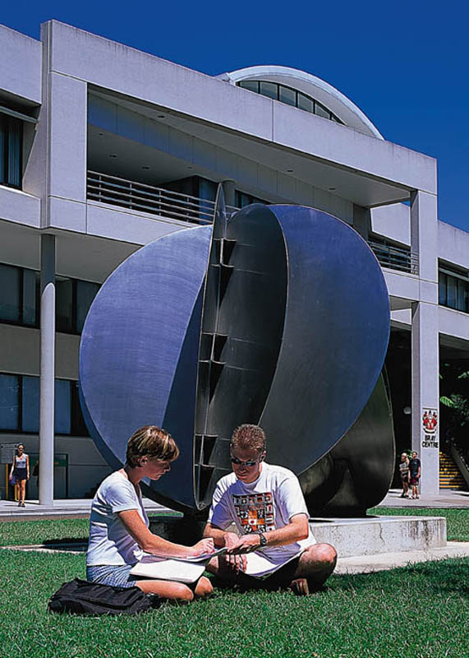
2509ICT Software Engineering
Software Processes
Professor R.G. Dromey
Dr. Larry Wen
School of Information and Communication Technology
Lecture 2
© R.G.Dromey, Griffith University, 2006

Slide 2
Software Process
What is process?
What is software process?
Why software process?

Slide 3
Process
Input
A series activities (tasks)
Output

Slide 4
Software process
A process to build software
What is input?
What are activities
What is the output

Slide 5
Why software process
Scale and complexity
The qualities
The budgets
etc

Slide 6
Software process model
An abstract and formal representation of development processes which
  specifies how the activities are to be organized.
A process model is intended to address the
  What shall we do next?
  How long shall we continue to do it?

Slide 7
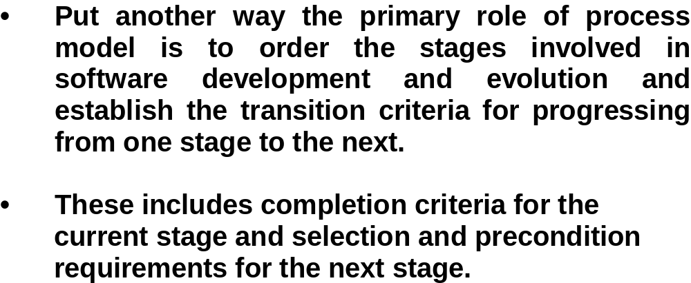
Process Models

Slide 8
Software Process model
Provide underline principle
Quality of the product
Development is under control
Different levels of process model

Slide 9
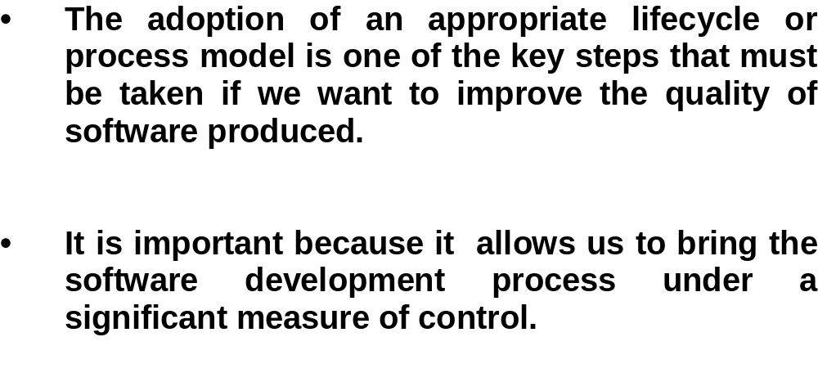
Process Models

Slide 10
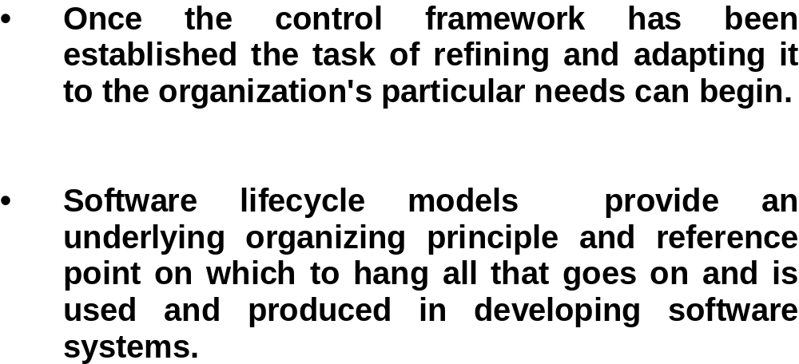
Process Models

Slide 11
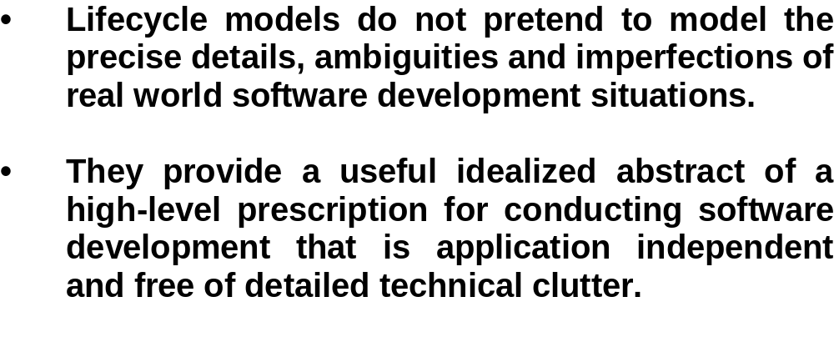
Process Models

Slide 12
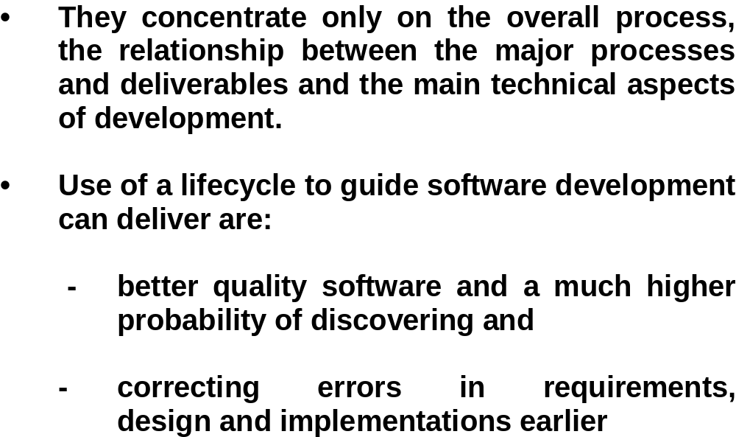
Process Models

Slide 13
Standard
ISO/IEC 12207
  Information technology—Software life cycle processes
  5 Primary life cycle processes
    5.1 Acquisition process
    5.2 Supply process
    5.3 Development process
    5.4 Operation process
    5.5 Maintenance process
  6 Supporting life cycle processes
    6.1 Documentation process
    6.2 Configuration management process
    6.3 Quality assurance process
    6.4 Verification process
    6.5 Validation process
    6.6 Joint review process
    6.7 Audit process
    6.8 Problem resolution process
  7 Organizational life cycle processes
    7.1 Management process
    7.2 Infrastructure process
    7.3 Improvement process
    7.4 Training process

Slide 14
ISO/IEC 12207
5.3.1.1 If not stipulated in the contract, the developer shall define or select a software life cycle model appropriate to the scope, magnitude, and complexity of the project. The activities and tasks of the Development Process shall be selected and mapped onto the life cycle model.

Slide 15
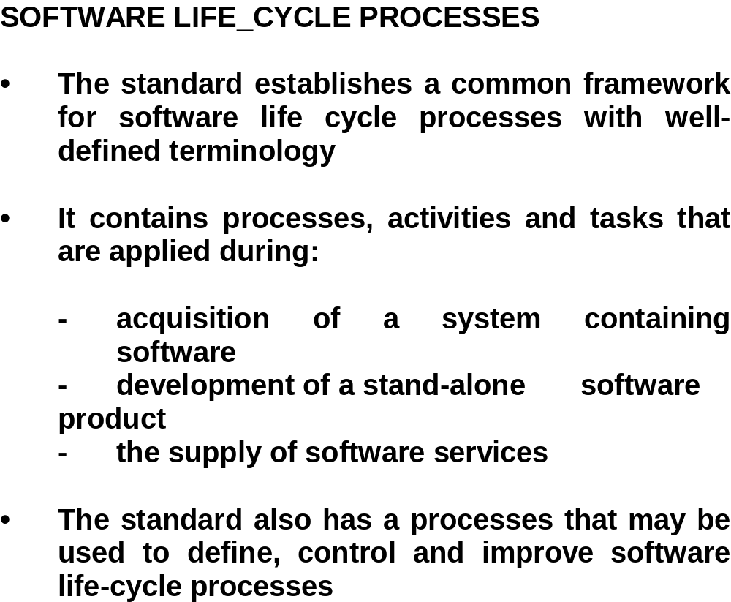
Standard ISO/IEC 12207

Slide 16
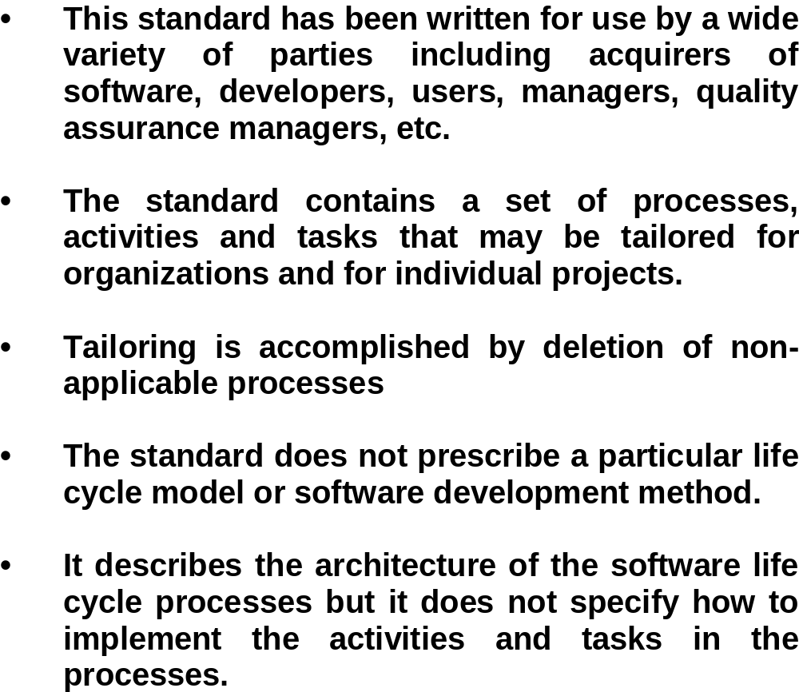
Standard ISO/IEC 12207

Slide 17
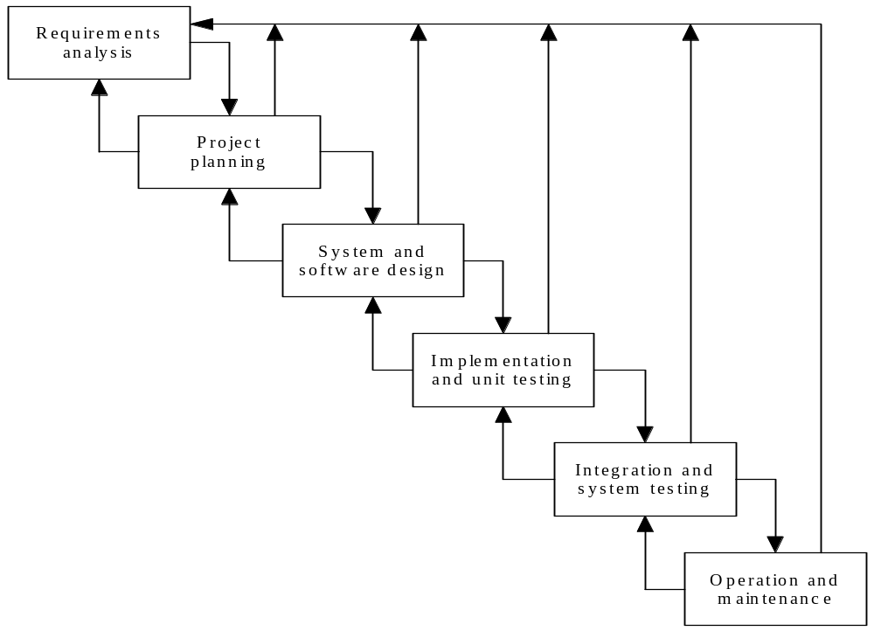
Waterfall Model

Slide 18
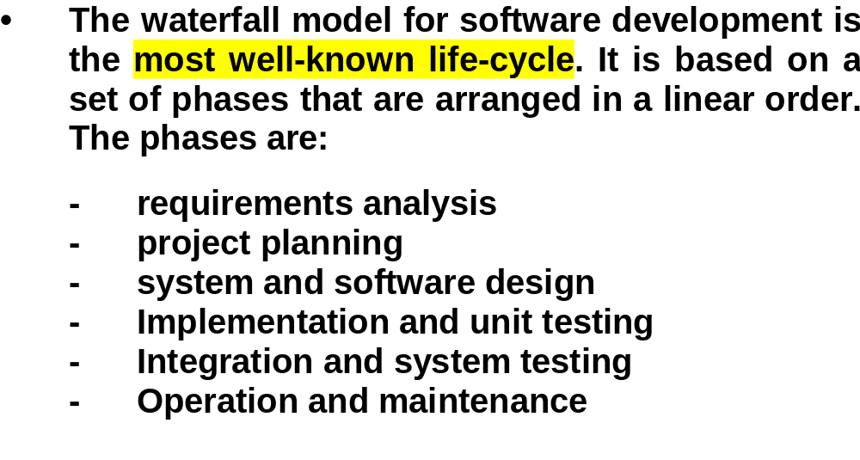
Waterfall Model
The following Web Resource gives a good introduction
http://courses.cs.vt.edu/csonline/SE/Lessons/Waterfall/index.html

Slide 19
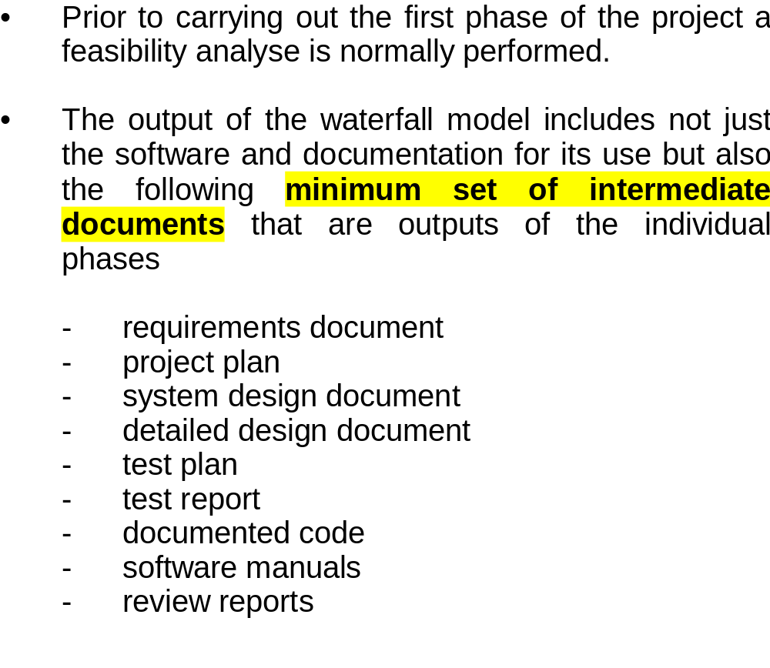
Waterfall Model

Slide 20
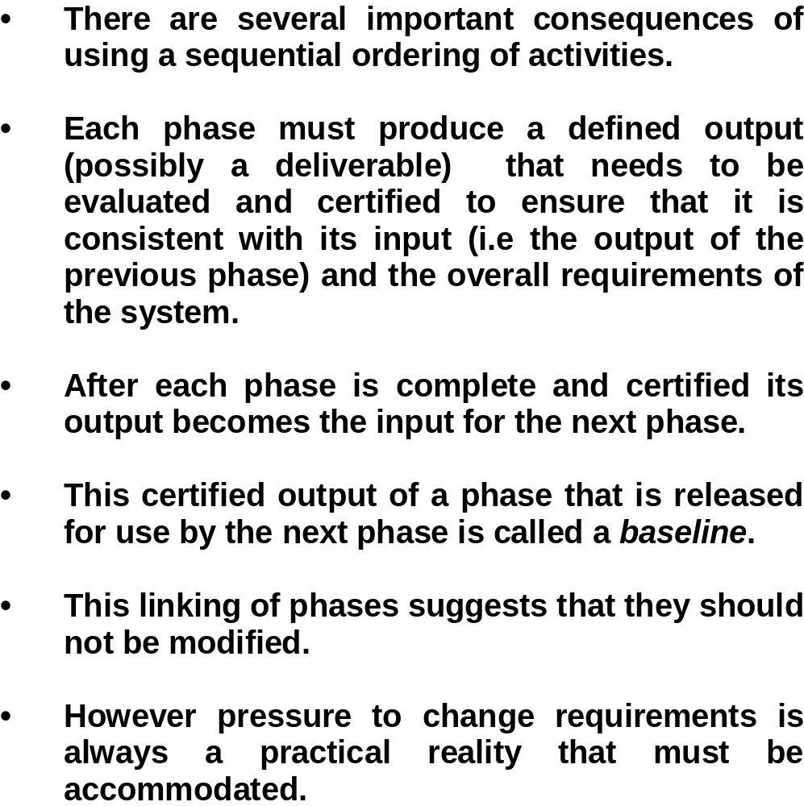
Waterfall Model

Slide 21
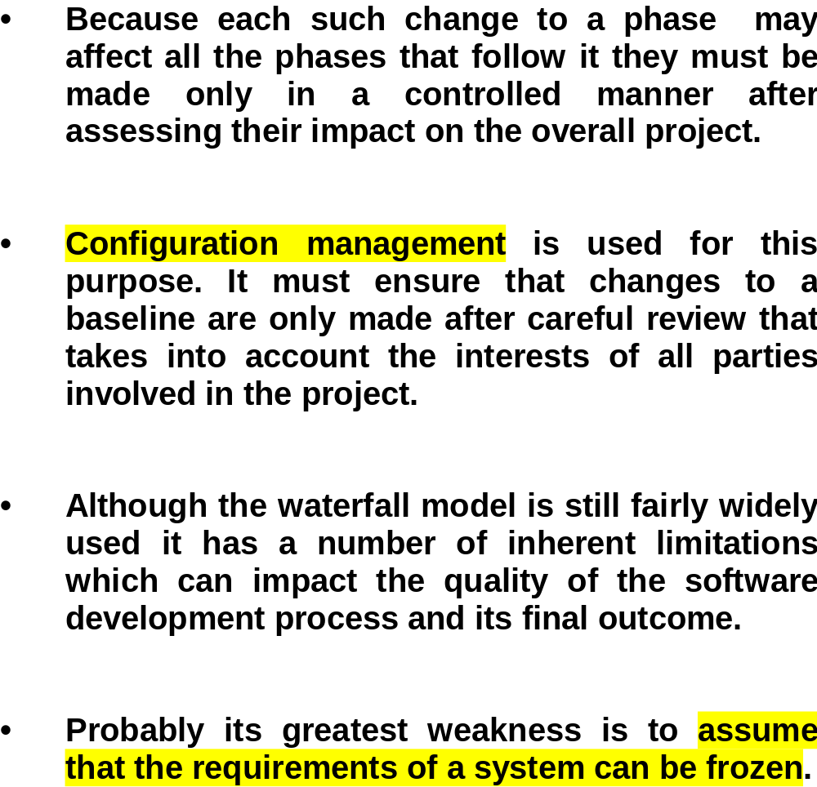
Waterfall Model

Slide 22
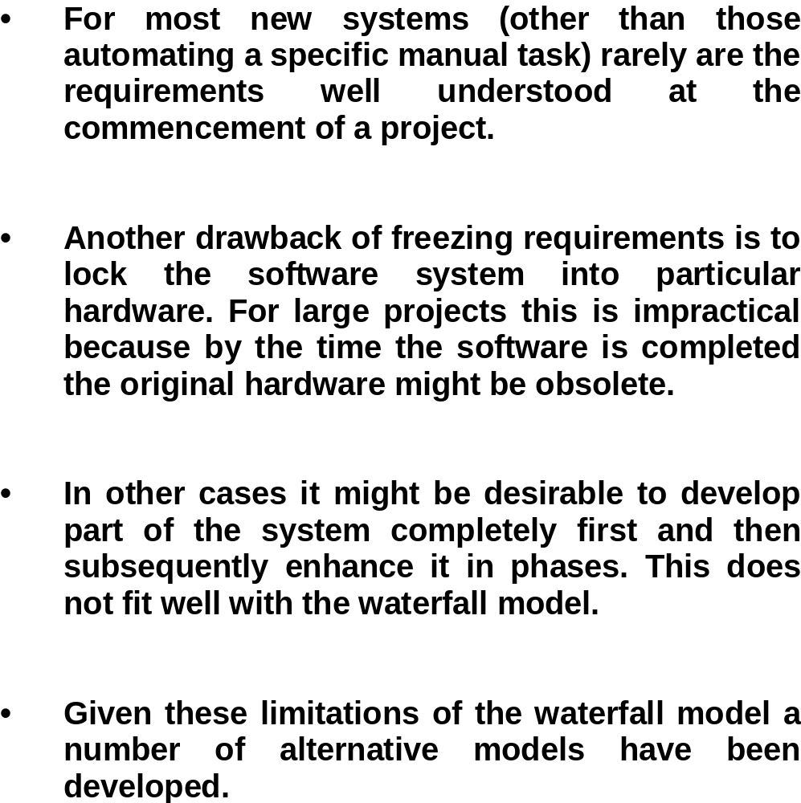
Waterfall Model

Slide 23
Comments on waterfall model
Document driven
Assume that the requirements are frozen
Has a very bad reputation
Still used in many projects
How about your assignment?
The concepts is the base for other models

Slide 24
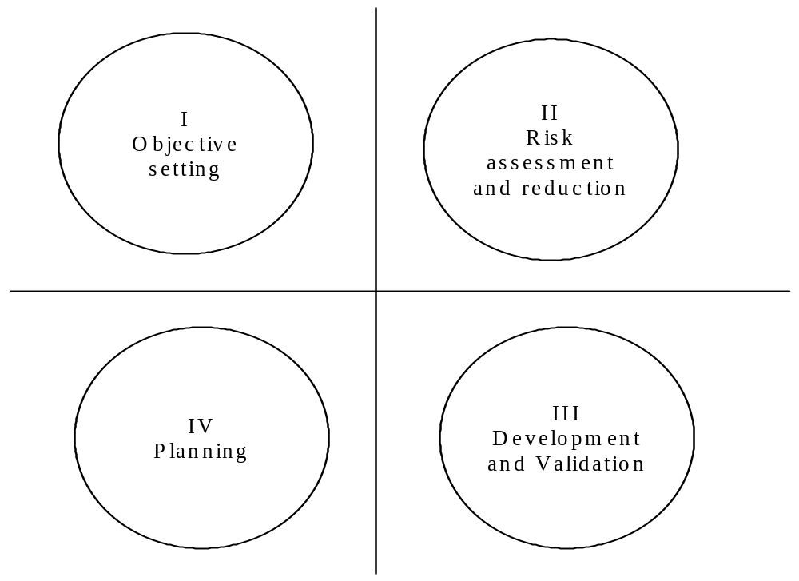
Spiral Model –four sectors

Slide 25
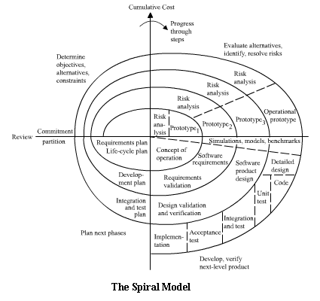
Spiral Model
Image source : http://courses.cs.vt.edu/csonline/SE/Lessons/Spiral/index.html

Slide 26
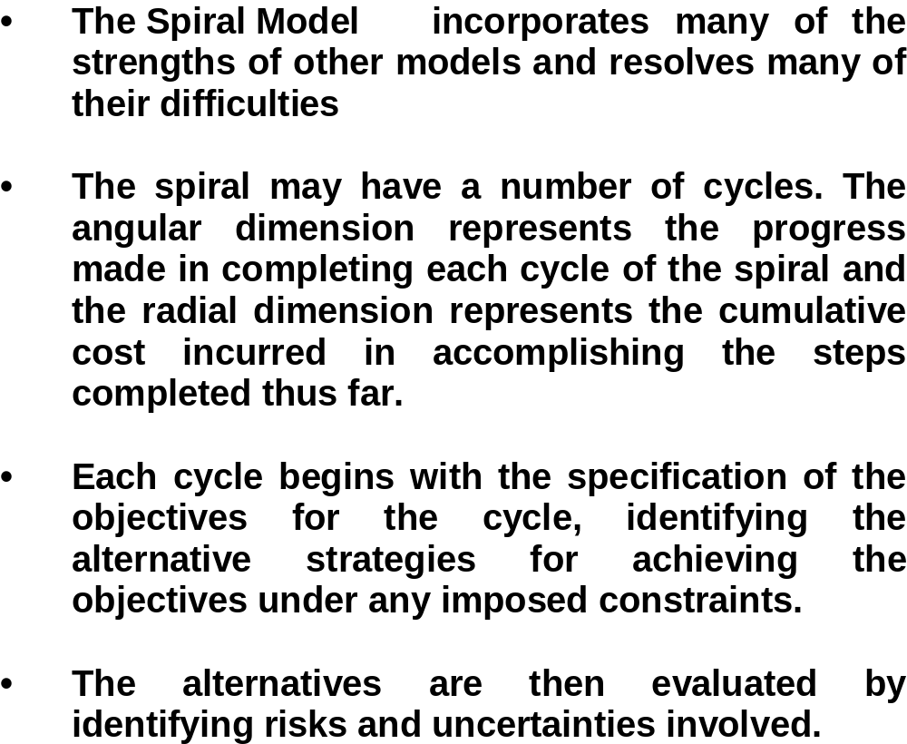
Spiral Model

Slide 27
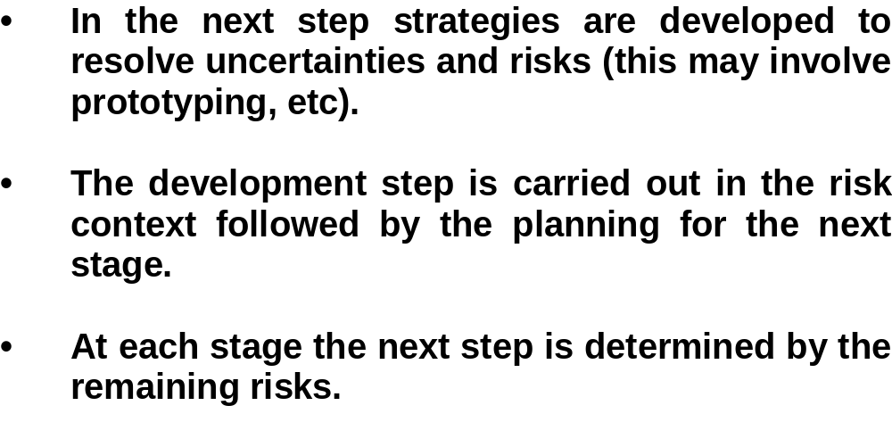
Spiral Model

Slide 28
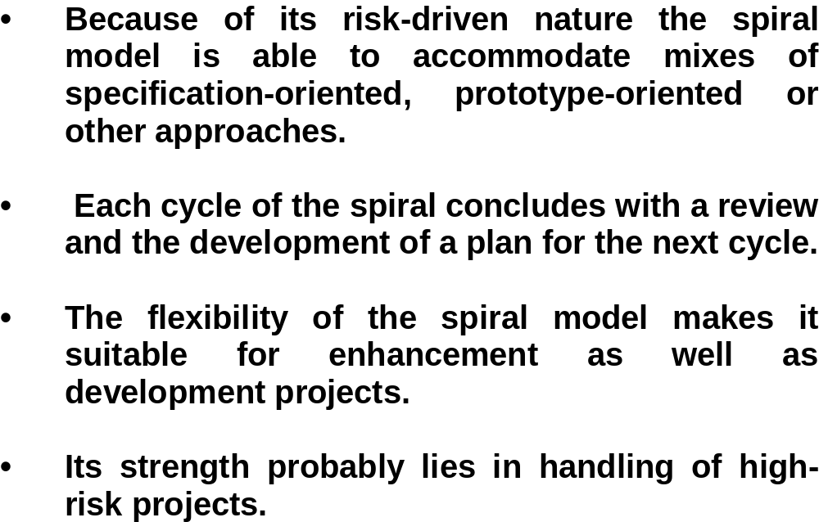
Spiral Model

Slide 29
Comments on Spiral
Risk driven
Flexible
  Combined with other models
Focus on most risky issues in early stage
Matching Deming circle

Slide 30
Prototyping
Before the development of the real system
  Build a quick prototype to demonstrate the functions of the system
With the prototype, many issues can be clarified among different parties
With the refined knowledge, start to build the real system

Slide 31
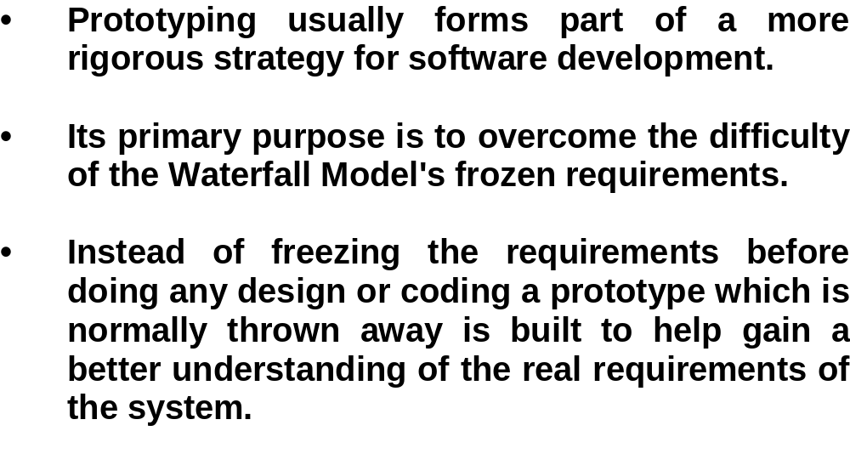
Prototyping

Slide 32
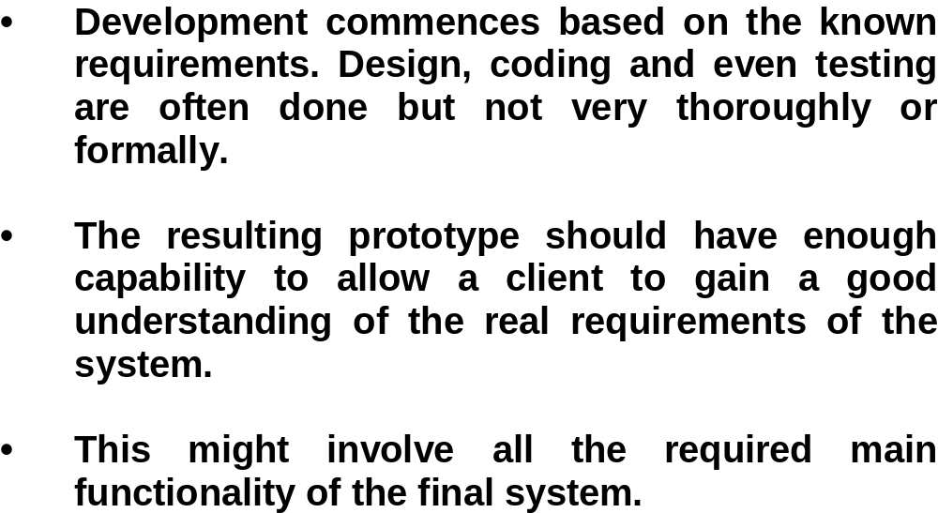
Prototyping

Slide 33
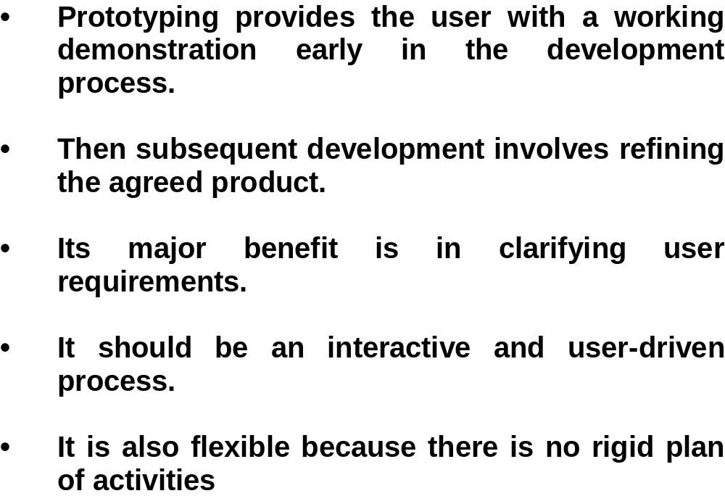
Prototyping

Slide 34
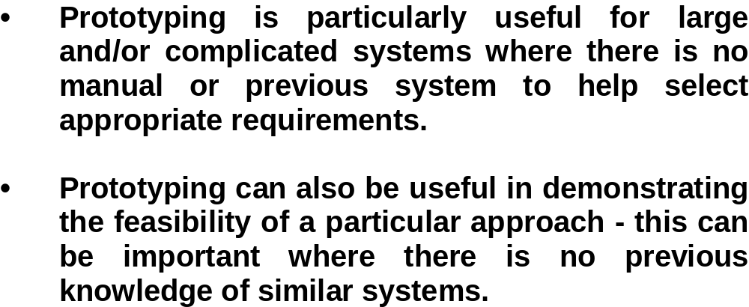
Prototyping

Slide 35
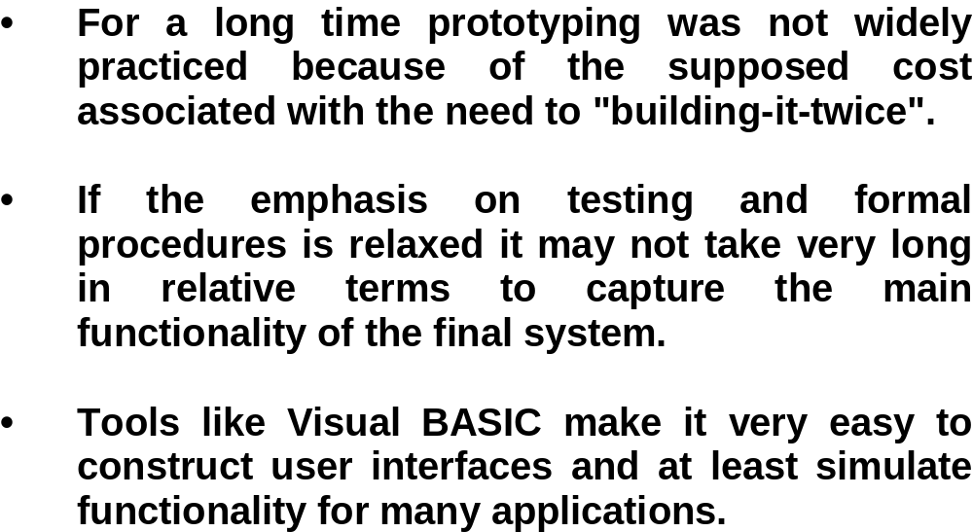
Prototyping

Slide 36
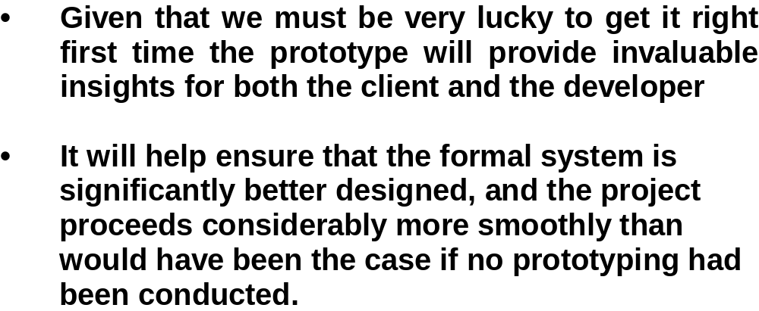
Prototyping

Slide 37
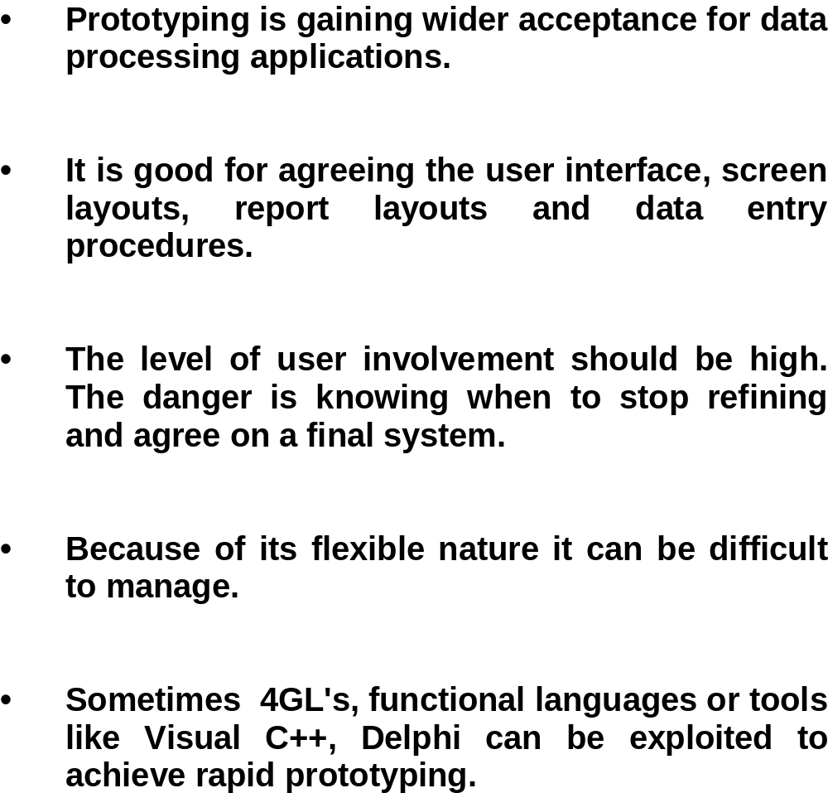
Prototyping

Slide 38
Advantages
User driven approach
Good for large and complex and totally new systems
Get better understanding of the requirements
Useful for GUI design
With help from 4GL language, it becomes quicker to develop a prototype
Help customer to refine their requirements

Slide 39
Disadvantages
Maybe difficult to manage
  For the development of the prototype
Need to build system twice
The prototype may not be able to capture all the critical issues

Slide 40
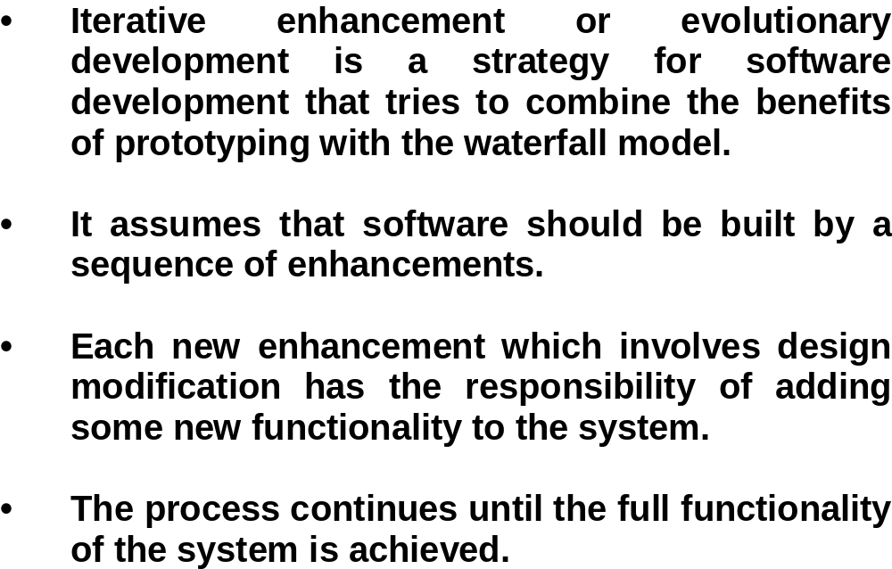
Iterative Enhancement

Slide 41
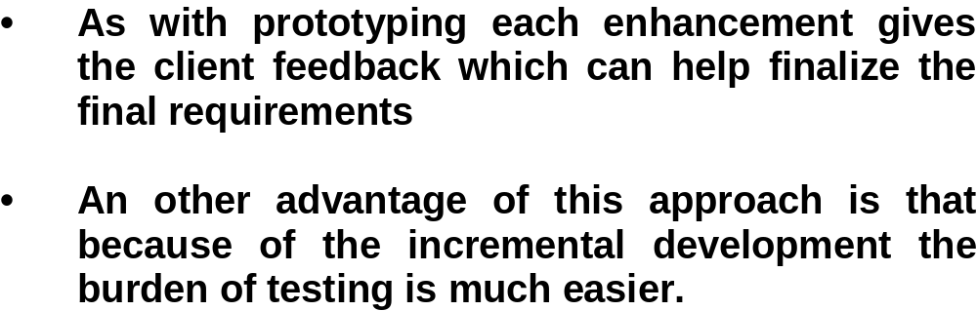
Iterative Enhancement

Slide 42
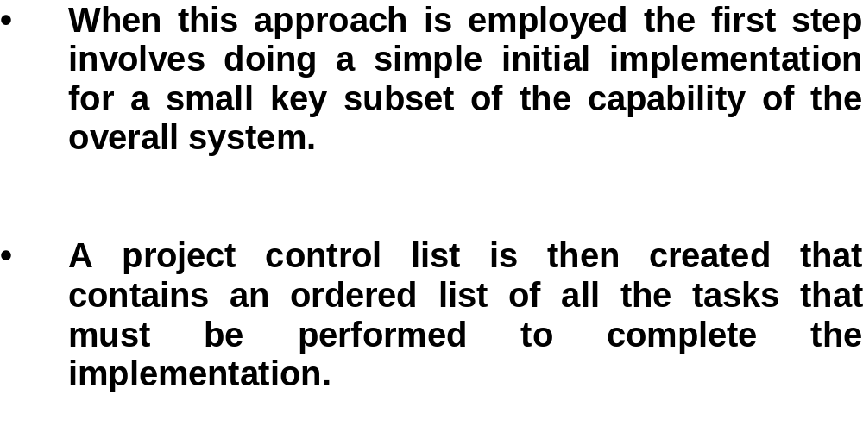
Iterative Enhancement

Slide 43
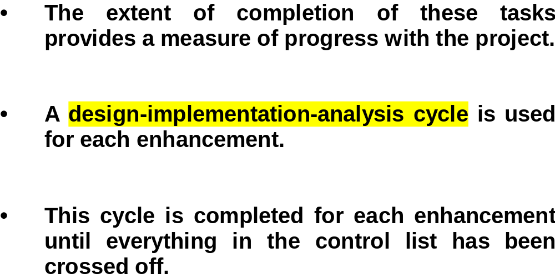
Iterative Enhancement

Slide 44
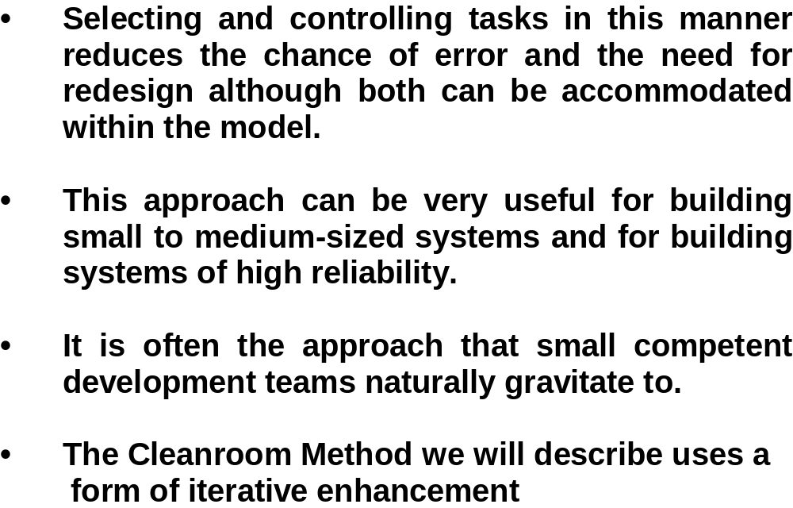
Iterative Enhancement

Slide 45
Example
Problem: summing the numbers in a two dimensional array and writes out the result.
three iterative enhancements
  solves the problem for the case where the array is empty (this handles the initialization and the output)
  handles the case where there is only one row
  handles the case of a fully two-dimensional array.

Slide 46
Discussion
What is the difference between the spiral model and iterative model?
What is the difference between the prototype and the iterative model?
What are the advantages and disadvantages for each of the four models?

Slide 47
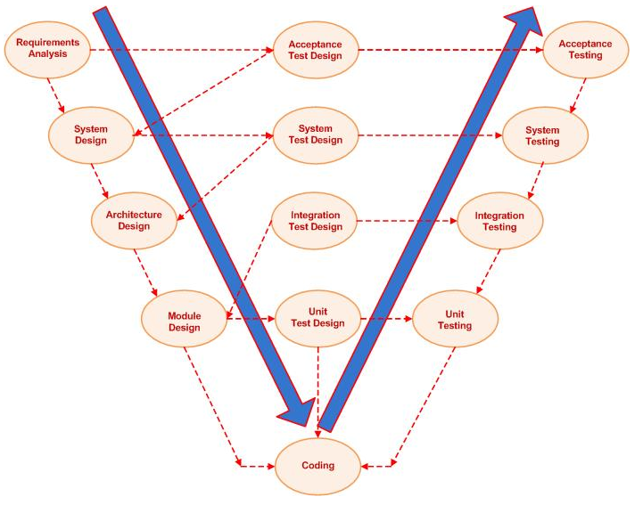
V model
Image source: http://upload.wikimedia.org/wikipedia/commons/9/96/V-model.JPG

Slide 48
V model
An improved version of waterfall model
Focus on testing (V&V)
For each development phase, the associated verification and validation are considered simultaneously
May still have the weakness of waterfall model but the developers have more confidence of the product

Slide 49
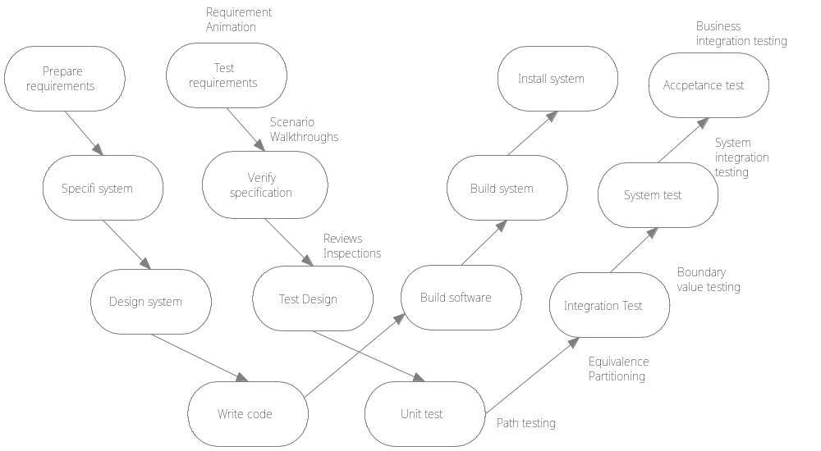
W model

Slide 50
W model
Improved from V model
Testing and development are two interweaved lines
Show the relationship between plan and do
Still not be able to overcome the limitation of waterfall model. How to handle changes and risks

Slide 51
Behavior Engineering Process
Requirements Translation (Formalization)
Requirements Integration (Fitness-for-purpose test)
Defect/issue resolution (Formal Specification)
Dependability Analysis (Model-checking, Simulation)
Refinement (Integrated behavior/component design)
Implementation (Component framework/publish-subscribe)

Slide 52
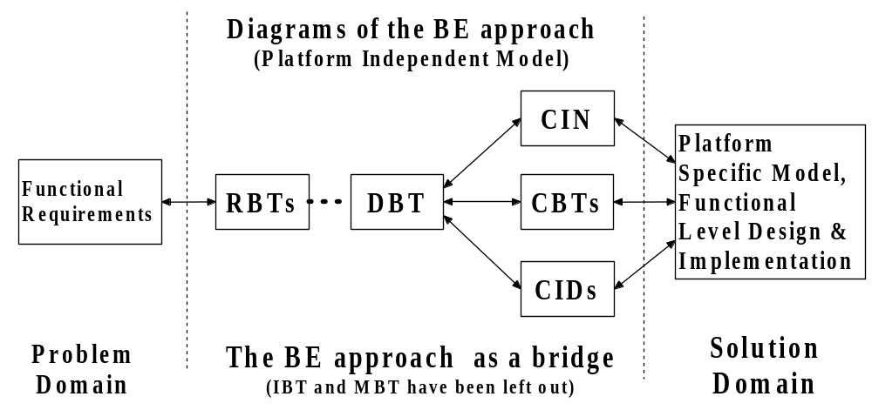
Behavior Engineering Process
Details will be explained in the later lectures

Slide 53
Rational Unified Process
Inception The goal of the inception phase is to establish a business case for the system.
Elaboration The goals of the elaboration phase are to develop and understanding of the problem domain, establish an architectural frame work for the system, develop the project plan and identify key project risks.
Construction The construction phase is essentially concerned with system design, programming and testing.
Transition The final phase of the RUP is concerned with moving the system from the development community to the user community and making it work in a real environment.
RUP has been derived from the work on UML. It is a high level business driven process.

Slide 54
Personal Software Process (PSP)
Planning. This activity isolates requirements and develops both size and resource estimates. In addition, a defect estimate (the number of defects projected for the work) is made. All metrics are recorded on worksheets or templates. Finally, development tasks are identified and a project schedule is created.
High-level design. External specifications for each component to be constructed are developed and a component design is created. Prototypes are built when uncertainty exists. All issues are recorded and tracked.
High-level design review. Formal verification methods are applied to uncover errors in the design. Metrics are maintained for all important tasks and work results.
Development. The component level design is refined and reviewed. Code is generated, reviewed, compiled, and tested. Metrics are maintained for all important tasks and work results.
Postmortem. Using the measures and metrics collected (this is a substantial amount of data that should be analyzed statistically), the effectiveness of the process is determined. Measures and metrics should provide guidance for modifying the process to improve its effectiveness.

Slide 55
Team Software Process (TSP)
Build self-directed teams that plan and track their work, establish goals, and own their processes and plans. These can be pure software teams or integrated product teams (IPT) of three to about 20 engineers.
Show managers how to coach and motivate their teams and how to help them sustain peak performance.
Accelerate software process improvement by making CMM Level 5 behavior normal and expected.
Provide improvement guidance to high-maturity organizations.
Facilitate university teaching of industrial-grade team skills.

Slide 56
Summary
Why we need software process model?
What are the development phases of the waterfall model?
What are the advantages and disadvantages of the waterfall model?
What are the 4 sectors of the spiral model?
What are the advantages and disadvantages of the spiral model
What is software prototyping, and why is it helpful?
What is the limitation of software prototyping?
What is the iterative enhancement process?
What are the advantages and shortages of the iterative enhancement process?

