Slide 1
Eat your fruit and vegetables
By: Anthony Guevara

Slide 2
Why eat plants?
Eating healthfully is important in many aspects of living
The definition of vegetarian
Benefits for the planet
Prevention and reversal of dis-ease

Slide 3
What is a vegetarian?
Define: vegetarian:
“A vegetarian is someone who lives on a diet of grains, pulses, nuts, seeds, vegetables and fruits with, or without, the use of dairy products and eggs”

Slide 4
Types of vegetarians:
Lacto-ovo-vegetarian: “Eats both dairy products and eggs. This is the most common type of vegetarian diet.”
Lacto-vegetarian: “Eats dairy products but not eggs.”
Ovo-vegetarian: Eats eggs but not dairy products

Slide 5
Pseudo vegetarian:
Someone who calls themselves vegetarian but still consumes animal prodcuts
Pescatarians: “Someone who does not consume meat products with the exception of fish.
Flexitarians: “on and off” vegetarian

Slide 6
Vegan
Does not eat dairy products, eggs, or any other animal product.

Slide 7
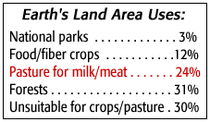
Beneficial for the planet
30% of the worlds land mass is used for raising animals for food
70% percent of the grain and cereals that are grown are fed to farmed animals.

Slide 8
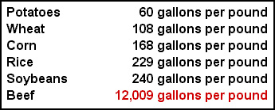
1lb ground beef = 1197.5 calories
1lb potatoes = 288 calories.
4.5lbs of potatoes (calories) = 1lb ground beef (calories)
It requires 50 times more water to produce a calorie from beef as it does from potatoes.

Slide 9
Benefits of plant matter
May prevent and help fight off the following diseases:
Cancer
Arthritis
Alzheimer’s

Slide 10
“Let food be thy medicine and medicine be thy food” _{hippocrates}
Broccoli: sulforaphane compound helps fight cancer and arthritis
Tomatoes: lower cholesterol levels in the blood and prevent clotting.
Grapes: may help prevent alzheimers by block genes associated with the Alzheimer's pathway and decrease inflammatory gene expression in the brain.

Slide 11
Conclusion
Different types of vegetarians
Environmental benefits to eating fruit and vegetables
Healing properties of food

