Slide 1
Advanced Google searching
By: Anthony Guevara – Oct 21, 2013

Slide 2
Why advanced searching
Find information faster
Filter through unnecessary information

Slide 3
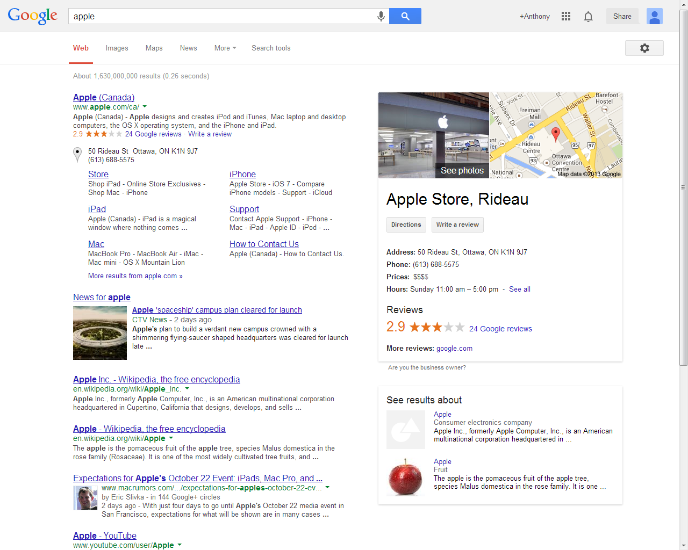
Search Term
BASIC SEARCH

Slide 4
EXCLUDE search (“-”)
Helpful when filtering results
Used for synonym words (I.E the word jaguar (animal vs the vehicle))
Prepend a word with the “-” operator

Slide 5
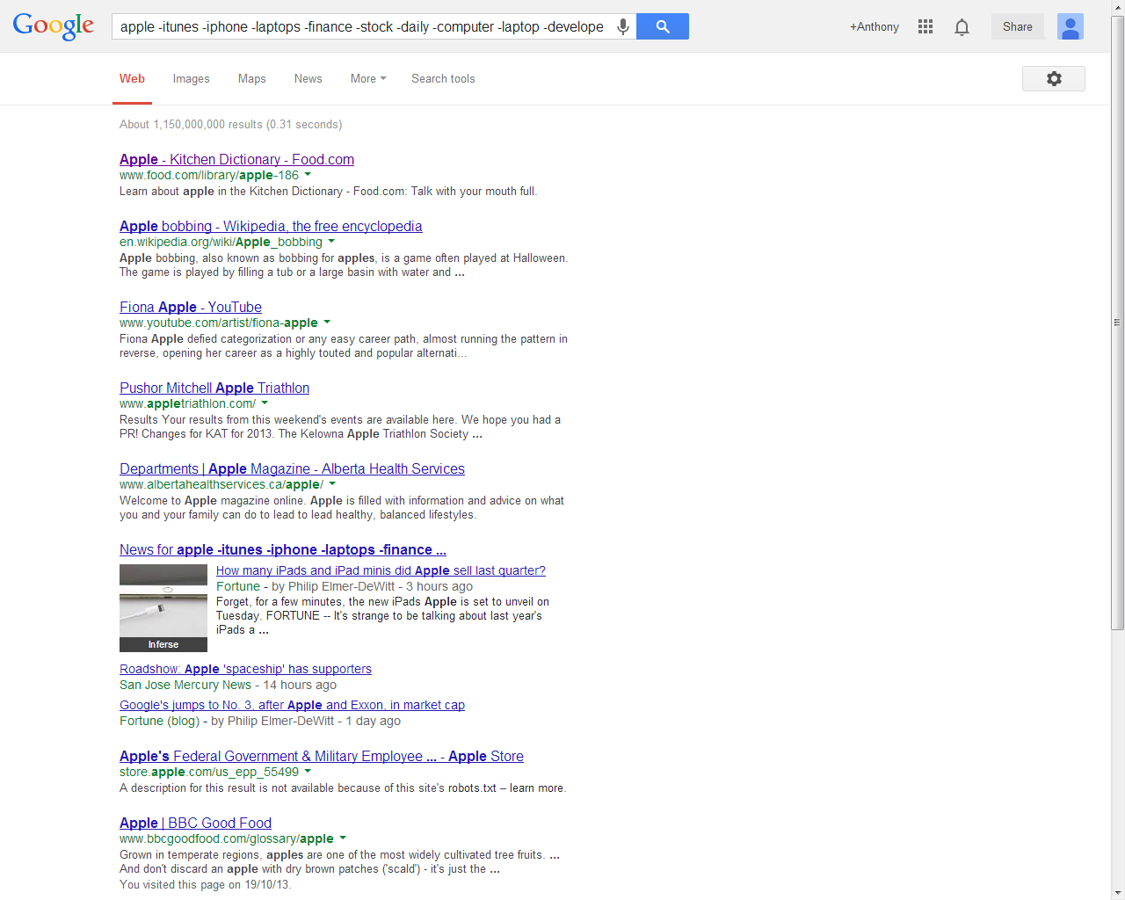
Search Terms
EXCLUSIVE SEARCH

Slide 6
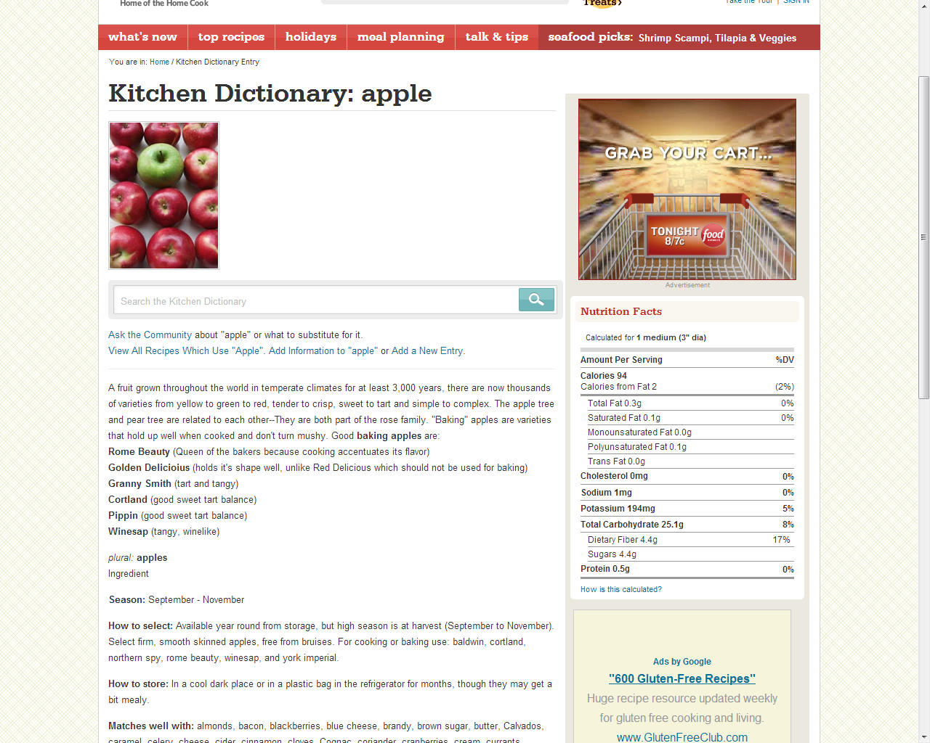

Slide 7
EXACT WORD search (“ “)
Helpful when searching for song names or famous quotes
Should only be used when you know the exact words
Uses the quotation operators “search term goes here”
Ex: “once upon a midnight dreary”

Slide 8
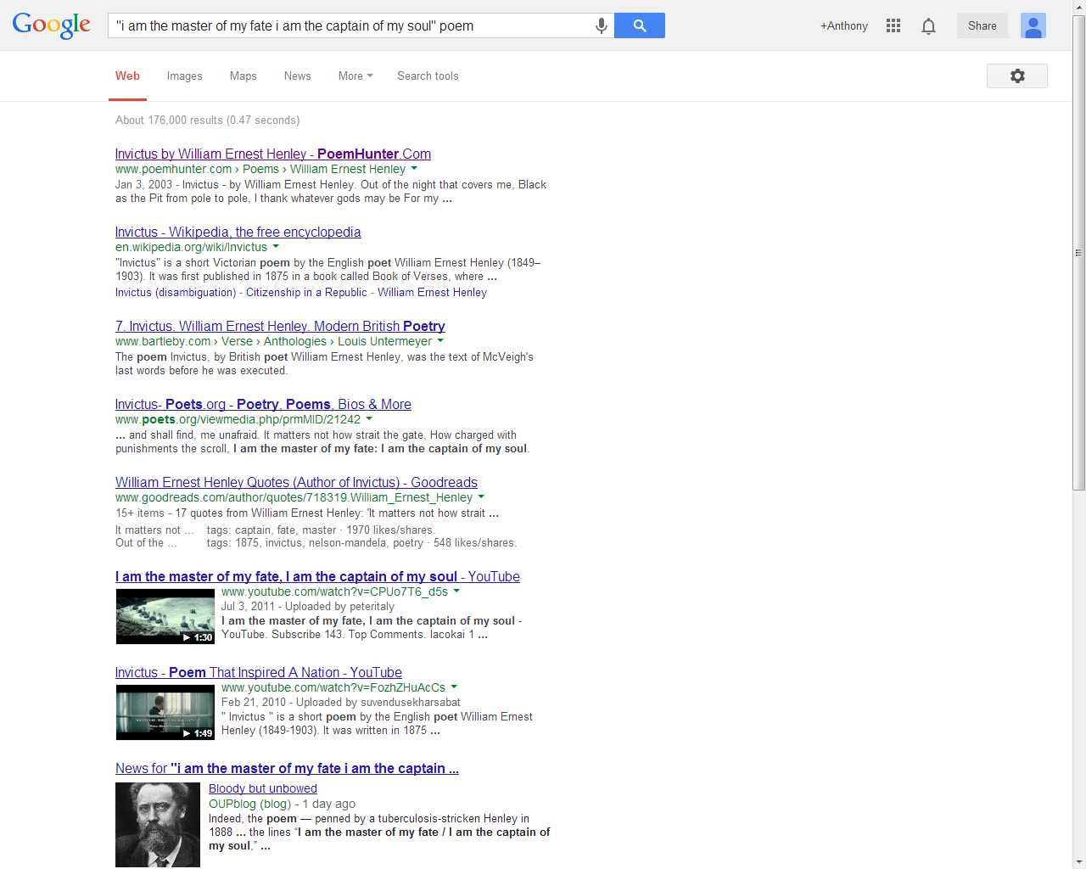
Search Terms
EXCLUSIVE SEARCH

Slide 9
WEBSITE OR DOMAIN search (“site:”)
Useful for finding information inside a particular website OR
Useful for filtering results based on website URL ending (I.E .com, .ca, etc)
Prepend a domain or website with the “site:” operator

Slide 10
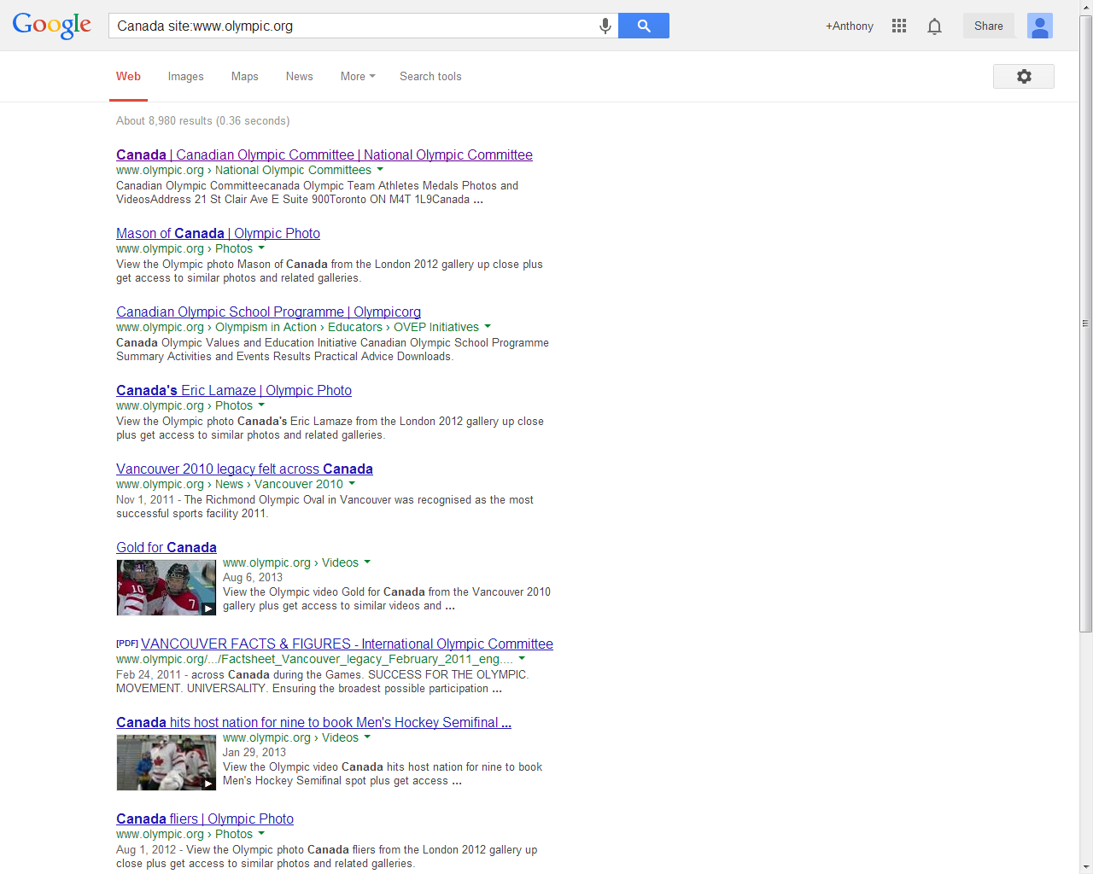
Search Terms
INSIDE A SITE
SEARCH

Slide 11
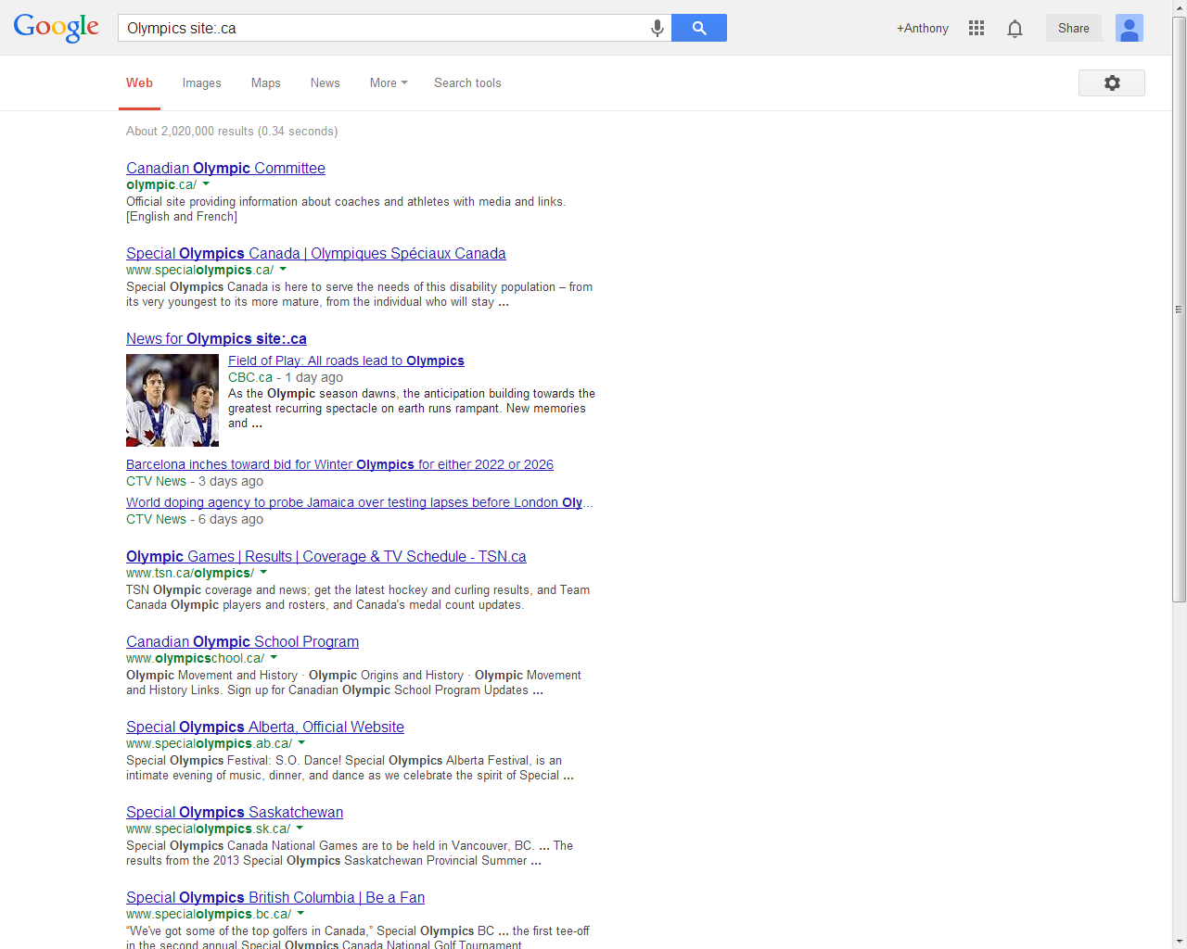
Search Terms
DOMAIN
SEARCH

Slide 12
SIMILAR search (“similar:”)
Find pages that are similar to other pages
Useful for discovering new sites
Prepend a site with the “similar:” operator

Slide 13
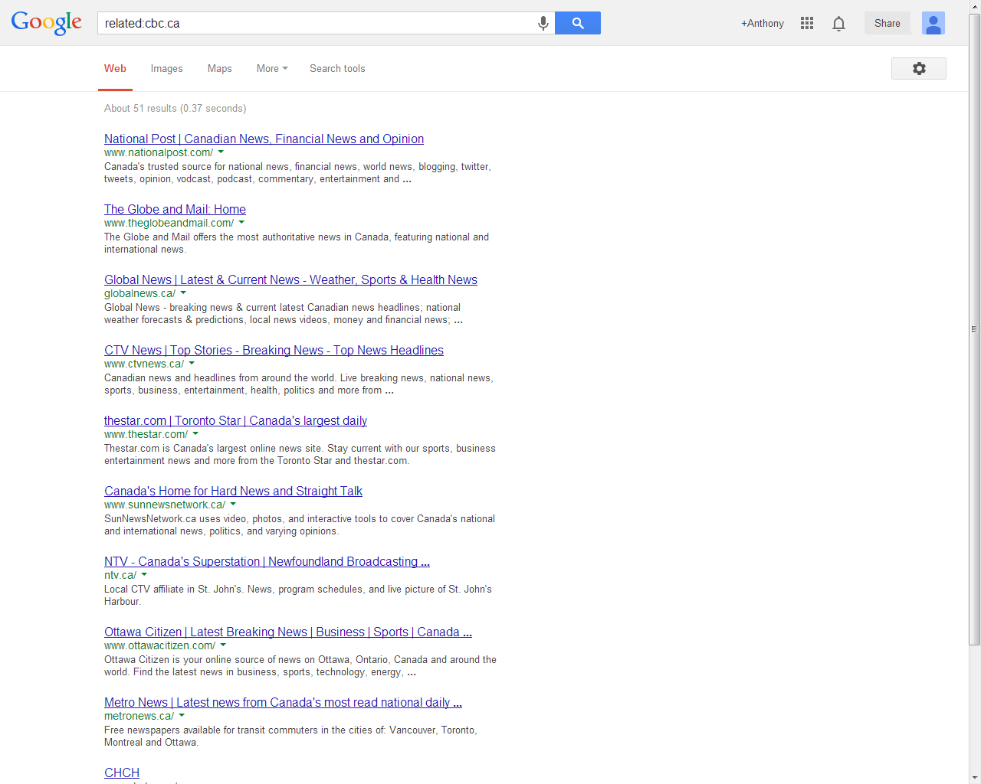
Search Terms
SIMILAR
SEARCH

Slide 14
FILL IN THE BLANK search (“*”)
Used as a placeholder to find terms that are unknown or wildcards
Useful for searching for items where you know some terms but not all in a search sequence

Slide 15
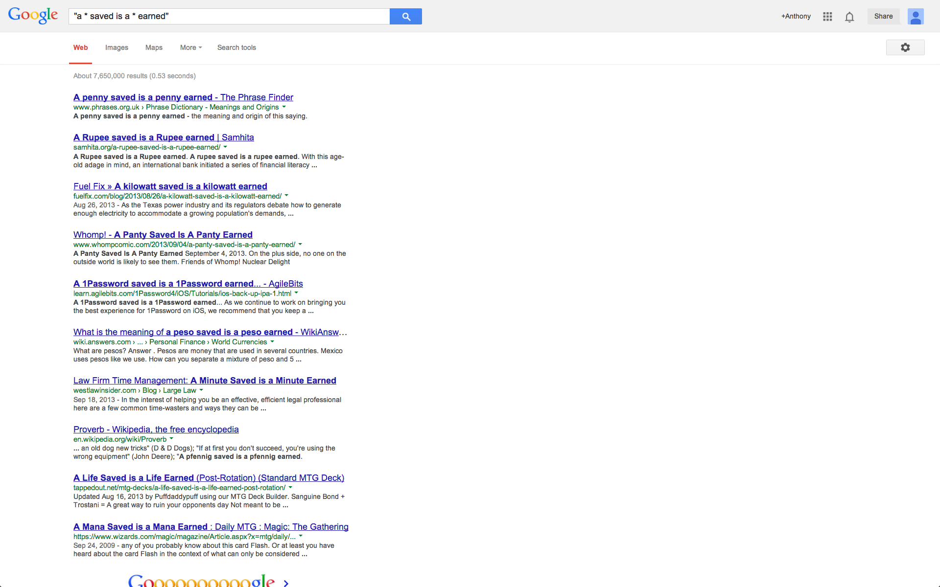
Search Terms
FILL IN THE BLANK
SEARCH

Slide 16
And more…
Search for a number range (Ie. Looking for a camera in a certain price range)
Search for either word
Search for pages that link to a URL
And more!

Slide 17
Lucky for you…
None of these operators need to be memorized
Use the advanced search option

Slide 18
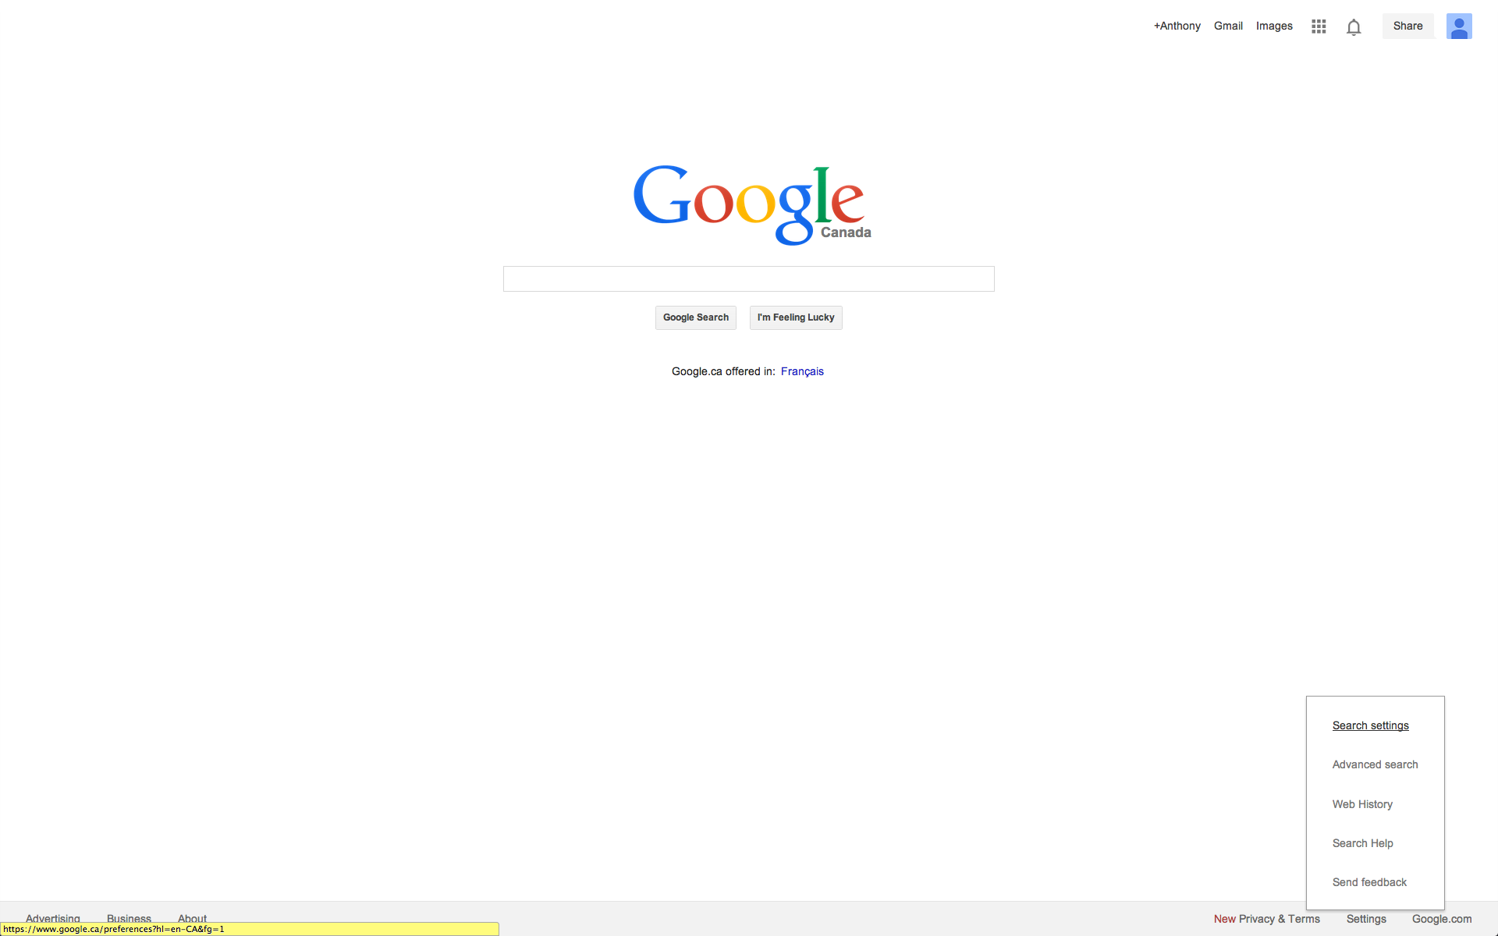
Advanced Search

Slide 19
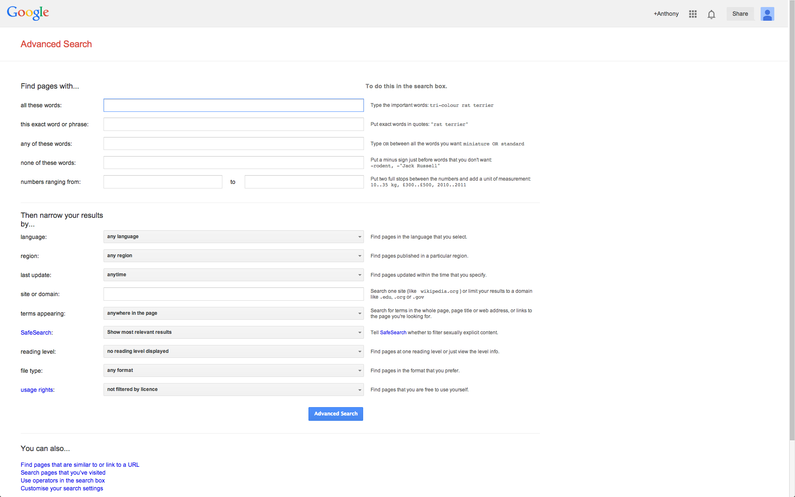

Slide 20
The end
Save time by finding information more quickly
Find related sites to topics of interest
Filter results
Use the advanced search tab
Explore other operators that better fit your needs

