Slide 1
Australia – In a nutshell
By: Anthony Guevara

Slide 2



Trivia
Q: What’s the capital of Australia?
A: Canberra
Q: What’s the population of Australia?
A: 22.8 Million
Q: Which flag is Australia’s?
a)
b)
c)

Slide 3
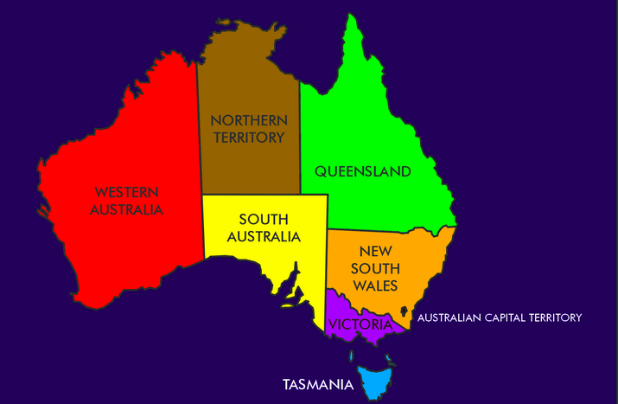
Geography
Notes:
-6th largest Country in the world by total area made of of the main island, Tasmania, and other small islands.
-Australia is made up of 6 different states:
1. New South Wales
2. Queensland
3. South Australia
4. Victoria 5. Tasmania
6. Western Australia
And 2 Territories: 1. Northern territory
2. Australian Capital Territory
Each state and territory have their own parliament.
In most cases the territories operate very similarly to the states however the Commonwealth Parliament can override any legislation of the territories parliament.

Slide 4
Climate
Wide range of different climates
Northern part of the island is warm
Southern part of the island is cooler
Notes:
Although the majority of Australia is very arid or desert there are a variety of different temperature zones that vary between tropical rainforest, grasslands, and deserts. In comparison to other countries the weather doesn’t fluctuate as much between winter and summer. Temperatures are moderated by the lack of mountain ranged and the surrounding oceans. The northern part of the island is tropical while the southern part of the island tends to be more temperate with desert environment in between the two. Summer is December – February, winter June to August.

Slide 5
Skiing
Possible to go skiing in the temperate region states:
New South Wales
Tasmania
Victoria
Australian Capital Territory
Imagine going skiing and swimming at the beach on the same day!

Slide 6
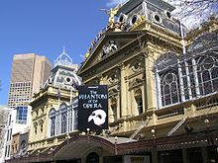
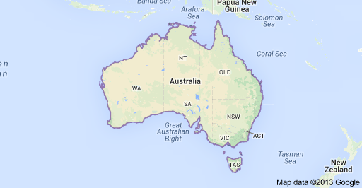
Melbourne, Victoria
Notes:
Second most populous city in Australia and the Capital of Victoria 4 million people. Historically known for growing it’s population by nearly ¾ during the Gold rush of 1851 from 25,000 to 40,000.
Known for being a cultural center: holding major events, festivals, theatre, musicals, comedy, literature, and film.

Slide 7
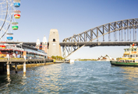
Sydney, New South Wales
Notes:
Population 4.6 million
Largest city in Australia, State capital of New South Wales. Inhabitants are called Syndeysiders. Established in 1788 by Captain Arthur Phillip but radio carbon dating suggests that indigenous people people have lived here for at least 30, 000 years prior.
Iconic image: Sydney Opera House.

Slide 8
End
Thank you for listening!

