Slide 1
Tourists Guide to Manhattan
By: Anthony Guevara

Slide 2
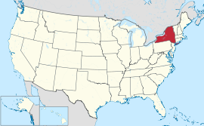
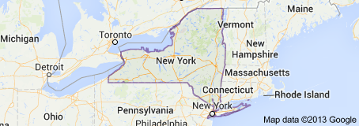
New York City The city that never sleeps
Most populous city in the United States
Finance, culture, theatre, immigration

Slide 3
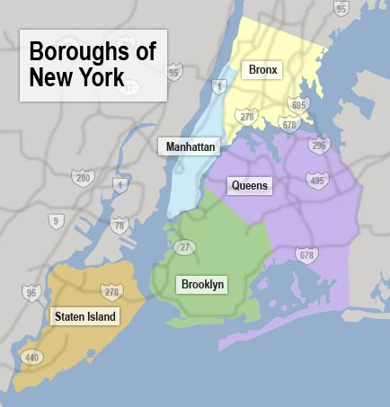
Manhattan, NY
Most densely populated of 5 boroughs:
Manhattan
The Bronx
Brooklyn
Queens
Staten Island

Slide 4
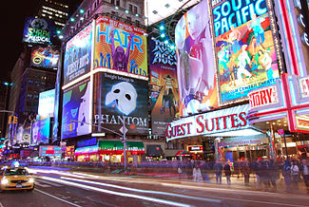
Attractions
Empire state building
Statue of Liberty
Various Museums
Central Park
Time Square
Theatre

Slide 5
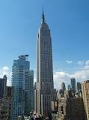
Empire State Building
Tallest building from completion for nearly 40 years
103 story sky scraper
$27.00 to visit

Slide 6
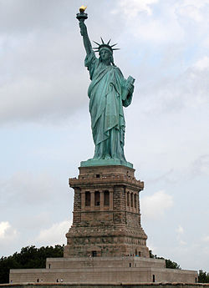
Statue of Liberty
Located in the middle of New York habour
Gift from France
Robed female representing roman goddess
Icon of freedom

Slide 7
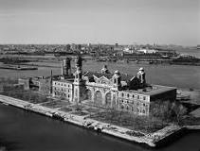
Ellis Island

Slide 8
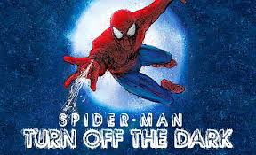
Spider Man Turn Off The Dark
Musical theatre
Tickets are approximately around $100.00

Slide 9
Accommodation and Transportation
Hostels and hotels
Taxis and buses
Subway
Ferry
Horse and carriage
Renting a vehicle
Bikes

Slide 10
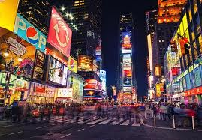
End
Lots to do and see

