Slide 1

Ruffle
Disruptive anonymous picture messaging

Slide 2
Ruffle Web Application

Slide 3
Ruffle Application

Slide 4
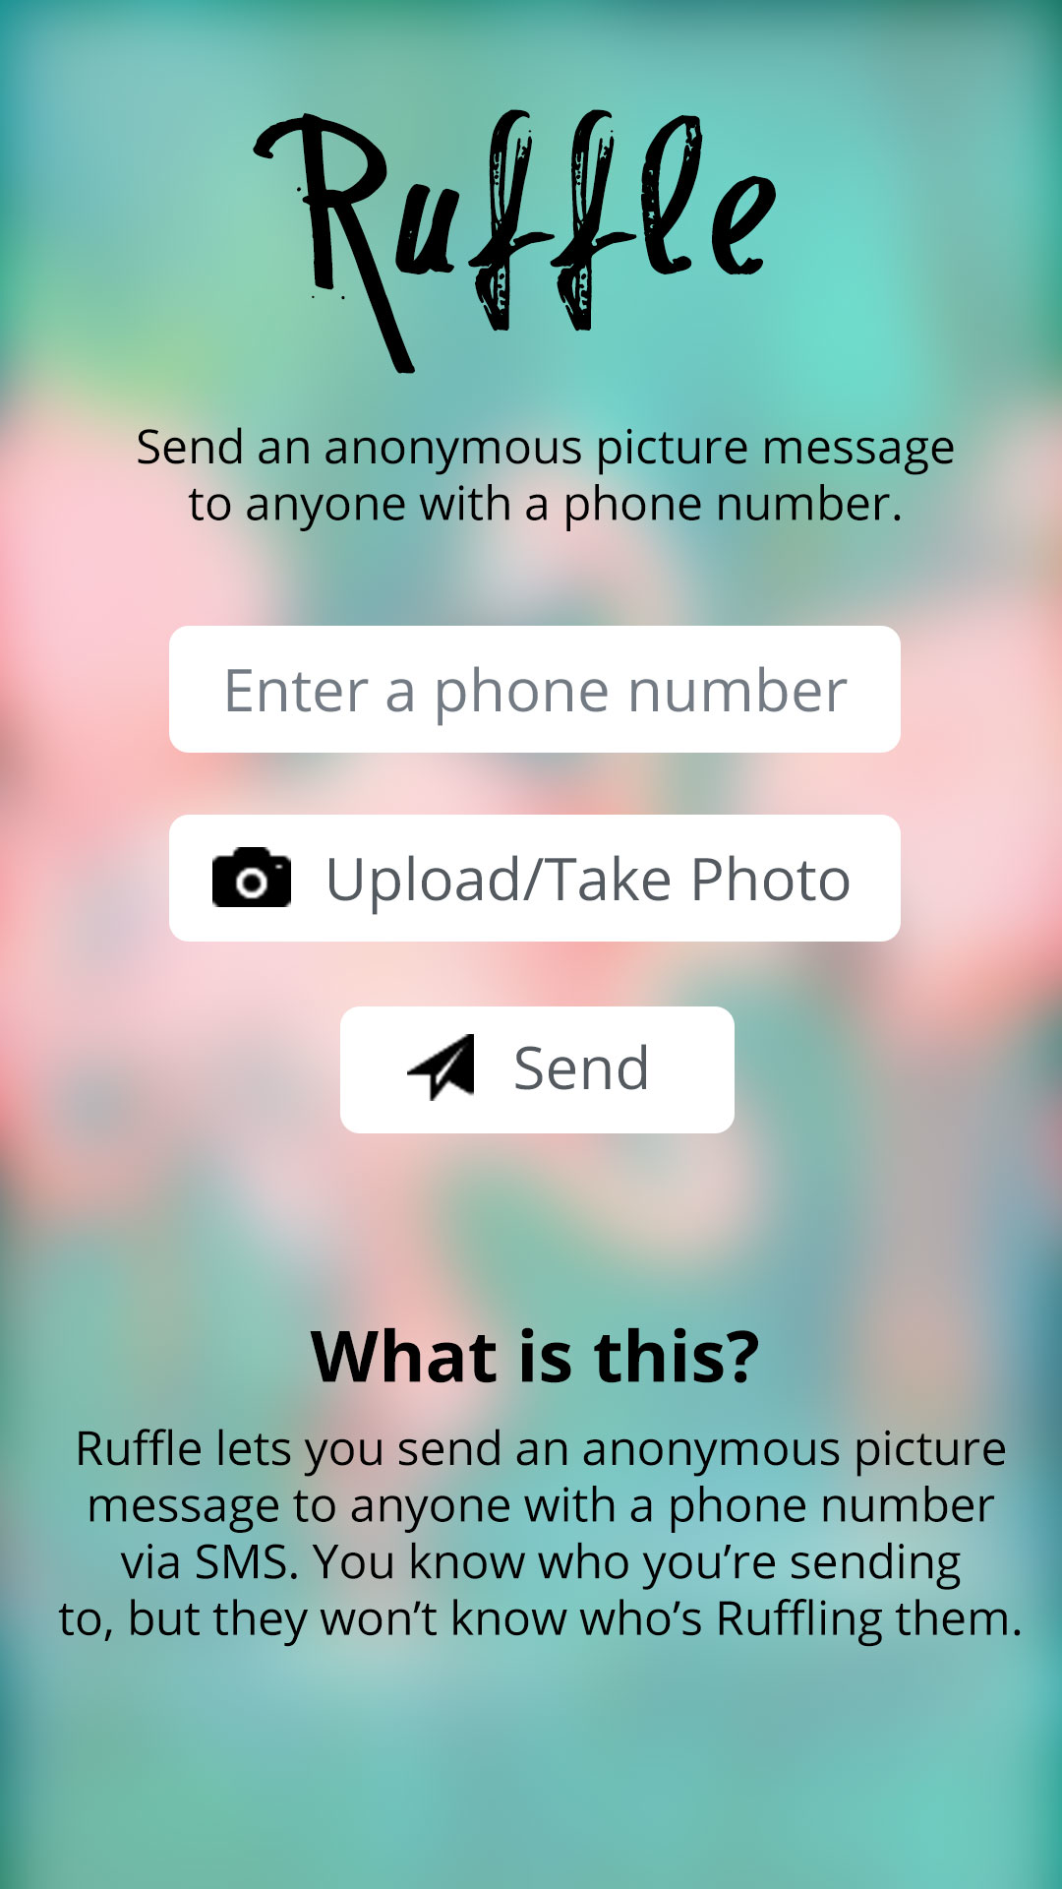

Slide 5
