Slide 1
COMBINATORIAL GAME THEORY
THE WORLD OF PILES OF STONES

Slide 2
What is Combinatorial Game Theory?
Set of 5 rules:
i) Two Players
ii) No Chance
iii) Perfect Information
iv) Turn Based
v) Winning Condition

Slide 3
Examples
Nim
Nimble
The silver dollar game
Two dimensional Nim
Wythoff’s Game
Green Hackenbush

Slide 4
Analysis of Nim Game
N-Position, P-Position
Supposing three piles of (1,2,3)

Slide 5
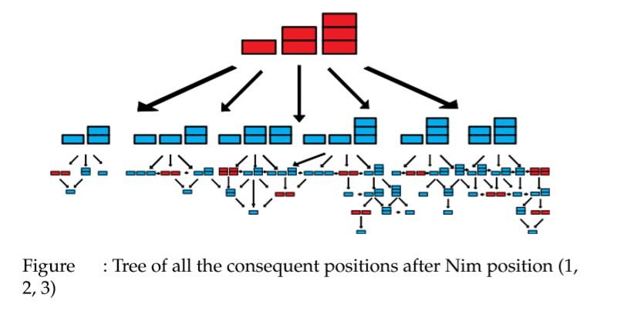

Slide 6
Bouton Algorithm (Nim-Sum)
Rule 1: If current indicator is zero then next move will not have zero.
Rule 2: If current indicator is zero then next move will not have zero.

Slide 7
Three piles:
37 , 20 , 29
37 = 1 0 0 1 0 1 20 = 0 1 0 1 0 0 29 = 0 1 1 1 0 1
SUM = 1 0 1 1 0 0

Slide 8
Summing other piles
0 1 0 1 0 0 + 0 1 1 1 0 1
-------------------------------------------
0 0 1 0 0 1 (9)
9 , 20 , 29
9 = 37 – x
X = 28

Slide 9
Indicator = 0 1 0 0 1 (9)
20 = 0 1 0 1 0 0 29 = 0 1 1 1 0 1
0 1 0 1 0 0
+ 0 1 1 1 0 1
----------------------------------
0 0 1 0 0 1
+ 0 0 1 0 0 1
----------------------------------
0 0 0 0 0 0

Slide 10

For M Piles

Slide 11
CONCLUSION
Game is interaction between people.
Cooperative (Hangouts etc.)
Non-cooperative (Prisoner’s Dilemma)

Slide 12
MOVING TOWARDS OUR PROGRAM

