Slide 1
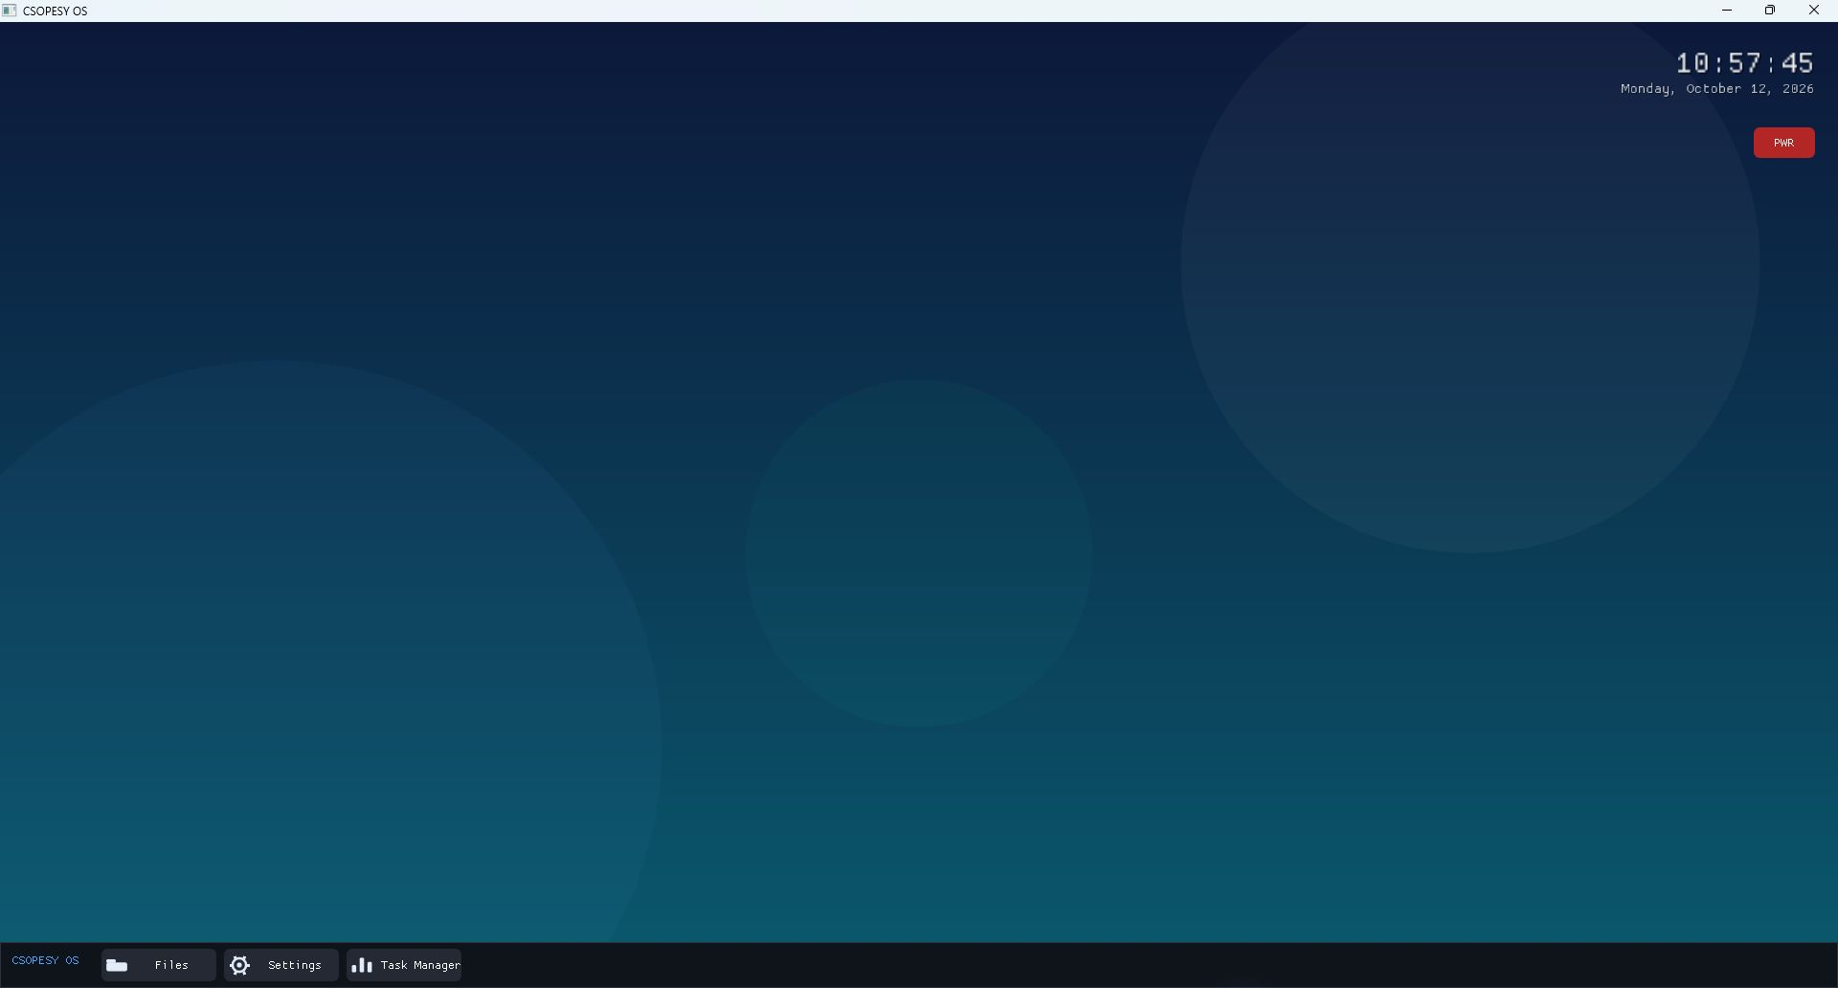
CSOPESY OS
Desktop-Style OS Mockup with Dear ImGui
TECHNICAL REPORT
Karl Matthew Dela Cruz
Jose Miguel Espinosa
Bon Windel Aquino
Dencel Angelo Pineda
CSOPESY · October 2026
Notes:
Runtime screenshot captured from the project's csopesy_os executable on October 12, 2026.

Slide 2
02
Video Walkthrough
Reserved for the final seamless demonstration
VIDEO PLACEHOLDER
Insert the final MP4 here
480p–720p · one continuous take · Run/Debug through PWR shutdown
Leave this slide in place until the final recording is ready.
Notes:
Replace the placeholder with the final embedded MP4. Keep the recording seamless and show the IDE Run/Debug action, the UI walkthrough, and PWR shutdown.

Slide 3
03
Compositor Architecture
One immediate-mode frame rebuilds the desktop, windows, and foreground taskbar
GLFW + OpenGL Host
events, window, graphics context
OsState
boot phase
window flags
shutdown request
1 Desktop
wallpaper, clock, PWR
2 Application Windows
Files, Settings, Task Manager
3 Taskbar
fixed foreground controls
Dear ImGui Draw Data
OpenGL renderer presents the completed frame
Source: src/main.cpp and src/OsState.h
Notes:
Architecture derived from src/main.cpp and src/OsState.h. The compositor renders the desktop first, application windows second, and the taskbar last before Dear ImGui submits draw data to OpenGL.

Slide 4
04
Implementation Code Snippets
The frame loop controls layer order, while PWR owns the shutdown path
src/main.cpp · compositor loop
src/Desktop.cpp · controlled shutdown
while (!state.shutdownRequested) {
glfwPollEvents();
if (glfwWindowShouldClose(window)) {
glfwSetWindowShouldClose(window, GLFW_FALSE);
}
Desktop::Render(state);
if (state.showFileExplorer)
FileExplorer::Render(state);
if (state.showSettings)
Settings::Render(state);
if (state.showTaskManager)
TaskManager::Render(state);
Taskbar::Render(state);
}
if (ImGui::Button("PWR", btnSize)) {
ImGui::OpenPopup("Shut Down?");
}
if (ImGui::Button("Shut Down",
ImVec2(120, 0))) {
state.shutdownRequested = true;
ImGui::CloseCurrentPopup();
}
The native title-bar close request is cleared in the frame loop. Only the confirmed PWR action sets shutdownRequested.
Desktop first, app windows second, taskbar last
Selected implementation excerpts
Notes:
Code excerpts from src/main.cpp and src/Desktop.cpp. The frame loop preserves compositor ordering and blocks the native title-bar close action. The PWR confirmation sets the shared shutdown flag.

Slide 5
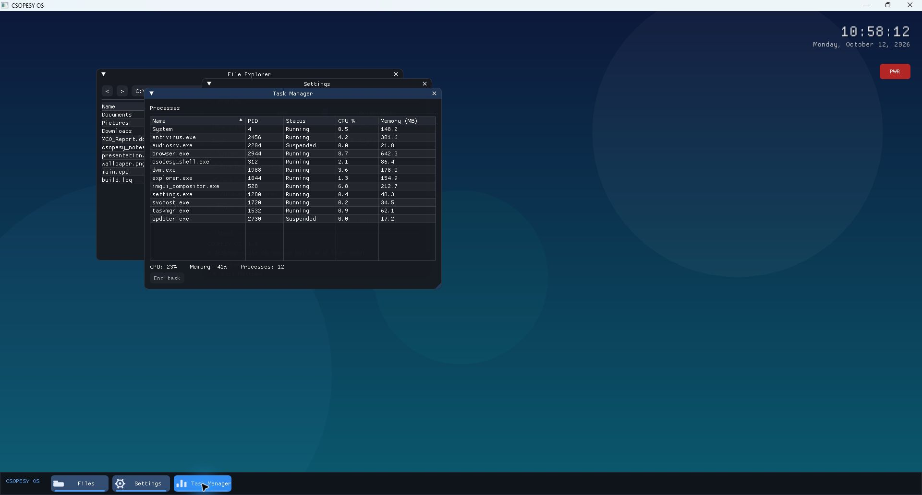
05
Desktop Design Discussion
A small shared state and explicit frame order keep the shell predictable
Design decisions
The desktop fills the viewport and draws a gradient wallpaper, soft patterns, the live clock, and PWR control every frame.
OsState stores the boot phase, open-window flags, and shutdown request so every screen reads the same state.
The taskbar toggles File Explorer, Settings, and Task Manager while active indicators show which windows are open.
Task Manager uses a sortable Dear ImGui table with dummy process, CPU, and memory values.
The compositor draws the desktop first, application windows next, and the taskbar last. A confirmed PWR action ends the loop.
Runtime composition
The screenshot shows independent ImGui windows layered over the desktop while the fixed taskbar stays in the foreground.
Runtime view captured from build/csopesy_os.exe
Notes:
The screenshot was captured from the project's csopesy_os executable on October 12, 2026. Design details are based on src/Desktop.cpp, src/Taskbar.cpp, src/OsState.h, and the application sources under src/apps/.

