Slide 1
Examify
Exzur G. Lamanilao
Lance Macabodbod

Slide 2
USE CASE DIAGRAM

Slide 3
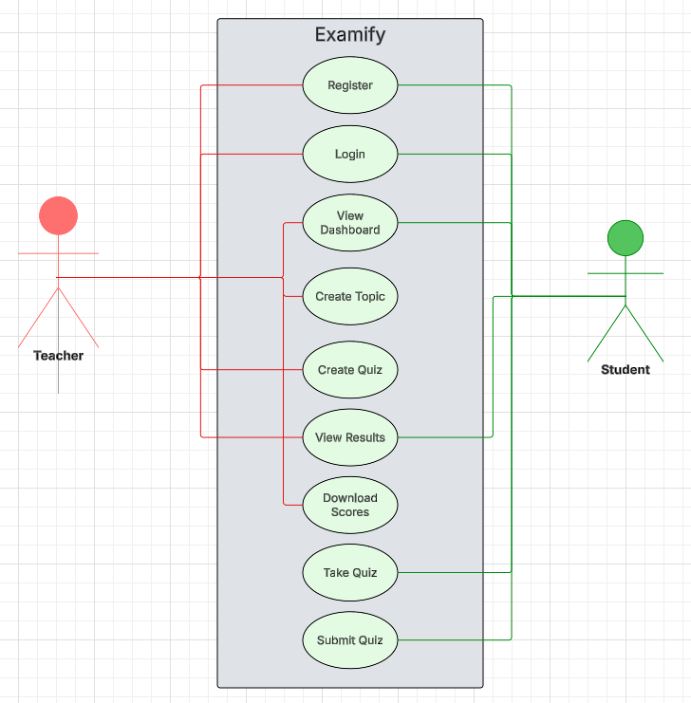
FIGURE 1

Slide 4
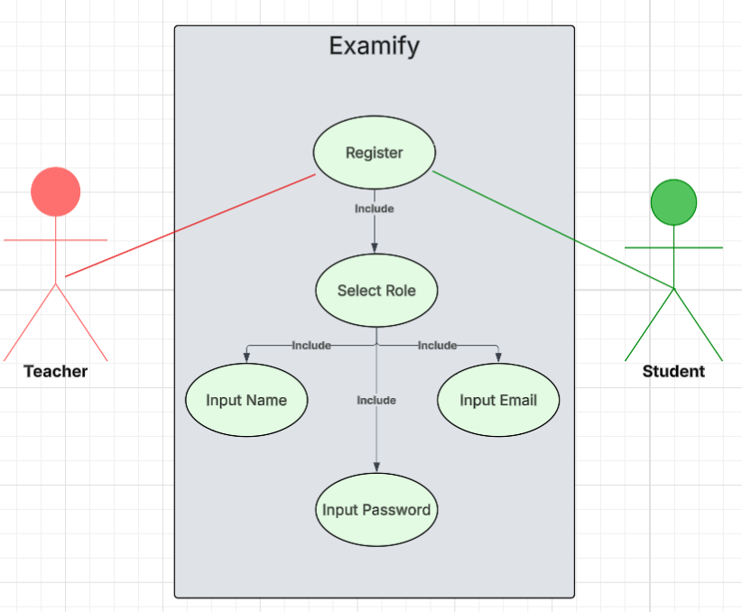
FIGURE 1.1

Slide 5
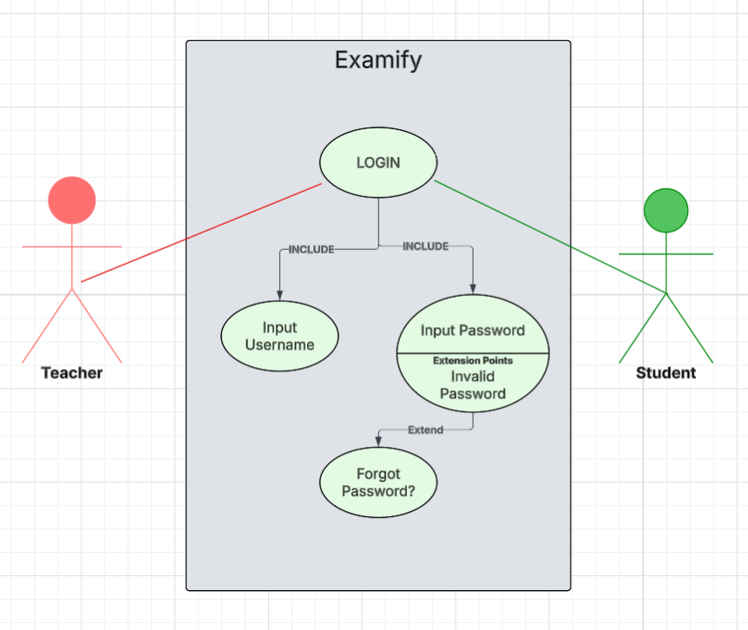
FIGURE 1.2

Slide 6
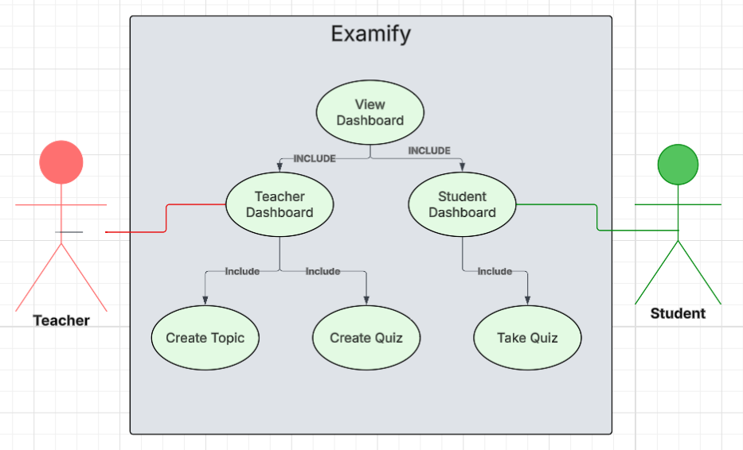
FIGURE 1.3

Slide 7
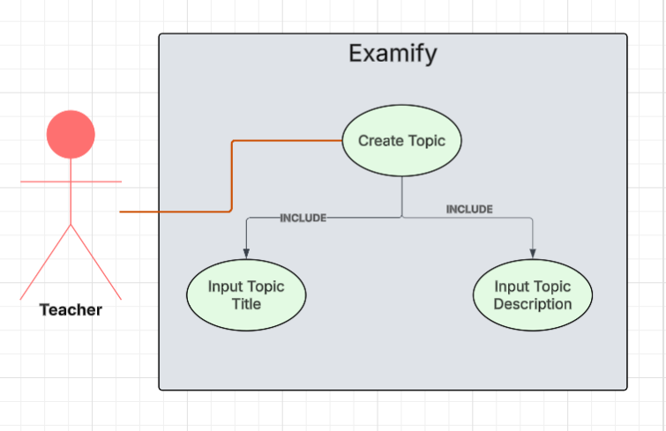
FIGURE 1.4

Slide 8
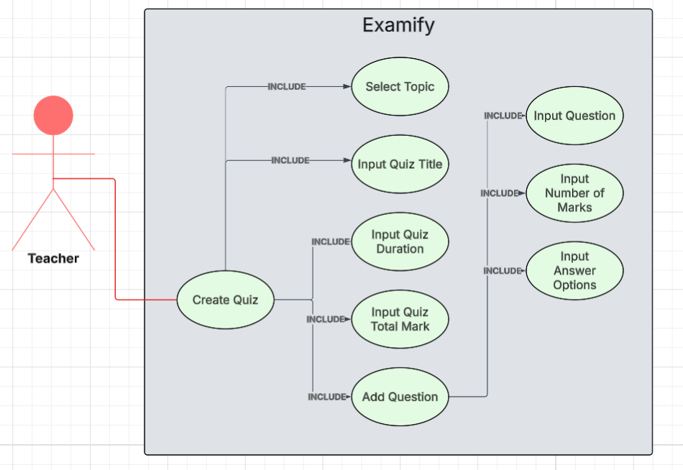
FIGURE 1.5

Slide 9
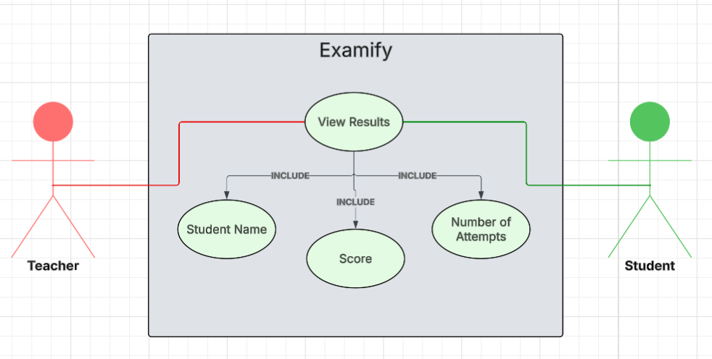
FIGURE 1.6

Slide 10
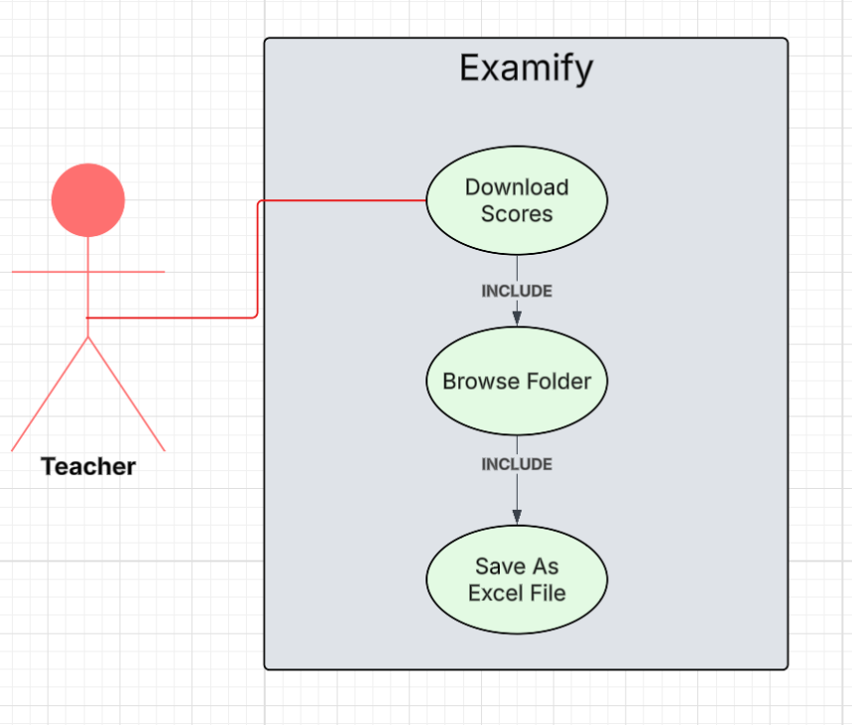
FIGURE 1.7

Slide 11
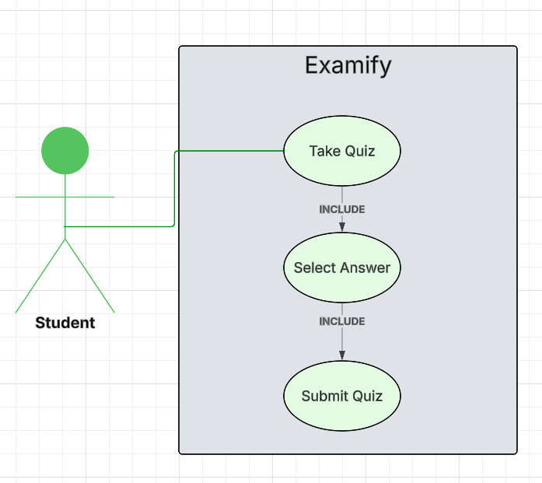
FIGURE 1.8

Slide 12
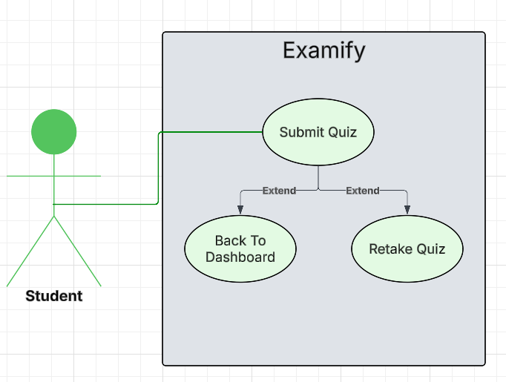
FIGURE 1.9

Slide 13
ACTIVITY DIAGRAM

Slide 14
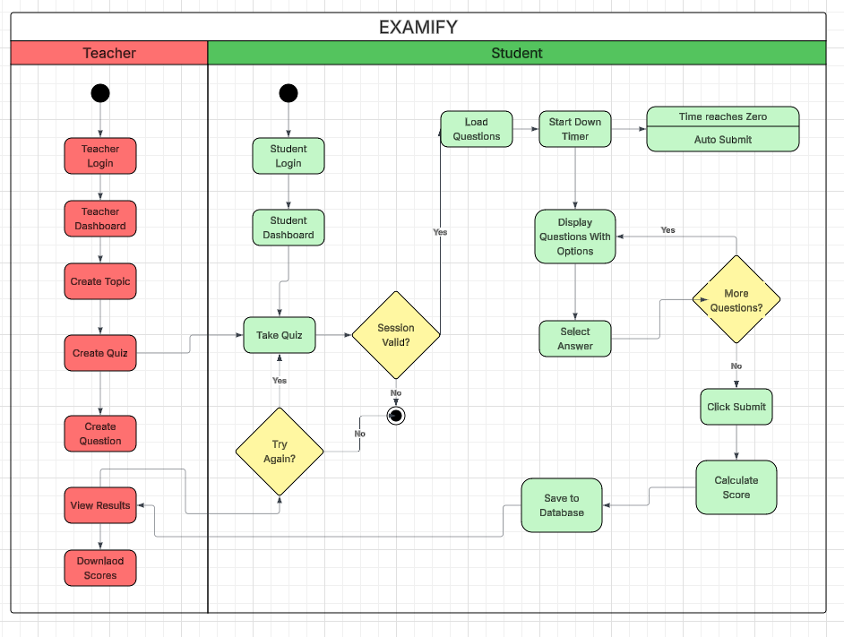
FIGURE 2

Slide 15
SEQUENCE DIAGRAM

Slide 16
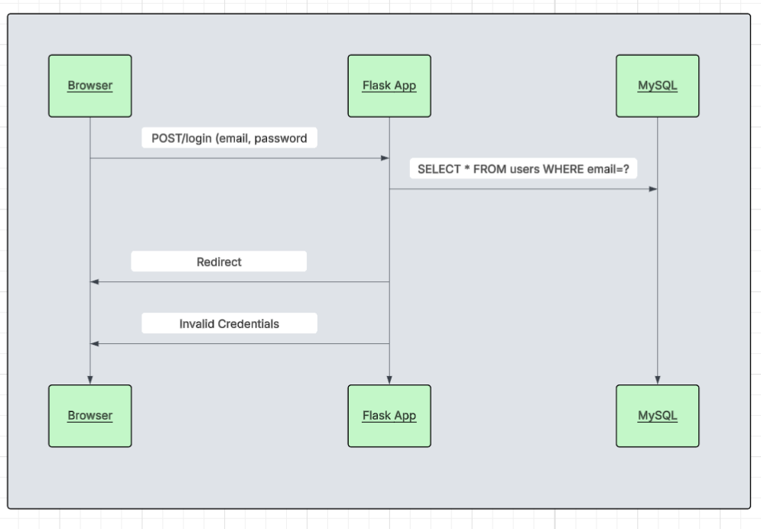
FIGURE 3.1
Login Sequence

Slide 17
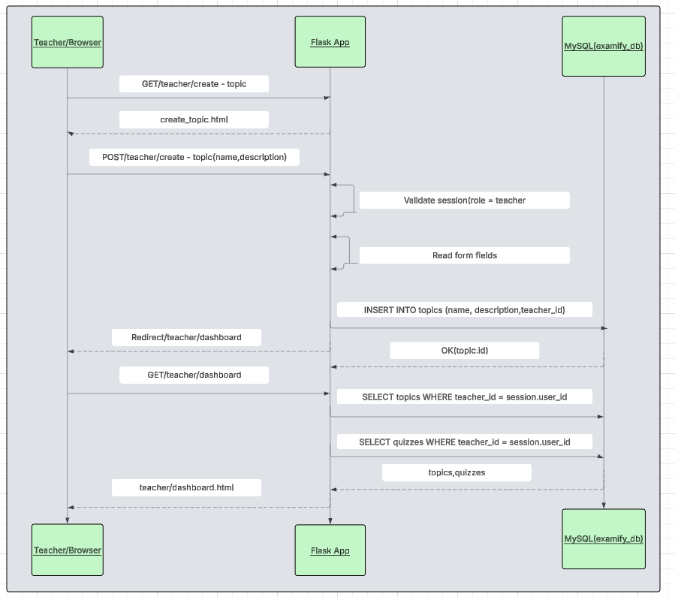
FIGURE 3.2
Create-Topic
Sequence

Slide 18
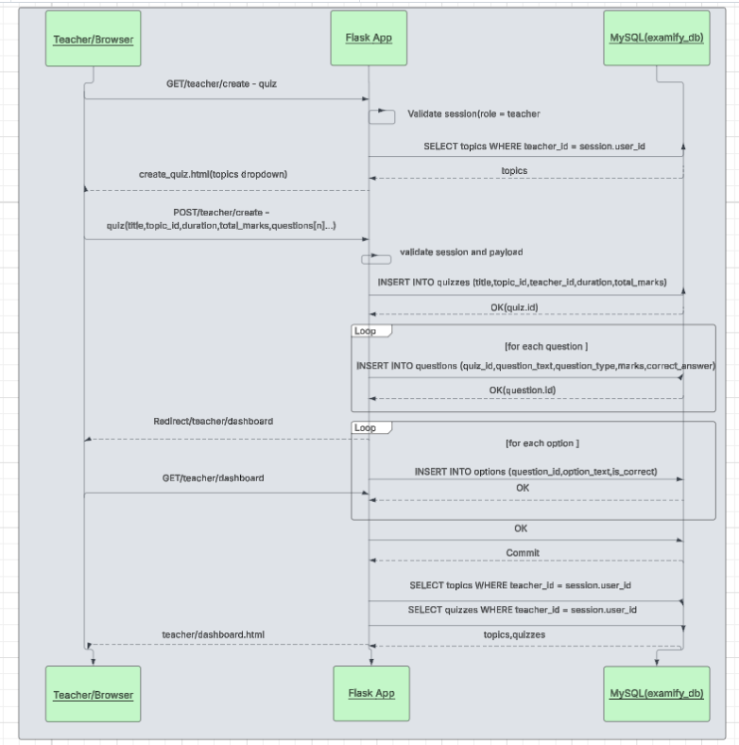
FIGURE 3.3
Create-Quiz
Sequence

Slide 19
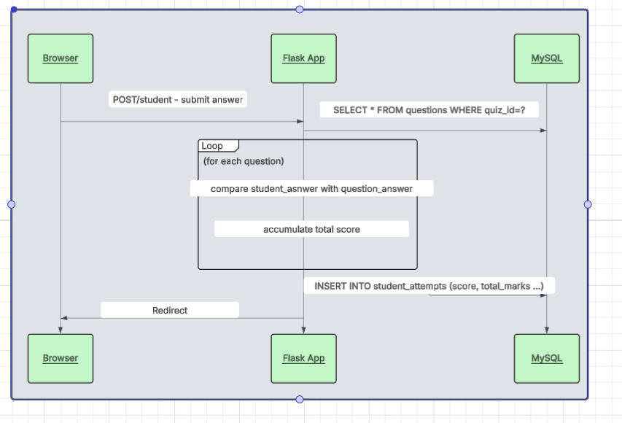
FIGURE 3.4
Take-Quiz Sequence

Slide 20
CLASS DIAGRAM

Slide 21
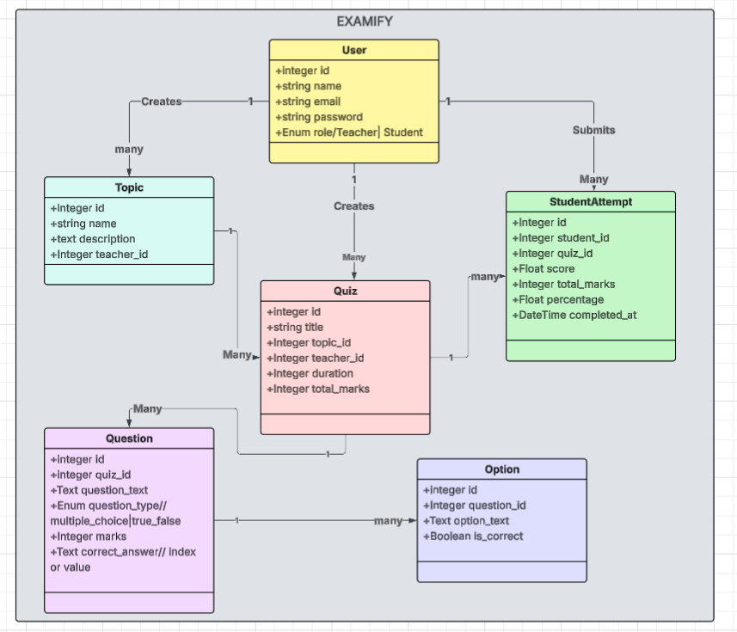
FIGURE 4

Slide 22
DEPLOYMENT DIAGRAM

Slide 23
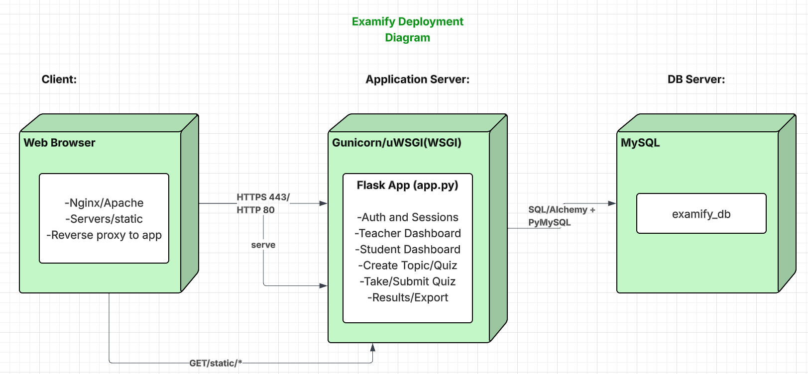
FIGURE 5

