Slide 1


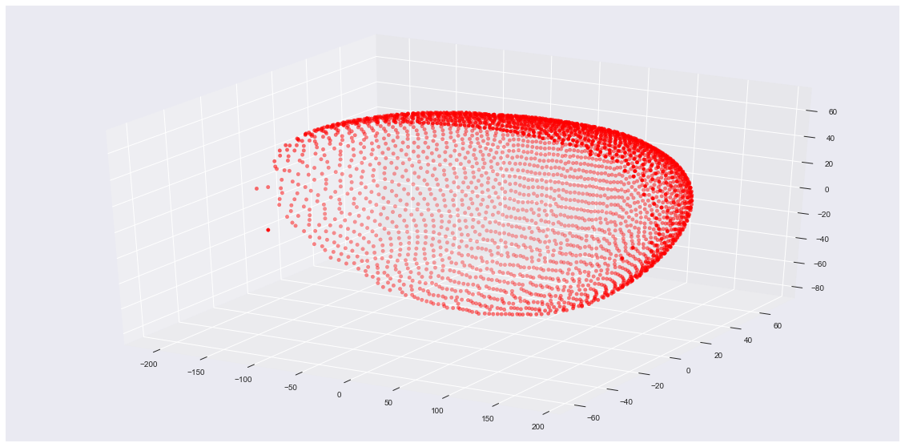
1270 Sequences of length 8000+84
RNA-seq of cells in early stage
3039 Sequences of length 84/60/20
In-situ readout of cells in adult fly
The only available known function is Max(MCC)
Challenge is to find another function that uses less in-situ genes

