Slide 1
DREAM challenge
October 24th

Slide 2
Input data:
1. Provided to us as part of the challenge:
SC data
9000 genes
X
1300 cells
In-Situ
84 genes
X
3000 positions

Slide 3
Input data:
2. Generated by us
Dani’s scrapped data
9000 genes
X
100’s of functions
Tom’s gene-gene interactions
8300 genes
X
Number of interactions for each
Tom’s area assigned genes from FlyBase
~1200 genes
X
1 of 5 possible locations
(Ventral – Dorsal – Anterior – Posterior – Lateral)

Slide 4
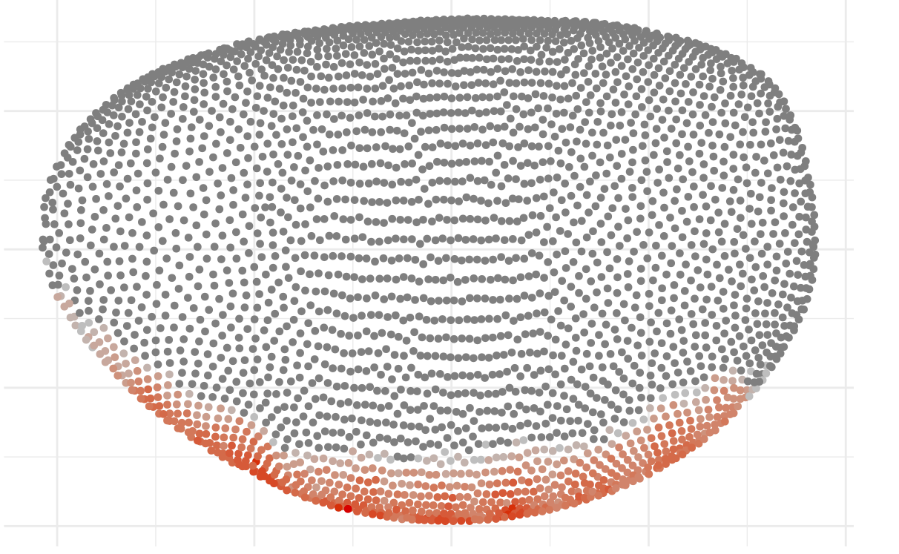
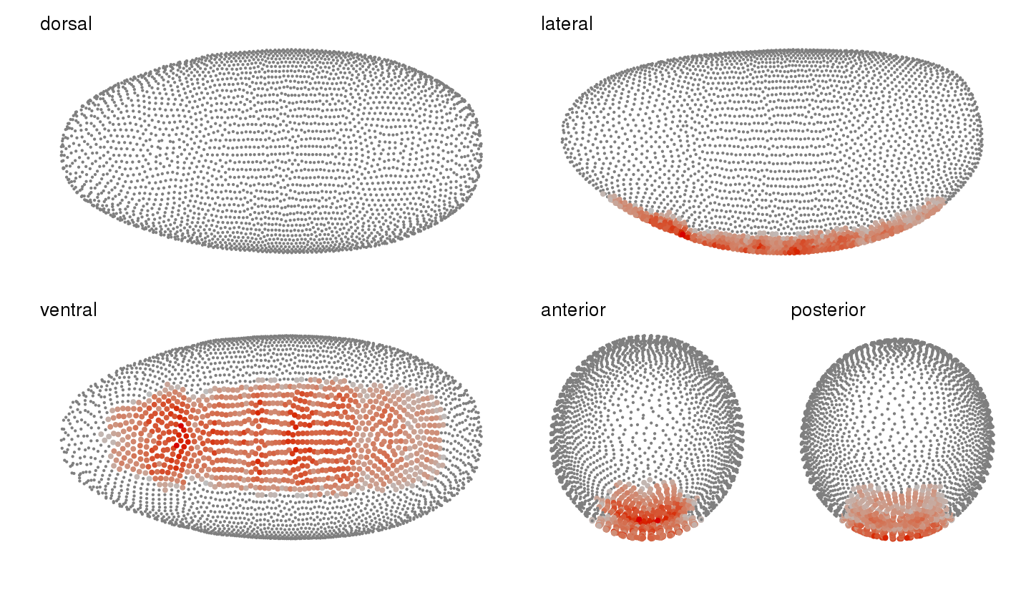
Defining the 5 areas

Slide 5
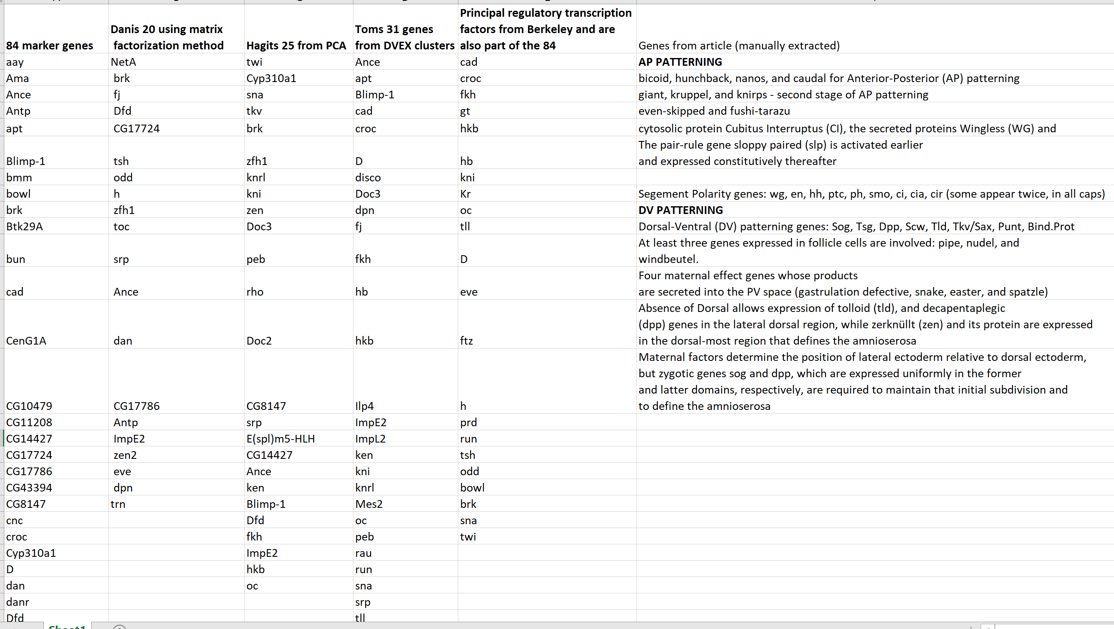
Gene subsets – getting there!

Slide 6
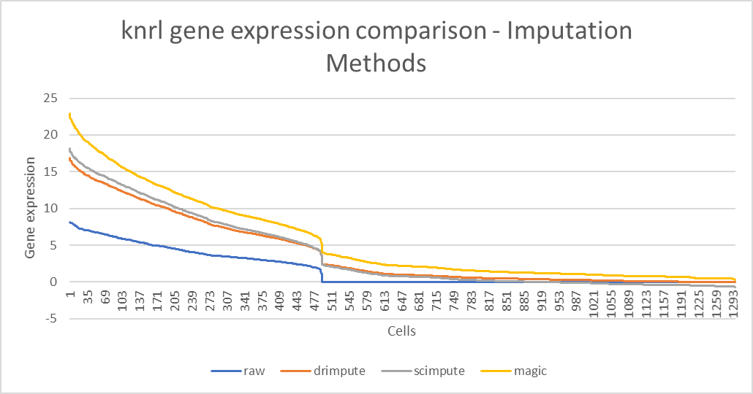
Or’s work
How zero imputation works:

Slide 7
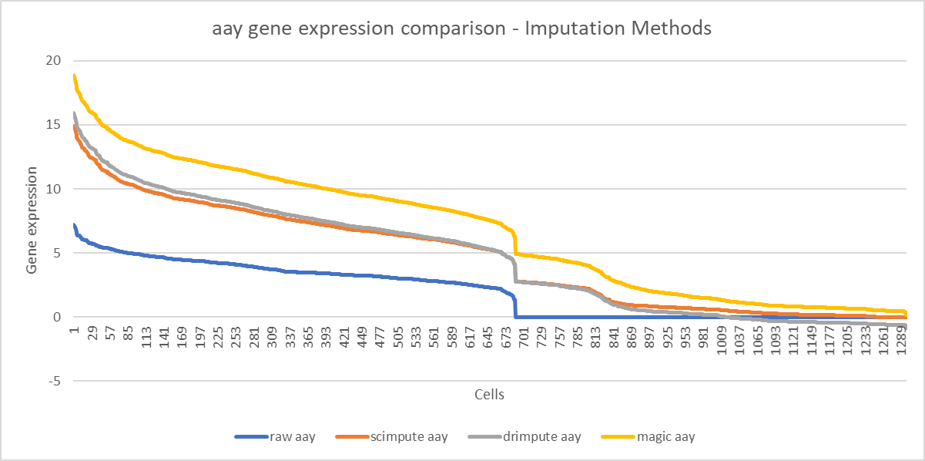

Slide 8
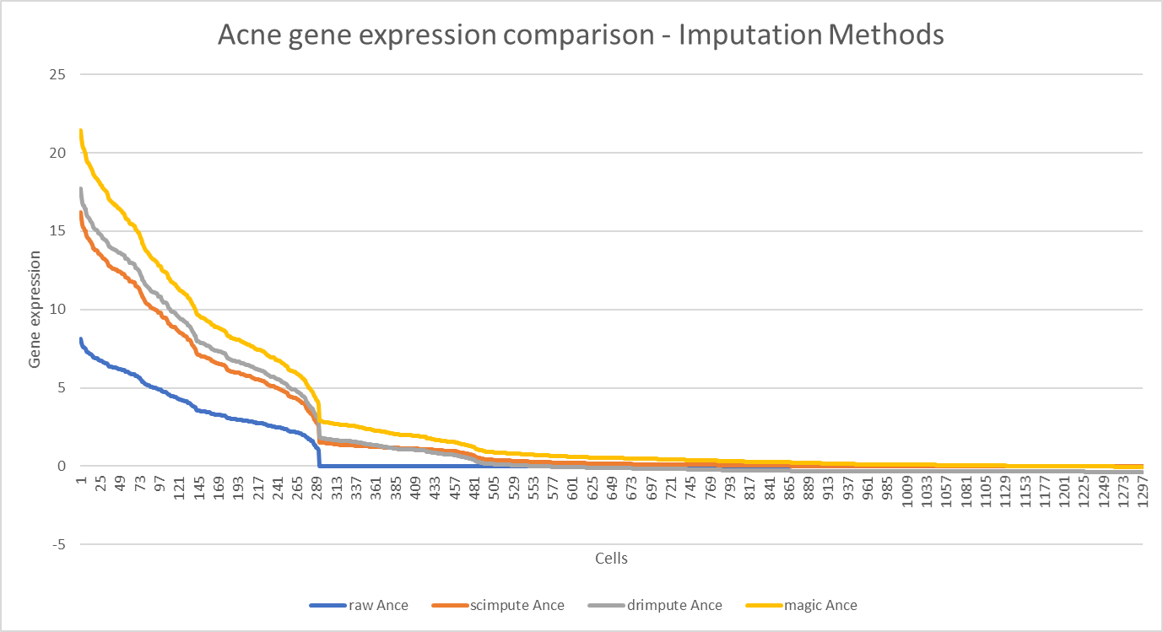

Slide 9
Hagit’s work
Looked at differentially expressed genes and pathways.
Only 3 genes are shown as important in this aspect:
Tkv
Trn
Aay
We will prioritize these genes in our subsets, as they add a regulatory pathway aspect to our analysis (even if not substantial)

Slide 10
Timeline
Mid-way submission by Nov 1st – just the CSV files
Submission + write-up by Nov 21st – According to the format detailed at the website.

Slide 11
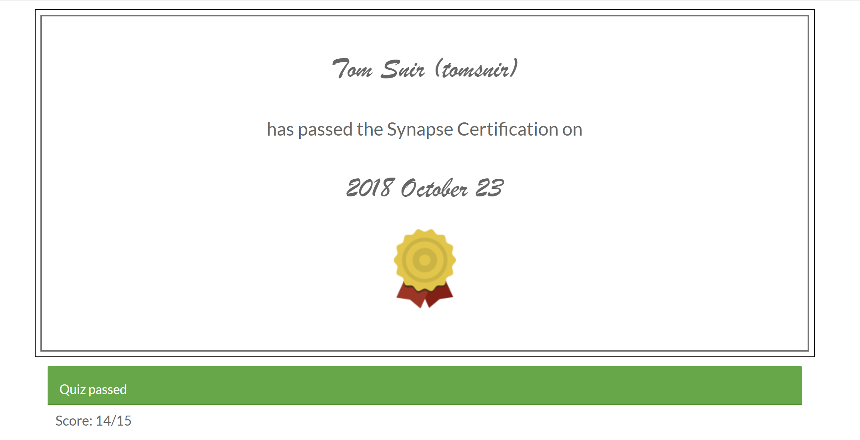
Certification!

