Slide 1
Livewire in Action
KU Rehan
17th September 2022

Slide 2
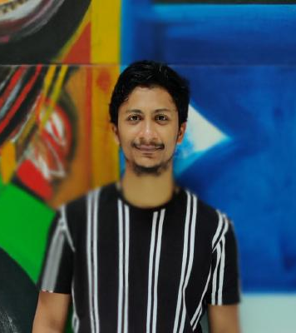
Hi 👋 I’m Rehan
LCC Organizer
5+ Exp. in Full Stack
Backend Biased
Building getevaluate.app
KU Rehan / @im_zrehan

Slide 3

Quiz Time
KU Rehan / @im_zrehan

Slide 4
Which Stack would you choose to create something like getevaluate.app?
KU Rehan / @im_zrehan

Slide 5
Zero lines 🔥
KU Rehan / @im_zrehan

Slide 6
Pros
No need of FE dev.
Plain ‘Ol Blade Engine
Comfort of Laravel
KU Rehan / @im_zrehan

Slide 7
Cons
API cannot be Developed
Abstraction to DDD/Action Design Pattern
Load on Server (Only, if used incorrectly)
KU Rehan / @im_zrehan

Slide 8
Let’s see some code in Action
Get ready for some magic!
KU Rehan / @im_zrehan

Slide 9
Questions?
KU Rehan / @im_zrehan

