Slide 1
Observer Pattern
Map Rendering for high frequency Geo-Data Generation

Slide 2
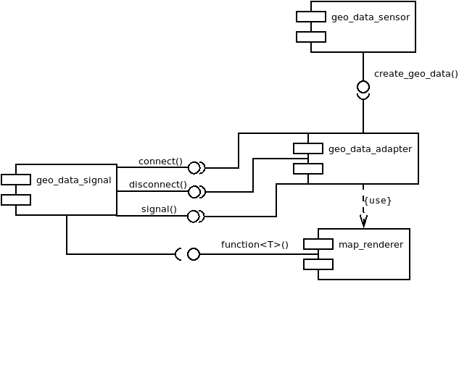
Architecture Concept
Clean Architecture

Slide 3
Benefits of signals2
Thread Safe
Managed
Combinable
Trackable
SOLID
Loose Coupling
Testable

Slide 4
Drawbacks of signals2
Compile Time(-O3):
observer_pattern_signals2(perf): 7,2s
observer_pattern_list(perf): 3,9s
observer_pattern_signal(perf): 4,6s
Performance: 100 million rings, 2 Observer
observer_pattern_signals2(perf): 21,2s
observer_pattern_list(perf): 14,6s
observer_pattern_signal(perf): 9,1s

Slide 5
Conclusion
Boost::signal2 is flexible
Low performance
Use leightweight implementation e.g. based on flat_map and inplace_function
Combine boost::signals2 with inplace:function

