Slide 1
Intelligent Doctor System
Group members
Name | ID
Md. Obaidullah Al-Faruk | 2013-2-60-038
Sadia Jannath Zuthy | 2013-2-60-011
Samira Akter | 2013-2-60-006
Md. Mahmudun Hassan | 2013-2-65-013
S.M. Mominul Haque | 2013-2-60-009

Slide 2

Introduction
What is Intelligent Doctor system ?

Slide 3
An Intelligent Doctor System :
Putting the doctor mind into computer system
NLP based
Calculates probability
Disease confirmation
Prescribe primary medicines
Suggests test

Slide 4
Scope
Any person
Any medical institutes like
Clinic
Small hospital
Diagnostic center
Commercial and Educational Institute

Slide 5
Requirement
Login
Register
Analyze symptoms
Prescribe medicine
Check up After 7days
Suggest Specialist doctors

Slide 6
Team Structure
Analysis:
Sadia Zannath Zuthy
Design:
Samira Akter
Development:
S. M. Mominul Haque
Md. Obaidullah Al Faruk
Deployment and Testing:
Md. Mahamudun Hassan

Slide 7
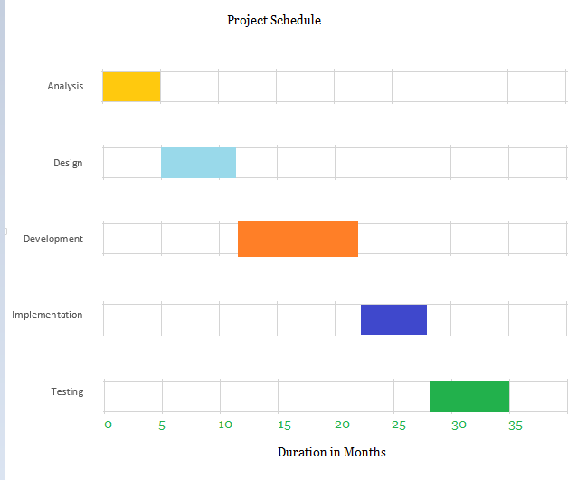
Project Schedule
Duration in weeks

Slide 8
Test Case
Step | Test Steps | Test Data | Expected Result | Actual Result | Status (Pass/Fail)
1 | Navigate to login page
2 | Provide valid username | Username: user1234 | User should be able to login | User is navigated to dashboard with successful login | Passed
3 | Provide valid password | Password: 1234
4 | Click on Login button

Slide 9
Step | Test Steps | Test Data | Expected Result | Actual Result | Status (Pass/Fail)
1 | Navigate to search page |  | Show estimated result regarding the symptom | Show results with higher probability. | Pass
2 | Provide symptoms about the patients disorder | Headache
3 | Press submit button

Slide 10
Step | Test Steps | Test Data | Expected Result | Actual Result | Status (Pass/Fail)
1 | Navigate to prescribe page |  | Give proper medicine | Tell user about medicines to take | Pass
2 | Suggest some medicine | Prescribe some anti-biotics
3 | Schedule user for re-check after 1 week | Show reminder to check again after 1 week
4 | Show printable prescription

Slide 11
Traceability Matrix
Test case | L1.1 | L1.2 | R2.1 | R2.2 | AS3.1 | AS3.2 | AS3.3 | AS3.4 | AS3.5 | P4.1 | CUP5.1 | CUP5.2 | SD6.1
Requirements
Login |  ✓ | ✓
Register |  |  | ✓ | ✓
Analyze symptoms |  |  |  |  | ✓ | ✓ | ✓ | ✓ | ✓
Prescribe medicine |  |  |  |  |  |  |  |  |  | ✓
Check up After 7days |  |  |  |  |  |  |  | ✓ | ✓ |  | ✓ | ✓
Suggest Specialist doctors |  |  |  |  |  |  |  |  |  |  |  |  | ✓

Slide 12
Conclusion
So we can assume that this system will be helpful for primary level disease detection and also when no doctor is available.

Slide 13
Thank You
Questions?

