Slide 1
CS 4311
Software Design and Implementation
Spring 2012

Slide 2
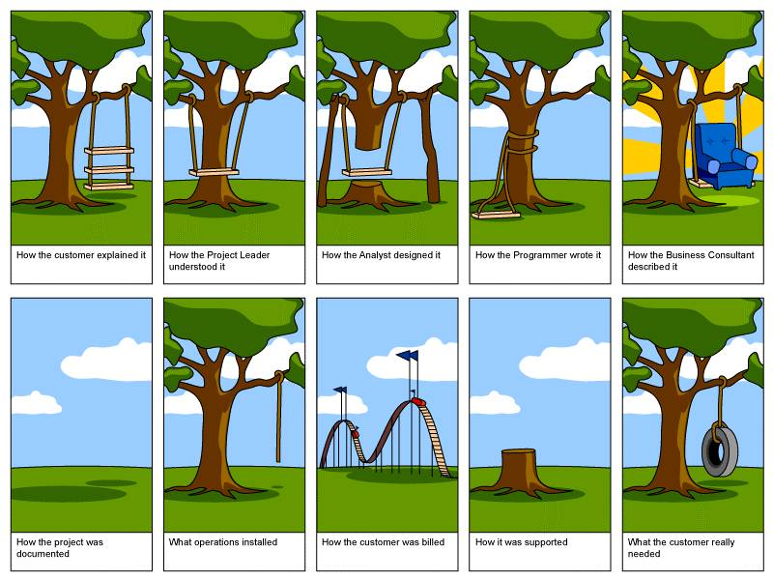

Slide 3
CS4310 Catch-up
“The paper prototype models the system.”
“The system prototype is used to design the system.”
“Since I am the system analyst I don’t need to be involved in the V&V process.”
“The tester should not be involved in an SRS inspection.”
  Verifiability

Slide 4
CS4310 Catch-up
“I would model the system’s requirements by doing a traceability matrix.”
“Requirements cannot be traced back to the feasibility report because the document is written by the SE team.”

Slide 5
Create a Venn Diagram that shows the set of programs that solves the problem, and of those that are feasible, maintainable, efficient
3 minutes, pairs

Slide 6
Create a Venn Diagram that shows the set of programs that solves the problem, and of those that are feasible, maintainable, efficient
Maintainable
Solves Problem
Efficient
Feasible
Feasible

Slide 7
What does this diagram say?
(pairs, 1 minute)
Maintainable
Solves Problem
Efficient
Feasible
Feasible

Slide 8
Create a Venn Diagram that shows the set of programs that solves the problem, and of those that are feasible, maintainable, efficient
We’d like one of these
Maintainable
Solves Problem
Efficient
Feasible
Feasible

Slide 9
What 4311 is About
Design
Implementation
Testing

Slide 10
What 4311 is About
Design
Implementation
Testing
What are these?
(pairs, 3 minutes)

Slide 11
What 4311 is About
Design
  Detailed view of classes
  Detailed understanding of responsibilities and methods to accomplish those
  Detailed understanding of interactions (collaborations) between objects
Implementation
  Coding
  Documenting
Testing
  Verification

Slide 12
Design
Many possible designs for any given problem
You have to make choices
Some are better than others
First design is rarely the best

Slide 13
Outline of 4311
Architecture
High-level design
Detailed Design
V&V and Testing
Implementation
Integration

