Slide 1

Adaptive Visual Context
From CARES Research to a Verified Agent Workflow
A rigorous bridge from query-conditioned resolution research to deterministic tooling, executable scientific checks, and narrowly scoped Lean proofs.
Daniel Liezrowice
Research attribution
Presenter · Engineering Software Lab
AI SDLC Consultants
CARES — Kimhi, Shabtay, Giryes, Baskin & Schwartz (2025)
arXiv:2510.19496v3
Independent Apache-2.0 implementation · not affiliated with or endorsed by CARES authors
OPENING
https://arxiv.org/abs/2510.19496v3
01
Notes:
Paper: https://arxiv.org/abs/2510.19496v3,ESL is presented as AI SDLC Consultants; no authorship or endorsement of CARES is implied.

Slide 2
Executive scientific thesis
THESIS
r* = π(x, q) — not π(x) alone
IMAGE
x
QUERY
q
Conditioning changes allocation
The same pixels can require very different evidence: “summarize layout” may tolerate a proxy; “read CVE-2026-…” may require an exact crop. Resolution is therefore a decision conditioned jointly on image x and query q.
Policy π(x,q)
Allocate the least visual context sufficient for the objective.
resolution / crop / tokens
RESEARCH
https://arxiv.org/abs/2510.19496v3
02

Slide 3
VLM pipeline — where visual cost enters
pixels
vision encoder
projector
LLM decoder
answer
H×W
patch tokens
modality bridge
self-attention
G tokens
TOKENS
COST
Consequence
T = Q + V + G
Ωdecoder ≈ 2s²h + 12sh²
Increasing visual sequence V increases both attention-like s²h work and projection/MLP-like sh² work. Pixel count is only a proxy: tokenization and latency remain target-model specific.
Q — query
100
V — visual
2880
G — generated
80
FOUNDATIONS
https://arxiv.org/abs/2411.03312
03

Slide 4
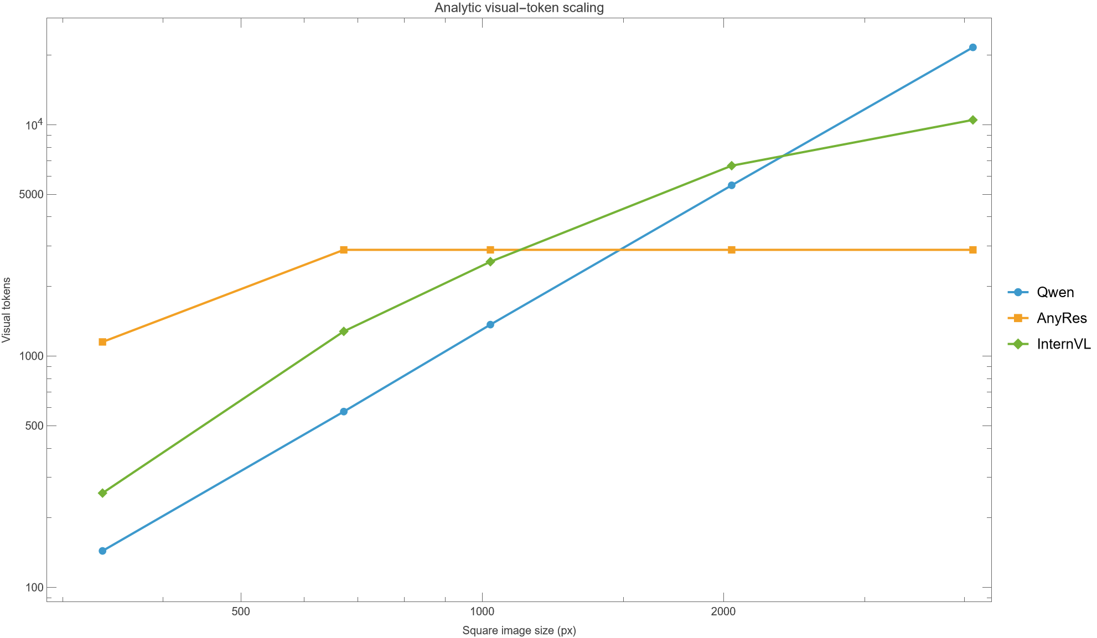
Why visual tokens dominate
At 4096 px
Qwen: 21,609 visual tokens (99.54% with 100 text)
InternVL: 10,496 (99.06%)
AnyRes analytic cap: 2,880 (96.64%)
IDENTITY
share_visual = V / (V + Q)
Scientific boundary
These are analytic token-accounting reproductions of the paper’s Table 7 formulas—not measured target latency and not a benchmark-accuracy reproduction.
FOUNDATIONS
Project-generated: exports/token_scaling.csv; CARES Table 7
04

Slide 5
Capability versus allocation
AnyRes / LLaVA-NeXT
Native dynamic resolution
CARES selector
Tiling preserves local detail and handles varied aspect ratios. It expands the feasible visual budget; it does not decide whether this query needs that budget.
Qwen2-VL maps varying image sizes into varying token counts. Dynamic capability is not itself objective-conditioned allocation.
A query-aware selector predicts the smallest sufficient input range before invoking an untouched target VLM.
DISTINCTION
more available tokens ≠ more useful evidence
RESEARCH
https://llava-vl.github.io/blog/2024-01-30-llava-next/ · https://arxiv.org/abs/2409.12191
05

Slide 6
CARES problem definition
OBJECTS
x: image q: query F: target VLM x⁽ʳ⁾: resized image
UTILITY
GOAL
T(r): target utility at input range r
rₛ = min { r ∈ R : sufficient(T, r) }
Finite support
Target untouched
Minimal sufficient
R = {r₁,…,rK}; deployment chooses among supported target input ranges.
Selection is upstream; F is not retrained or modified by the CARES controller.
The objective is not globally minimal pixels; it is the first supported range satisfying a metric-derived criterion.
CARES METHOD
https://arxiv.org/abs/2510.19496v3
06

Slide 7
Label generation — utility and sufficiency
EQ. 1
EQ. 2
uᵢ = ANLS(F(x⁽ʳⁱ⁾,q), y)
uᵢ ≥ τ ∧ maxⱼ>ᵢ(uⱼ − uᵢ) ≤ δ
Thresholds
Non-monotonic utility
Terminal fallback
Paper setup: τ = 0.85 utility floor; δ = 0.10 tolerance for any later improvement. Both define labels and encode metric/teacher assumptions.
Use all higher classes, not only the next one. Example u={.86,.80,.99}: r₁ fails because a later gain .13 > δ, despite an intermediate drop.
If no lower range qualifies, the highest supported class is selected. This is positional selection over finite support.
ANLS = average normalized Levenshtein similarity; labels inherit metric sensitivity.
CARES METHOD
https://arxiv.org/abs/2510.19496v3
07

Slide 8
CARES architecture
low-res proxy
truncated SmolVLM
intermediate feature
classifier
target VLM
cheap view
≈350M selector
image + query
K resolution classes
untouched
Key separation
Information ceiling
Compatibility
Selector inference is paid once; routed target inference dominates the remaining cost.
A low-resolution selector cannot reliably infer evidence completely absent from its proxy.
No target fine-tuning is required; predicted resolution is mapped to a supported target input.
CARES METHOD
https://arxiv.org/abs/2510.19496v3
08

Slide 9
Training protocol and variant
training samples
80000
Base selector
Low-resolution proxy + truncated SmolVLM representation + classification head. Labels come from target-VLM utility sweeps.
datasets
4
label smoothing
0.05
AR Granite-Docling variant
CE
The paper also reports an autoregressive variant for Granite-Docling-oriented settings; architecture choice remains task/model dependent.
L = −Σₖ ỹₖ log pₖ
Interpretation
80K / four datasets / 0.05 are reported training facts—not reproduced here.
CARES METHOD
https://arxiv.org/abs/2510.19496v3
09

Slide 10
Continuous inference and upward rounding
EQ. 3
p = softmax(z), r̃ = Σₖ pₖ rₖ
336 × 0.10
672 × 0.25
1024 × 0.45
2048 × 0.20
EXAMPLE
r̃ = 33.6 + 168 + 460.8 + 409.6 = 1,072
round upward to 2048
Why upward?
Boundary
Avoid selecting a supported range below the continuous expectation.
Rounding guarantees support membership and order—not empirical sufficiency.
CARES METHOD
https://arxiv.org/abs/2510.19496v3
10

Slide 11
Reported evidence across target models
Target | reported score | reported cost
Granite | .59 → .60 | −63%
InternVL | .77 → .77 | −64%
Qwen2.5-VL-72B | .79 → .80 | −70%
GPT-4o | .69 → .68 | −55%
Scope
Nine benchmarks · four target models (paper report).
Evidence status
REPORTED, NOT INDEPENDENTLY REPRODUCED. Score aggregation, hardware, routing overhead, and exact cost definition must be checked in an empirical replication.
DO NOT READ AS OUR BENCHMARK
EVIDENCE
https://arxiv.org/abs/2510.19496v3
11

Slide 12
Scientific interpretation and limitations
Selector overhead
Proxy blindness
Metric dependence
Break-even requires Cₛ + E[Cᵣ] < Cₕ. Small target jobs can erase routing gains.
The selector cannot see what low resolution hides; OCR and tiny-object evidence are especially exposed.
ANLS labels inherit teacher, answer, threshold, and benchmark choices.
Interaction scope
Safety gap
Cost proxy
Paper focus is single-image / single-turn; video, multi-page and conversation state need new policies.
No independent safety, adversarial, calibration, or out-of-distribution study is supplied by this OSS project.
Pixel or token reduction does not guarantee target-specific latency, memory, energy, or quality.
EVIDENCE
https://arxiv.org/abs/2510.19496v3
12

Slide 13
Literature map by intervention stage
INPUT
ENCODER
VLM SPARSITY
DEPTH
ELASTIC
CASCADE
DRNet · AnyRes · Qwen2-VL
DynamicViT · EViT · ToMe
HiRED · SparseVLM
PyramidDrop · VTW
TokenFLEX · M3 · LLaVA-Mini
SGL · compute-optimal scaling
MAP
allocation → pruning → merging → withdrawal → elastic training → collaboration
LITERATURE
See reference slides 35–39
13

Slide 14
Input-resolution lineage
DRNet (2021)
AnyRes / LLaVA-NeXT
Qwen2-VL
Learns per-input dynamic resolution for efficient recognition. Training changes the model; query awareness is not the central VLM objective.
Grid/tile strategy increases preserved detail and aspect-ratio support. Mechanism exposes capacity, but does not choose based on question.
Native dynamic resolution maps arbitrary image size to variable visual-token counts. Again: capability, not necessarily allocation.
AXIS
query-aware? CARES: yes | DRNet / AnyRes / Qwen2-VL: not as the same controller objective
LITERATURE
2106.02898 · LLaVA-NeXT blog · 2409.12191
14

Slide 15
ViT token reduction mechanisms
DynamicViT
EViT
ToMe
keep ratio ρ = |Skeep| / N
fused token = Σᵢ aᵢxᵢ / Σᵢaᵢ
m(a,b) = (sₐa+sᵦb)/(sₐ+sᵦ)
DynamicViT
EViT
ToMe
Predicts which tokens to retain; attention masking supports differentiable training.
Keeps attentive tokens and fuses less attentive tokens into a summary token.
Merges similar tokens, preserving aggregate “size” weights; no token classifier is required.
Composition warning
Reducers can remove evidence selected by upstream resolution. Joint calibration—not independent optimization—is required.
LITERATURE
2106.02034 · 2202.07800 · 2210.09461
15

Slide 16
VLM inference sparsification
HiRED
SparseVLM
Allocates a visual-token budget using high-resolution encoder signals, retaining spatially informative tokens before the language model.
Uses text-to-vision relevance and visual-token ranking to sparsify inference while seeking task-aware retention.
BUDGET
RELEVANCE
bᵢ = B · wᵢ / Σⱼwⱼ
rel(vᵢ,q) = maxⱼ sim(vᵢ,tⱼ)
SCHEMATIC
rank(vᵢ) = rel(vᵢ,q) + λ·centrality(vᵢ)
Equations here summarize controller structure; consult papers for exact definitions and implementation.
LITERATURE
2408.10945 · 2410.04417
16

Slide 17
Depth-wise visual-token reduction
SCHEDULE
DECODER
s₀ → s₁ → … → sL, sℓ₊₁ ≤ sℓ
Ω ≈ 2s²h + 12sh²
PyramidDrop
Visual Tokens Withdrawal
Drops visual tokens progressively across LLM depth, exploiting the hypothesis that later layers need less raw visual detail. Savings compound because s enters both quadratic and linear terms.
Withdraws visual tokens at selected layers after their information has influenced textual states. Timing is a fidelity/control variable.
resolution controls input evidence
depth controls retention
LITERATURE
2410.17247 · 2405.05803
17

Slide 18
Elastic trained models and controller gap
TokenFLEX
Matryoshka Multimodal Models
LLaVA-Mini
Trains operation over flexible visual-token budgets; supports runtime budget choice but requires elastic training.
Nested representations aim to remain useful at multiple token granularities; deployment still needs a budget controller.
Compression-oriented architecture reduces visual-token burden through learned modality interaction; architecture is not a query policy.
GAP
elastic capability + controller objective + calibrated gate = adaptive system
LITERATURE
2504.03154 · 2405.17430 · 2501.03895
18

Slide 19
Small–large collaboration and compute optimality
COST
SCALING
F_inf = O(NT), T = Q + V + G
Y(N,T) = (A/Nᵅ)·(B/Tᵝ) + D
SGL: small–large collaboration
Compute-optimal VLMs
A smaller model can route, draft, or handle easier work while escalating hard cases to a larger model. Selector overhead and error correlation determine value.
Allocation across model size N and token budget T exposes a joint design space. More image tokens are not universally optimal.
OCR caveat
Tiny text is discontinuous: below a readability threshold, extra model capacity cannot recover missing characters.
LITERATURE
2412.03324 · 2411.03312
19

Slide 20
Composition thesis — a generalized controller
ACTION
a = [r, crop, Benc, merge, withdrawal layer, model, escalate]
CARES upstream
encoder/projector
decoder depth
cascade
select evidence scale
prune or merge
withdraw progressively
choose model / escalate
Control objective
Minimize expected cost subject to fidelity, safety, support, and evidence-retention constraints.
SYNTHESIS
Independent synthesis from cited literature
20

Slide 21
OSS project goals and evidence philosophy
Practical runtime
Executable science
Narrow formalization
Portable Agent Skill + deterministic Pillow CLI. It applies an explicit keyword policy—not the trained CARES ≈350M selector.
Wolfram reproduces Algorithm 1, Equation 3, Table 7 accounting, sensitivity, and break-even economics.
Lean proves selected exact statements under explicit assumptions. It does not prove the paper or empirical accuracy.
trace every claim to an evidence class
PROJECT
https://github.com/zuwasi/adaptive-visual-context
21

Slide 22
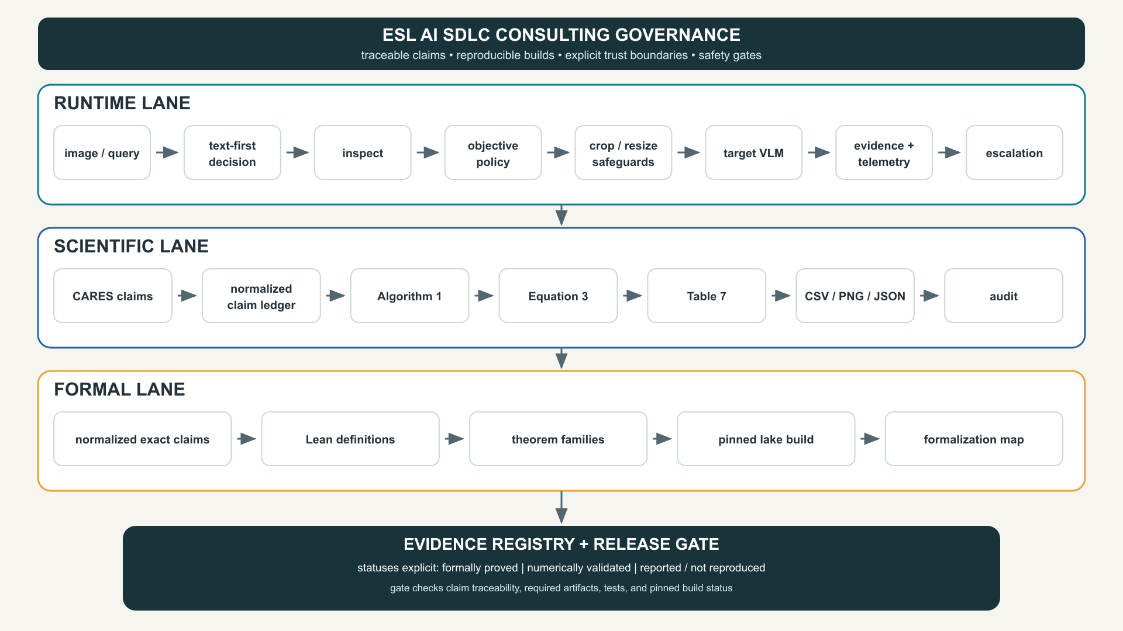
End-to-end project workflow
PROJECT
Original diagram: presentation/project-workflow.svg
22

Slide 23
Agent Skill runtime behavior
1
2
3
4
5
6
TEXT FIRST
INSPECT
OBJECTIVE
CROP FIRST
SAFE RESIZE
ESCALATE
Text-first gate
Fidelity policy
Escalation
If source text, DOM, OCR, or structured data already answers the question, avoid image inference.
overview 1280/JPEG88; detail 2048/PNG; exact and critical preserve dimensions by default.
Warnings and consequential evidence trigger source verification or higher-fidelity processing.
RUNTIME
skill/optimizing-visual-context/SKILL.md
23

Slide 24
Python implementation — deterministic by design
CLI / API
Safeguards
Deterministic JSON
inspect PATH
prepare PATH --objective …
--mode auto|overview|detail|exact|critical
--crop X,Y,W,H
--max-edge N
EXIF transpose before coordinates; crop before resize; no upscale; no overwrite; frame count and color-mode checks.
policy + reason; original/result dimensions; crop; format; pixel reduction; max-edge provenance; warning.
POLICY
Verification
classifier = ordered keyword boundary matching
19 focused tests reported in the repository; current QA reruns pytest.
Pixel reduction is only a proxy for target-specific visual-token and latency reduction.
RUNTIME
src/adaptive_visual_context · tests/test_adaptive_visual_context.py
24

Slide 25
Worked path — exact evidence in a report
report.png
objective
policy
crop
output
target VLM
2200×1400
“Read exact CVE + version”
exact
840,120,620,400
evidence.png
verify source
FULL REPORT
CROPPED, LOSSLESS
No downsampling
Source remains unchanged
CVE table region
deterministic JSON audit trail
RUNTIME
README.md quick-start example
25

Slide 26
Wolfram architecture and generated artifacts
CARESModel.wl
CARESReproduction.nb
build_project.wls
proof_audit.wls
exports/
validated functions
executable narrative
deterministic build
claim checks
CSV · PNG · JSON · reports
Package boundary
Build boundary
Evidence boundary
Input validation, exact selector semantics, analytic token formulas, break-even predicate.
Seeded / deterministic data generation; required-artifact check; validation and audit reports.
10/10 numerical/analytic checks passed. Empirical benchmark performance remains out of scope.
SCIENTIFIC LANE
wolfram/ · exports/
26

Slide 27
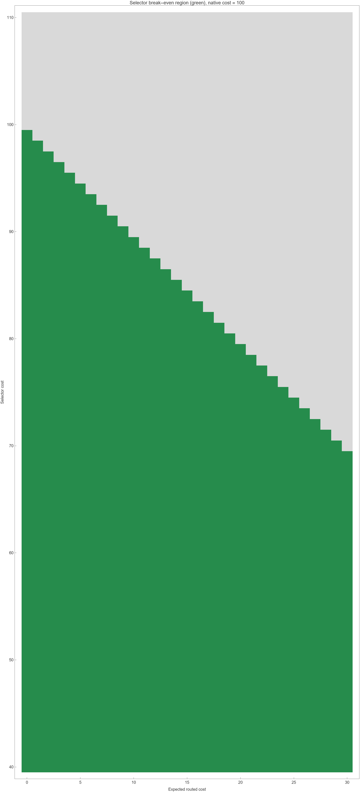
Wolfram scientific checks
BREAK-EVEN
Cₛ + E[Cᵣ] < Cₕ
Algorithm 1
First supported class passing τ and all-higher-gain δ; non-monotonic case included.
Equation 3
Weighted expectation, one-hot recovery, deterministic bounds.
Table 7
Hard-coded published token-count targets and percentages checked analytically.
SCIENTIFIC LANE
exports/validation_report.md · selector_break_even.png
27

Slide 28
Lean formalization — trust boundary
Definitions
Theorem families
Pinned build
Finite three-class expected resolution; upward rounding; positional sufficiency selector.
Bounds, one-hot identities, upward mass transfer, supported rounding, first-pass/fallback behavior.
Lean 4.19.0; Mathlib v4.19 revision c44e0c8…; lake build exit 0; all theorem proofs complete.
Critical boundary
Lean proves these mathematical statements under assumptions. It does NOT prove CARES empirical accuracy, datasets, implementation fidelity, compute savings, or the paper as a whole.
FORMAL LANE
lean/ · exports/lean_build_report.txt
28

Slide 29
Lean proof sketches and assumptions
BOUNDS
IDENTITY
TRANSFER
r₁ ≤ Σₖpₖrₖ ≤ r₃
oneHot(k) ⇒ E[r] = rₖ
mass ↑ ⇒ E[r] nondecreasing
Assumptions
Round-up
Selector semantics
pₖ ≥ 0; Σpₖ=1; ordered support r₁≤r₂≤r₃. Upward transfer preserves total mass and nonnegativity.
Returned value is supported, no lower than the continuous estimate, and no higher than the largest support value—within defined cases.
Proof is positional first-pass / second-pass / highest fallback over booleans. It is not a theorem of numeric minimality over ℝ.
no “Lean proves the paper” claim
FORMAL LANE
lean/AdaptiveResolution/*.lean
29

Slide 30
Evidence matrix — do not collapse categories
Claim | Formally proved | Numerically validated | Reported / not reproduced
Expectation bounds / one-hot | ✓ | ✓
Algorithm 1 examples |  | ✓ | paper mechanism
Table 7 token accounting |  | ✓ | published values
Benchmark accuracy / savings |  |  | ✓
Python policy safeguards |  | 19 tests | project behavior
CARES trained selector accuracy |  |  | ✓
FORMAL ≠ NUMERICAL ≠ EMPIRICAL
EVIDENCE
docs/claim-ledger.md · docs/formalization-map.md
30

Slide 31
CI, release, licensing, and provenance
CI / release gate
Licensing
Upstream boundary
pytest → artifact checks → pinned lake build. Wolfram is a documented licensed-local release check. Evidence statuses remain explicit.
This independent implementation: Apache-2.0. CARES paper: CC BY-SA 4.0. Paper attribution does not transfer software provenance.
CARES repository lacked a software license at inspected commit 1bedb45d32ac1e6ed641fdcbb32952d9d89aa96a; no upstream source was copied/adapted.
PROVENANCE
claim → source → executable check → evidence status → release decision
Repository is independent and not affiliated with or endorsed by CARES authors or institutions.
GOVERNANCE
LICENSE · NOTICE · .github/workflows
31

Slide 32
ESL — AI SDLC Consultants
Discovery
Architecture
Governance
claims · risks · constraints
trust boundaries · controls
evidence · release gates
Reproducibility
Formal verification
Safety + adoption
Pinned tools, generated artifacts, auditable scientific checks.
Narrow theorem statements, explicit assumptions, mapped claims.
Escalation policy, fidelity gates, latency/quality/user metrics.
https://eswlab.com
GOVERNANCE
https://eswlab.com
32
Notes:
ESL consulting framing is independent of CARES paper authorship or endorsement.

Slide 33
Roadmap — from policy prototype to measured controller
v0.2
v0.3
v0.4
v1.0
OCR / text extraction
frame selection
plugin hooks
empirical harness
learned router
calibration / OOD
joint resolution + token controller
safety & adoption gates
SUCCESS
measure quality, latency, memory, energy, escalation, and calibration together
ROADMAP
Project roadmap synthesis
33

Slide 34
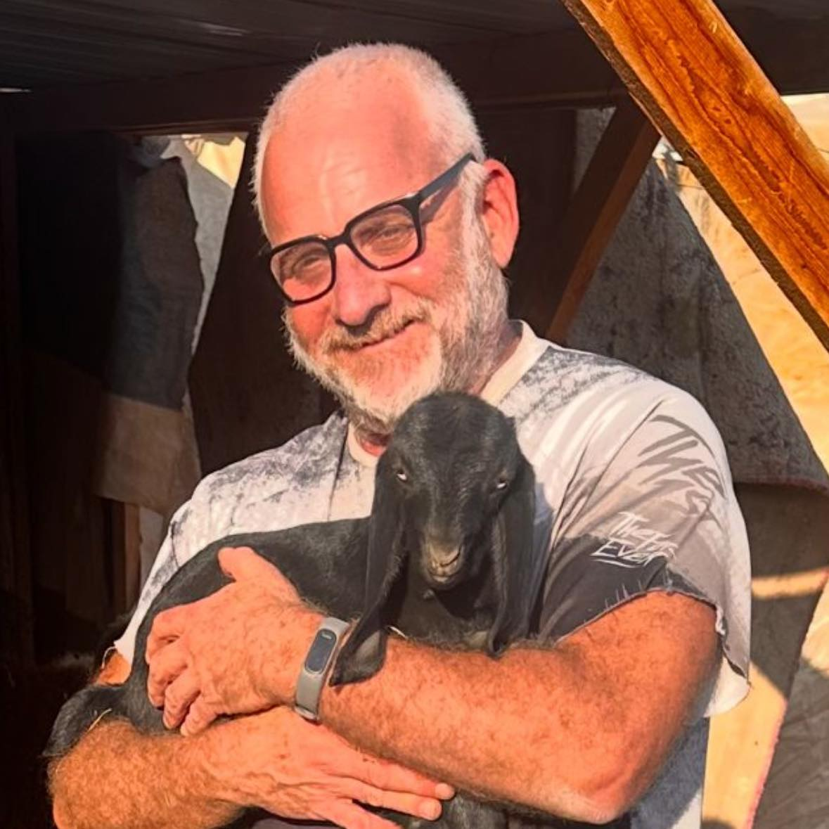
Conclusion — adaptive context needs evidence discipline
1 · Scientific thesis
Resolution is conditioned on image and query; capability alone is not allocation.
2 · Engineering thesis
Deterministic safeguards and telemetry make practical behavior auditable.
3 · Verification thesis
Formal, numerical, and reported evidence must remain separate.
Daniel Liezrowice
linkedin.com/in/liezrowice
VERIFY THE CLAIM · PRESERVE THE EVIDENCE
CLOSING
https://www.linkedin.com/in/liezrowice
34

Slide 35
References I — CARES and model foundations
CARES · Kimhi et al. · arXiv:2510.19496v3
01
https://arxiv.org/abs/2510.19496v3
SmolVLM · arXiv:2504.05299
02
https://arxiv.org/abs/2504.05299
Granite Vision · arXiv:2502.09927
03
https://arxiv.org/abs/2502.09927
lmms-eval · arXiv:2407.12772
04
https://arxiv.org/abs/2407.12772
REFERENCES
Full URLs shown below
35

Slide 36
References II — resolution architectures
Dynamic Resolution Network · arXiv:2106.02898
05
https://arxiv.org/abs/2106.02898
LLaVA-NeXT / AnyRes
06
https://llava-vl.github.io/blog/2024-01-30-llava-next/
Qwen2-VL · arXiv:2409.12191
07
https://arxiv.org/abs/2409.12191
DynamicViT · arXiv:2106.02034
08
https://arxiv.org/abs/2106.02034
REFERENCES
Full URLs shown below
36

Slide 37
References III — token reduction and sparsity
EViT · arXiv:2202.07800
09
https://arxiv.org/abs/2202.07800
Token Merging (ToMe) · arXiv:2210.09461
10
https://arxiv.org/abs/2210.09461
HiRED · arXiv:2408.10945
11
https://arxiv.org/abs/2408.10945
SparseVLM · arXiv:2410.04417
12
https://arxiv.org/abs/2410.04417
REFERENCES
Full URLs shown below
37

Slide 38
References IV — depth and elastic models
PyramidDrop · arXiv:2410.17247
13
https://arxiv.org/abs/2410.17247
Visual Tokens Withdrawal · arXiv:2405.05803
14
https://arxiv.org/abs/2405.05803
TokenFLEX · arXiv:2504.03154
15
https://arxiv.org/abs/2504.03154
Matryoshka Multimodal Models · arXiv:2405.17430
16
https://arxiv.org/abs/2405.17430
REFERENCES
Full URLs shown below
38

Slide 39
References V — cascade, scaling, and project
LLaVA-Mini · arXiv:2501.03895
17
https://arxiv.org/abs/2501.03895
SGL · arXiv:2412.03324
18
https://arxiv.org/abs/2412.03324
Compute-optimal VLMs · arXiv:2411.03312
19
https://arxiv.org/abs/2411.03312
Adaptive Visual Context source
20
https://github.com/zuwasi/adaptive-visual-context
Engineering Software Lab
21
https://eswlab.com
REFERENCES
Full URLs shown below
39

