Slide 1

MANTIQ FACTOR | CASE STUDY
From a PDF brief to a verified quantum program
Antenna tilt optimization with QAOA on real Tel Aviv cell-tower data, computed in Wolfram, proved in Lean 4, engineered and run on Classiq
Daniel Liezrowice
Team Quantum Headache, QUBIT 2026 hackathon | September 2026
github.com/zuwasi/mantiq-factor-antenna-tilt
1 / 16
Notes:
MantiQ Factor is the production line: input, conversion, understand, compute, verify, engineer, output. This deck walks the antenna-tilt challenge through all seven stages and shows the numbers that came out at each one.

Slide 2
SLIDE 2 / 16 | WHAT IT IS
MantiQ Factor: a seven-stage production line
Every stage leaves an artifact on disk (Markdown, JSON, .nb, .lean, .qmod) so the next stage consumes a file, not a memory
Compute and Engineer are separated: the exact simulation picks the angles, the SDK builds the circuit
Verify is a formal step, not a code review: Lean 4 theorems about the cost function and the circuit
One agent (Amp) drives the tools; humans decide the model and read the numbers
Result: every claim in the final program traces back to a proof, a simulation or a dataset
The pipeline: Input, Conversion, Understand, Compute, Verify, Engineer, Output. Tools: Amp (agentic orchestration), Wolfram Mathematica, Lean 4, converters, skills, knowledge bases.
2 / 16
MantiQ Factor | Antenna tilt with QAOA | QUBIT 2026 case study
Notes:
The picture is the one we animated. The key property is that stages hand over files, so the workflow is reproducible and each number can be re-derived.

Slide 3
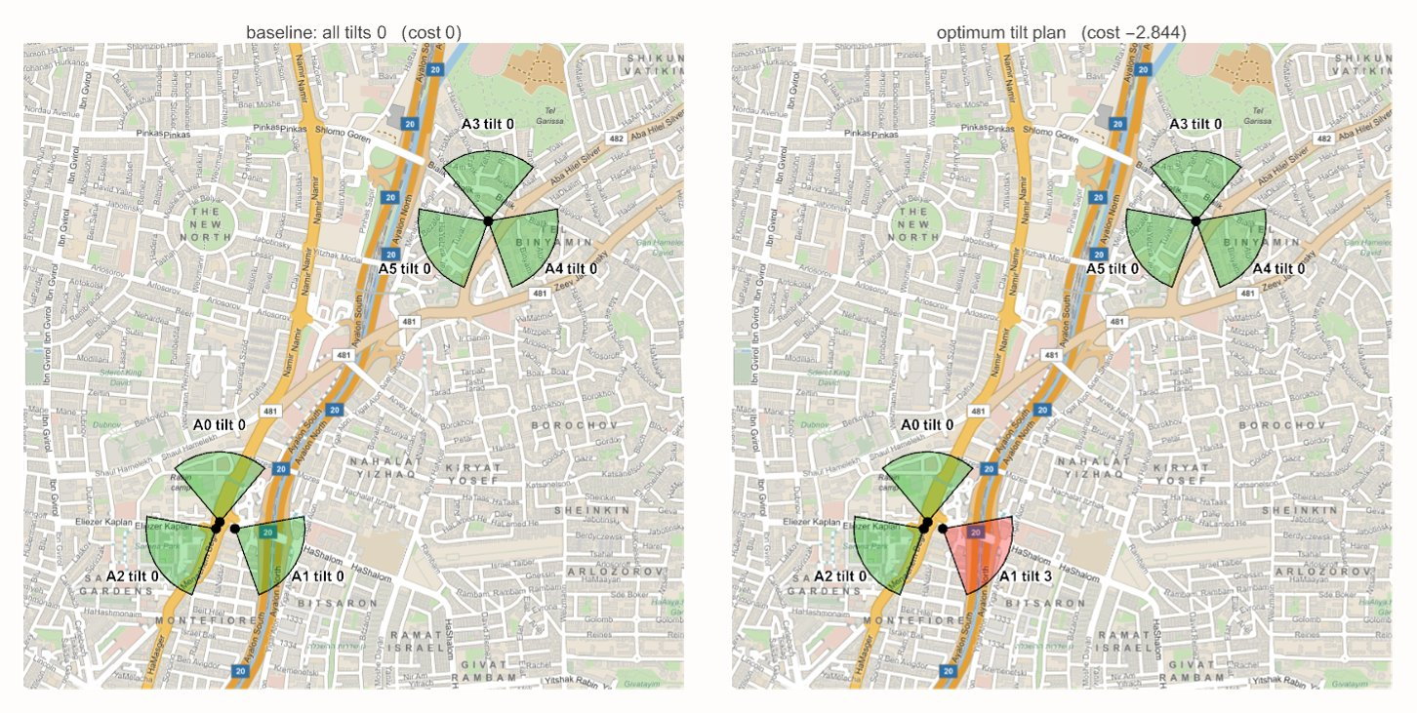
SLIDE 3 / 16 | INPUT
Stage 1, Input: the challenge and what the team handed over
Challenge (QUBIT 2026): choose the electrical down-tilt of every sector antenna. Tilting down cuts interference on neighbours but shrinks coverage
Inputs received as documents, not code: the challenge brief (PDF), the team Hamiltonian note (Markdown with LaTeX), the k-means hierarchy concept (PDF), the group deck (Google Slides)
Team utility: U(t) = alpha Q(t) - beta I(t) - gamma D(t); quality, interference, unmet demand
Team proposal: 27 three-sector configurations packed into 5 qubits, groups by k-means with k = 5
Constraint: Classiq student edition, 15 parallel jobs, simulator only
Six real sector antennas from OpenCelliD, Tel Aviv (data/opencellid_il2.csv). Interference matrix from pairwise distances and azimuths.
STAGE 1 Input
3 / 16
MantiQ Factor | Antenna tilt with QAOA | QUBIT 2026 case study
Notes:
Stage 1 is deliberately about what arrives, in whatever format it arrives. Real data was pulled from OpenCelliD (CC BY-SA) rather than a toy grid.

Slide 4
SLIDE 4 / 16 | CONVERSION
Stage 2, Conversion: documents become machine-readable facts
PDF brief, team PDF
Read with a PDF converter into Markdown; formulas kept as LaTeX. Output: docs/qaoa_antenna_hamiltonian_explanation.md
Google Slides deck
Exported to PDF, read slide by slide, merged into one PPTX built from code (build_deck.js), so the deck is reproducible too
OpenCelliD CSV
Pipeline data/opencellid_pipeline.py: filter Tel Aviv sectors, compute distances, azimuth overlap, interference matrix I and coverage vector c
What conversion decided (and recorded in the Markdown):
Keep the team utility form; maximize U is the same as minimize Cost = -U (later proved as theorem maximize_utility_iff_minimize_negative)
Fix the weights for the real dataset: beta = 1 (interference t^T I t), alpha = 1.5 (coverage c.t), gamma = 0.3 (tilt penalty sum t)
Four discrete tilt levels per antenna (0, 2, 4, 6 degrees) instead of continuous angles: the register is exactly 2 qubits
Six antennas give 4^6 = 4096 plans: small enough to enumerate exactly, so every quantum number can be checked against the truth
STAGE 2 Conversion
4 / 16
MantiQ Factor | Antenna tilt with QAOA | QUBIT 2026 case study
Notes:
Conversion is where formats stop mattering. Every later stage reads the Markdown, the CSV and the JSON, never the original PDF.

Slide 5
SLIDE 5 / 16 | UNDERSTAND
Stage 3, Understand: 2 qubits per antenna, not a 5-qubit pack
 | Team proposal: 27 configs in 5 qubits | Chosen: 2 qubits per antenna (QNum[2])
Encoding | 3 tilts x 3 sectors = 27 states of 32; 5 states invalid | 4 tilts per antenna; all 4096 states valid
Cost Hamiltonian | Arbitrary 5-qubit diagonal: terms up to ZZZZZ | 2-local Ising: 12 Z + 60 ZZ + offset (73 terms)
Invalid-state mass (team numbers) | 15.6% at start, 3% after training | 0%, by construction
P(optimum) / uniform (team numbers) | 0.5x to 1.2x | 27x (Wolfram), 27x to 29x (Classiq)
Scales to more antennas | No: 3 sectors fixed per pack | Yes: 2n qubits, still 2-local
Provable | Hard: decode is a lookup table | decodeTilt is a bijection (Lean theorem)
This is the decision the whole pipeline depends on. It was made here, with the exact enumeration in hand, before any circuit existed
The team hierarchy idea (k-means groups, one QAOA per group, recursive refinement) was kept: our 12-qubit problem is one leaf of that tree
STAGE 3 Understand
5 / 16
MantiQ Factor | Antenna tilt with QAOA | QUBIT 2026 case study
Notes:
The 5-qubit pack looked cheaper but its Hamiltonian is dense and not scalable, and the team measured almost no quantum gain from it. The 2-qubit register gives a 2-local Ising model that Classiq synthesizes efficiently.

Slide 6
SLIDE 6 / 16 | UNDERSTAND
Stage 3, Understand: the cost function and its Pauli decomposition
Cost(t) = t^T I t - 1.5 c . t + 0.3 sum(t)
t in {0,1,2,3}^6 (tilt levels), I = 6x6 interference matrix from the map, c = coverage per antenna
tilt_i = 2 q_{2i} + q_{2i+1}, so t_i is linear in its two qubits and t_i t_j gives only ZZ terms
4096
-2.844
plans enumerated exactly
unique minimum at (0,3,0,0,0,0)
73
12
Pauli weight | terms | meaning
0 | 1 | offset 35.499 (global phase, dropped)
1 (Z) | 12 | coverage gain and tilt penalty, 2 per antenna
2 (ZZ) | 60 | 15 interfering pairs x 4 qubit pairs
3, 4, 5 | 0 | none: the model is 2-local
Pauli terms, all weight <= 2
qubits: 6 antennas x QNum[2]
Only antenna 1 tilts (level 3); the other five stay flat. That is physically sensible: it is the antenna with the most overlap
Naive layer cost: 72 RZ + 120 CX; Classiq synthesis merges parity ladders down to 92 CX
gates/pauli_terms.json: Walsh-Hadamard transform of the 4096-entry cost table, checked to 1e-9 against every entry.
STAGE 3 Understand
6 / 16
MantiQ Factor | Antenna tilt with QAOA | QUBIT 2026 case study
Notes:
The classical truth is cheap here on purpose. It is what lets Wolfram, Lean and Classiq be compared number by number.

Slide 7
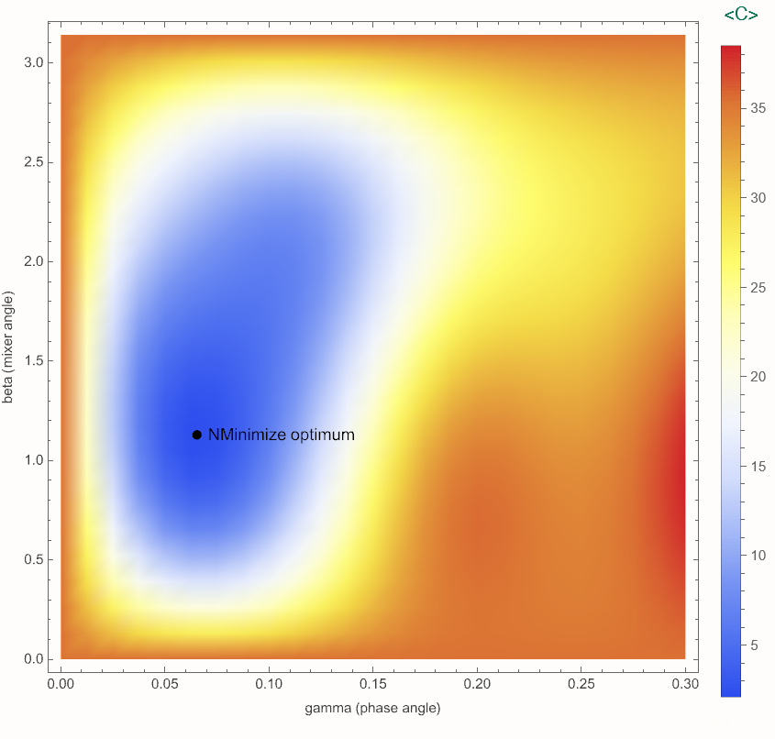
SLIDE 7 / 16 | COMPUTE
Stage 4, Compute: Wolfram exact simulation picks the angles
wolfram/wolfram_realdataset_algorithms.wl builds H_C from the same JSON, applies exp(-i gamma H_C) and the RX mixer as dense matrices, no sampling noise
p = 1 optimum: gamma = 0.0654, beta = 1.1293, giving <Cost> = 1.9985, P(cost < 0) = 0.53, P(optimum) = 0.0066 (27x uniform)
p = 2 optimum: <Cost> = -0.3825, P(cost < 0) = 0.67
Also compared: VQE, Grover-style amplification and plain uniform sampling on the same cost table
The angles are written to wolfram_realdataset_algorithms.json: this is the hot start the Classiq circuit later uses
1.9985
0.53
27x
Expected cost over (gamma, beta) for p = 1, evaluated exactly on the 4096-dimensional state. Minimum marked.
predicted <Cost>, p=1
P(cost < 0), p=1
P(optimum) vs uniform
STAGE 4 Compute
7 / 16
MantiQ Factor | Antenna tilt with QAOA | QUBIT 2026 case study
Notes:
Compute means the numbers are known before any SDK is opened. The Classiq run then becomes a test of the engineering, not an exploration.

Slide 8
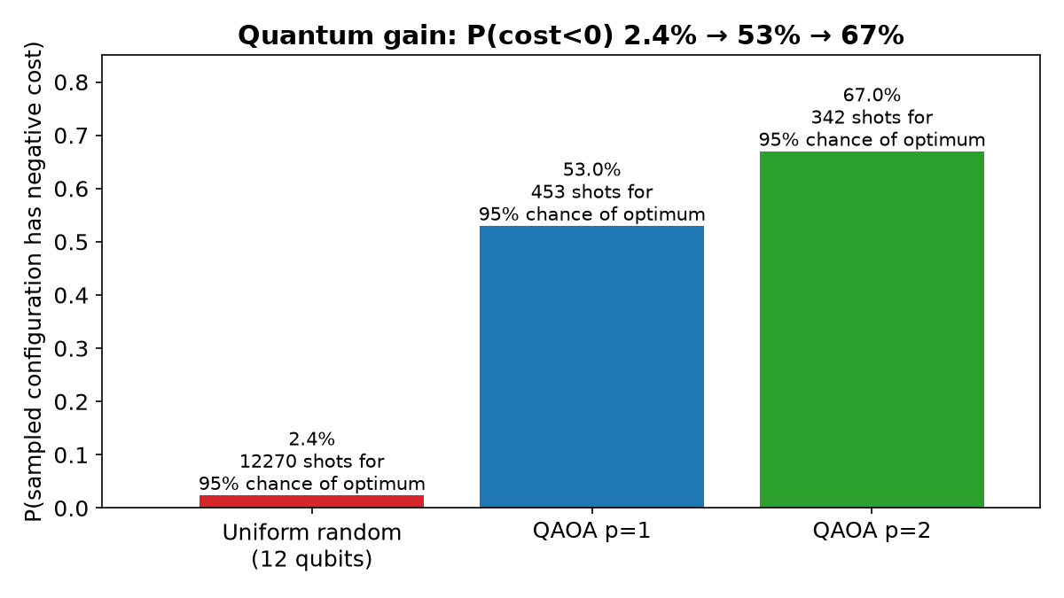
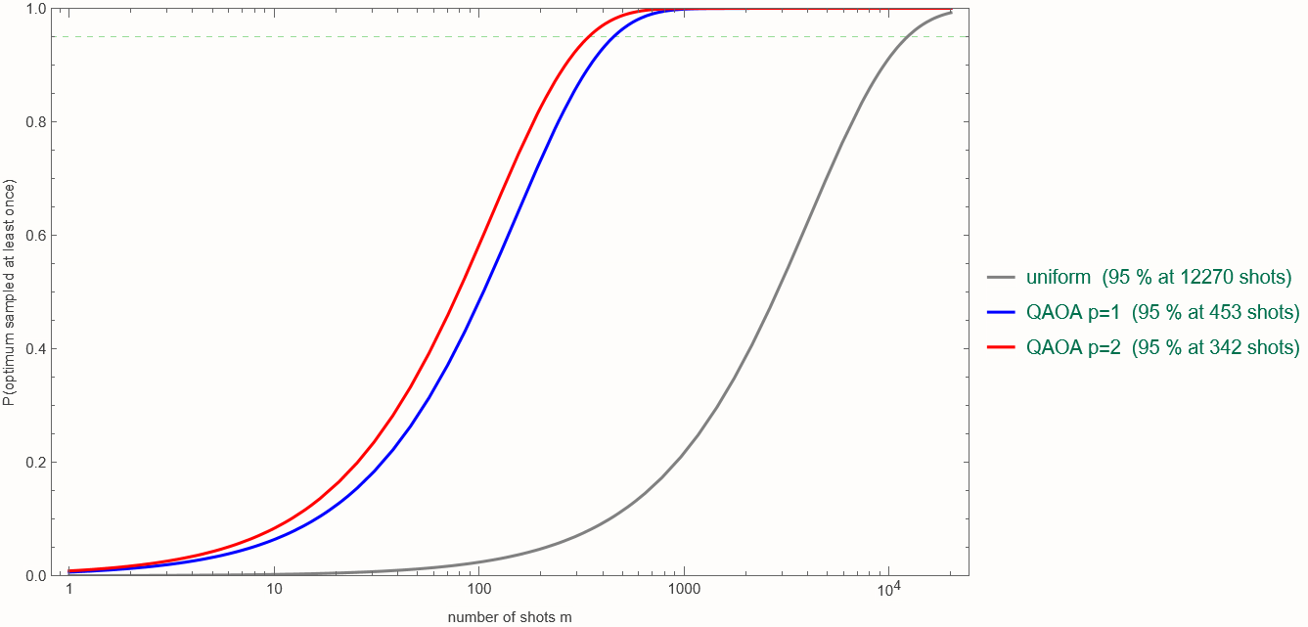
SLIDE 8 / 16 | COMPUTE
Stage 4, Compute: what the quantum gain is worth in shots
Shots needed for a 95% chance of sampling the optimum at least once.
sampler | P(opt) | shots for 95%
uniform | 1/4096 | 12,270
QAOA p = 1 | 0.0066 | about 450
QAOA p = 2 | 0.0098 | about 300
charts/quantum_gain.png: probability of the optimum and of a negative-cost plan, uniform vs QAOA p=1 and p=2.
Honest framing: at 12 qubits a laptop enumerates 4096 plans instantly. The gain is a property of the algorithm we can measure exactly here and carry to sizes where enumeration stops (slide 13).
STAGE 4 Compute
8 / 16
MantiQ Factor | Antenna tilt with QAOA | QUBIT 2026 case study
Notes:
27x at p=1 and about 40x at p=2. The shots table is the operational meaning of that gain.

Slide 9
SLIDE 9 / 16 | VERIFY
Stage 5, Verify: Lean 4 theorems, zero sorry
def decodeTilt (q0 q1 : Fin 2) : Fin 4 := ...
theorem decodeTilt_bijective :
Function.Bijective (fun q : Fin 2 x Fin 2 => decodeTilt q.1 q.2)
def costS (t : Fin 6 -> Fin 4) : Int := ... -- scaled x 10^4
def optTilt : Fin 6 -> Fin 4 := ![0, 3, 0, 0, 0, 0]
theorem costS_optTilt : costS optTilt = -28440
theorem costS_lower_bound : forall t, -28440 <= costS t
theorem costS_unique : forall t, costS t = -28440 -> t = optTilt
theorem cost_phase_norm : forall gamma c : Real,
norm (Complex.exp ((gamma * c : Real) * Complex.I)) = 1
theorem cost_phase_preserves_probability : ...
theorem two_smul_P0 : (2 : Rat) * P0 = 1 + Z -- Z decomposition
Encoding: the 2-qubit register maps one-to-one onto the four tilt levels, so no state is invalid or double-counted
Classical truth: -2.844 is the minimum, it is attained at (0,3,0,0,0,0), and nowhere else
Circuit: the cost layer exp(i gamma Cost) has unit norm, so it changes phases only and keeps every measurement probability of a basis state
Bridge to the gate set: 2 P0 = 1 + Z and 2 P1 = 1 - Z justify the Z-only decomposition of the Hamiltonian
These are the statements the Wolfram numbers and the Classiq samples are later checked against
lean/TiltQAOA.lean, 109 lines, Mathlib. Build log: lean/tilt_qaoa_lean_build.log. Cost scaled by 10^4 so the theorems are over integers and decide by computation.
STAGE 5 Verify
9 / 16
MantiQ Factor | Antenna tilt with QAOA | QUBIT 2026 case study
Notes:
Verify does not prove the whole QAOA algorithm. It proves the parts that engineering can get wrong silently: encoding, the classical optimum, and that the phase layer is unitary and diagonal.

Slide 10
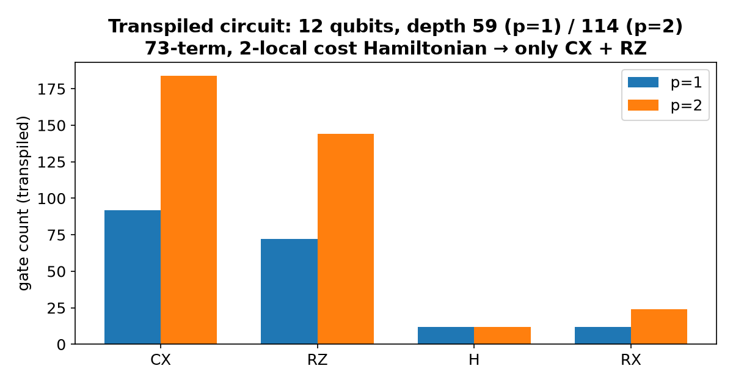
SLIDE 10 / 16 | ENGINEER
Stage 6, Engineer: the cost becomes a Qmod phase() statement
class Tilts(QStruct):
tilts: QArray[QNum[2], 6] # 6 antennas x 2 qubits
def cost(t: Tilts) -> CReal:
interference = sum(I[i][j] * t.tilts[i] * t.tilts[j] ...)
coverage = sum(c[i] * t.tilts[i] ...)
return interference - 1.5 * coverage + 0.3 * sum(t.tilts)
@qfunc
def main(gammas: CArray[CReal, P], betas: CArray[CReal, P],
t: Output[Tilts]):
allocate(t)
hadamard_transform(t)
repeat(P, lambda k: [phase(cost(t), gammas[k]),
apply_to_all(lambda q: RX(2*betas[k], q), t)])
qprog = synthesize(qmod) # width 12, depth 59, 92 CX
res = execute(qprog, gammas=[0.0654], betas=[1.1293]) # hot start
charts/circuit_stats.png: synthesized circuit sizes for p = 1 and p = 2.
No hand-built CX ladders: phase() takes the arithmetic cost expression and Classiq synthesizes the diagonal unitary
The Pauli decomposition (gates/) exists only to predict gate counts and to feed Wolfram; the SDK never sees it
Deliverables: antenna_tilt_optimization.ipynb, .qmod, .synthesis_options.json, .metadata.json (classiq-library format)
classiq/qaoa_tilt_classiq.py is the standalone script with COBYLA on the simulator
STAGE 6 Engineer
10 / 16
MantiQ Factor | Antenna tilt with QAOA | QUBIT 2026 case study
Notes:
Engineer is the only stage that touches the SDK. Everything it needs, the cost, the angles, the expected numbers, arrives as files from the earlier stages.

Slide 11
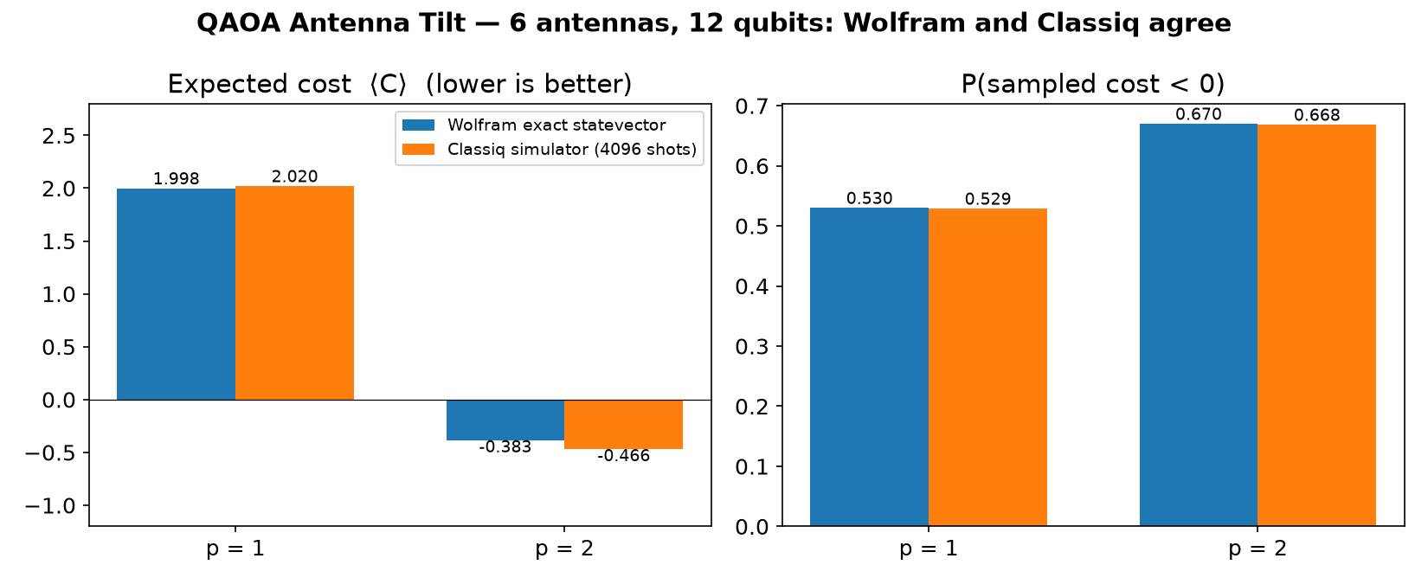
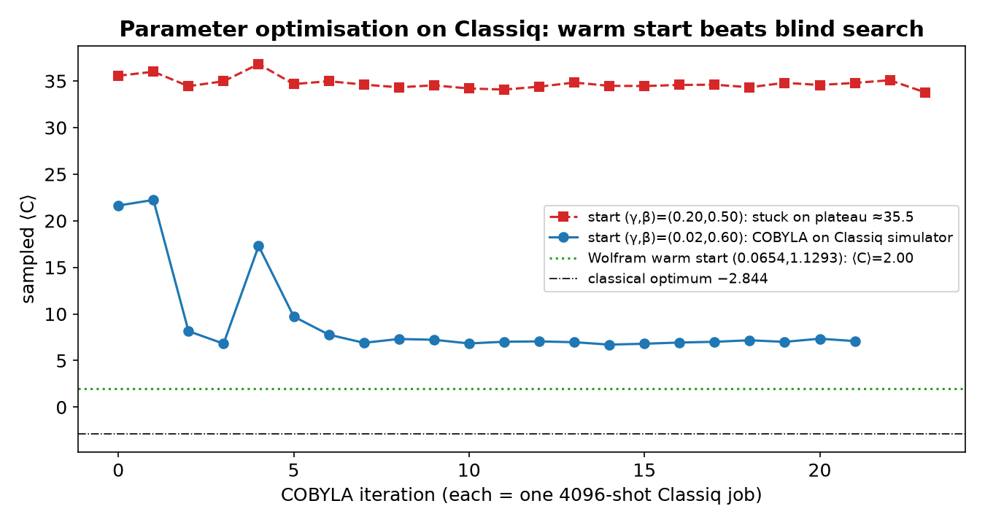
SLIDE 11 / 16 | OUTPUT
Stage 7, Output: Classiq reproduces the Wolfram prediction
COBYLA on Classiq starting from the Wolfram angles: 8 iterations, no improvement over the hot start, angles stay at (0.065, 1.149).
charts/wolfram_vs_classiq.png: exact statevector (Wolfram) against 4096-shot samples on the Classiq simulator at the same angles.
2.06
0.525
29x
-0.39
(0,3,0,0,0,0)
Classiq <Cost> p=1 (pred. 2.00)
P(cost<0) (pred. 0.53)
P(optimum) vs uniform (pred. 27x)
Classiq <Cost> p=2 (pred. -0.38)
best sampled plan = proven optimum
STAGE 7 Output
11 / 16
MantiQ Factor | Antenna tilt with QAOA | QUBIT 2026 case study
Notes:
Differences are within shot noise at 4096 shots. The best sampled plan is exactly the plan Lean proved optimal.

Slide 12
SLIDE 12 / 16 | CROSS-CHECK
Three independent engines, one set of numbers
quantity | Lean 4 (proof) | Wolfram (exact state) | Classiq (4096 shots) | agree
minimum cost | -2.8440 (theorem) | -2.8440 | -2.8440 (best sample) | yes
argmin | (0,3,0,0,0,0), unique | (0,3,0,0,0,0) | (0,3,0,0,0,0) | yes
encoding valid | bijection | 4096 states, all decode | all samples decode | yes
<Cost> p=1 at hot start |  | 1.9985 (Qiskit statevector of the exported QASM: 1.9985) | 2.02 to 2.06 (4096 shots), 1.99 after COBYLA | shot noise
P(cost < 0) p=1 |  | 0.53 | 0.525 | yes
P(optimum) p=1 |  | 0.0066 (27x) | 0.0066 to 0.0071 (27x to 29x) | yes
<Cost> p=2 |  | -0.3825 | -0.39 | yes
phase layer diagonal, unit norm | theorem | matrix check | synthesized as RZ ladders only | yes
The value of MantiQ Factor is this table: no number in the demo rests on a single tool
Blind COBYLA starts on Classiq (hackathon runs): start (0.20, 0.50) stuck at <Cost> 35.5, start (0.02, 0.60) reached only 7.0 after 20 jobs. From the Wolfram angles: 2.0 in the first job, and 8 more iterations found nothing better
12 / 16
MantiQ Factor | Antenna tilt with QAOA | QUBIT 2026 case study
Notes:
If any row disagreed, the pipeline would tell you which stage to reopen: a proof failure means the model, a Wolfram mismatch means the Hamiltonian, a Classiq mismatch means the circuit.

Slide 13
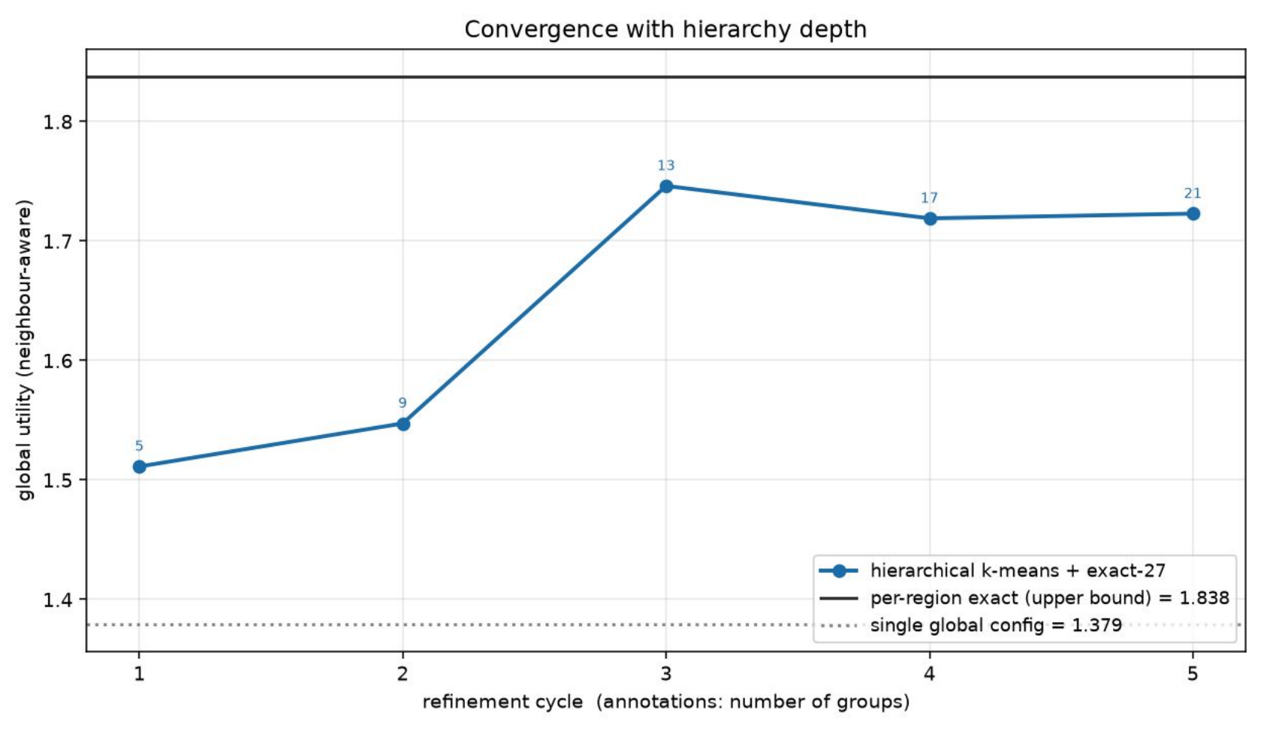
SLIDE 13 / 16 | SCALING
Where this leaf sits: k-means hierarchy and the road to 1000 qubits
10^301
about 45 qubits
about 13,000 CX
plans for 500 antennas x 4 tilts (today: 4096)
ceiling of exact statevector simulation (50 q = 18 PB)
one QAOA layer at 1000 qubits, still 2-local
Network -> 5 groups -> 25 -> 125: k-means on region feature vectors, one QAOA job per group, refine where the utility gain is worth it. Our 12-qubit problem is one job in that tree
Best non-quantum tools at 1000 qubits: brute force 10^283 s at exascale; exact QUBO solvers run hours to days without certifying; annealing and tabu give a good plan in minutes with no guarantee (1.833 vs 1.838 on the toy benchmark). Nobody can simulate QAOA past about 48 qubits
A real 1000-qubit gate-based machine: physical qubits exist (IBM Condor 1121, Atom Computing 1200), but 13,000 CX at 99.9% fidelity means about 13 errors per shot, so the run must be error-corrected (2,000 to 100,000 physical qubits; roadmaps 2028 to 2030)
Once available: depth ~10^2 per layer, 10^4 shots x 20 iterations = seconds to minutes; the Wolfram hot start cuts the iterations. Same Qmod, Classiq synthesizes for the target; only the backend changes
What carries over unchanged: the encoding proof, the 2-locality, the hot-start habit (train angles on a small exact instance, transfer to the large one)
Team benchmark, 48-region toy network: refinement 5 -> 21 groups. Cycle 3 (13 groups, 13 QAOA jobs) reaches 1.75 = 95% of the per-region ceiling 1.838 (48 jobs); one plan for all gives 1.379.
13 / 16
MantiQ Factor | Antenna tilt with QAOA | QUBIT 2026 case study
Notes:
This slide keeps the team contribution visible: the hierarchy is theirs, the verified leaf is ours, and they compose. The 1000-qubit numbers come from the hackathon deck (slide 13 there).

Slide 14
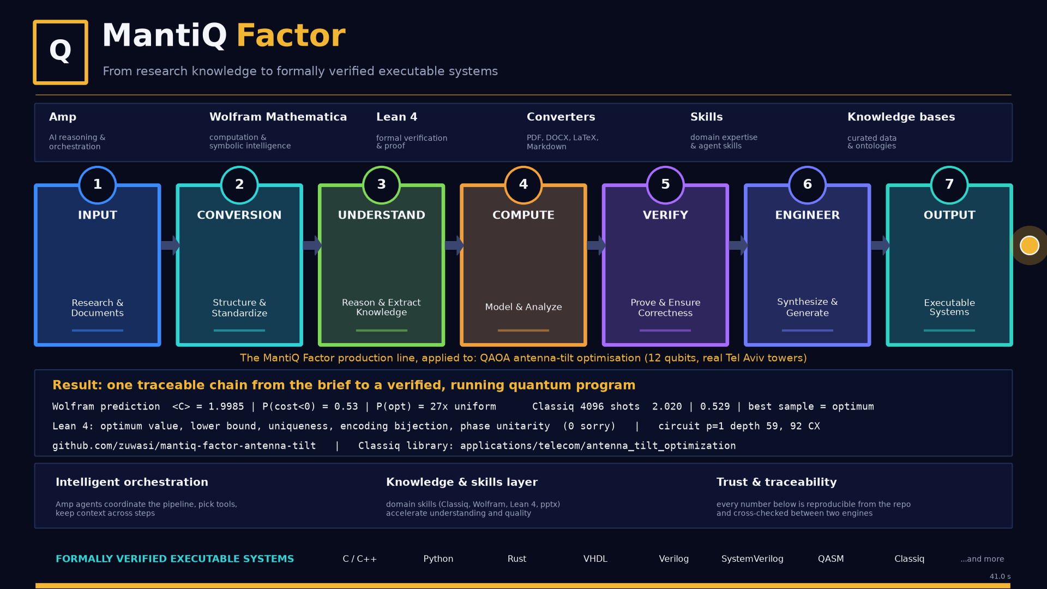
SLIDE 14 / 16 | OUTPUT
Deliverables: everything is public and reproducible
artifact | where
Concluded solution (MIT) | github.com/zuwasi/mantiq-factor-antenna-tilt
Classiq library demo (PR) | applications/telecom/antenna_tilt_optimization in Classiq/classiq-library
Hackathon repo and 5-min video | github.com/zuwasi/quantum-headache-antenna-tilt, youtu.be/OSEtTWnRQhc
Data | data/opencellid_il2*.csv (OpenCelliD, CC BY-SA 4.0)
Wolfram | wolfram/*.wl, .nb, .pdf, .json (angles, probabilities)
Lean 4 | lean/TiltQAOA.lean + build log
Classiq | notebook/*.ipynb, .qmod; classiq/results/*.json, *.qasm
This deck | presentation/build_deck.js (pptxgenjs) and the PPTX/PDF it builds
animation/mantiq_pipeline.mp4 (41 s): the MantiQ Factor pipeline animated with the real numbers of this case, built with matplotlib.
14 / 16
MantiQ Factor | Antenna tilt with QAOA | QUBIT 2026 case study
Notes:
Every row is a folder in the repo. The notebook is the classiq-library contribution; the rest is the evidence behind it.

Slide 15
SLIDE 15 / 16 | LESSONS
What the MantiQ Factor workflow bought us
Compute before you engineer
Wolfram found the angles exactly; the Classiq run confirmed them in one shot and COBYLA had nothing left to do. Blind starts on the simulator got stuck at 35.5 or reached only 7.0 after 20 jobs: shot noise hides the gradient.
Prove the parts that fail silently
Encoding bijection, the true optimum, and the diagonal phase layer are where a QAOA demo can be wrong while still producing plausible histograms.
Make the model decision explicit
The 2-qubit vs 5-qubit choice was argued with numbers (invalid mass, Pauli weight, team gain) and written down before code, so the team could veto it.
Files between stages, not memory
JSON angles, Markdown Hamiltonian, Lean source and Qmod are the interfaces. Any stage can be rerun alone, and this deck was rebuilt from them.
Real data raises the bar cheaply
Six OpenCelliD antennas cost nothing more than a toy grid to model, and the result (only the most overlapping antenna tilts) reads as physics, not as a puzzle.
Agentic orchestration is the glue
Amp drove the converters, Mathematica kernel, Lean build and Classiq SDK from one thread with skills and knowledge bases; humans read numbers and decided.
15 / 16
MantiQ Factor | Antenna tilt with QAOA | QUBIT 2026 case study
Notes:
Close with the point that the workflow, not the 12-qubit result, is what transfers to the next problem.

Slide 16
Thank you
MantiQ Factor: input, conversion, understand, compute, verify, engineer, output
Repository (MIT) github.com/zuwasi/mantiq-factor-antenna-tilt
Classiq library demo applications/telecom/antenna_tilt_optimization
Hackathon repo github.com/zuwasi/quantum-headache-antenna-tilt
Video youtu.be/OSEtTWnRQhc
Data OpenCelliD, CC BY-SA 4.0
Daniel Liezrowice | Team Quantum Headache | QUBIT 2026
16 / 16

